Slide 1
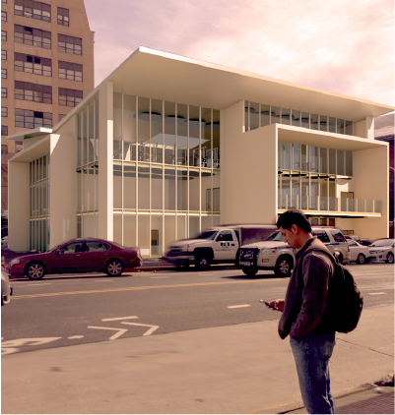
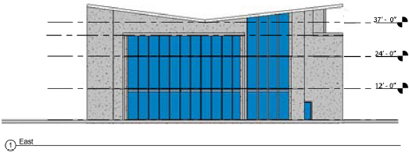
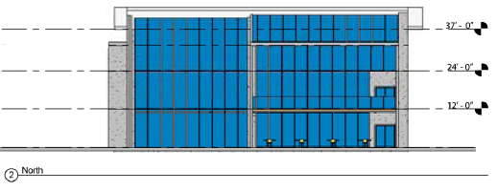
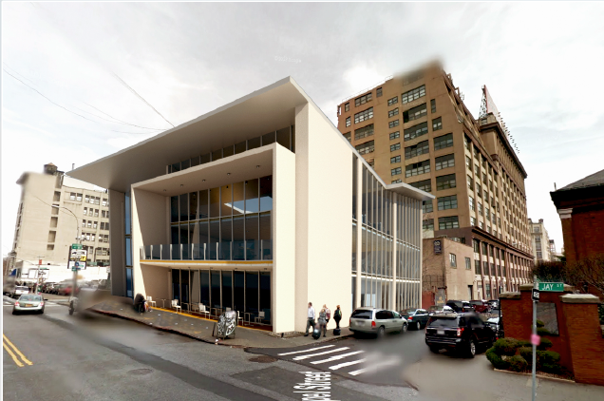
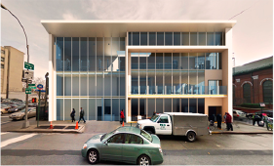
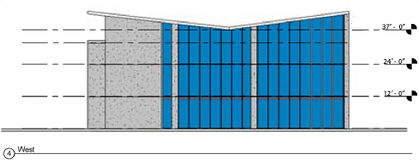
Total Fitness Gym
By Student Architect Jhonatan Rubio
Project Analysis Final Presentation:
Waleed Bhutta, Tamara Panaccio, Joel Cardenas
Building Tech 3
Prof. King

Slide 2
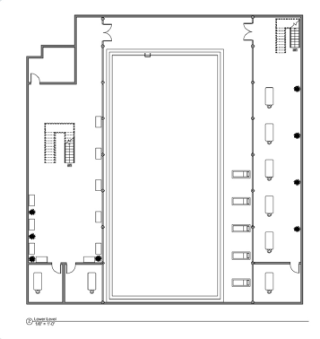
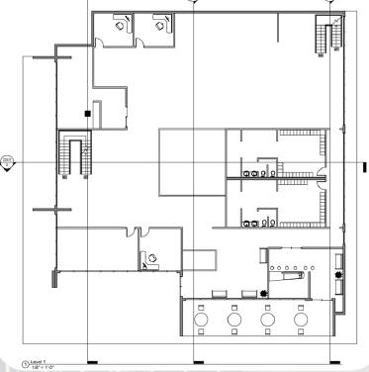
Floor Plans

Slide 3
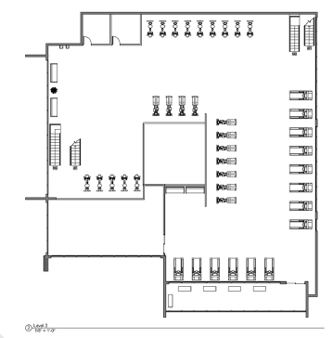
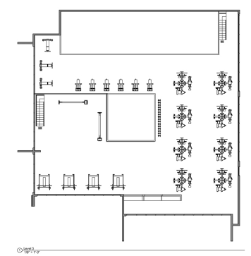
Floor Plans

Slide 4
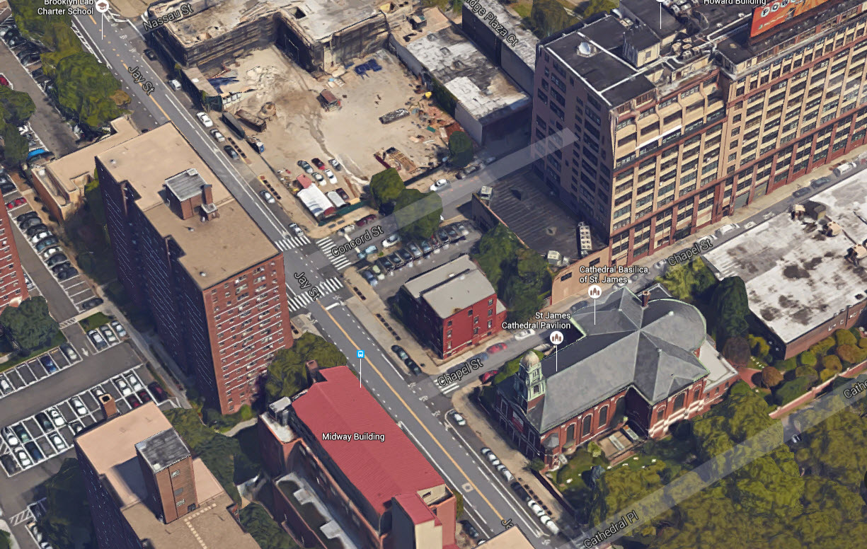
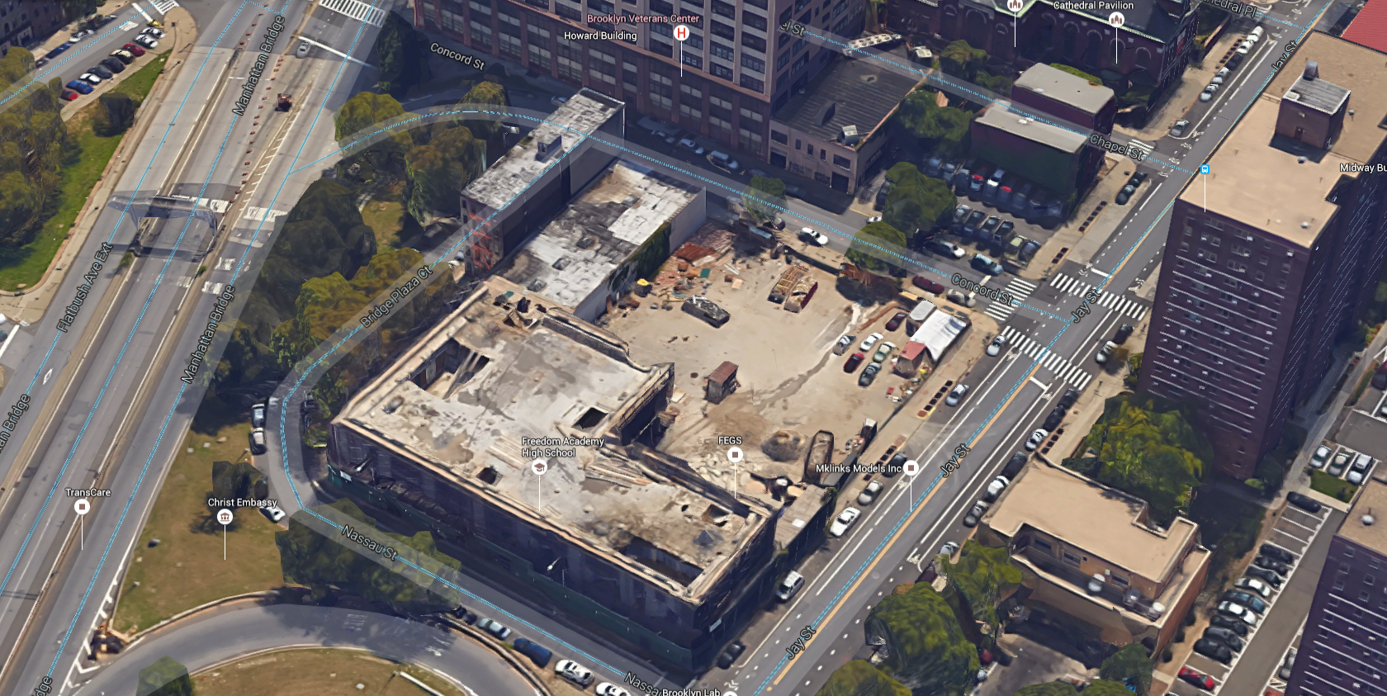
ZONING
ORIGINAL SITE
VARIANCE SITE
Based on our zoning analysis we needed to change our site because the building footprint exceeded the lot size. Prof.King granted us a variance to relocate it to Block 107,Lot 1.
219 Jay St. Brooklyn NY 11201
Block 118 LOT 1
Primary Zoning C6-2
Commercial / Office Building
C6-2 General Central Commercial District
203 Jay St. Brooklyn NY 11201
Block 107 LOT 1
Primary Zoning C6-2
Commercial / Office Building
C6-2 General Central Commercial District

Slide 5
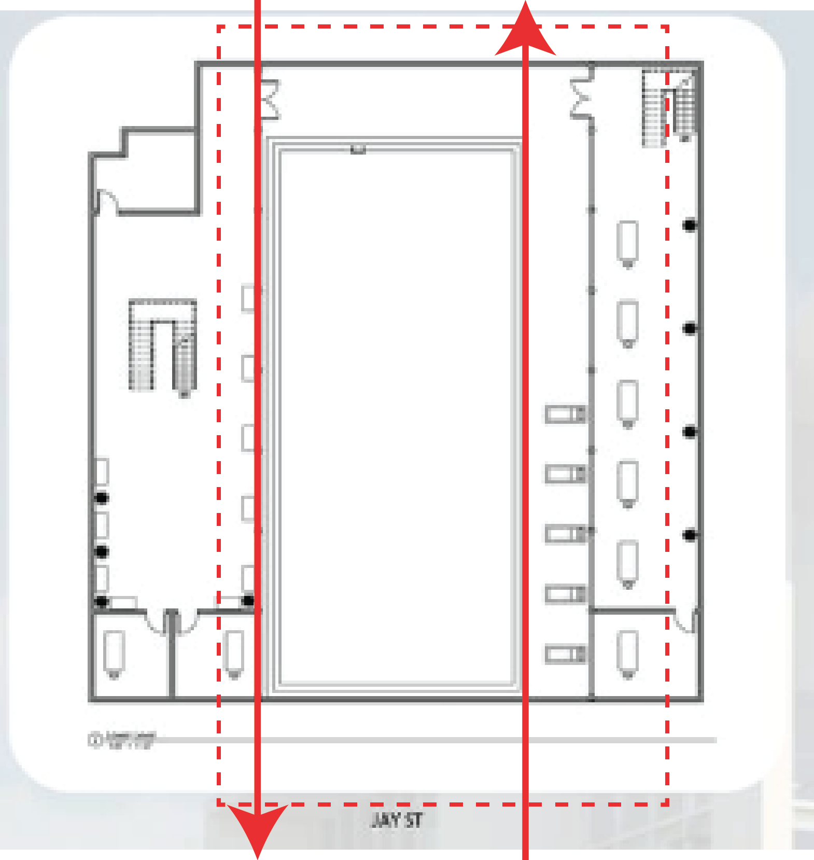
STRUCTURE
Our building shows no structures, and we noticed large spaces that needed to be addressed to make this design work. We considered the option of adding long beams along the basement where the pool is located. It takes up most of the basement creating the struggle of where to place columns that will support the above floors.

Slide 6
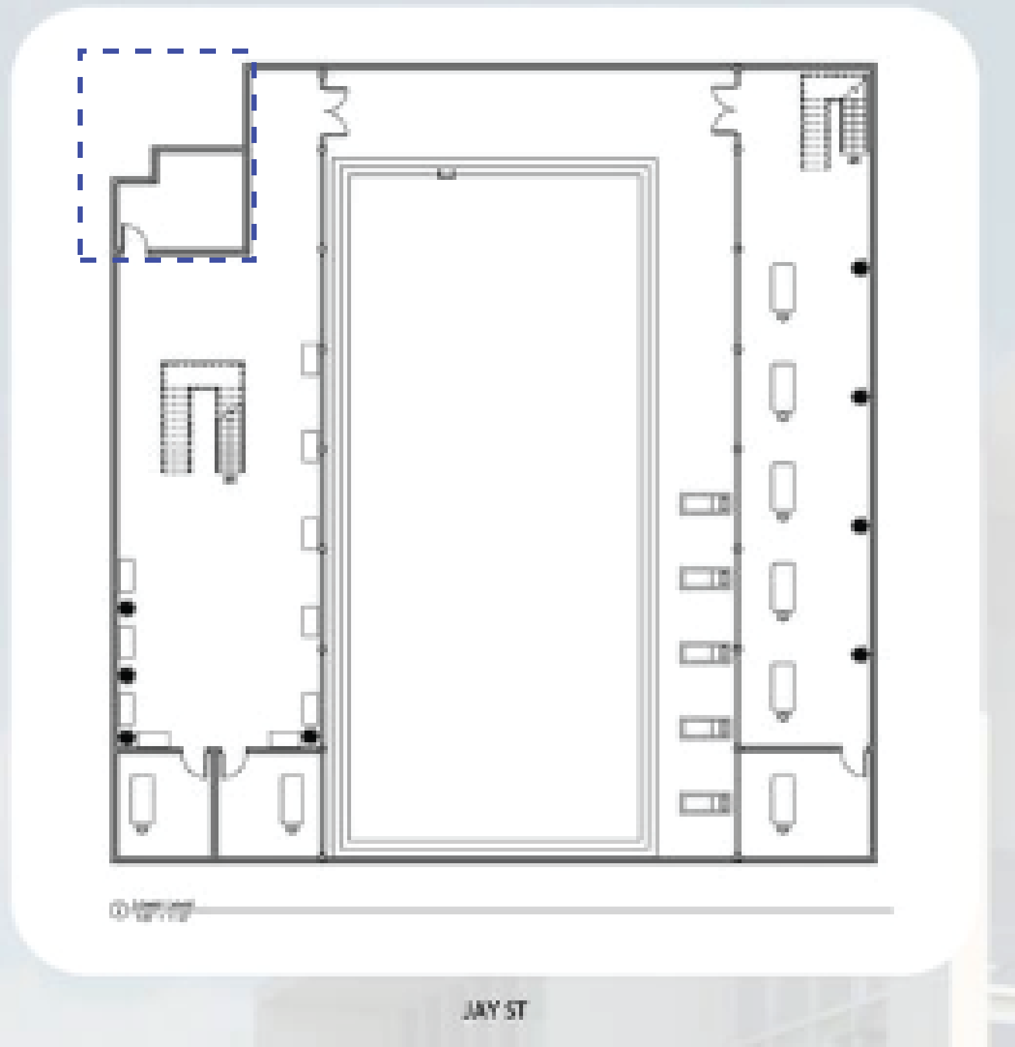
MEP (Mechanical Electrical Plumbing) Systems
There was no sign of a mechanical room, ventilation ducts or mechanical shafts. But we noticed a corner of the structure that was unused and wouldn’t change the design of the architect.

Slide 7
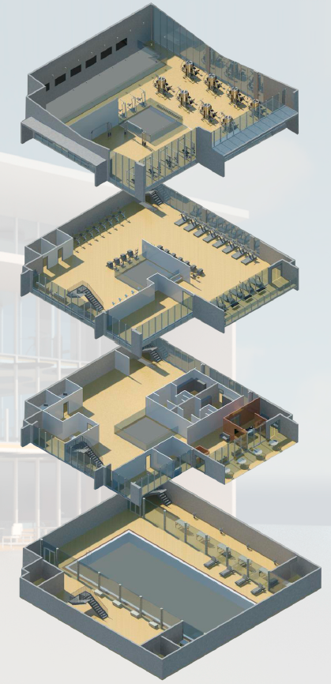
Room Layout, Circulation, Egress, & Fire Safety Code
There were dead ends (side of pool, 3rd floor) and besides the main entrance there was no Egress.
No sprinkler system or smoke curtain along the shafts located in the center of the building.
There was no proper vertical circulation, and stairs were not drawn correctly. According to code; the distance between each set of stairs must equal ⅓ the diagonal distance of the building and one must exit directly out the building.
The functionality of certain rooms did not comply with their layout and were not fire code compliant (1hr corridors, 2hrs stairs, 3hrs mechanical rooms).

Slide 8
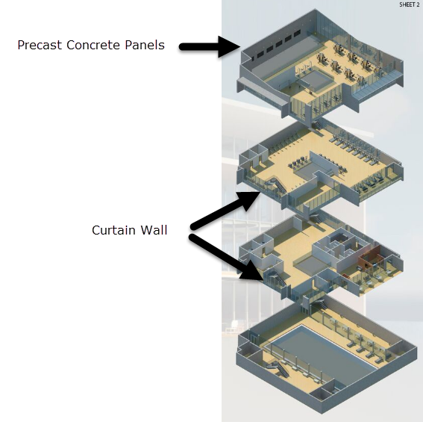
Materials & Building Assembly
The exterior walls had a mix of both glass, mullions, and solid walls.
The building indicated two types of materials on the exterior that we assumed were:
Precast Concrete Panels
Stick Panel Curtain Wall System

Slide 9
WALEED BHUTTA

Slide 10
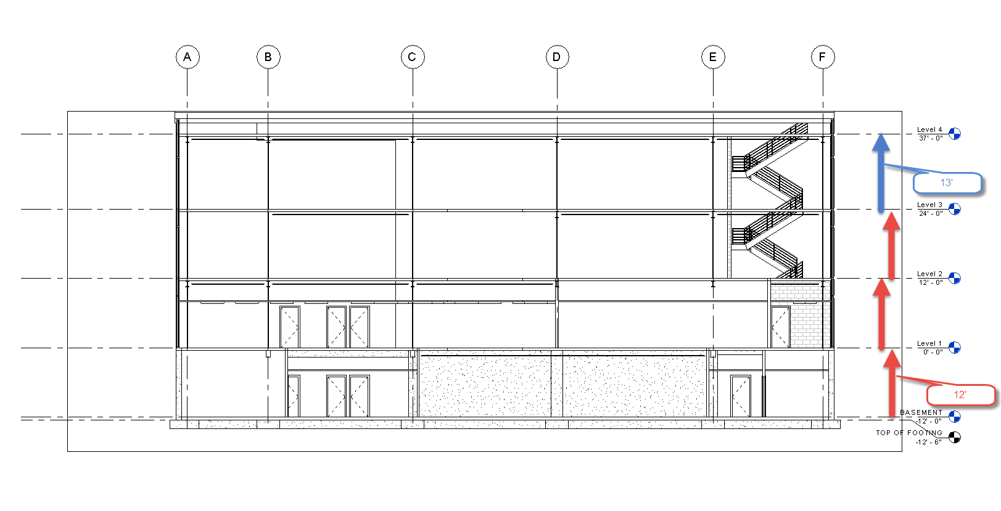
STRUCTURE
Floor to floor heights were consistent with the initial design

Slide 11
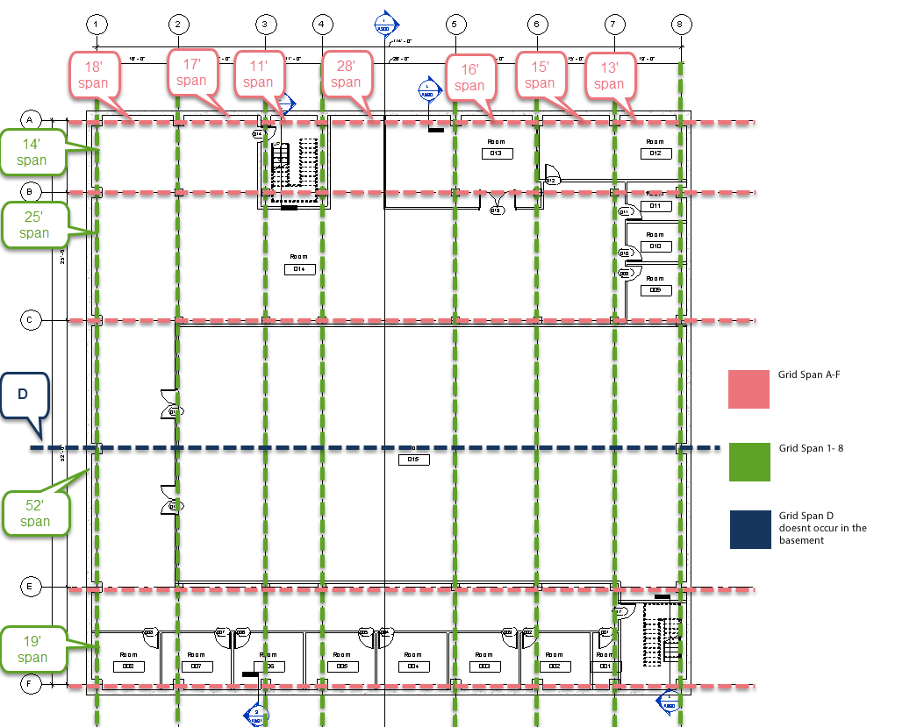
STRUCTURE
We decided to create a column grid that would allow us to transfer loads the shortest distance we could while working in the spaces necessary

Slide 12
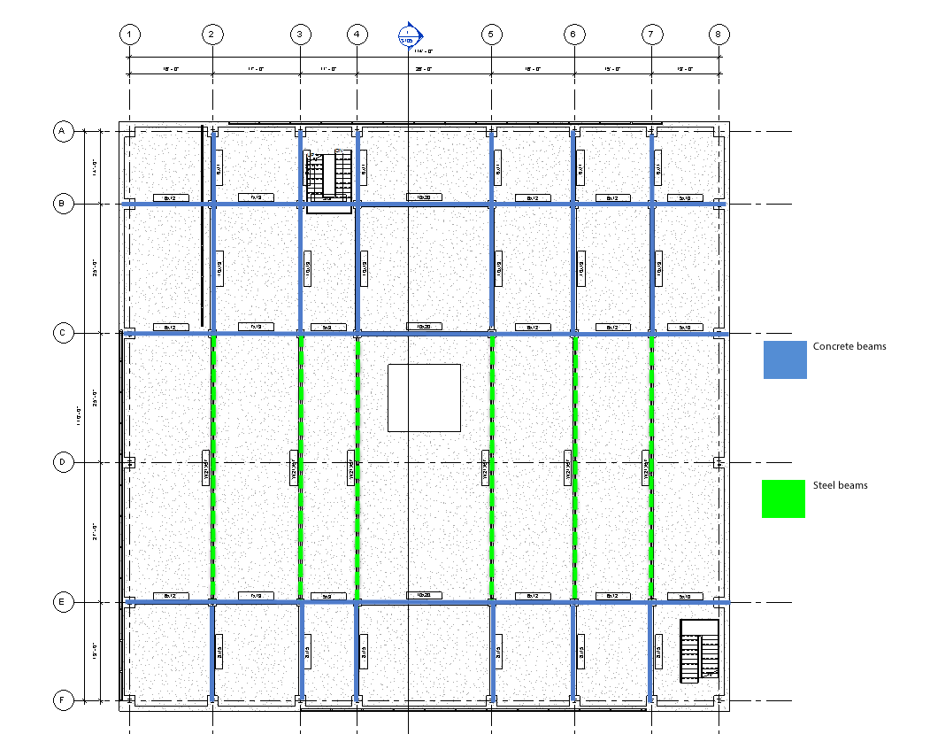
STRUCTURE
This defines where our long spans occurred and how we decided to address them. We used steel beams in our basement rather than concrete. We also considered the possibility of having a double beam.

Slide 13
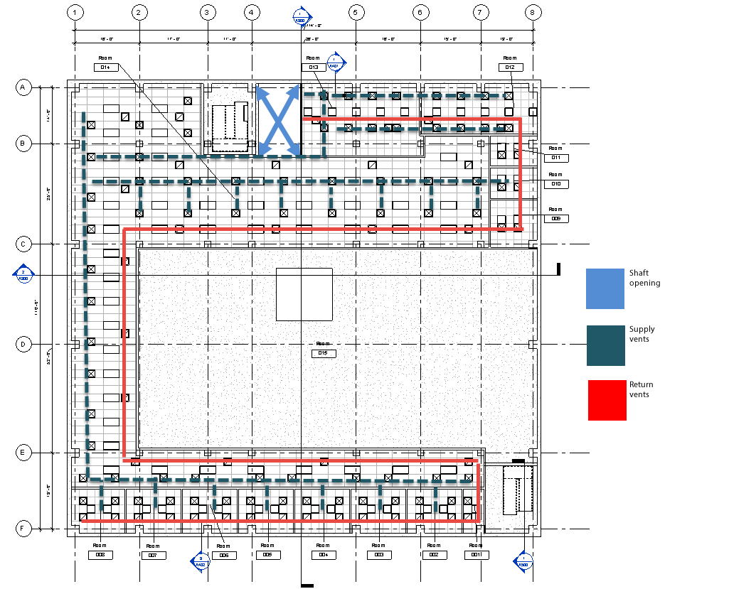
MEP MECHANICAL ELECTRICAL PLUMBING
We had to address the MEP issues in the building and I decided to locate my shaft near my elevator and mechanical room.

Slide 14
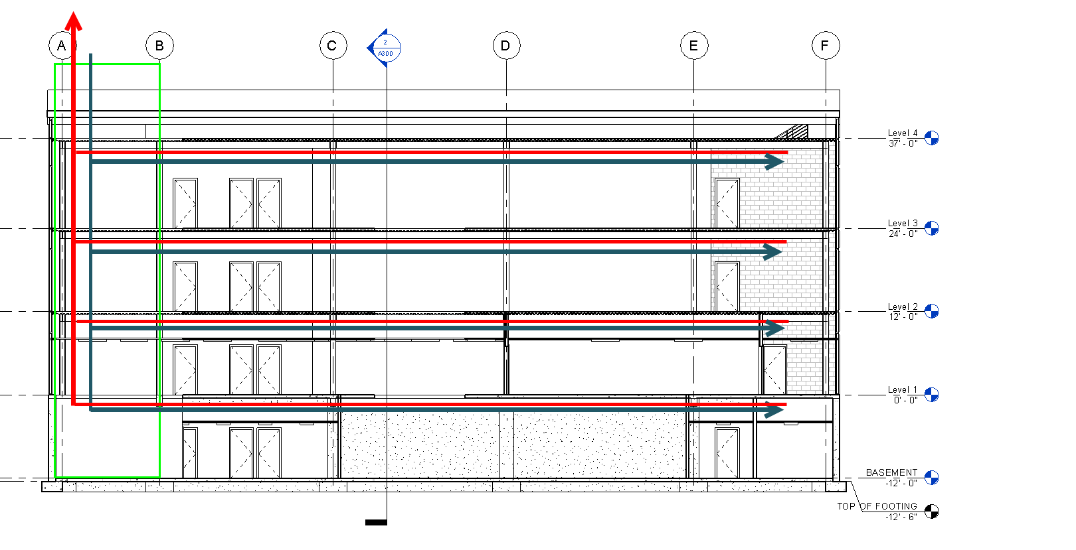
MEP MECHANICAL ELECTRICAL PLUMBING
This diagrams an idea of how air will be circulated vertically and horizontally in the building. It shows how it will travel in and out of the building.

Slide 15
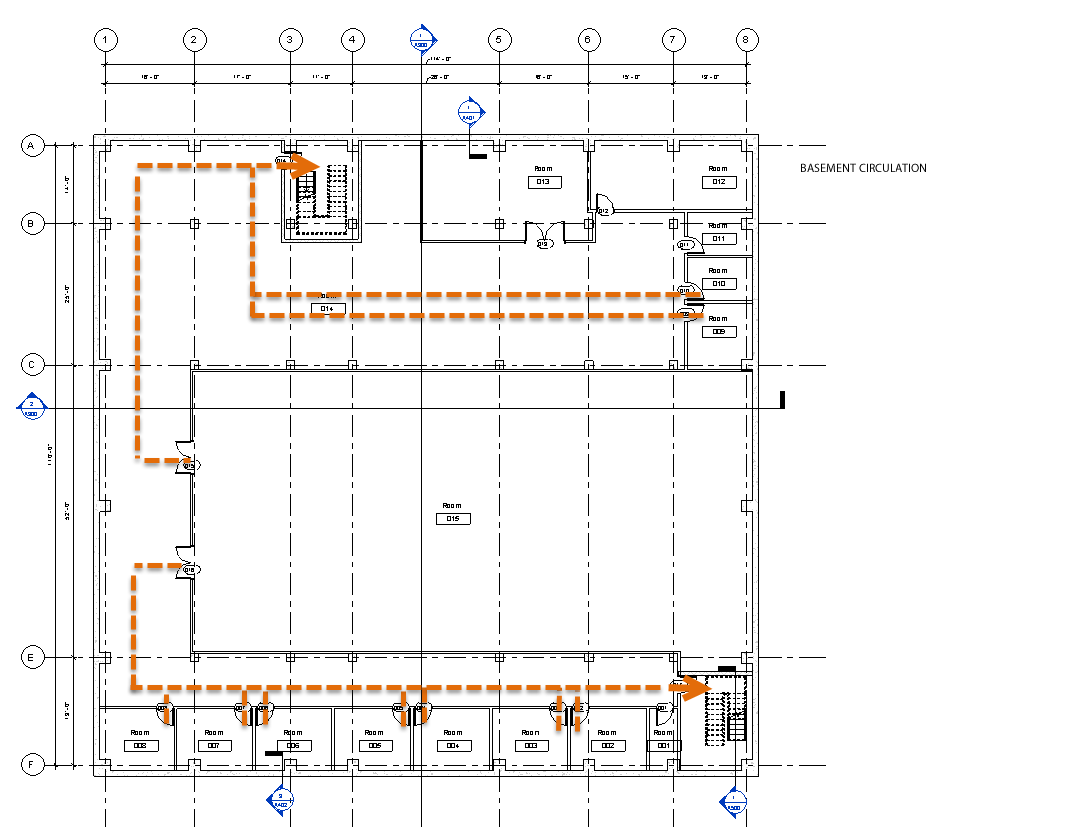
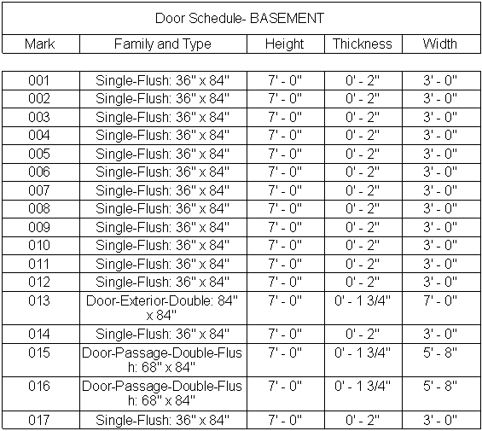
ROOM LAYOUT
Some of the spaces in the building were not code compliant and there were dead ends. By rearranging the rooms and spaces, this is an iteration that works to control circulation successfully.

Slide 16
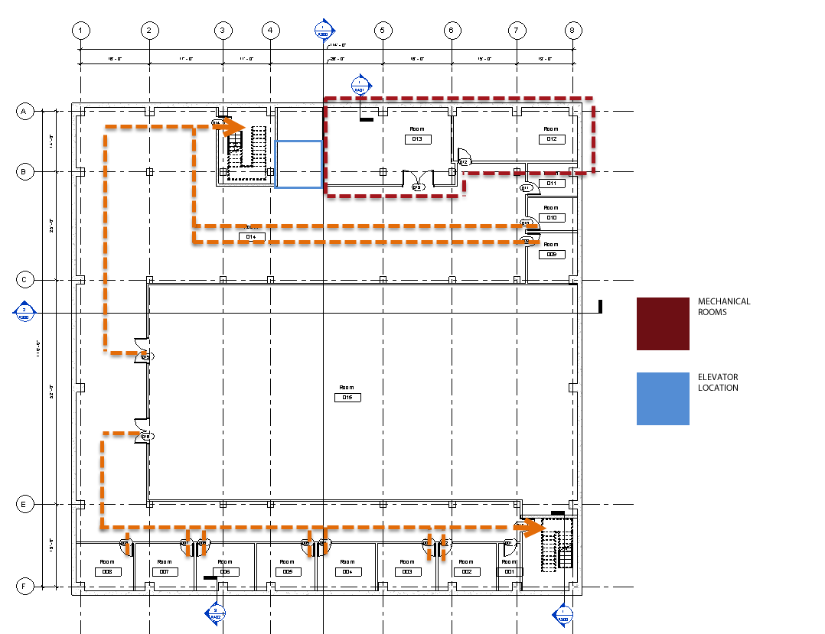
ROOM LAYOUT
We decided to add in an additional corner of the building that wouldn't affect the design of the building. This allowed us to create two mechanical rooms, which is important due to the amount of equipment needed for MEP and the pool.

Slide 17
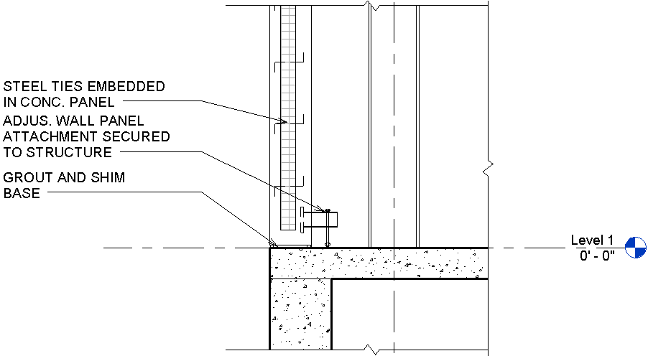
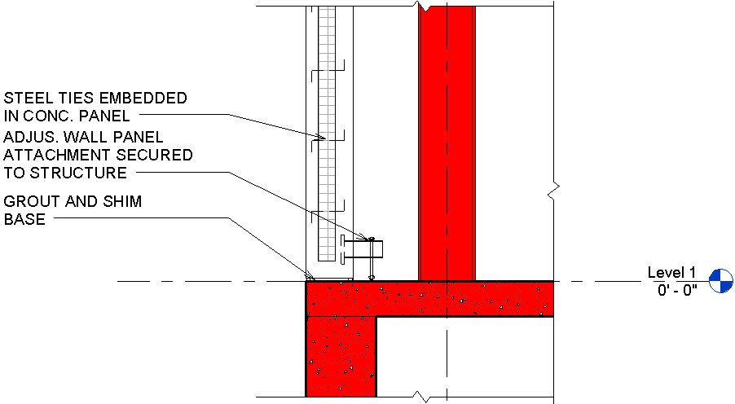
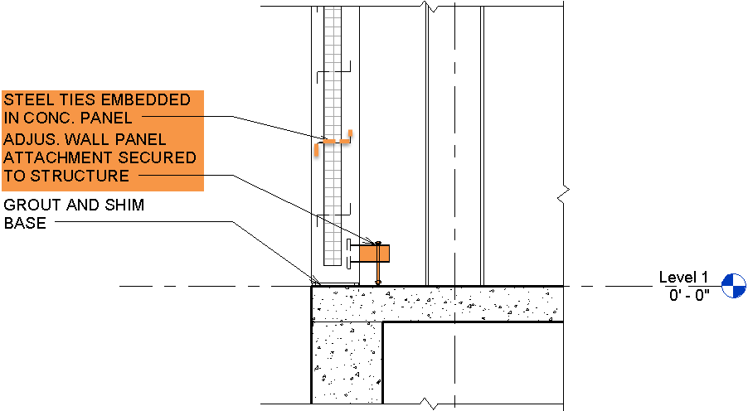
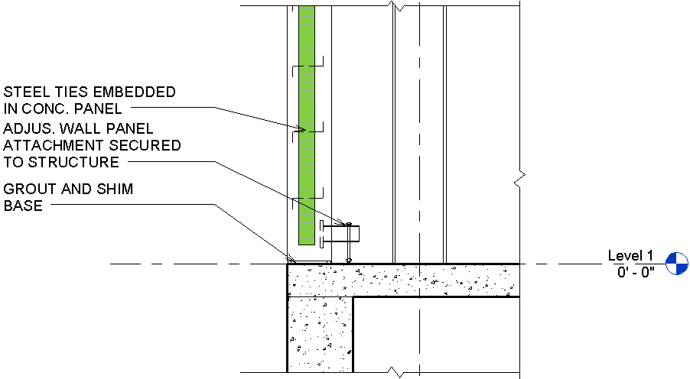
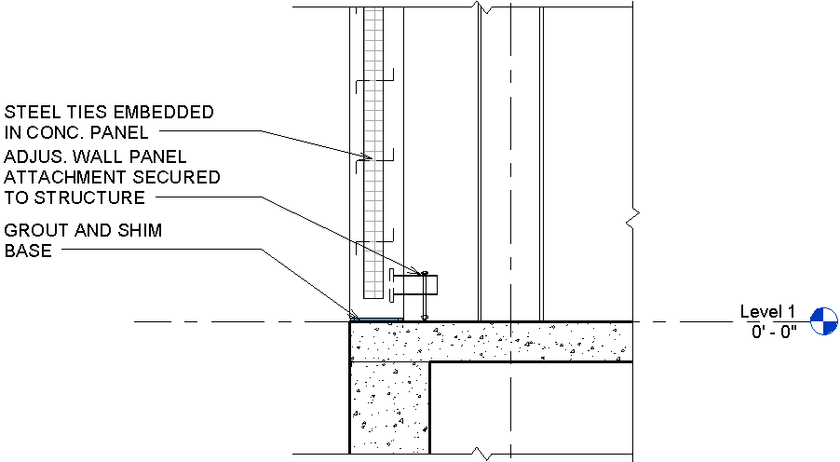
Materials and building assembly
Original, Structure (red), Waterproofing(blue), Thermal(green), Attachments(orange), Fire protection(yellow)

Slide 18
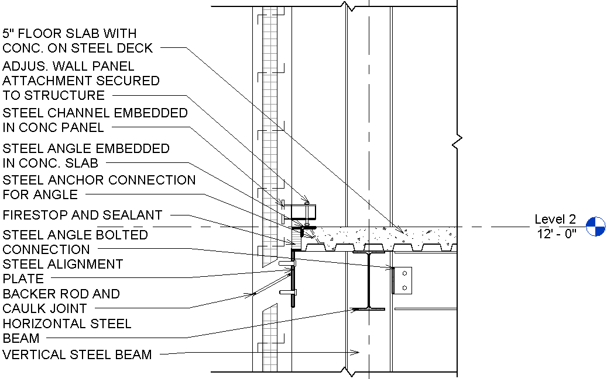
Materials and building assembly

Slide 19
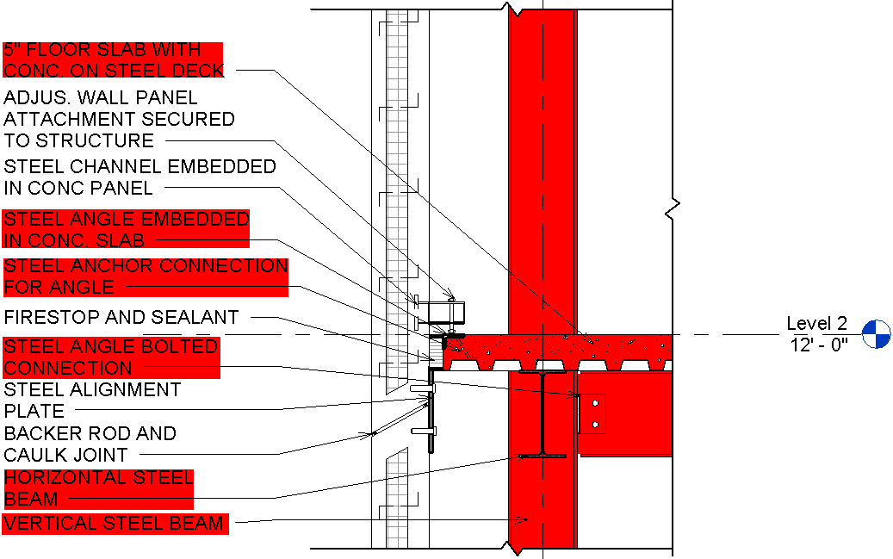
Materials and building assembly
STRUCTURE

Slide 20
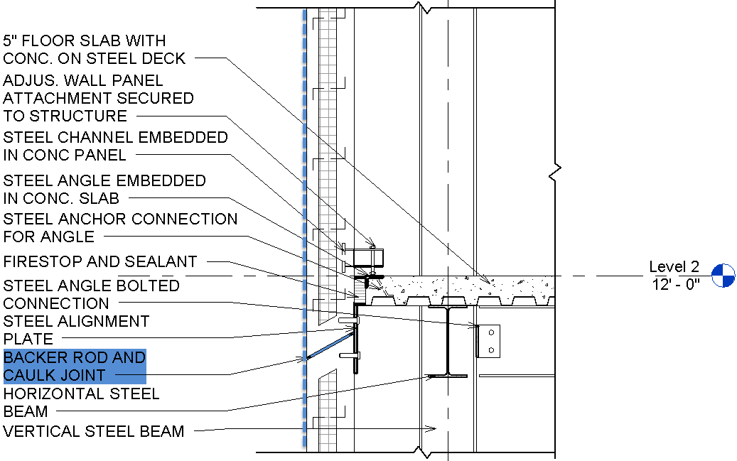
Materials and building assembly
WATERPROOFING

Slide 21
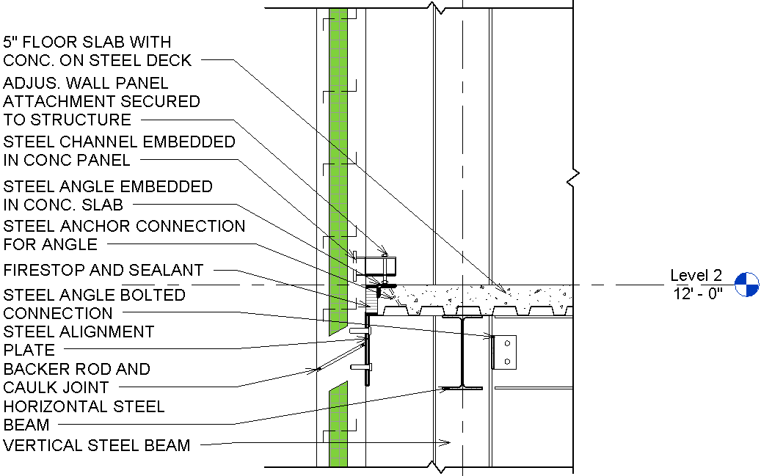
Materials and building assembly
INSULATION

Slide 22
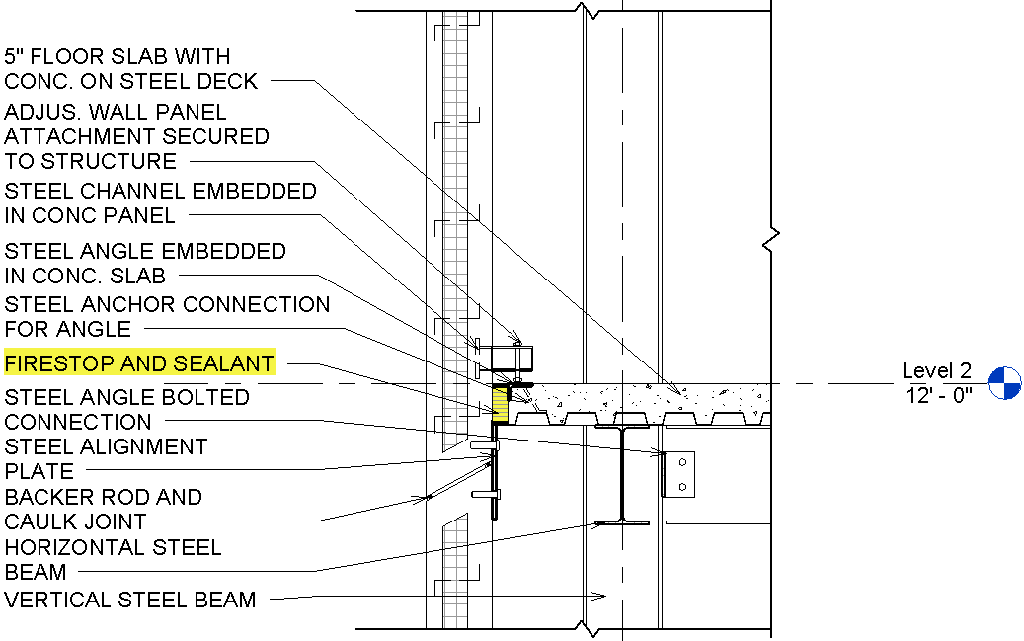
Materials and building assembly
FIRE SAFING

Slide 23
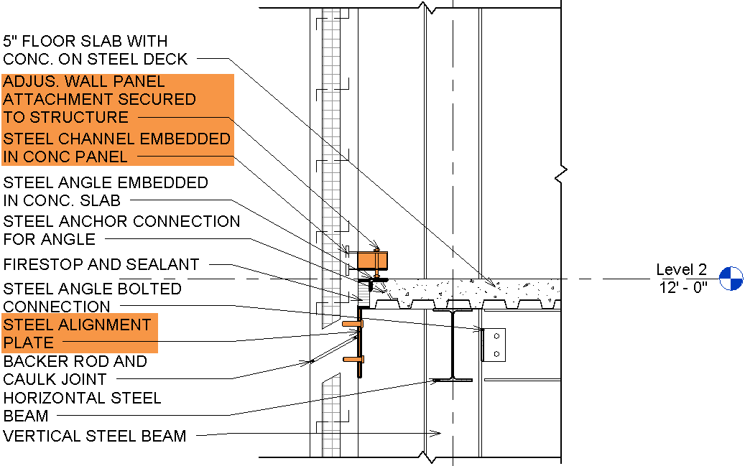
Materials and building assembly
ATTACHMENTS

Slide 24
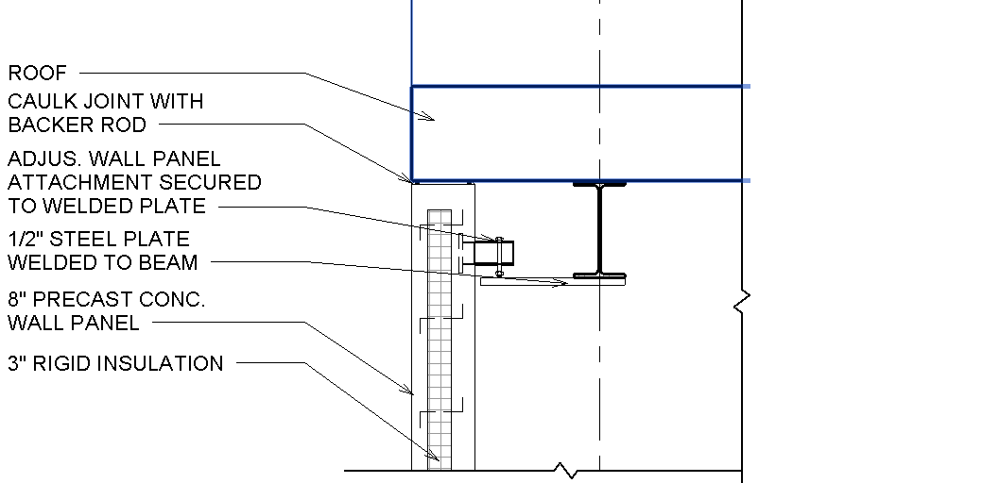
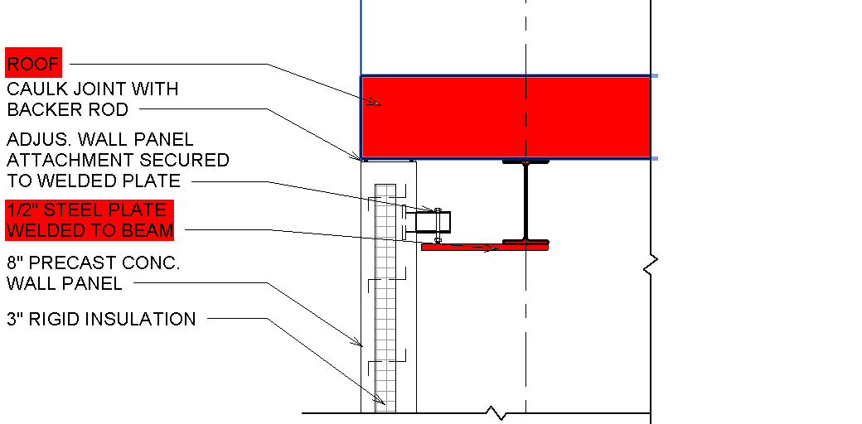
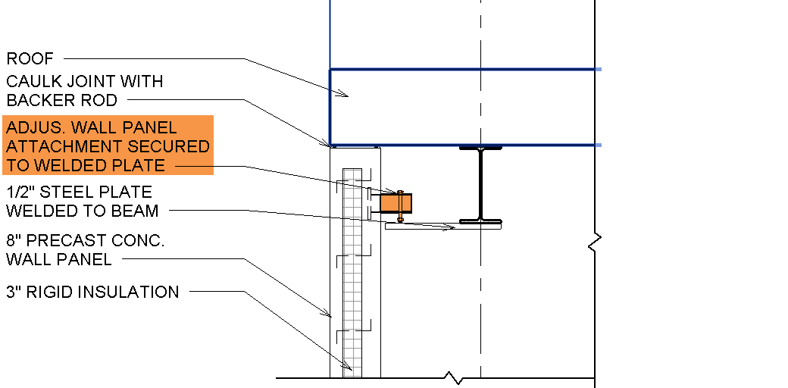
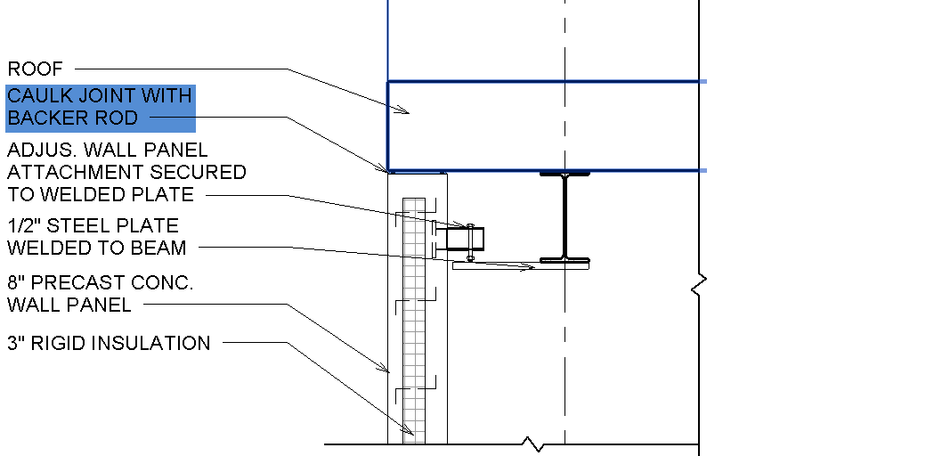
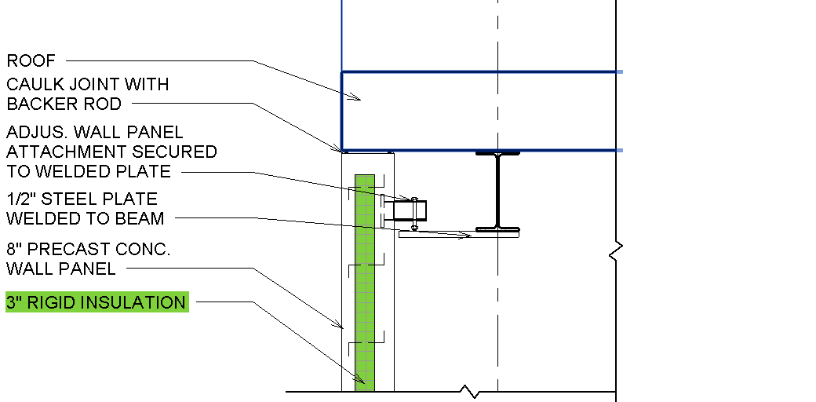
Materials and building assembly

Slide 25
Tamara Panaccio

Slide 26
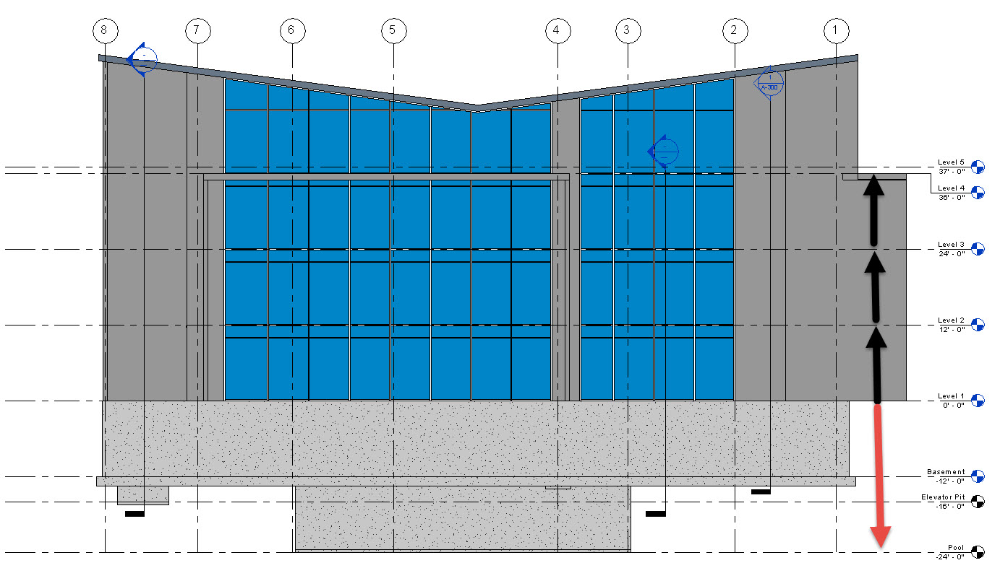
Structure
We kept the same floor to floor height because there was enough room to run beams and ductwork.
In addition we researched the depth of and olympic pool and elevator pit and we included it in the drawings.

Slide 27
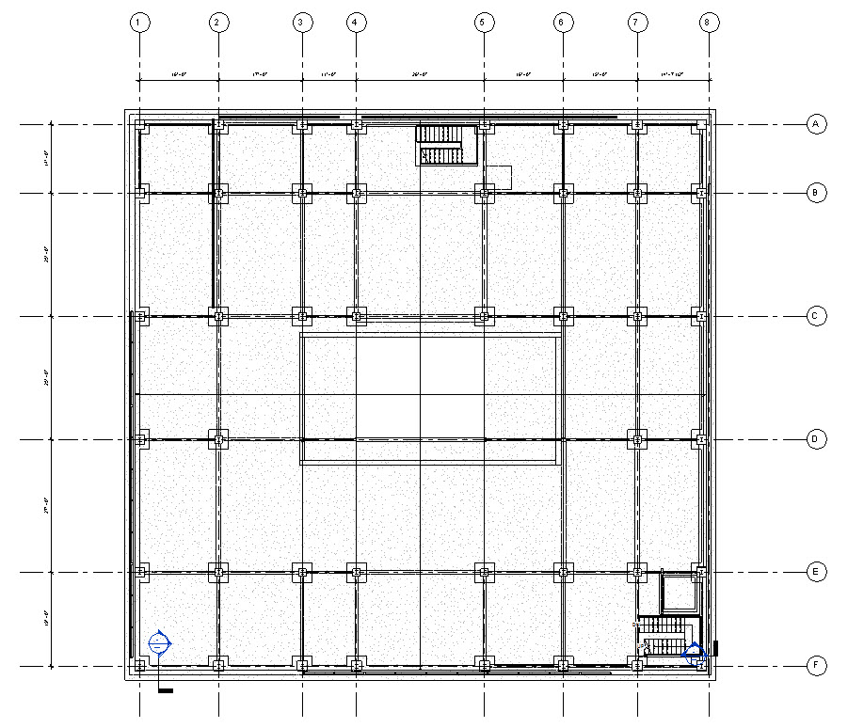
Structure
We designed a structural grid allowing us to transfer loads in shorter distance due to having a pool in the basement level that limited our column locations.
For the long spans we replaced concrete beams for 21X57 wide flange steel beams.

Slide 28
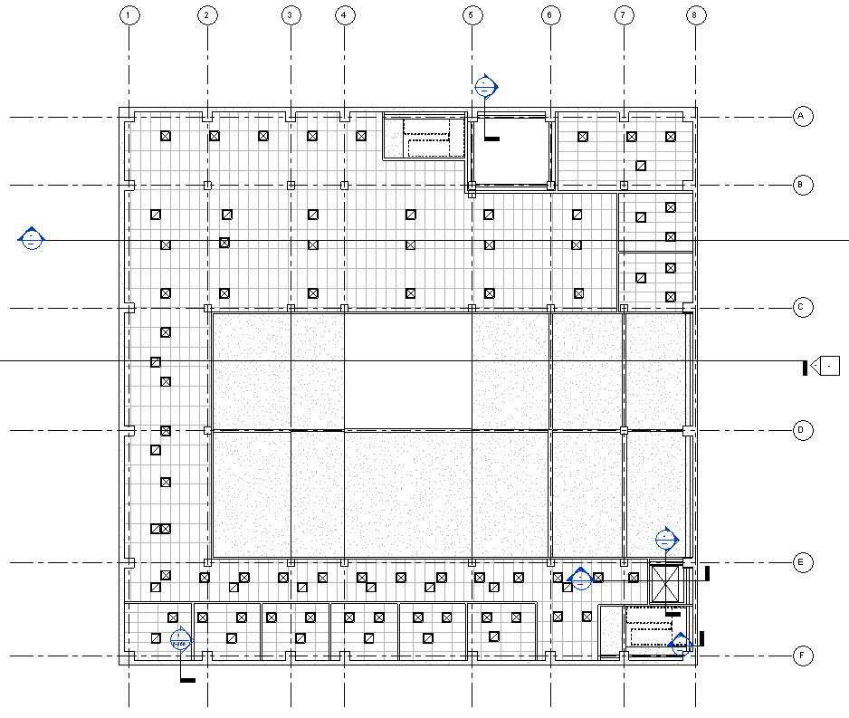
MEP Systems
There was no MEP systems.
The mechanical room is in the basement and located next to the stair in order for the shaft to run vertically right along them.
Mechanical Shaft
Supply Vents
Return Vents

Slide 29
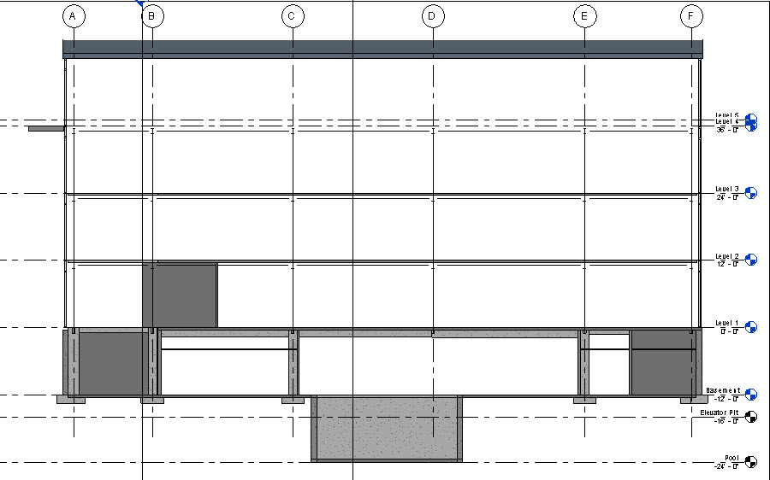
MEP Systems
This diagram shows the circulation of air throughout the building in section.
Mechanical shaft
Supply
Return

Slide 30
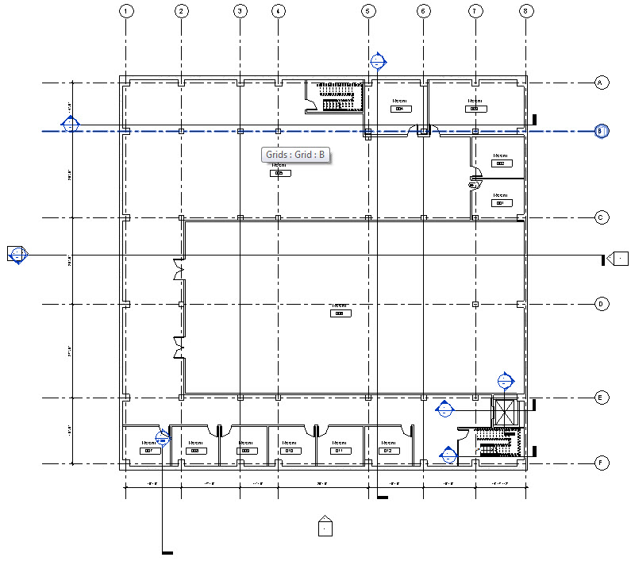
Room Layout
In the original layout there were no mechanical rooms assigned. There was a cut out corner in the basement, we decided to place the mechanical room there because it wouldn’t affect the design of the building.

Slide 31
Room Layout
According to code; the distance between each set of stairs must equal ⅓ the diagonal distance of the building and one must exit directly out the building.
Now both stairs are fire coded and exit directly out the building.
We also added an elevator that is required by code.

Slide 32
Materials & Building Assembly
For building materials we chose precast concrete panels because they are waterproof and pre insulated.

Slide 33
Materials & Building Assembly
Structure
Waterproofing
Thermal
Fire protection

Slide 34
Materials & Building Assembly
STRUCTURE:

Slide 35
Materials & Building Assembly
WATERPROOFING:

Slide 36
Materials & Building Assembly
THERMAL:

Slide 37
Materials & Building Assembly
FIRE PROTECTION:

Slide 38
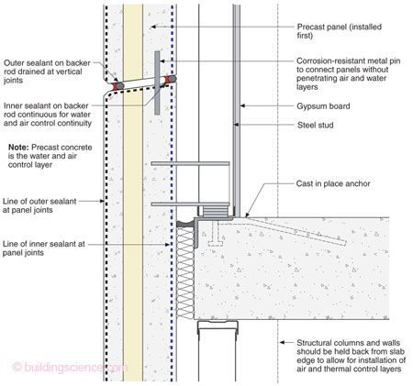
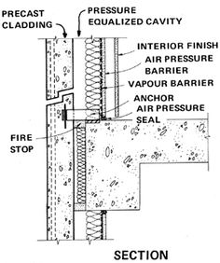
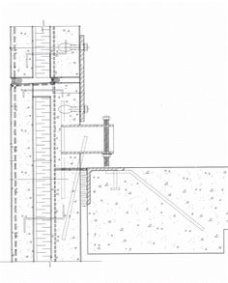
Materials & Building Assembly
References:

Slide 39
Joel Cardenas

Slide 40
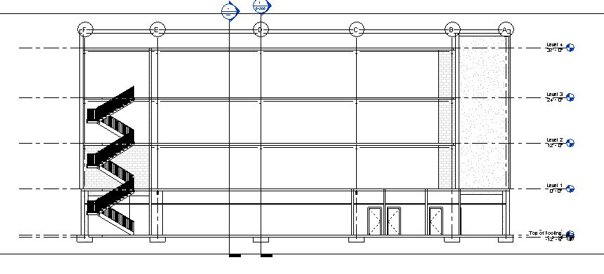
Structure
Floor heights were kept the same as the original design
13’
12’
12’
12’

Slide 41
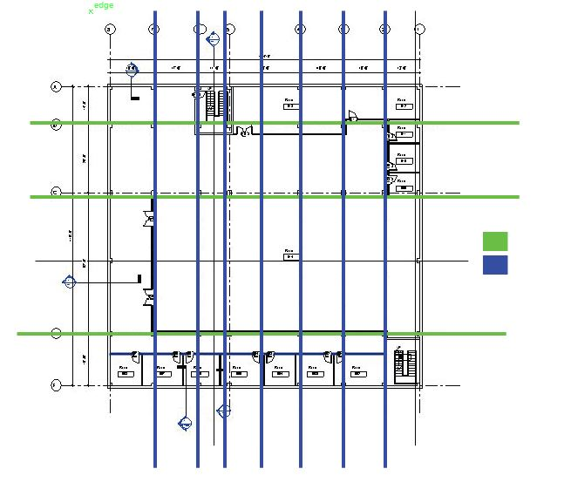
Structure
While we created our column grid we tried to have as short spams as possible so the loads can transfer in a short distance
Long span
Short span

Slide 42
Structure
It was necessary have longer spans hence the fact that the design consisted of having a pool in the middle of the plan

Slide 43
MEP
MEP issues were important. I accommodated the shaft near the elevator and mechanical room

Slide 44
MEP
Diagram is an illustration of how air will move around the building.

Slide 45
Room Layout
Most of the rooms in the original design had dead ends that violated the code. We tried to work on these spaces by providing a better circulation.
Originally, the building had a cut on one of the corners, as a group we used that space to add mechanical room

Slide 46
Materials and Building Assembly
Structure
Waterproofing
Thermal
Fire Protection

