Slide 1
DEN1218-D230
Prof. Child
Joanne Lin
04/01/2019

Slide 2
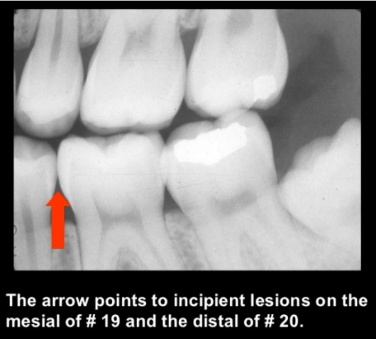
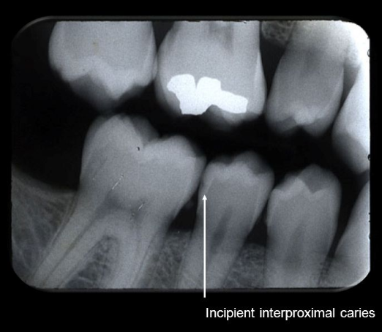
Incipient Caries
Definition
The earliest sign of a new carious lesion is the appearance of a chalky white spot on the surface of the tooth, indicating an area of demineralization of enamel. This is referred to as a white spot lesion, an incipient carious.

Slide 3
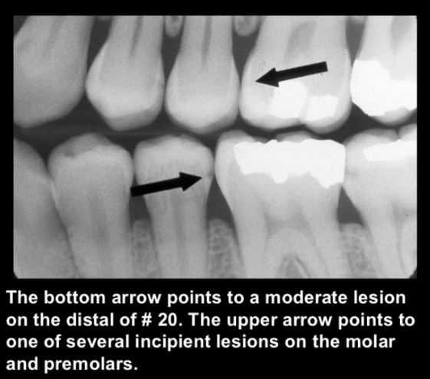
Moderate Caries
The caries has penetrated up to the dentin and spreads two-dimensionally beneath the enamel defect where the dentin offers little resistance.

Slide 4
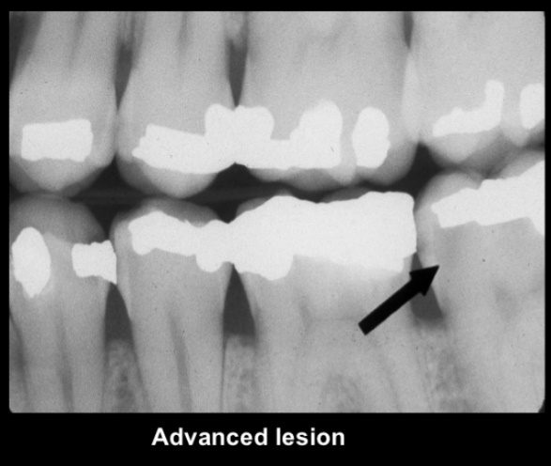
Advanced Caries
Lesion that extends to or through the DEJ but does not extend more than half the distance to the pulp
.

Slide 5
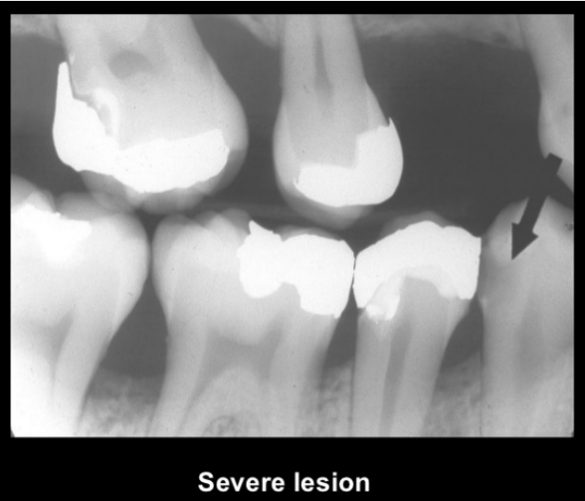
Severe Carious
Caries lesion past half way through dental and maybe even pulp.
Fracture if one or more caries teeth cervically are a frequent occurrence.

Slide 6
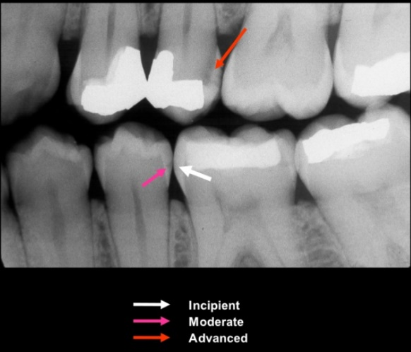
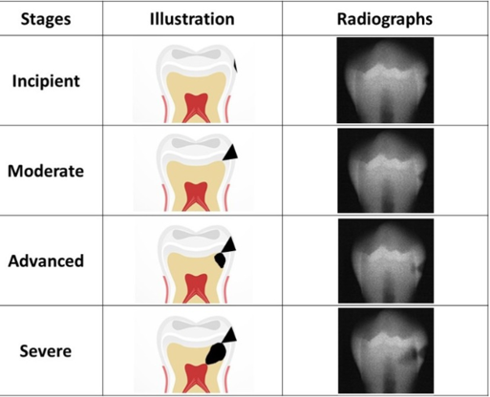
Stages of Caries Lesion
Incipient: Lesion that extends less than halfway through the enamel
Moderate: Lesion that extends more than halfway through enamel but does not involve the dentino-enamel junction (DEJ)
Advanced: Lesion that extends to or through the DEJ but does not extend more than half the distance to the pulp
Severe: Lesion that extends through enamel, through dentin, and more than half the distance to the pulp

Slide 7
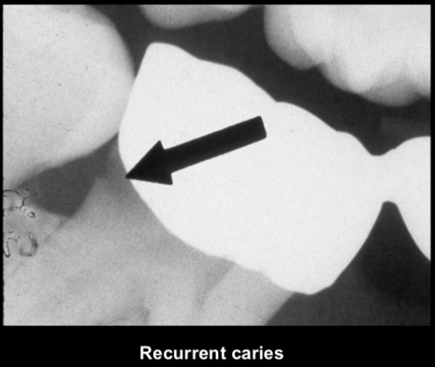
Recurrent Caries(Secondary Caries)
This type of caries is observed around the edges and under restorations.
The common locations of secondary carious are the rough or overhanging margin and fracture place in all locations of the mouth.
It may be result of poor adaptation of a restoration, which allows for a marginal leakage, or it may be due to inadequate extension of the restoration.
In addition caries may remain if there has not been complete excavation of the original lesion, which later may appear as a residual or recurrent caries.

Slide 8
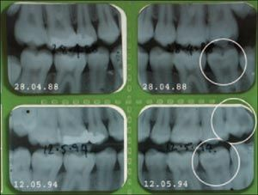
Arrested Caries
Arrested lesions can be observed clinically as intact, but discolored, usually brown or black spots.
The change in color is presumably due to trapped organic debris and metallic ions within the enamel.
These discolored, remineralized lesions are intact and are highly resistant to subsequent caries,

Slide 9
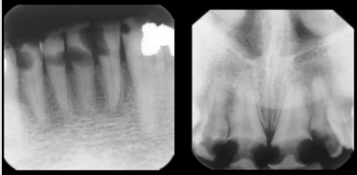
Rampant Caries
Rampant caries is defined as suddenly appearing wide spread, rapidly burrowing type of caries resulting in the early involvement of the pulp.
This frequently involves surfaces of teeth that do not usually experience dental caries eg, bottle or nursing caries baby caries, radiation caries, or drug-induced caries.

Slide 10
References:
https://www.slideshare.net/PARTHPMT/radiographiccariesdiagnosis
https://www.nature.com/articles/4814002

