Slide 1
LinkedIn Workshop: Part I
February 21, 2019
Presented by:
James Mitchell
In partnership with:
City Tech Professional Development Center

Slide 2
LinkedIn is a Tool
Networking
Business Oriented Search Engine

Slide 3
Application
Self-
Presentation
Recommendation
Perceived
Fit

Slide 4
Principles of Online Networking
LinkedIn is not a stand alone strategy. A good profile won’t get you far on it’s own. You’ll have to fuel it.
Members are what make this platform work.
“Content is King,” and drives the traffic of your experience.
Manage your efforts into campaigns. Set campaign goals and analyze your results toward progress.
(http://www.fmsinc.org/Documents/MemberCenter/WhitePapers/SixEssentialPrinciplesForSocialMediaSuccess.pdf)

Slide 5
Definitions
Campaign – working in an organized way to meet a social goal.
Employer – contact that makes the hiring decision.
Recruiter – screens and recommends applicants to the employer, potential employer.
Career – an occupation undertaken for a significant period of an individual’s life with room to advance.
Member – someone registered on the LinkedIn platform.
Content – the information that appears in your LinkedIn experience.

Slide 6
Mobile vs Desktop
Desktop is needed to fine tune your profile, and exercise your presence on the platform.
Mobile is suggested for stay updated with notifications, and respond quickly.

Slide 7
Getting Familiar
Navigation Bar
Account Settings
Profile

Slide 8
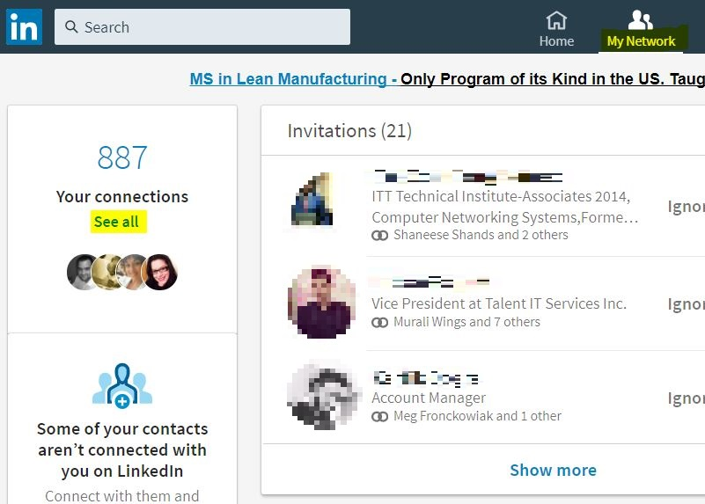
Navigation Bar: My Network
Tab to use when launching a networking campaign
Notes:
The “My Network” Tab is where you will manage connections, respond to friend invites, and recommendations.
Navigate to a connection through this tab.
Find and add connections through this tab.

Slide 9
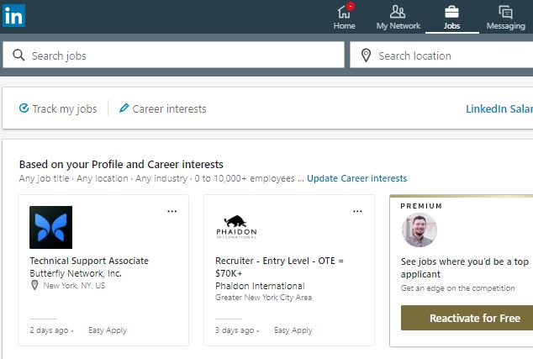
Navigation Bar: Jobs
Launch a job searching campaign using the “Jobs” tab

Slide 10
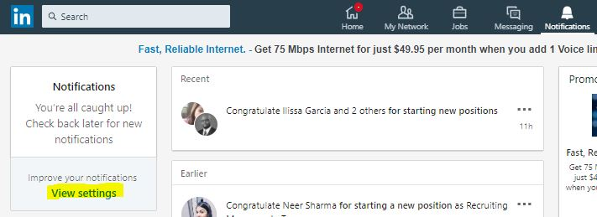
Navigation Bar: Notifications
Adjust which notifications you receive
View Notifications

Slide 11
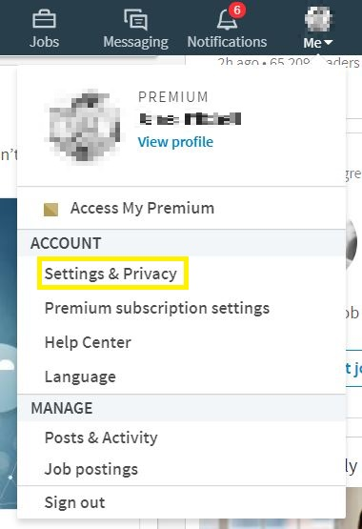
Navigation Bar : Me
Adjust account settings and privacy
Click “View Profile” to begin personalizing
Always “Sign Out”

Slide 12
Ingredients Needed for Your Profile
Professional Picture
Resume
Certifications
Credentials
Emails of Contacts (Outlook can Sync)

Slide 13
Sculpting Your Profile
Complete all fields including those with a
Be clear and genuine in your content
Be prepared to discuss the content on your page
Include any and all certifications, affiliations, and degrees
Use your resume, but don’t copy it
Match keywords and skills by analyzing a real job

Slide 14
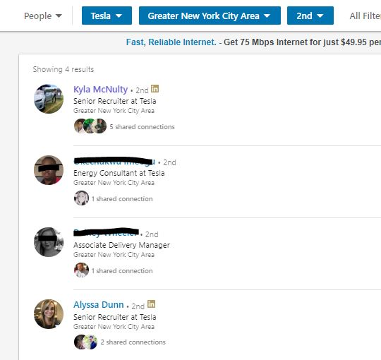
Networking: Using the Tool
Search for contacts that align with your interests
Introduce yourself with a message of why you’re available

Slide 15
Groups and Interests
Adds
Credibility
Enriches Your Experience
Network Growth
and Larger Broadcasts

Slide 16
Engaging Contacts
Socialize
Connect on LinkedIn
Make New Contacts

Slide 17
Questions?? www.linkedin.com/in/jmitch007/

Slide 18
LinkedIn Workshop: Part II March 14 12:45 pm
Presented by:
James Mitchell
In partnership with:
City Tech Professional Development Center

