Slide 1
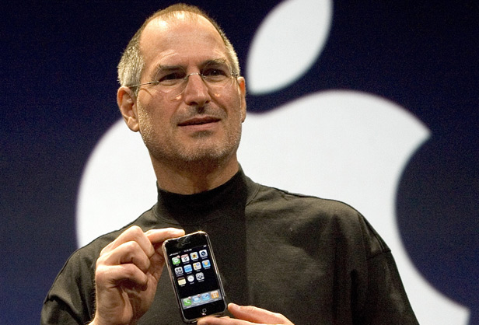
Steve Jobs
James Mateo, GRA 1111

Slide 2
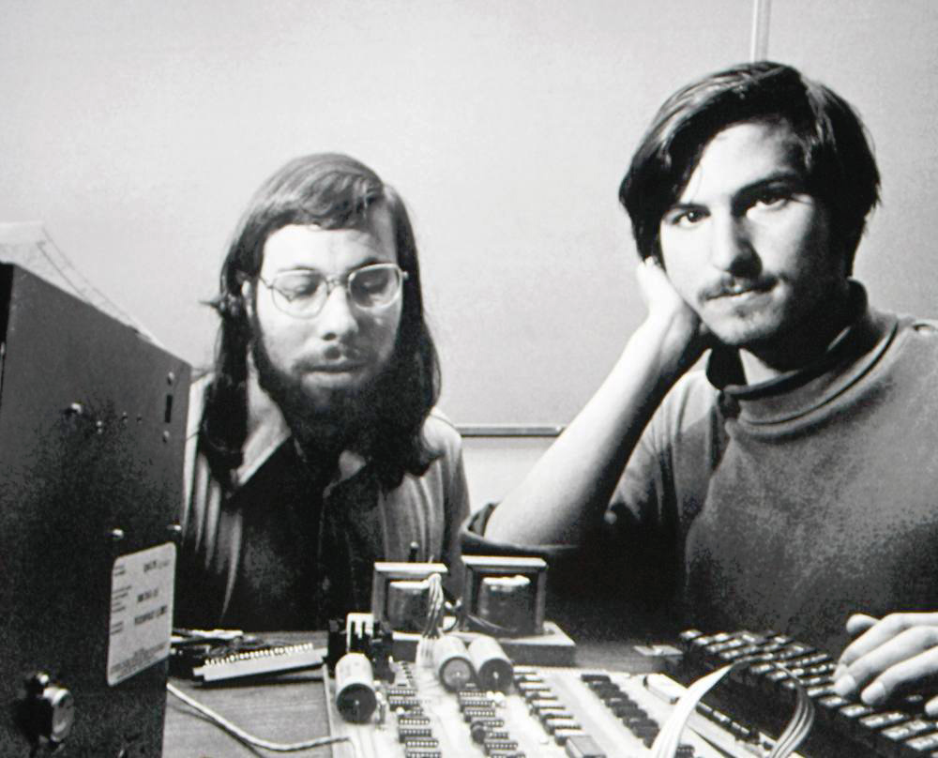
Steve Jobs was the world renowned CEO and founder of Apple
Founded in 1976 in his garage, Apple is now one of the most valuable and influential companies in the world

Slide 3
The Macintosh
With the release of the Macintosh in 1984, Steve Jobs and Steve Wozniak pioneered the development of the personal computer.
This ushered in the digital age where everyone has access to computers once meant only for big data companies and the government.

Slide 4
From Print to Digital
The Macintosh not only revolutionized personal computing but the field of Graphic Design as well
It transitioned from a primarily print medium to digital

Slide 5
Macintosh’s advantage for designers
The newly release Macintosh had features that made for an easy transition for graphic designers
The mouse allowed intuitive control
The screen displayed bitmap graphics or pixels that could be manipulated
This lead to the creation of digital fonts and software like Adobe Postscript that displayed text and images to be printed to a printer

Slide 6
Other revolutions
In addition to personal computing Steve Jobs and his team at Apple and Pixar revolutionized other fields such as
Music
Mobile Communication
Film Animation
Hardware and Interface Design

Slide 7
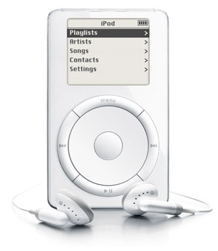
The iPod
The release of the iPod in 2001 marked the first major installment of the I series of products that revived Apple and Steve Jobs stature as a visionary
It featured a seamless wheel for users to navigate their music and the technological capacity to hold thousands of songs in one relatively small device.

Slide 8
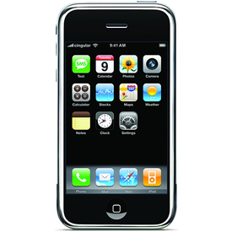
The iPhone
When first released iPhone was noted for its unique and incredible approach to creating a smartphone interface and design.
It was completely removed from having any buttons and instead utilized a touchscreen to navigate the device.
In addition to the interface the apps and music that can be stored on the device changed the smartphone market forever.

Slide 9
Pixar
Steve Jobs founded Pixar after his departure from Apple.
Initially a part of Lucas films, Steve Jobs bought the rights to the team and their technology from George Lucas.
From this investment he as well as John Lasseter and Edwin Catmull founded the company we know today as Pixar.
Pixar has gone on to pioneer the digital 3d animated feature film genre and win film awards and gain many box office hits.

Slide 10
Lasting influence
Because of Steve Jobs and Apple’s innovations in a variety of fields the way we practice in the field of Graphic Design has changed innumerably.
Graphic Design is now a primarily digital medium that is created through software usually through a Personal Computer and a mouse, all pioneered by Jobs and Apple.

Slide 11
Influence to ADGA
The design curriculum in this school and every other is centered around the technology pioneered by Steve Jobs and Apple.
As students in this classroom we are face to face with Steve Jobs’ influence every class with Macs on our desk loaded with programs to accomplish any type of design work.

Slide 12
Steve Jobs influence as a visionary for technology and design is unparalleled.
His vision to see through products that rethought user interface and our capabilities with a computer changed everyone's life and firmly ushered in the digital age.

