Slide 1
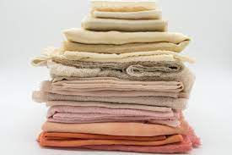
Sustainability in Fashion
Janet Gili
Dr. Munroe
BUF 4246
Future, Fashion, and Textiles
Summer 2023

Slide 2
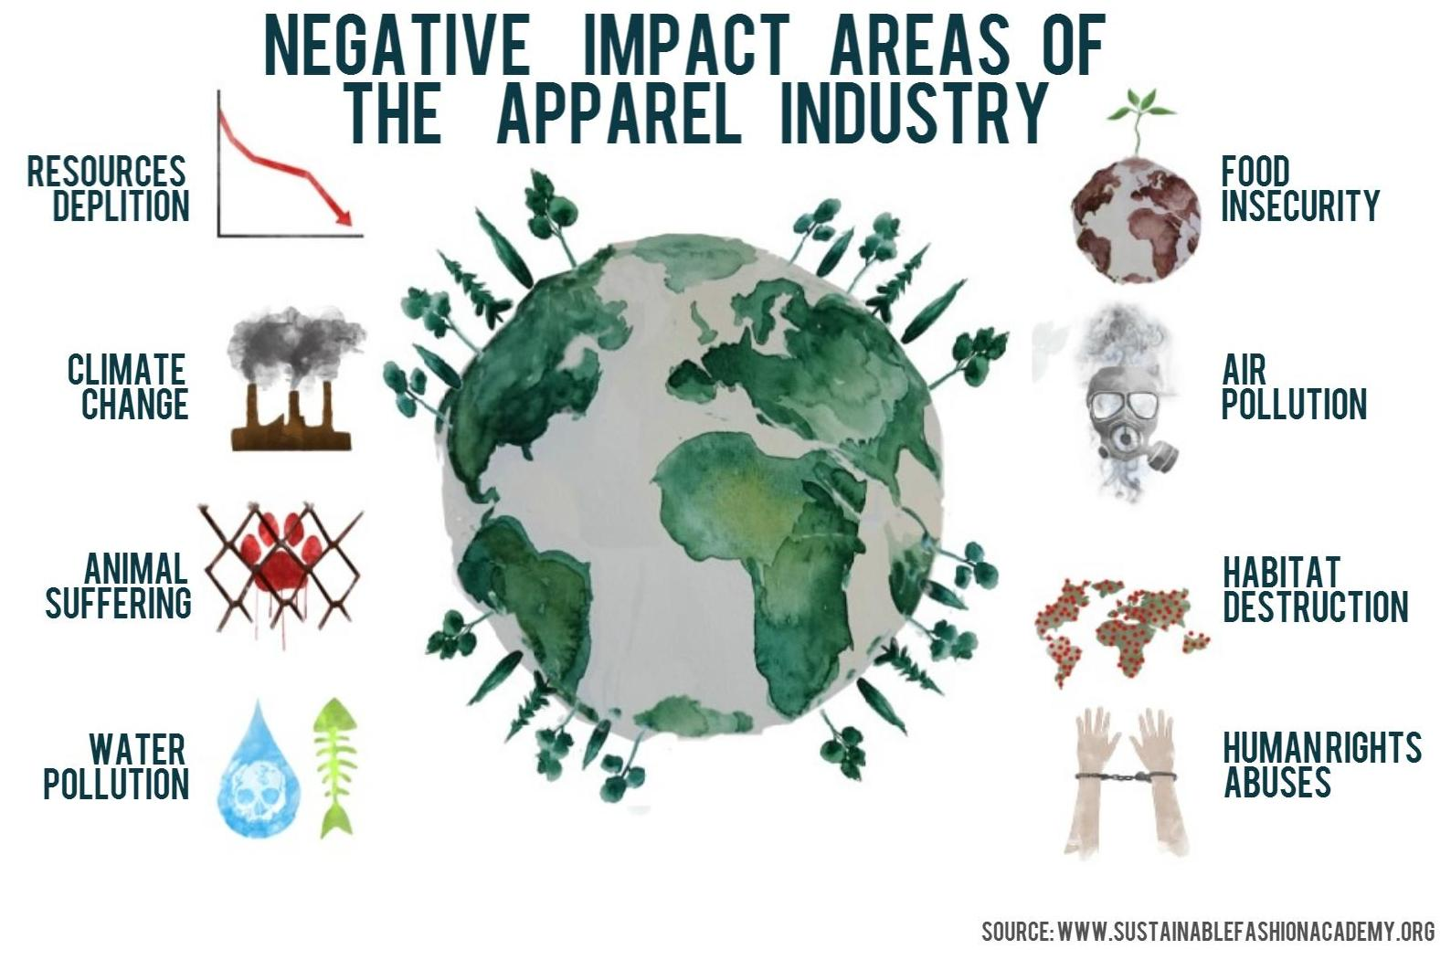
Why is there a need for sustainability in the Fashion Industry?
Positive Impacts of Sustainable Fashion
Saves Natural Resources
Reduces Carbon footprint
Saves Animal lives
Requires less water
Supports fairer & safer working conditions
Healthier for people & the planet
Doesn’t support child labour
Teaches us how to love our clothes again
(“8 Reasons Why Sustainable Fashion Matters,” 2019)
(Sustainable Fashion Academy, 2022)

Slide 3
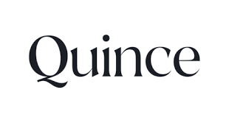
Mission Statement:
“We started Quince to challenge the existing idea that nice things have to cost a lot. Create products of equal or greater quality than the leading luxury brands at a much lower price. Because we believe quality should never be a luxury. We never cut corners when it comes to quality, sustainability or fair manufacturing practices (About Us, n.d.).”
Values: Quality, Sustainability, Affordability
Headquarters: San Francisco, CA
C0-Founder/CEO: Sid Gupta
Business Model: Direct to Consumer
“A Vision For Sustainability, Accountability, Transparency & Amazing Value”.
(About Us, n.d.)

Slide 4
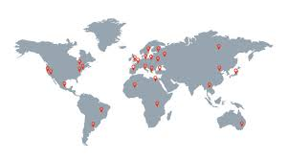
Where are Quince products made and who is making them?
products are made in a global network of partner factories visited by Quince who are committed to responsible production and safe working conditions (About Us, n.d.).
Cut out the middlemen keeping carbon emissions low
Manage every element of the items creation including packaging & transportation
Partner only with factories that pay fair wages to their workers
Produce goods in a sustainable manner
Use of Eco- friendly dyes & material whenever possible
Working towards 100% Compostable packaging with zero virgin plastic
(About Us, n.d.)

Slide 5
Are Quinces products actually Eco- Friendly?
Quince prioritizes the use of sustainable materials and partners exclusively with manufacturers who uphold a commitment to providing exceptional work environments and the emphasis on durability and quality serves to discourage the culture of excessive consumption prevalent in the fashion industry (Maracina, 2023).
The brand seeks to use the highest quality materials for each product and sell them at the lowest possible price.
Quince works with factories around the world, known for their expertise in particular local materials.
Towels are made in Turkey using local cotton, leather goods are made in Italy from locally tanned cowhides, and jewelry is made in India
Business model “manufactures to consumer” eliminates a tremendous amount of cost, which they pass back to the customer.
(Segran, 2021)
(George, 2022)
Sustainability and responsibility “can’t just be for this very small elite group that can afford it, because then are you really making an impact in the world?”
(Mainwaring, 2021)

Slide 6
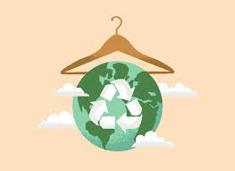
No More Intermediaries!
“By cutting out the intermediaries in various ways, Quince can match supply with demand not seasonally or semi-seasonally or even monthly, but in real-time (Mainwaring, 2021)”
Allows the Company to sell more eco-fibers often
Allows the company to charge less for what it does sell Direct to Consumer
Allows the Company to pay their workers fair wages
Mongolian Cashmere Crewneck Sweater
100% Washable Silk Slip Dress
Classic Italian Leather Tote
European Linen Duvet Cover Set
100% European Linen Drawstring Pants
Cotton Modal Tank
Vintage Wash Tencel Camp Shirt
100% Organic Cotton Crochet Cover-Up Maxi Dress
$50.00
$79.90
$99.90
$139.90
$49.90
$15.00
$29.90
$49.90
(Thomson, 2023)
(About Us, n.d.)

Slide 7
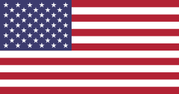
Who is buying Quince Products?
Male
AGE
Top Competitors
18- 24
25- 34
35- 44
45- 54
55- 64
65 +
——15.70%
——32.26%
——17.39%
——13.36%
——12.31%
——8.97%
Everlane
Madewell
Italic
Able Clothing
The Reformation
Female
(Challenge Validation, n.d.)
(Challenge Validation, n.d.)
Untied States
(Challenge Validation, n.d.)
Quince believes everyone should be able to afford the best, so the brand has set out to make luxurious pieces at accessible prices and has been rated the top most affordable eco-friendly brand according to the good trade (Our Editors, 2023).
95.54%
(Challenge Validation, n.d.)

Slide 8
References
8 Reasons Why Sustainable Fashion Matters. (2019, September 18). Narah Soleigh. https://www.narahsoleigh.com/en-us/blogs/blog/8-reasons-why-sustainable-fashion-matters
Sustainable Fashion Academy. (2022, October 21). Homepage - Sustainable Fashion Academy. https://sustainablefashionacademy.org/
About Us. (n.d.). https://www.quince.com/about-us#:~:text=Our%20mission%20was%20simple%E2%80%94create,should%20never%20be%20a%20luxury.&text=We%20never%20cut%20corners%20when,sustainability%20or%20fair%20manufacturing%20practices.
Maracina, C. (2023, May 28). The Best Sustainable Clothing Brands You’ve Probably Never Heard Of. CNET. https://www.cnet.com/culture/fashion/the-best-sustainable-clothing-brands-you-probably-never-heard-of/#:~:text=Quince-,Quince,reduce%20waste%20and%20carbon%20emissions.
Segran, E. (2021). You can get a cashmere sweater for only $50 from this radically transparent basics company. Fast Company. https://www.fastcompany.com/90566182/you-can-get-a-cashmere-sweater-for-only-50-from-this-radically-transparent-basics-company
George, S. (2022, April 28). How To Value A D2C Business Model? As It Gains Ground. Appscrip Blog. https://appscrip.com/blog/how-to-value-a-d2c-business-model/
Mainwaring, S. (2021, December 20). Purpose At Work: How Online DTC Retailer Quince Profits From A More Circular Economy. Forbes. https://www.forbes.com/sites/simonmainwaring/2021/12/20/purpose-at-work-how-online-dtc-retailer-quince-profits-from-a-more-circular-economy/?sh=3cf016f94b8f
Thomson, J. (2023, January 20). Building The Circular Economy: Finance Leadership In The Sustainable Fashion Revolution. Forbes. https://www.forbes.com/sites/jeffthomson/2023/01/20/building-the-circular-economy-finance-leadership-in-the-sustainable-fashion-revolution/?sh=5ff8d0da3ffc
Challenge Validation. (n.d.). https://www.similarweb.com/website/onequince.com/
Our Editors. (2023, June 5). 9 Best Affordable Clothing Brands For Sustainable Fashion - The Good Trade. The Good Trade. https://www.thegoodtrade.com/features/affordable-ethical-fashion-brands/

