Slide 1
Pain managment
Urban health- Professor joseph victory-stewart, MSN, RN
Janelle Evans-Nwagu

Slide 2
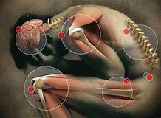
Pain What you need to know
Not a normal part of aging.
Sign that something is wrong.
Pain management is an important part of care
Does not mean you will no longer experience pain
Tolerable level that allows the greatest level of function

Slide 3
Types of pain
ACUTE
CHRONIC
- Caused by illness or injury
- Sudden, lasts a SHORT period of time
-Continuous
-Gets worse, over a LONG period of time

Slide 4
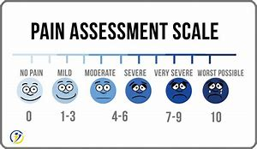
Pain What you need to know
PAIN IS SUBJECTIVE
- IT IS WHATEVER YOU SAY IT IS!
Healthcare provider examination
- They will identify painful areas
- Ask you to describe the pain

Slide 5
Medications that treat pain
Acetaminophen (Tylenol)
Decreases pain and fever
Over the counter (OTC)
Can cause liver damage if used incorrectly
NSAIDs (Motrin)
Decreases swelling, pain and fever
Over the counter (OTC)
Can cause stomach bleeding or kidney problems in certain people
Prescription medications
Opioids and Narcotics
Prescription needed
Can cause stomach bleeding or kidney problems in certain people

Slide 6
Pain medicine safety
Take medication as directed
Overdosing can cause breathing problems and other health issues
Do not suddenly stop taking medications
Can be dangerous if stopped after taking for longer than 2 weeks
Do not drink alcohol
Can cause drowsiness and slow breathing rates.
Time your medication correctly
Should be taken 30 minutes before exercise or physical therapy to reduce pain

Slide 7
Ways to manage pain without medicine
EXERCISE
Improve movement and strength. Can decrease pain.
COGNITIVE BEHAVIORAL THERAPY
Can gain control over your pain and how you react to it.
HEAT
Decreases pain and muscle spasms. 20 to 30 minutes every 2 hours or as directed
ICE
Decreases swelling and pain. Helps prevent tissue damage. Place on area 15 to 20 minutes every hour or as directed.

Slide 8
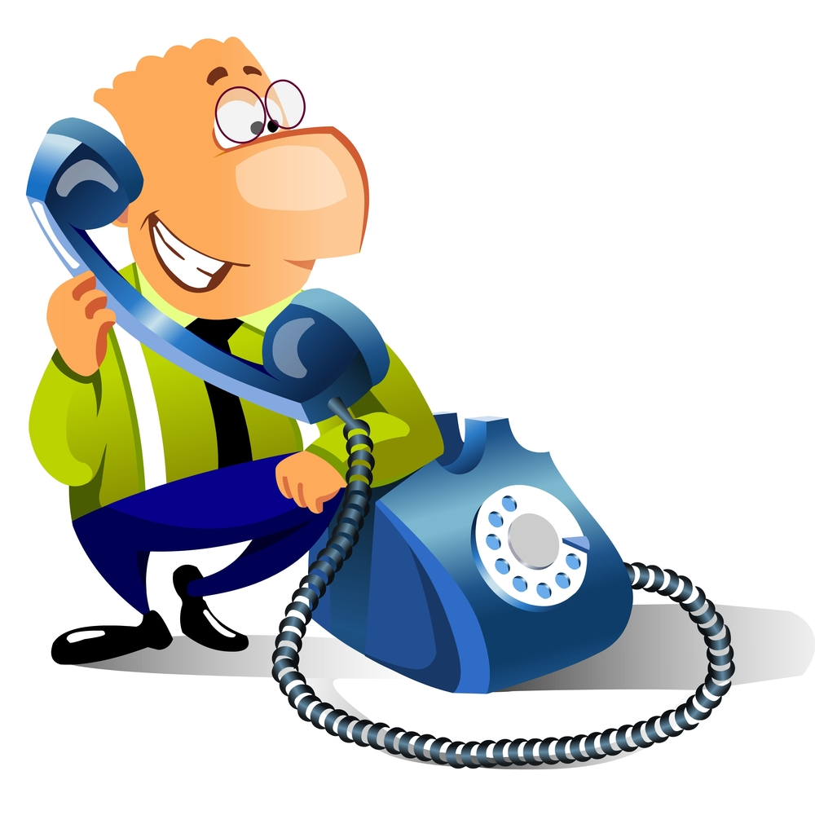
When to call the doctor?
Untreated pain
Depression
Decrease in activity
Decrease in food and fluid intake
Contact Doctor
Pain gets worse or you have new pain
New symptoms ( numbness or tingling)
Questions or concerns about your condition or care.

Slide 9
References
http://www.annarbor.com/passions-pursuits/7-considerations-for-pain-management-in-the-elderly/
https://www.drugs.com/cg/pain-management-in-older-adults.html
https://geriatricpain.org/pain-management/core-principles-pain-treatment *

