Slide 1
Di-lacerATION, ACCESSORY ROOTS, & ENAMEL PEARL
BY: JESSICA MACHADO

Slide 2
DI-LACERATION
WHAT IS DILACERATION?
Di-laceration is a disturbance that may occur during root development, can be distorted root (roots) or crown angulation in a formed tooth. It can occur in any tooth or group of teeth.
What causes it?
This condition is due to trauma during the period in which the tooth is forming. This causes a distortion in position of the forming tooth, which results in the remaining part to be formed at an angle.

Slide 3
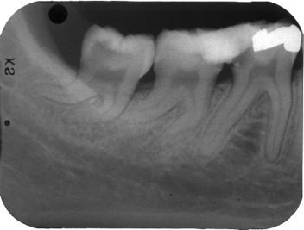
Di-Laceration
Di-laceration can cause problems during-
Extraction
Endodontic therapy
Esthetic due: to its altered shape
Tooth may be impacted or fail to erupt because of it’s sharp curve and get lodged in the jaw.

Slide 4
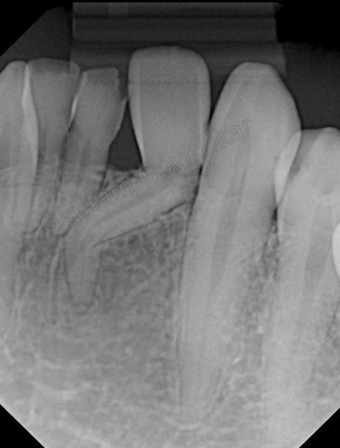
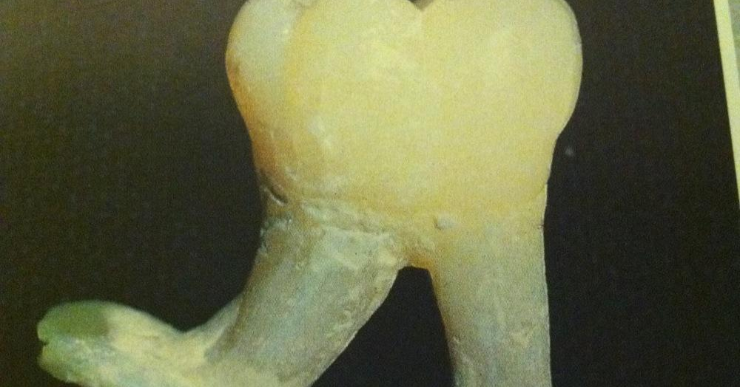
Di-Laceration

