Slide 1
Patient Profile
Mr. N is a 31 year old male who was there for an initial visit.
This 31 yr old gentleman lives in Jamaica, Queens and is single with no children. Currently this patient does not have an established dental home due to no dental insurance and dental costs being too high. Patient recently obtained employment at a cargo shipping facility where there is a year probation period in which no dental coverage is provided. This probation will be over in the next month to come and that is when he will make a dental appointment. Along with that he will be going to the Orthodontist to inquire about Invisalign.
The patient is a casual drinker who drinks approximately once a week. However, he is a heavy smoker. He smokes 10 cigarettes a day and has been smoking for over 16 years now. This patient is interested in quitting but only somewhat.
Mr. N is of South Asian descent and is from Bangladesh, where smoking amongst men is popular and a sign of being ‘cool’. In addition to this, dental hygiene is not seen as a priority.
Patients last visit to a dental office was over 5 years ago and was due to dealing with pain from one tooth. During this visit he had a few radiographs taken and was only treated for one tooth due to not being able to afford any other treatment of radiographs.
Patient states he brushes with a manual toothbrush that is soft bristled, but only once daily. He uses Colgate toothpaste when brushing and does not use any interdental aids or oral rinses. However, he uses his tooth brush to brush his tongue.

Slide 2
Chief Complaint(s)
Mr. N stated he did not have a routine dental check up or scaling for around more than 5 years and initially became a patient due to being interested in Invisalign. The patient was told a proper dental hygiene visit, as well as having any necessary dental treatment done, must be made before orthodontic treatment can begin. His chief complaint was “ My teeth are in bad shape both with tartar and alignment, so I am here to clean my mouth first and then go ahead and get my ortho treatment.”
This patient was a heavy case value, with both supragingival and subgingival calculus on almost all surfaces. Along with that, he had staining as well. He wanted to obtain a proper scaling in order to be able to get into better oral health and get orthodontic treatment so he can smile more often with confidence.
Blood Pressure: 130/73 ( which is a bit high, but patient reports his
Physician is aware and stated this reading is accurate for him.)
Pulse: 77 ASA II
Medical Conditions for patient:
Tobacco Smoker
Sleep Apnea
Current Medications:
Patient is not currently taking any medications at all.
He has a CPAP device (Continuous Positive Airway Pressure device)
which is used only at night time and not used everyday by the patient.
Health History Overview

Slide 3
Explanation of Condition
Signs and Symptoms of Condition:
Loud persistent snoring
Choking or gasping for air during sleep
Frequent bathroom visits
Irritability or fatigue
Intraorally, sleep apnea can present with wear on teeth, possible gingival recession, abnormally enlarged tonsils, and edematous or erythematous soft palate.
Poor concentration
Sleepiness during routine activities
Jaw pain
Morning headaches
Sleep Apnea is a condition where there is a cessation of breathing for someone when they are sleeping. In other words, sleep apnea is when the airway passage becomes blocked numerous times while you are asleep. There are 3 kinds of sleep apnea, which are obstructive, central and mixed. Obstructive is the most common and is when the tissue in the back of the throat closes while asleep. Central sleep apnea is where the brain fails to signal the muscles to breathe. Mixed is a combination of both sleep apneas mentioned.
The ceasing of breathing can occur hundreds of times during sleep and is involuntary. Most often people who have sleep apnea may not be aware this is happening to them while asleep because breathing is not stopped long enough for them to wake up. This condition can be caused due to other medical conditions or a persons physique. According to the National Heart, Lung and Blood Institute, obesity, enlarged tonsils, endocrine disorders, neuromuscular disorders, some genetic syndromes, and heart and kidney failure can lead to a person having sleep apnea. The risk for sleep apnea increases with age and living an unhealthy lifestyle.
“Sleep Apnea Information for Individuals.” SleepApnea.org, 12 Feb. 2017, www.sleepapnea.org/learn/sleep-apnea/.
“Sleep Apnea.” National Heart Lung and Blood Institute, U.S. Department of Health and Human Services, www.nhlbi.nih.gov/health-topics/sleep-apnea.
“What Are the Symptoms of Sleep Apnea?” Equipment Care | SleepApnea.com, www.sleepapnea.com/diagnosis/sleep-apnea-symptoms/.
“Sleep Apnea Information for Individuals.” SleepApnea.org, 12 Feb. 2017, www.sleepapnea.org/learn/sleep-apnea/.
“Sleep Apnea.” National Heart Lung and Blood Institute, U.S. Department of Health and Human Services, www.nhlbi.nih.gov/health-topics/sleep-apnea.
“What Are the Symptoms of Sleep Apnea?” Equipment Care | SleepApnea.com, www.sleepapnea.com/diagnosis/sleep-apnea-symptoms/.

Slide 4
ManageMENT
Dental Hygiene Management
Treatment for Sleep Apnea:
Continuous Positive Airway Pressure machine (CPAP)
Oral appliances
- Mandibular repositioning mouthpiece
- Tongue retaining device
Orofacial therapy ( strengthens muscles)
Surgery to clear airway
Weight loss
Mr. N experiences gasping for air several times during sleep, loud snoring (reported by partner) and jaw pain in the morning. The way in which he is managing is condition is through being under the care of a Physician and most importantly losing weight through better lifestyle choices. Through losing weight, the patient does not snore as much and does not have as severe jaw pain as before. Along with this, the patient has a CPAP machine he uses only at times during the night.
“Sleep Apnea Information for Individuals.” SleepApnea.org, 12 Feb. 2017, www.sleepapnea.org/learn/sleep-apnea/.
“Sleep Apnea.” National Heart Lung and Blood Institute, U.S. Department of Health and Human Services, www.nhlbi.nih.gov/health-topics/sleep-apnea.
“What Are the Symptoms of Sleep Apnea?” Equipment Care | SleepApnea.com, www.sleepapnea.com/diagnosis/sleep-apnea-symptoms/.
Currently there are no contraindications for treating a patient who has sleep apnea.
However, there are contraindications when it comes to treating a patients sleep apnea with a CPAP machine. These include:
Insufficient teeth to support the oral appliance
Active periodontal complications
Active TMJ disorder
No more than 5mm mandibular protrusion
Severe Bruxism
Patient Management Strategies: A way in which to manage a patient with Sleep apnea can be to ask whether their jaw hurts upon opening for long periods of time. The jaw can become sore from several dental hygiene procedures and if the patient experiences this, breaks can be given during the visit. Giving the patient breaks decreases the overall pain that can be felt. Overall, asking the patient of their comfort level with opening and closing their mouth can help throughout treatment.
Basile, John. “When to Use Oral Appliances for OSA Treatment.” Sleep Review, 2006, www.sleepreviewmag.com/2006/01/when-to-use-oral-appliances-for-osa-treatment/.
Petit, Francis- Xavier. “Mandibular Advancement Devices Rate of Contraindications in 100 Consecutive Obstructive Sleep Apnea Patients.” Proceedings of the American Thoracic Society, 2002, www.atsjournals.org/doi/full/10.1164/rccm.2008167.
Wickramasinghe, Himanshu. “What Are the Contraindications for Oral Appliance (OA) Treatment for Obstructive Sleep Apnea (OSA)?” Medscape Log In, 3 Dec. 2018, www.medscape.com/answers/295807-53660/53660-print.

Slide 5
Clinical Findings
Extraoral Examination: Macules on back of the neck due to previous rash, which is clearing up. Right submandibular lymph node is palpable with no pain to the patient. Patient has a 4mm “L” shaped scar on right side of his forehead from jumping off a table when younger.
Intraoral Examination: Petechia on right buccal mucosa near max tuberosity. Slight delayed saliva. Nicotine stomatitis and geographic tongue with anterior tip black since birth. Patient has bilateral mandibular tori.
Occlusion: Cl I bilaterally Overjet: 0mm on #24 and #25, 2mm on #23 and #26. Patient has #24 and #25 protruding outwards and #23 and #26 slanted inward towards tongue. Overbite: 10%.
4 Dental:
Missing teeth #1, 12, 16, 17, and 32, which were all extracted.
Class I restorations on #2, 3, 4, 5, 14, 30 and 31.
Malpositioned/crowding central and lateral mandibular incisors and #8 and 9 are slightly crossed on Facial aspect.
Facial fracture #6, 8, and 25 slightly.
Attrition on all canines
5. Deposits
Generalized extrinsic yellow stains due to smoking
Generalized Heavy subgingival calculus with moderate supragingival calculus.

Slide 6
Dental & Periodontal Charting
Dental Hygiene Diagnosis: Mr. N has Type II, active periodontitis due to generalized 3-4mm probing depths with a few 5mm posteriorly. Patient has moderate BOP, with mandibular posterior molars possibly leading to Grade I furcations. He has heavy subgingival calculus that needs to be thoroughly debrided along with generalized staining due to heavy smoking for over 16 years. The patient has crowding of mandibular anteriors and on the maxillary centrals, which makes it difficult to clean and remove plaque adequately. Along with this, Mr. N is at high risk for caries due to multiple risk factors and minimal protective factors. Patient has #12 missing due to caries, frequent exposure to sugary drinks such as sodas, delayed saliva, and difficulty maintaining proper oral hygiene due to crowded teeth.

Slide 7
Caries Risk Assessment
Clinical Evidence of Caries:
Decay noted on the occlusal of # 18, 19, 20 and decay on the occlusal and distal of #15.
Radiographic Evidence of Caries: No radiographic evidence of caries due to no radiographs available.
Patient is at high risk for caries due to missing #12 due to caries, frequent exposures to sugary drinks, and crowding of anterior teeth.
Gingival Description
&
Periodontal Status
Gingiva is generalized soft and melanin pigmented. Generalized red, inflamed gingiva with slightly snug papilla anteriorly and slightly rolled posteriorly.
Generalized slight periodontitis; Periodontal type II.
Generalized moderate BOP
Generalized 3-4 mm probe readings with some 5mms
No furcations
No mobility

Slide 8
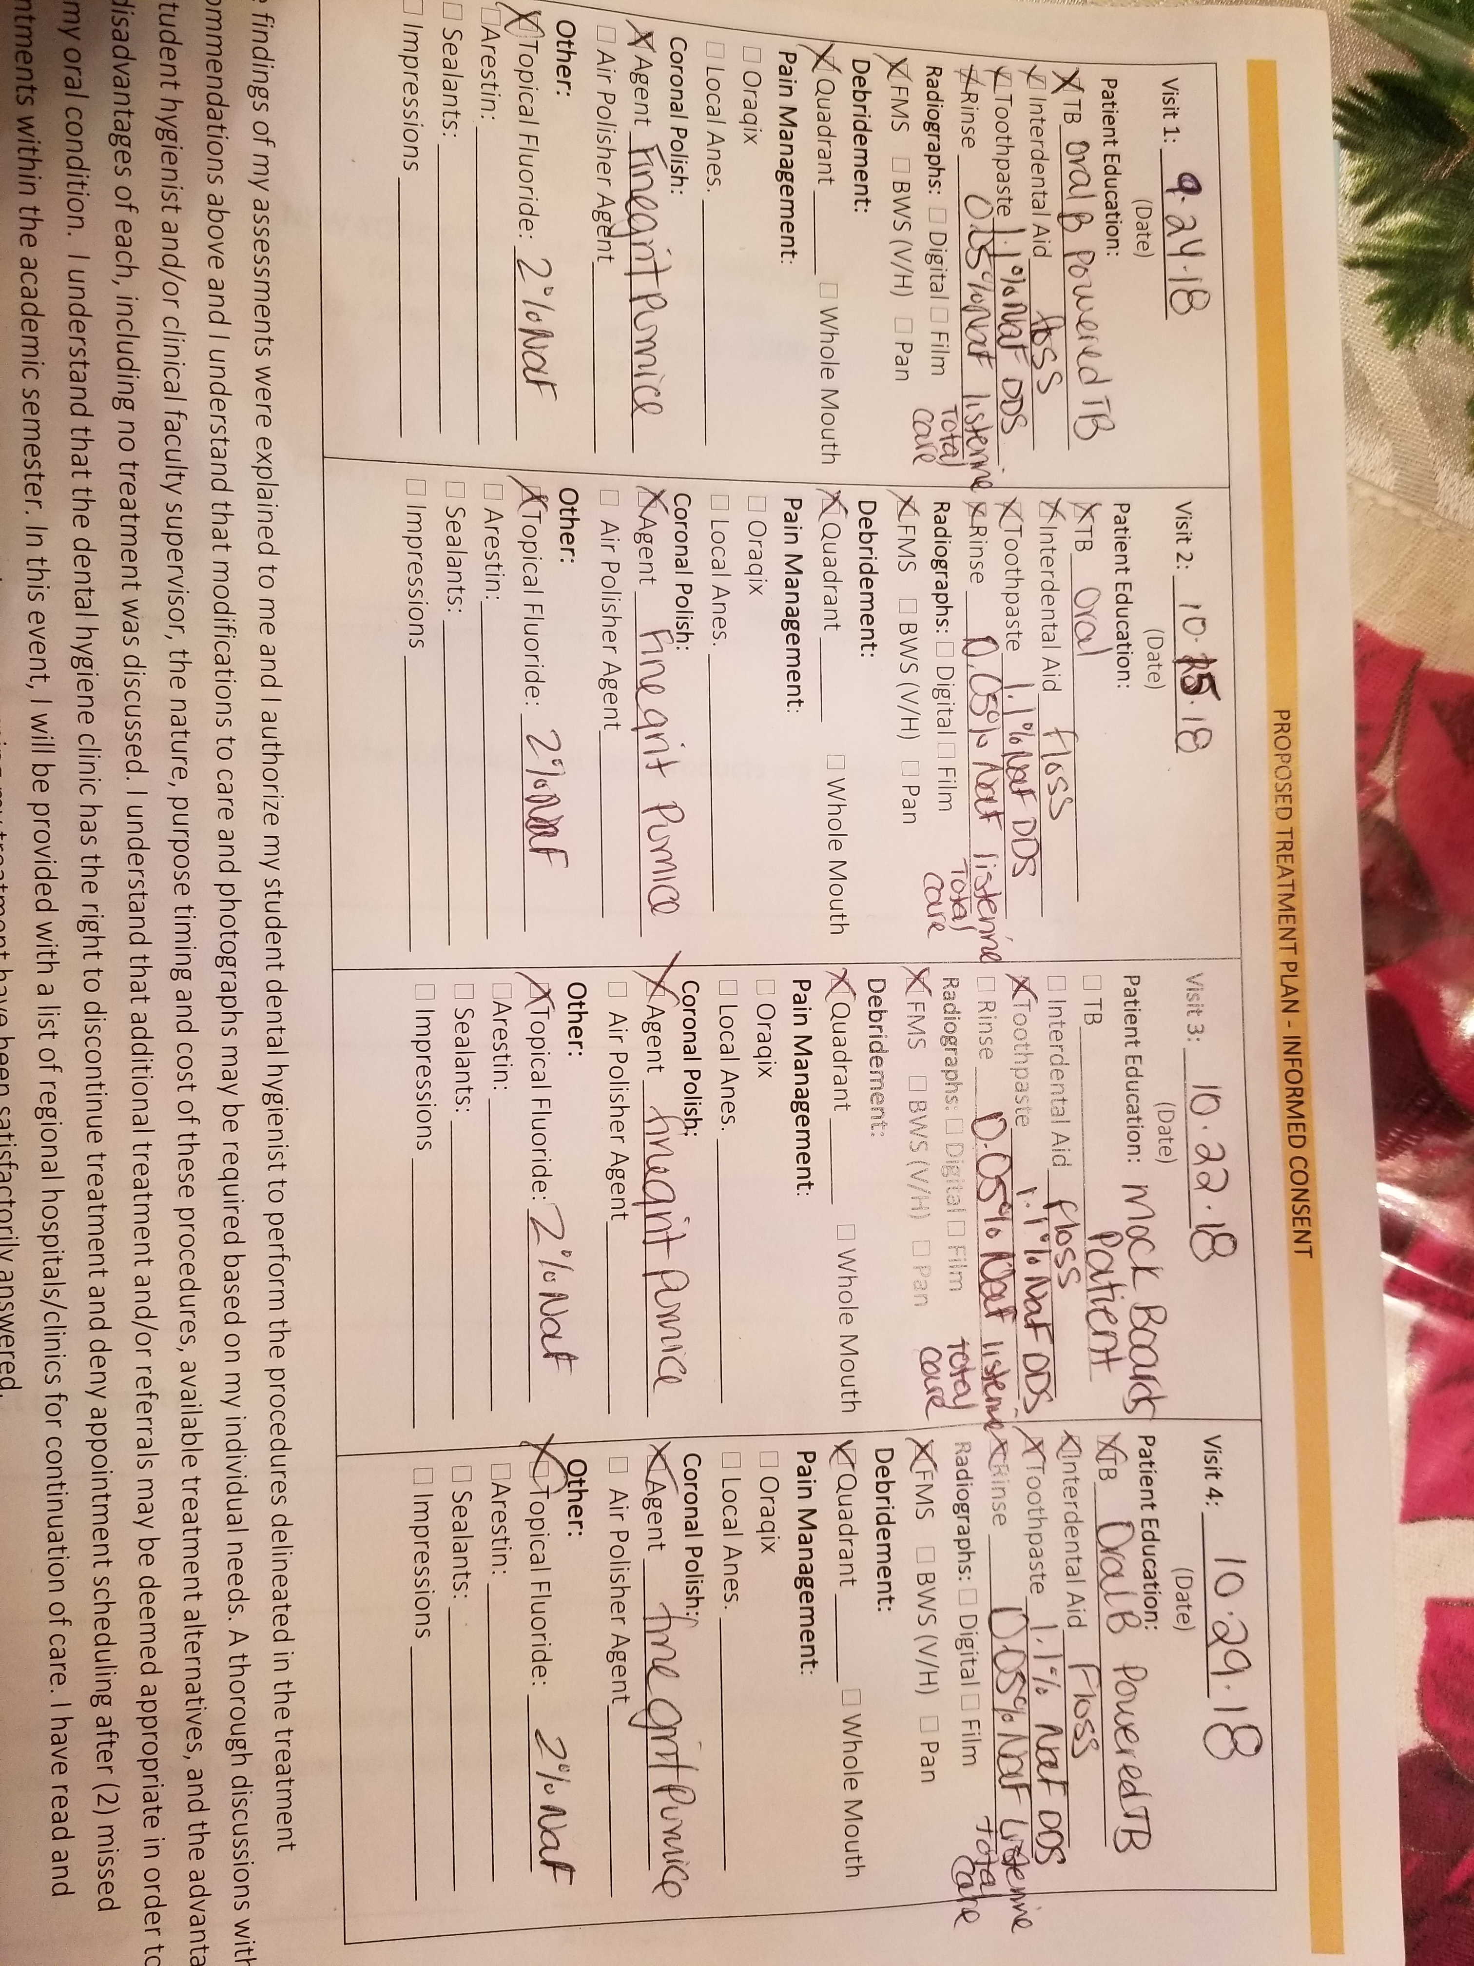
Dental Hygiene Care Plan
Reduce BOP by 50% by next 3 month recare.
Improve and arrest periodontal status through proper debridement, by the next 3 month recare.
Patient will report less consuming of sugary drinks and going to Dentist for suspected caries by next 3 month recare.
Patient will report using a soft bristled tooth brush or Powered toothbrush for 2 minutes, twice daily by next 3 month recare.
Patient will report starting to use floss as an interdental aid for atleast once daily by next 3 month recare.
Patient will report rinsing with .o5% NaFl 2 x’s day for 30 seconds.
Consent for Treatment

Slide 9
Implementation -Treatment
Preventive Services:
Oral Self-care Instructions: Patient was taught the modified bass method of brushing and informed to brush with a soft bristled manual tooth brush for 2 minutes daily. However, the patient was recommended to use a powered toothbrush and before treatment ended, patient bought an Oral B powered toothbrush. He was told to use this to brush twice daily.
Fluoride Therapies: The patient was advised to obtain a 1.1% Sodium fluoride toothpaste from the Dentist to use as his dentifrice twice daily.
Patient was not qualified for sealants
Antimicrobials: For antimicrobial, the patient was recommended to use a 0.05% Sodium fluoride rinse, such as Listerine Total care, twice daily for 30 seconds.
Dietary Guidance: Patient was recommended to stop or reduce the intake of sugary foods and drinks and try to drink as much water as possible instead of sodas.

Slide 10
Implementation –Treatment Continued
2. Debridement Performed:
Debridement was completed using a combination of the FSI- power 1000, triple bend ultrasonic tip and multiple hand instruments. Heavy calculus, both subgingival and supragingival, extrinsic staining, and biofilm from all four quadrants were removed in 4 visits.. Both intraoral and extraoral fulcrums were utilized for patient comfort, ergonomics and to be able to remove deposits successfully. Patient was engine polished using a fine grit pumice to aid in further stain removal and was given a 2% NaF tray application to help in reducing the risk of future caries.
No local anesthesia, Oraqix, or topical was used throughout all appointments. Patient managed the pain very well and suctioning was well maintained as well. Water and/or saliva accumulation was suctioned during the entire treatment to prevent the patient from “drowning” and prevent any accumulation. The patient was given bathroom breaks and breaks in between debridement when he needed. One difficulty during treatment of Mr. N was the crowding of the anterior teeth. This crowding made it difficult to properly reach deposits subgingivally on all surfaces. However, with extraoral fulcrums, adjusting the patient, and adjusting the angle of the ultrasonic or hand instrument made it possible to fully remove it all.

Slide 11
Evaluation of Care – Outcome of Care – Prognosis
Goal Statement | Prognosis
1. Reduce BOP by 50% and improve periodontal status through proper debridement, by the next 3 month recare. | 1. Goal to reduce BOP and periodontal status will be met due to adequate removal of all calculus and proper oral hygiene instructions.
2.. Patient will report less consuming of sugary drinks and going to Dentist for suspected caries by next 3 month recare. | 2. Goal to consume less sugary drinks and go to Dentist will be met because the patient is concerned with obtaining proper oral health and preventing further decay, especially after having Invisalign treatment done.
3. Patient will report using a soft bristled tooth brush or Powered toothbrush for 2 minutes, twice daily by next 3 month recare. | 3. Goal to use powered toothbrush will be and is being met because patient obtained the Oral B powered toothbrush after it was recommended during his visits to the clinic. He is highly motivated to maintain proper oral hygiene.
4. Patient will report starting to use floss as an interdental aid for atleast once daily by next 3 month recare. | 4. Goal to floss has potential to be met because patient stated he does not like flossing as much, but will try his best to do so at least once daily.
5. Patient will report rinsing with .o5% NaFl 2 x’s day for 30 seconds | 5. Goal to rinse will be met because patient states wanting his breath to smell fresh and likes having a rinse that will benefit his oral cavity as well as having no bad breath.

Slide 12
Continued Care Recommendations
Mr. N was given a 3 month recare interval due to heavy subgingival, supragingival calculus, extrinsic staining, and severe biofilm buildup. In addition to that the patient is a periodontal type II and this along with being high risk for caries entails 3 month evaluations. This is to ensure that the patient is maintaining proper oral hygiene care and has arrested his periodontal status to stop further destruction.
A referral was given to the patient to go to dental office in order to check the suspected caries present and to obtain the 1.1% Sodium Fluoride toothpaste that is only available through prescription.

Slide 13
Reflection
After finishing Mr. N, it felt like a great accomplishment. He was one of the first heavy case value patients I had for the semester and was my Mock Boards patient as well. I was able to complete this patient thoroughly and with no rescales on any surface, which was a thrilling feeling. Debridement as well as patient compliance went very well. The treatment plan was followed accurately with minor adjustment due to being a mock boards patient. Along with this the patient was very calm, relaxed, compliant and was able to manage all treatment with no numbing agents. However, during debridement, I had trouble for mandibular anteriors due to crowding. It was a bit difficult to access all of the calculus due to much overlap of the teeth but through the help of faculty, the patient, and adjusting the angulations of instruments used, I was able to remove all the calculus.
There was one aspect of treatment that could have been different, which was not using any numbing agents. During the entire treatment, the patient was asking if he was comfortable in which he stated he was. However, on the final visit, after all treatment was completed, Mr. N stated he did experience slight pressure and pain in certain areas. If topical or even Oraqix was used, the patient might not have felt this slight discomfort. All in all, this patient was great and treatment went smoothly. He stated he is awaiting his next 3 month recare.

