Slide 1
CALCULUS
Prof. Child
Joanna Chan

Slide 2
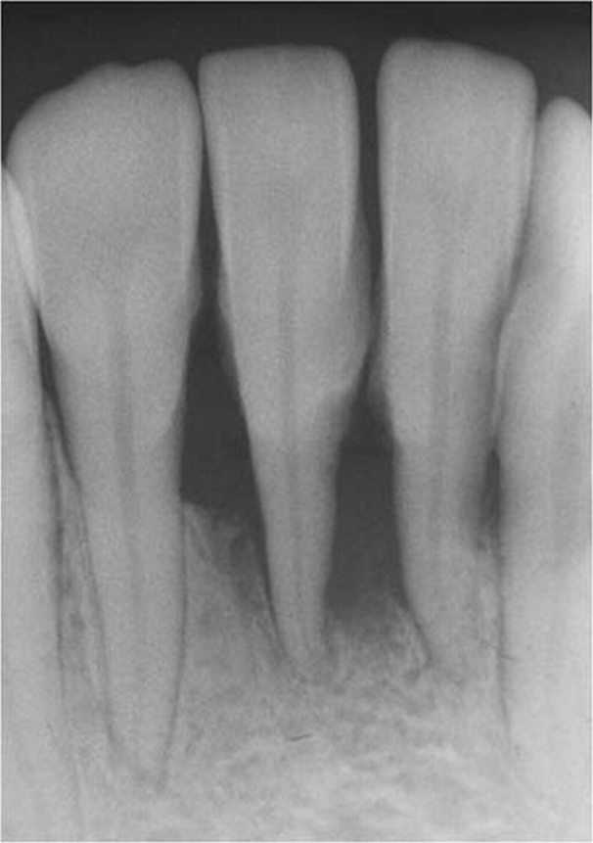
Periapical radiograph of the lower anterior with heavy calculus and bone loss

Slide 3
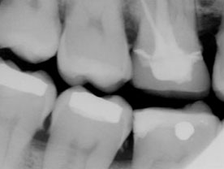
Molar bite-wing radiograph with heavy calculus and restorations

Slide 4
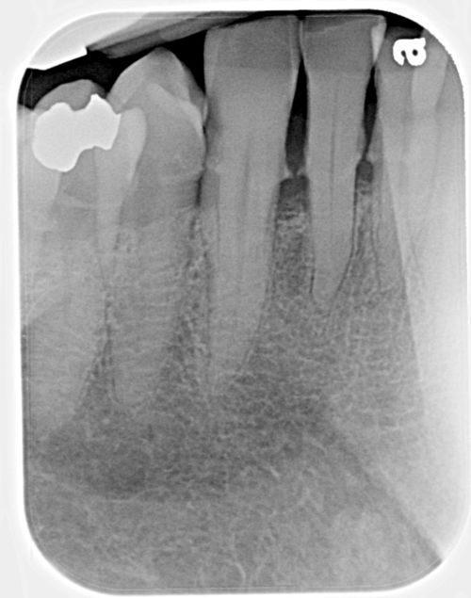
Periapical radiograph of lower anterior with interproximal calculus

Slide 5
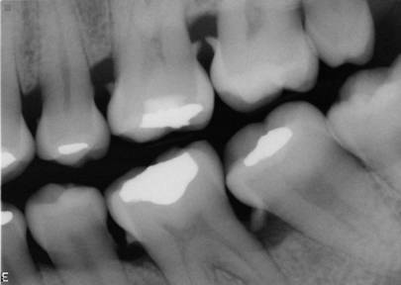
Molar bite wing radiograph with horizontal and vertical bone loss and calculus

