Slide 1
Tetracycline Stain

Slide 2
Tetracycline Stain
Tetracycline is in taken while teeth development discoloration can occur
Tetracycline have an affinity for mineralized tissues and are absorbed by the bones and teeth

Slide 3
Tetracycline Stain
Stain develops or originates from within the tooth, discoloration of the dentin reflects through the enamel
Endogenous Intrinsic Stain
Stain can not be removed by scaling

Slide 4
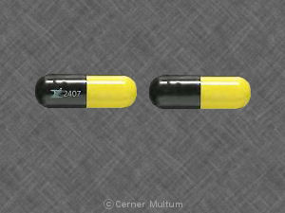
Tetracycline
Antibiotic
Infection
Malaria
Acne
Gum Infection

Slide 5
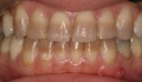
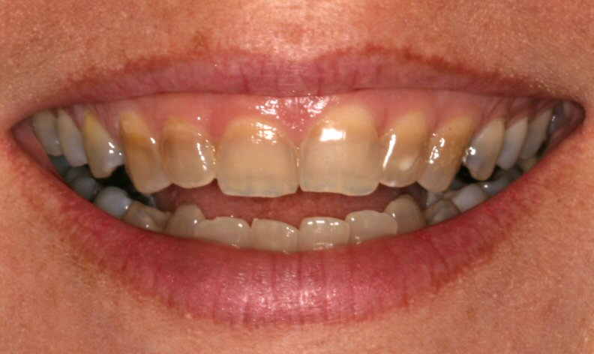
Tetracycline Stain

Slide 6
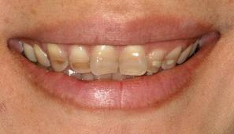
Tetracycline Stain

Slide 7
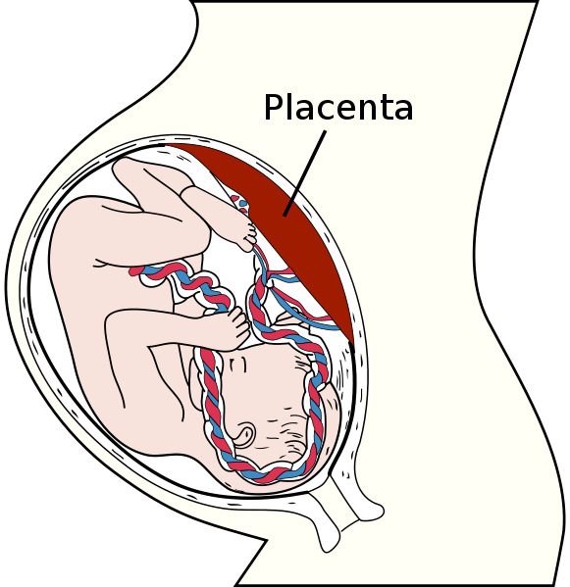
Pregnant Woman
Tetracycline transferred through the placenta and enter the fetal circulation
This effect occurs during mineralization of the primary teeth beginning at about 4 months of gestation

Slide 8
Infant –Early Childhood
Mineralization of the permanent teeth starts at birth and continues into adolescence

Slide 9
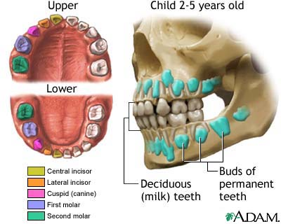
Discoloration
Discoloration may be generalized or limited to specific parts of individual teeth that were developing at the time of administration of the antibiotic

Slide 10
No tetracycline
Pregnant woman
Infant –until 12

Slide 11
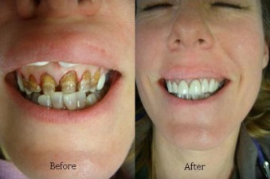
Dental Hygienest
Inform the patient
Whitening
Recommend Veneers

