Slide 1
My Artist Inspiration
Ivy Strickland
Featuring
Yi-Ying

Slide 2
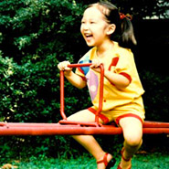
Background
Coincidentally enough in Chinese Yi means Happy & Ying means Creative. I’m sure Yi-Ying’s parents didn’t know she would be one of the most recognized creative artist in the 21st century but she sure is.
Yi-Ying was born in Shanghai on December 2nd she moved to Sydney Australia as a teenager. For 2 years she studied Exchange in Advertising, illustration and book design in London UK at Central St. Martins College of Arts & Design in 2006. She then moved back to Sydney Australia where she Graduated from The University of Technology Sydney with First – Class honors in Bachelors of Design Visual Communication.

Slide 3
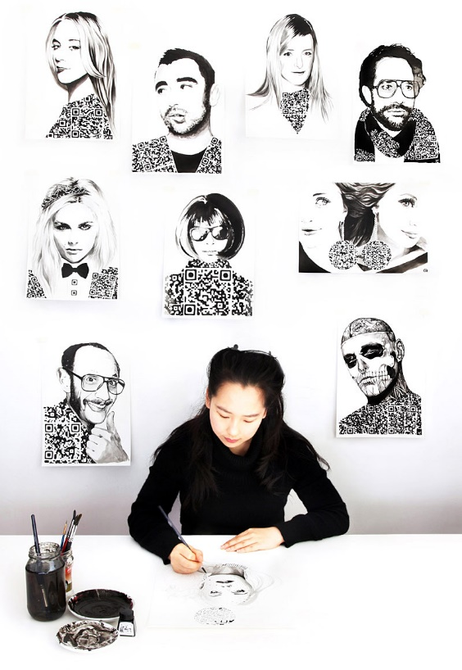
Recognition
Yi-Ying Lu is an award-winning designer with more than 10 years of experience in the creative realm. Her projects have been featured in many publications, including The New York Times, Forbes, The Atlantic, NBS News, TIME, Wired Magazine, The Verge, CNN, BBC, San Francisco Chronicles, TechCrunch, Mashable, Engadget, The Huffington Post and So Much More
She has worked as a creative advisor and designer for Disney, Microsoft, SXSW, Twitter, PepsiCo, Sony, Scholastic, Maybelline, Expedia and so on.
Yi-Ying was named a “Top 10 Emerging Leader in Innovation” in the Microsoft Next 100 series, published by The Australian. She is also the recipient of a Shorty Award, The One Show
Fashion Illustrations commisioned by US fashion and culture magazine Meets Obsession‘s “10 Most Intriguing in Fashion” feature story, which will profile ten notable names in fashion who have made the industry’s most intriguing headlines this year. Each of these “Most Intriguing” illustrations for Meets Obsession include an embedded Quick Response (QR) code, that once scanned with a mobile device, will reveal the name of the Fashion Icon, Artist name as well as a web address where users learn further information of this project, as well as get a physical copy of the Meets Obsession magazine online.

Slide 4
Lifting a Dreamer
In 2008 when twitter had only 2 million users, Lu licensed her piece called “ Lifting a Dreamer” to the startup company through a stock photo site. Now today with more than 332 million active users Lu’s piece has been widely viewed by the social media community.

Slide 5
Present Day
Today Yi-Ying resides in Sydney Australia where she owns her own studio as well as teaches at The University of Technology Sydney the same University that honored her. Encouraging other young talented artist to follow their passions. Yi-Ying leads creative direction at 500 Startups, the worlds most active venture capital film and startup accelerator.
Her passion is to help companies, organizations, and individuals find the “FUN” in the “FUNctional.”
- Link to Startups http://500.co/team/yiying-lu/

Slide 6
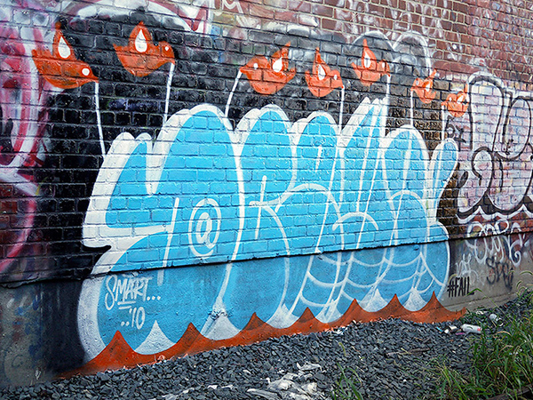
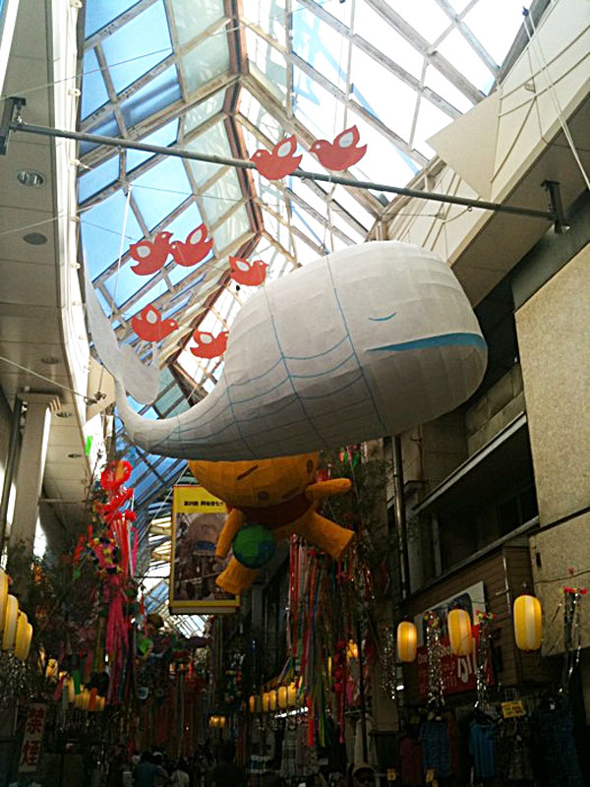
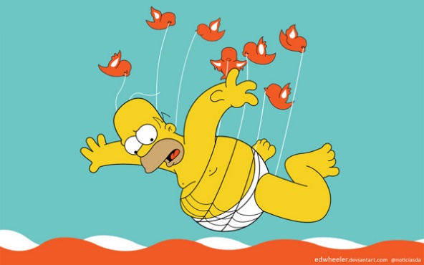
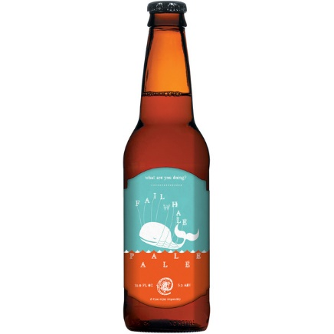
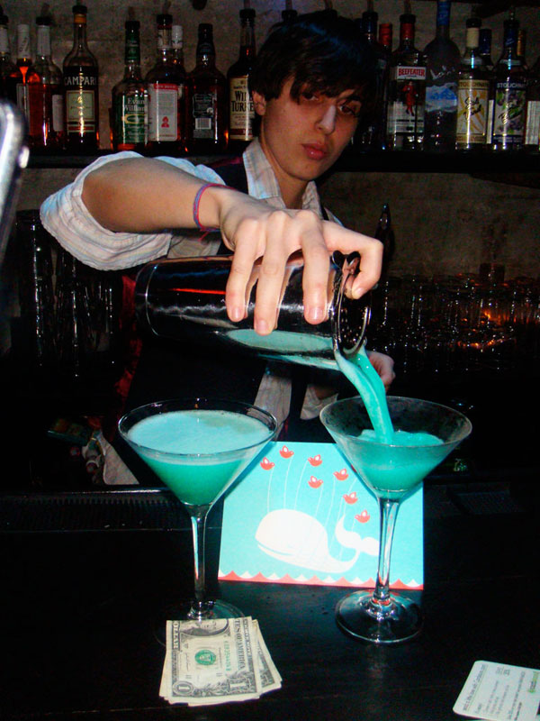
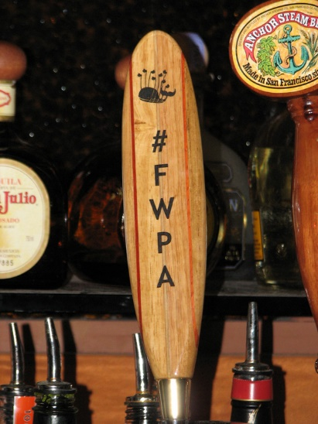
REMIX

Slide 7
Some Of Her Work
http://www.yiyinglu.com/

Slide 8
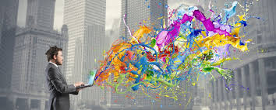
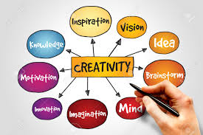
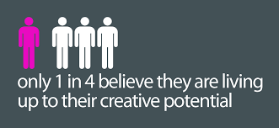
WHY ?
Yi – Ying Lu inspires me because she was a young woman who as far as she was concerned wasn’t good at typical things like math nor was she competitive but still while laying under the radar found something fun that interested her and was able to become very successful due to following her own passion. We are all sort of taught to follow the more “realistic” path which usually is far from our personal passions and I admire her will to be herself.

