Slide 1
Amelogenesis Imperfecta and Dentinogenesis Imperfecta
IRENA SHLOMOV
DEN1218/E612

Slide 2
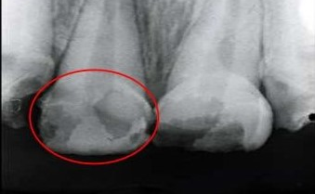
Amelogenesis Imperfecta
Enamel appears as radiolucent

Slide 3
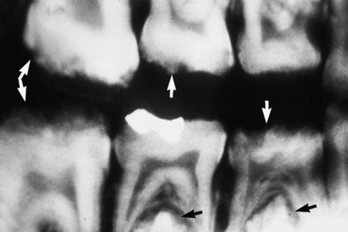
Right bitewing showing the enamel defects of Amelogenesis Imperfecta, arrows pointing to both the deciduous and permanent dentitions

Slide 4
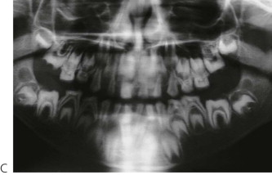
Panoramic radiograph of
Amelogenesis Imperfecta (showing absent or very thin enamel)

Slide 5
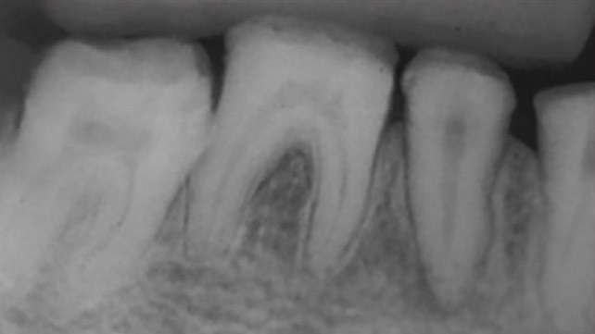
Amelogenesis Imperfecta:
thin enamel, looks less radiopaque on a radiograph

Slide 6
Amelogenesis Imperfecta
Note the square shape and thin enamel

Slide 7
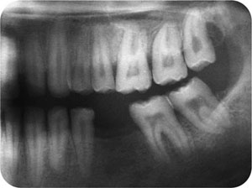
Hypoplastic Amelogenesis Imperfecta:
Note the thin enamel but normal underlying tooth structure.

Slide 8
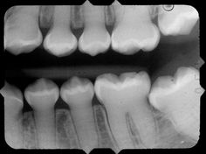
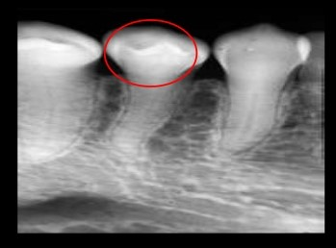
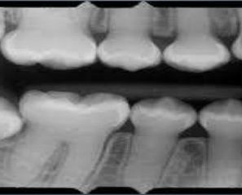
Dentinogenesis Imperfecta
Dentin appears as radiolucent area surrounded by faint radiopaque margins

Slide 9
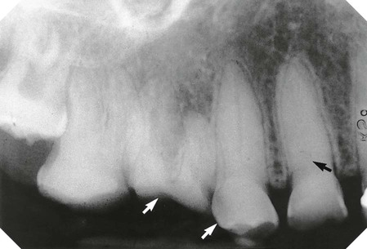
Periapical of maxillary premolars and molars showing Dentinogenesis Imperfecta.
Note the near obliteration of the pulp chamber (black arrow) and loss of the overlying enamel (white arrows).

Slide 10
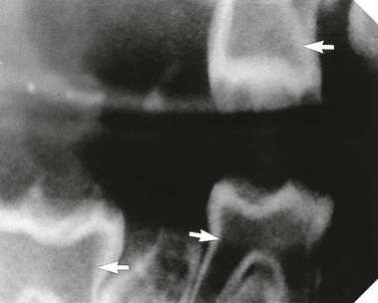
Bitewing showing so-called ”shell teeth” – a type of Dentinogenesis Imperfecta.
The enamel is essentially normal but there is almost no dentin and the pulp chambers are very large

Slide 11
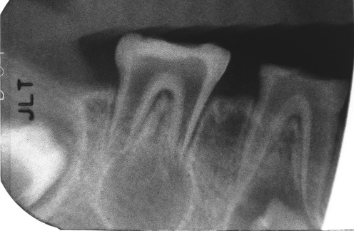
Dentinogenesis Imperfecta, Severe Form:
Periapical radiograph showing shell teeth with enlarged pulp chamber and thin radicular dentin.
Periapical radiograph of posterior molar regions
showing thin irregular enamel and dentin, with wide pulp chambers resembling “shell teeth”.

Slide 12
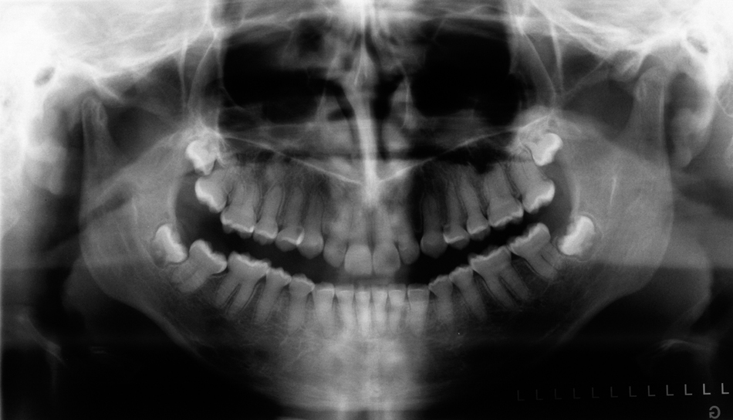
Panoramic radiograph of
Dentinogenesis Imperfecta

