Slide 1
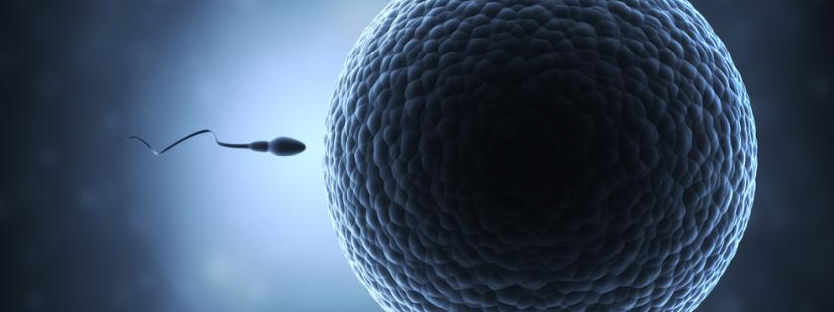
Evaluation of “The Egg and The Sperm”
How Society has involved Social Constructs in Male and Female Reproductive Processes

Slide 2
Author – Emily Martin
Emily Martin is an anthropologist and feminist who received her undergraduate degree from the university of Michigan and her PhD degree from Cornell University
In “The Egg and The Sperm”, Emily Martin speaks about “the possibility that culture shapes how biological scientists describe what they discover about the natural world” expressing inequalities.

Slide 3
Discriminating Terminology for Female Processes
Martin believes that the terminology used for describing female reproductive processes throughout some of the main textbooks used for study of male and female reproductive processes to be discriminating against females.
When discussing menstruation she refers to the medical texts that state menstruation is the "debris” of the uterine lining and that it is the "ceasing”, "dying” and "losing” of product. The terminology makes it seem that the process is wasteful as though the eggs are garbage.
She states that in a best selling book it says "Oogenesis is wasteful.“
(Oogenesis-The development of the egg cell)

Slide 4
Crediting Terminology for Male Processes
Martin brings up the favoring terminology for male reproductive processes as the medical texts state “Perhaps the most amazing characteristic of spermatogenesis is its sheer magnitude” and states that use of the word "remarkable” distinguishes male processes as enthusiastic and productive, opposite of the female processes.

Slide 5
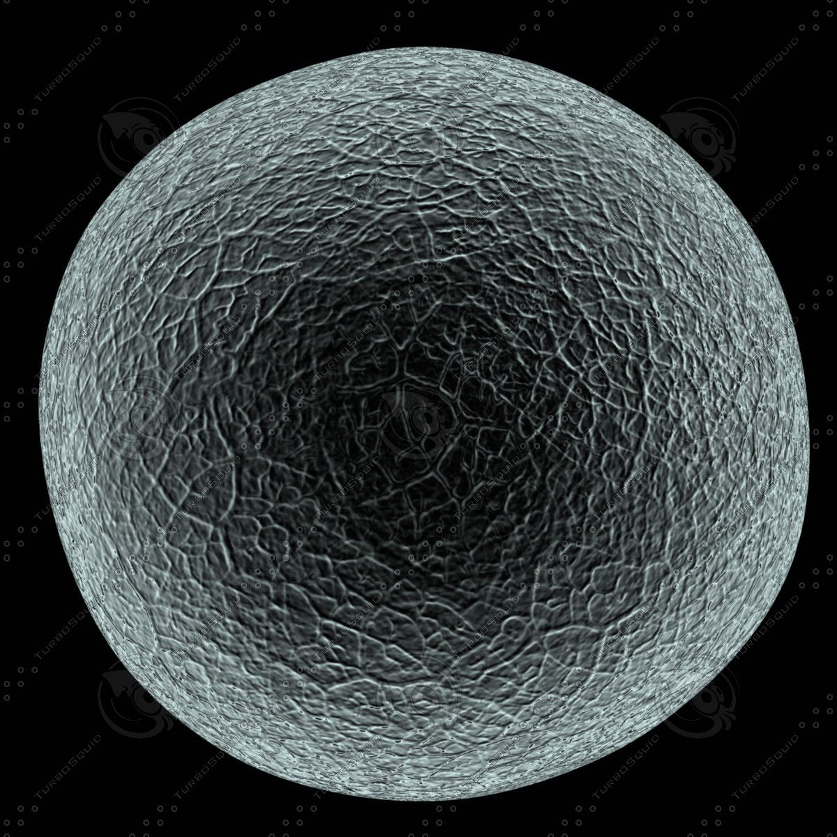
Eggs of the Female
As Martin states “they portray egg production as inferior because it is finished at birth”
A medical text states "During the 40 or so years of a woman's reproductive life, only 400 to 500 eggs will have been released," the authors write. "All the rest will have degenerated. It is still a mystery why so many eggs are formed only to die in the ovaries”, which gives the process a negative light in Martins opinion.

Slide 6
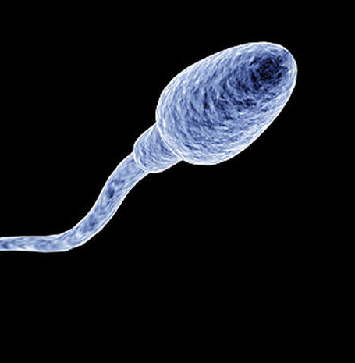
Sperm of the Male
On the other hand, according to Martin she doesn’t understand as why the “why the male's vast production of sperm is not seen as wasteful” as she states that a “man “produces" 100 million sperm per day (a conservative estimate) during an average reproductive life of sixty years” which would mean that over two trillion sperm would be produced in his lifetime but although many (sometimes over a trillion) are not used for reproduction it is not considered “wasted”.

Slide 7
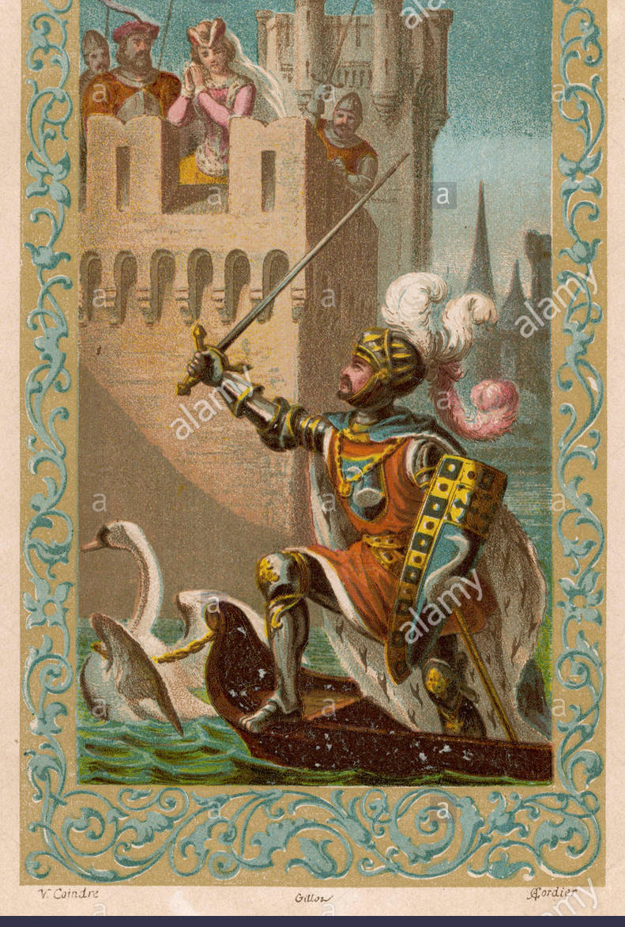
A Fairy Tale
Through Social Construct, according to Martin the Egg and Sperm have been given roles suited to femininity and masculinity. Martin states that the egg has “"vestments" a term usually reserved for sacred, religious dress” and a “"corona," a crown” which portrays the egg as “the queen to the sperm's king” which needs to be rescued, similar to the need for the sperm to travel and fertilize the egg. This correlates directly with old fairy tales of a princess (egg) being rescued by a brave knight (sperm). Martin also states that “One popular account has it that the sperm carry out a "perilous journey" into the "warm darkness," where some fall away "exhausted." "Survivors" "assault" the egg and that successful candidates "surrounding the prize” resembles a rescue mission.

Slide 8
Realistic Roles
The idea of the Sperm being the strong and dominant one in the reproductive process is argued by Martin as she states “the forward thrust of sperm is extremely weak, which contradicts the assumption that sperm are forceful penetrators” and that studies showed that “The egg traps the sperm and adheres to it so tightly that the sperm's head is forced to lie flat against the surface of the zona”.
Martin says suggests that unlike what is written in textbooks “research suggests the almost heretical view that sperm and egg are mutually active partners” which challenges the perception of the sperm being the dominant partner cell by penetrating with force and being the one who fertilizes.

Slide 9
Realistic Roles Continued
Martin states that the sperm cell had always been distinguished as the “key” and that the egg cell had been distinguished as the “lock”, so to say that the egg is acted upon by the dominant sperm cell.
Martin argues this idea by stating “Wassarman does credit the egg coat with having more functions than those of a sperm receptor” and that the egg cell “serves as a sophisticated biological security system that screens incoming sperm” that “selects” them, a much different role than portrayed by the “key” and the “lock” analogy.

Slide 10
A Different Stereotype
Martin suggests that another type of stereotype is now being made regarding the roles of the egg and the sperm by the stating that there is “into play another cultural stereotype: woman as a dangerous and aggressive threat.”
1
She supports this claim by saying that medical texts now portray the egg cell as the aggressor who "captures and tethers”, “interrupts”, and “clasps” the sperm.
2
Martin believes that is stereotype exists not only in the reproductive process but that “Images of woman as dangerous and aggressive, the femme fatale who victimizes men, are wide- spread in Western literature and culture”.
3

Slide 11
Conclusion
Martin believes that although new accounts of the sperm and egg cells interactions are less biased, the hierarchical image of the past is difficult to escape. She sees the “importation of cultural ideas about passive females and heroic males into the "personalities" of gametes” to be a widespread issue found in several of the most popular Medical Texts today. She firmly believes that “endowing cellular entities with personhood” is Social a Construct on Femininity and Masculinity that must not be maintained through ignorance and that feminists must “wake up sleeping metaphors in science”.

