Slide 1
Apocalypse
Trail
Midterm IMT 1102: 2 April 2015
Alessandro, Amoni, Mike
Notes:
Presentation Notes: Le Start :)

Slide 2
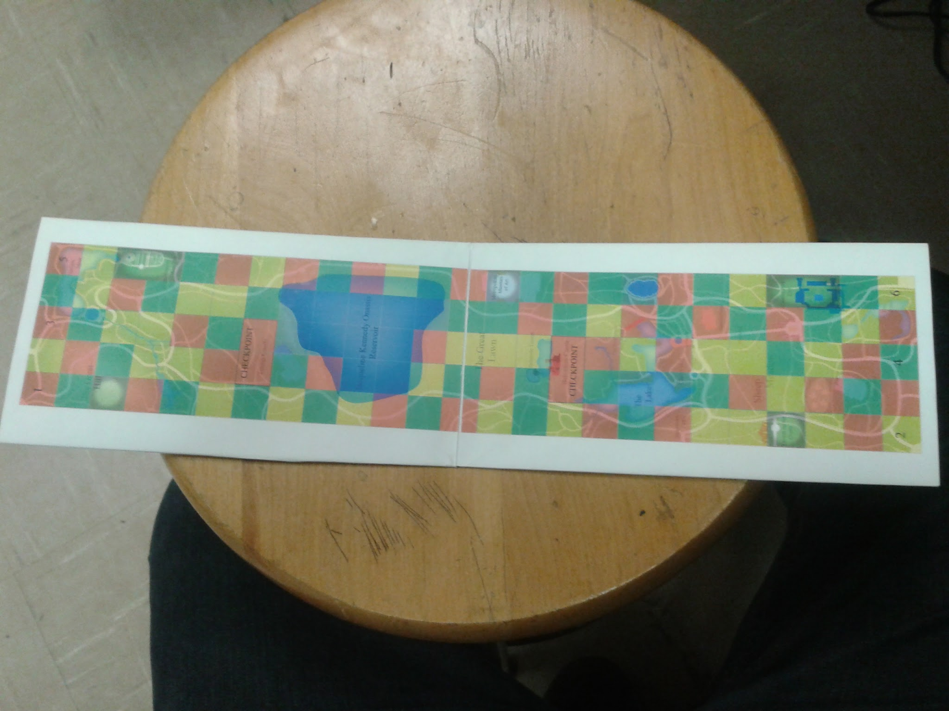
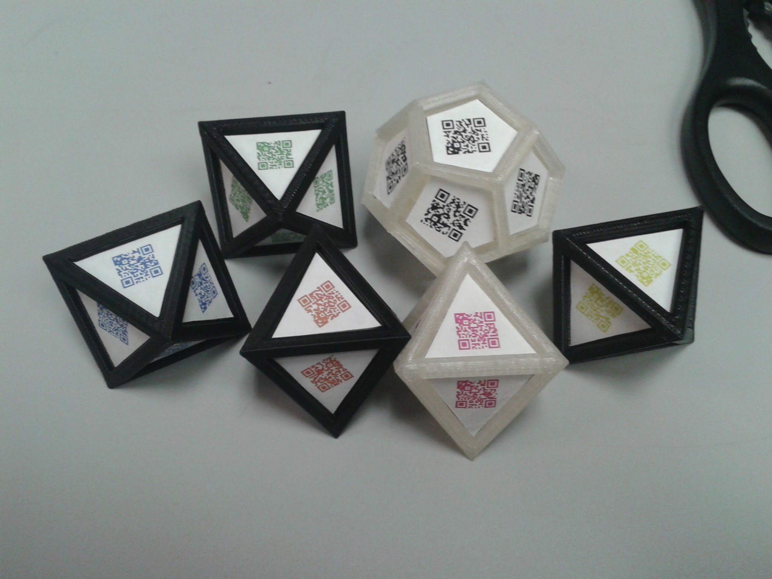
Inspiration
Notes:
PRESENTATION NOTES: Designers will describe the broad strokes of their project concept (Horizontal or Component Diagram)

Slide 3
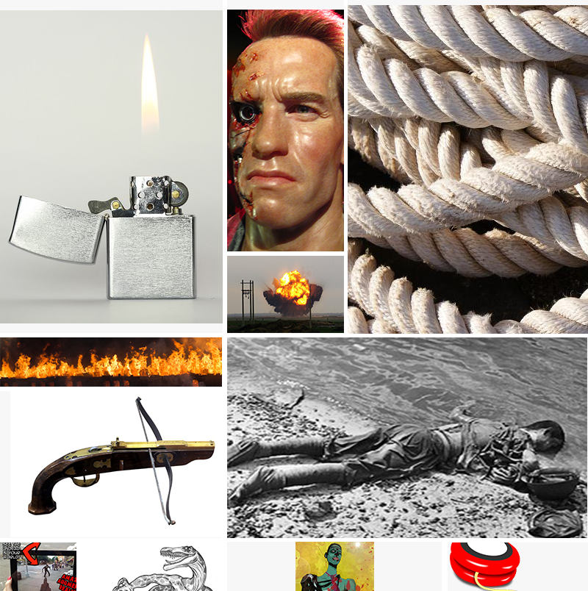
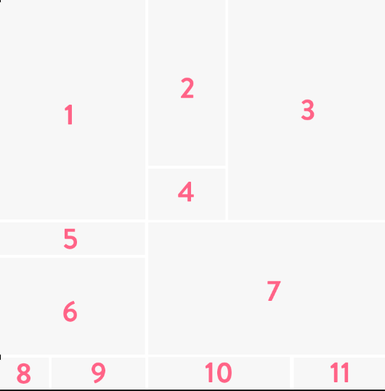
Project Description
Experience a new, fun and exciting augmented reality game played via your phone app. Feel as if you have been emerged into a post-apocalyptic world. Overcome tasks and defeat enemies in order to stay alive. Connect with friends and conquer missions together.
Notes:
PRESENTATION NOTES: Designers will describe the project concept

Slide 4
Target User Group:
This app is geared towards gamers interested in augmented reality apps. Due to the nature of the scenarios they will have to be ages 13 and up, with a focal point on teens and young adults that are interested in apocalyptic styled games.
Notes:
PRESENTATION NOTES: Designers will describe the Target User Group (Ideation Scenario Sheet #1)

Slide 5
Problem Context:
Many inexpensive games, that allow for multiplayer interaction, are stagnant. There is a need for more games that allow for actual physical activity while remaining interesting. Today’s generation is used to sitting down and just doing nothing so this game will allow users to be able to get some small exercise but be involved in a game that is immersive and fun.
Notes:
PRESENTATION NOTES: Designers will describe the context in which the problem exists (Ideation Scenario Sheet #2)

Slide 6
Motivation:
The main motivation for this game is to not only provide a game that is fun but also a game that can provide some small exercise. My little cousin is always just sitting on her phone not doing anything constructive. This game will allow people like her to be able to have fun on her phone but also to get some exercise and strengthen their strategy and teamwork skills.
Notes:
PRESENTATION NOTES: Designers will describe an incident or condition that motivates the use of the solution. (Ideation Scenario Sheet #3)

Slide 7
Solution:
This game will not only provide a fun and exciting experience but also a physical challenge that provides some exercise. With our game, users will be able to play with their friends or the online community while physically walking around and accomplishing augmented reality tasks.
Notes:
PRESENTATION NOTES: Designers will describes, in detail, how their project provides a solution to the proposed problem. (Ideation Scenario Sheet #4)

Slide 8
Outcome:
After having played the app you will see an increase in physical health, social skills, and “FUNdum.” What’s more fun than using the real world around you to play games.
Notes:
PRESENTATION NOTES: Designers will describes what their project hopes to accomplish--the payoff. (Ideation Scenario Sheet #5)

Slide 9
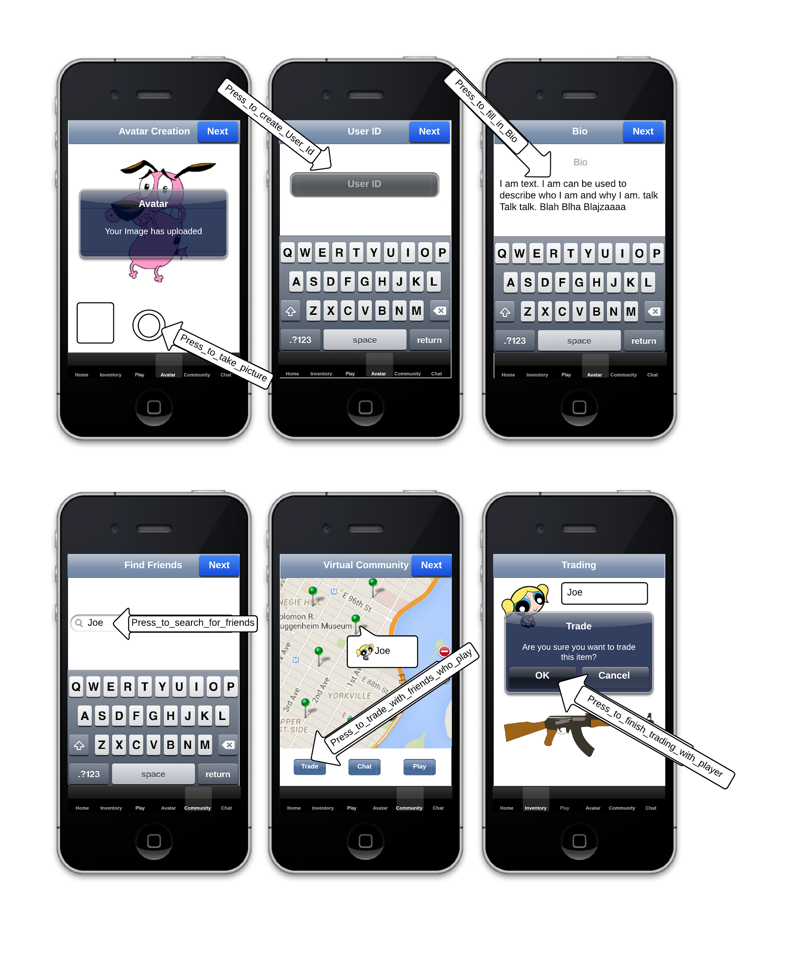
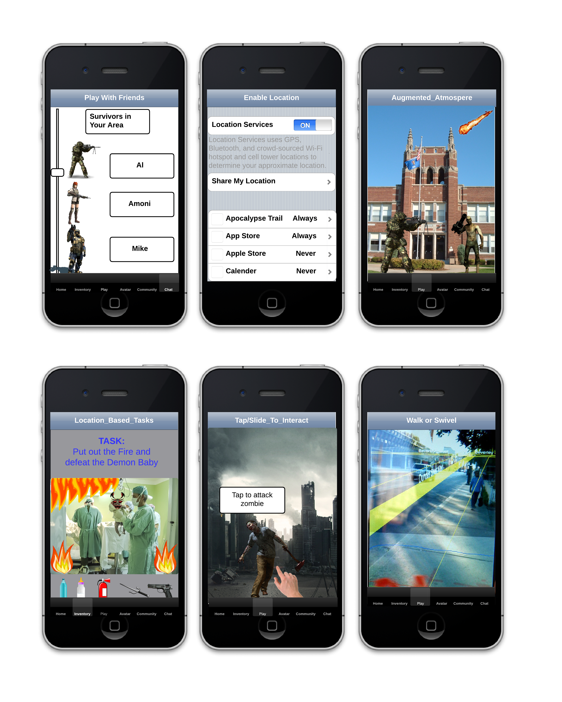
Vertical Horizontal
Notes:
PRESENTATION NOTES: Designers will describe the specific interactions of their project (Interaction Storyboard)

Slide 10
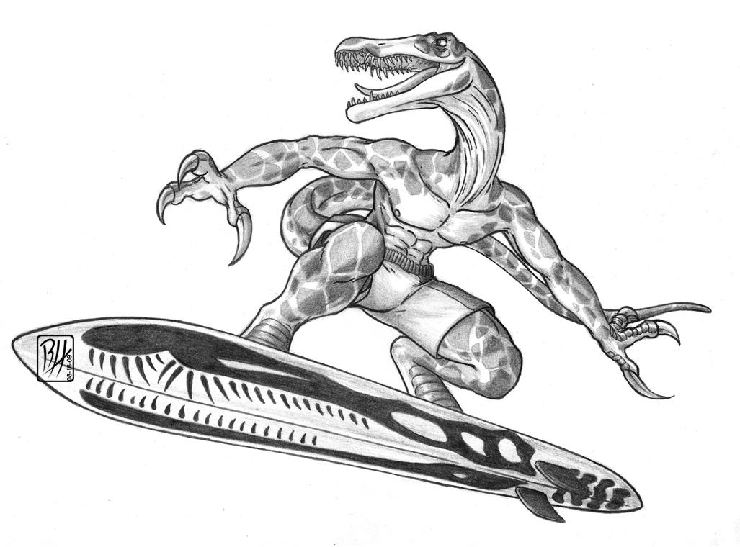
The End...or is it?

