Slide 1
Colorama
Lukasz and Kenny
Notes:
Introduce group members

Slide 2
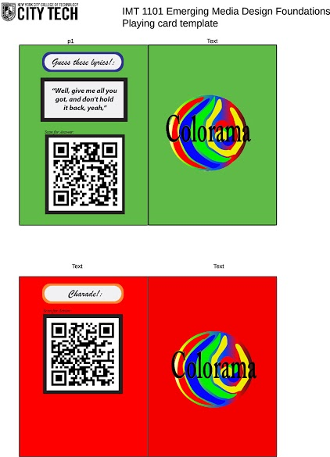
Project Description
The theme of the project is a board game where stepping on colored spaces allow you to pick a card and do the action based on which card you pick. For example, the green card is a guess the lyrics card. The lyrics are on the card and you have the guess the name of the song with the QR code being the answer. The goal is to get around the board first to win.
(Images of card samples on the right side.)

Slide 3
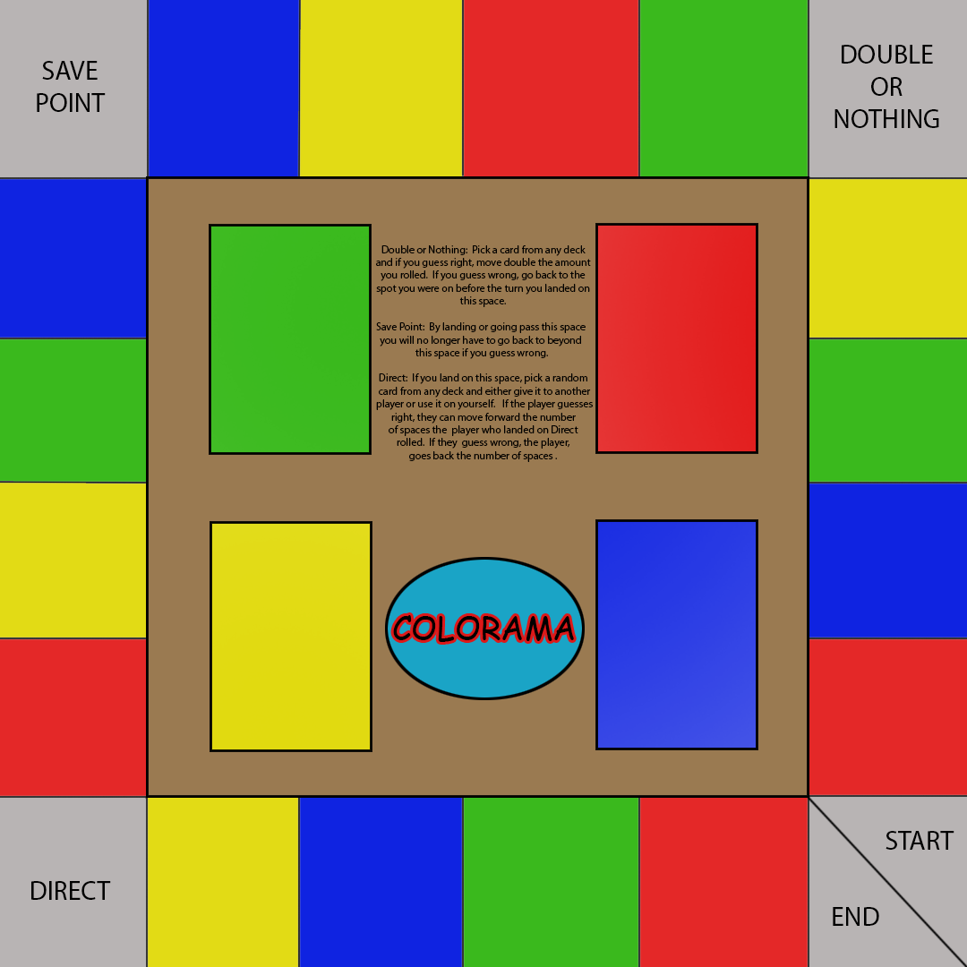
How it Works
The rules are as follow. Each player rolls a die when it is their turn. They move the piece according to the number of spaces. If they land on a colored space, they pick up the same colored card. Then in order to stay in the space you landed on, you have to answer correctly. If you don’t then you go back to the last space you were on. The first player to go one cycle around the board wins.
There are four corner spaces that each have a different effect. What each of these four corner spaces do can be viewed by the QR code found on the board itself.

Slide 4
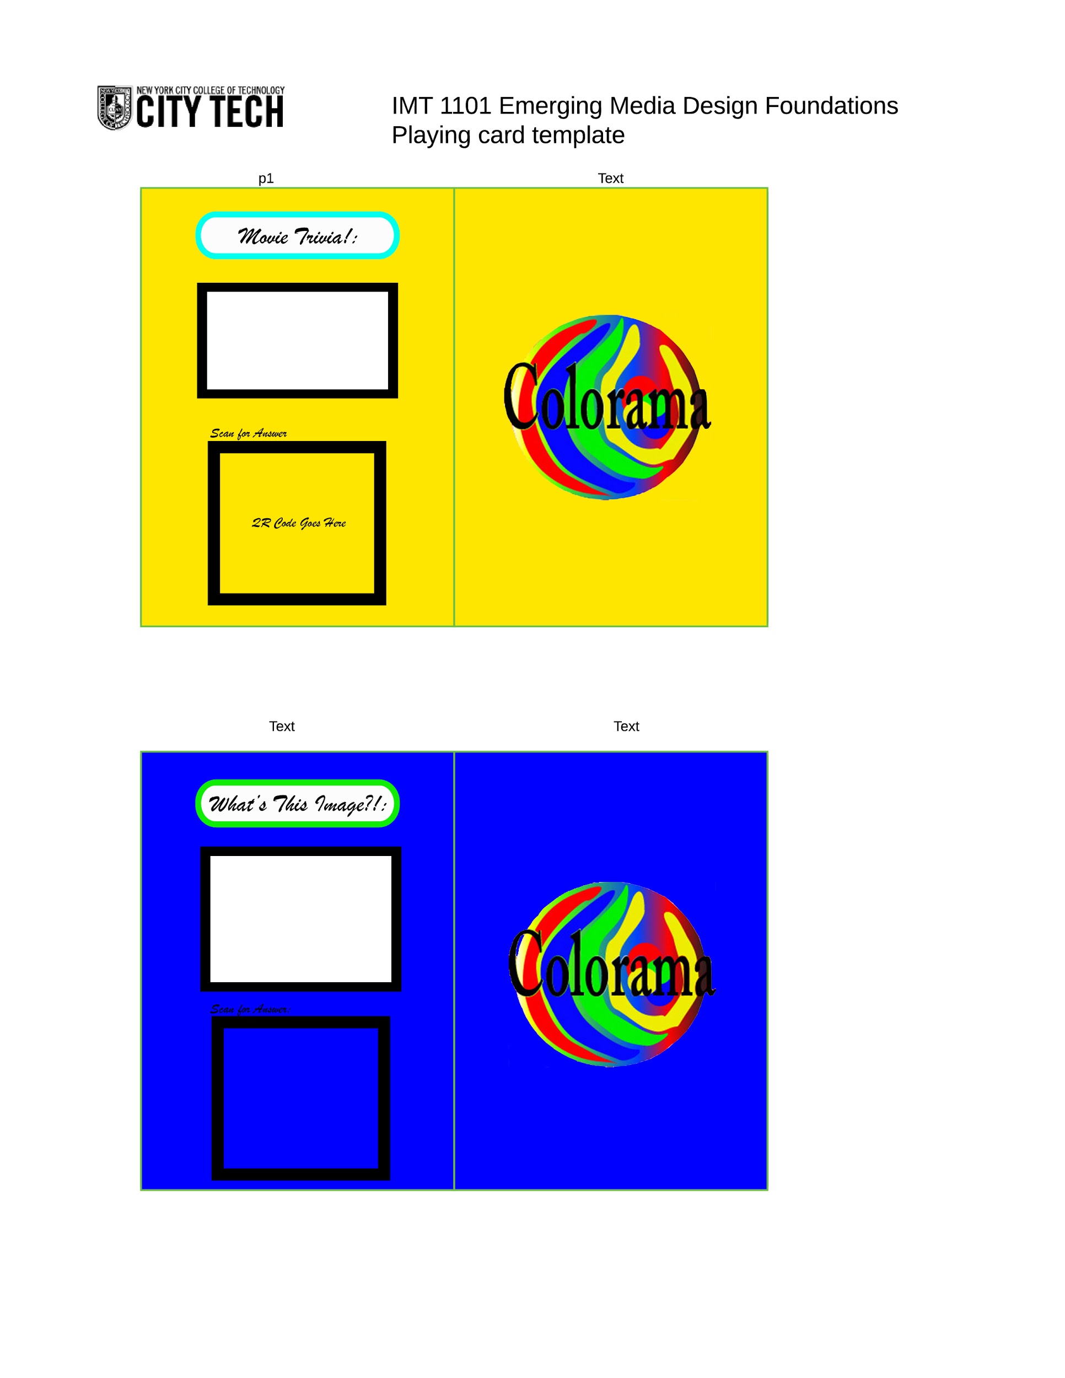
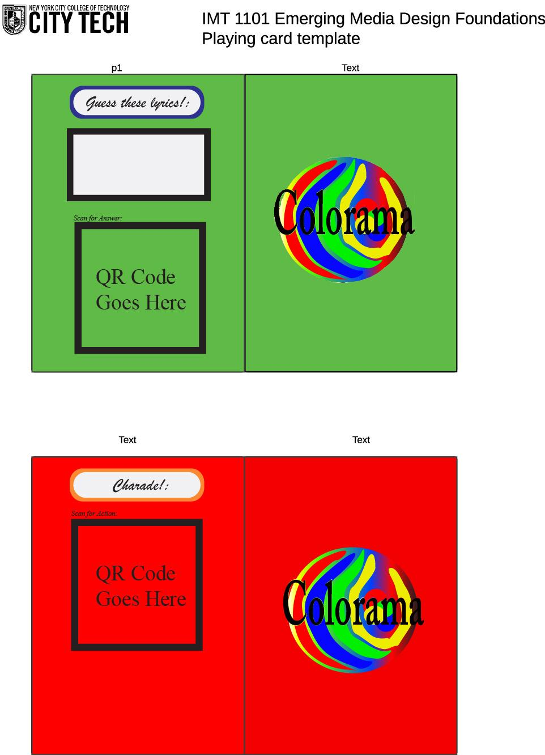
Card Samples

Slide 5
Future Versions
The future of this game would be more cards to be developed. We hope that this game can be played with families and get them closer together as a family night game of sorts. Just like monopoly, we hope to incorporate other ideas to the board game that will make it better, but for now we think this game can be fun to play with friends.

Slide 6
Group Members
Kenny - Card Creator, Coder, QR Code creator and co-game creator.
Lukasz - Board Creator, Image Manipulator, and co-game creator.

