Slide 1
Project 4: On-Site SEO

Slide 2
Keywords
 | Head Keywords | Tail Keywords
1 | Marketing | Online Digital Marketing Course
2 | Social Media | Social Media advertising
3 | Udacity | Udacity digital marketing program
4 | Ebook | Udacity DMND Ebook
5 | Website | Udacity website

Slide 3
Keyword with the Greatest Potential
The head Keyword with the highest potential would be “Udacity”
The tail keyword with the greatest potential would be “Social media advertising”

Slide 4
Technical Audit: Metadata
DMND URL: http://dmnd.udacity.com/
 | Current | Revision
Title Tag | Udacity Digital Marketing Nanodegree Program Website | Digital Marketing Nano Degree Program/Udacity
Meta-Description |  | Obtain real world experiences running live campaigns from mentors. Expand your knowledge on digital marketing.
Alt-Tag |  | -Udacity -Digital Marketing -Online Course -Online instructor

Slide 5
Suggested Blog Topics
Reasons why Online Digital Marketing Programs will expand your market strategy
5 reasons why Udacity Digital Marketing program is getting popular for college students
5 reasons why Online courses help build strong Companies
Summary: These are suggested blog topics relevant towards my expanding target persona. Starting with topic 1. Targeting business professionals trying to gain more knowledge, Topic 2 targets students who want to set up a foundation for their career and the last topic is targeting anyone trying to expand or grow their own personal company.

Slide 6
Off-Site SEO

Slide 7
Technical Audit: Backlink Audit
 | Backlink | Domain Authority (DA)
1 | twitter.com | 100
2 | Reddit.com | 97
3 | Facebook.com | 100

Slide 8
Link-Building
 | Site Name | Site URL | Organic Search Traffic
1 | Forbes | forbes.com | 39.8M
2 | I-programmer | i-programmer.info | 22.9K
3 | Business Wire | businesswire.com | 794K

Slide 9
Performance Testing

Slide 10
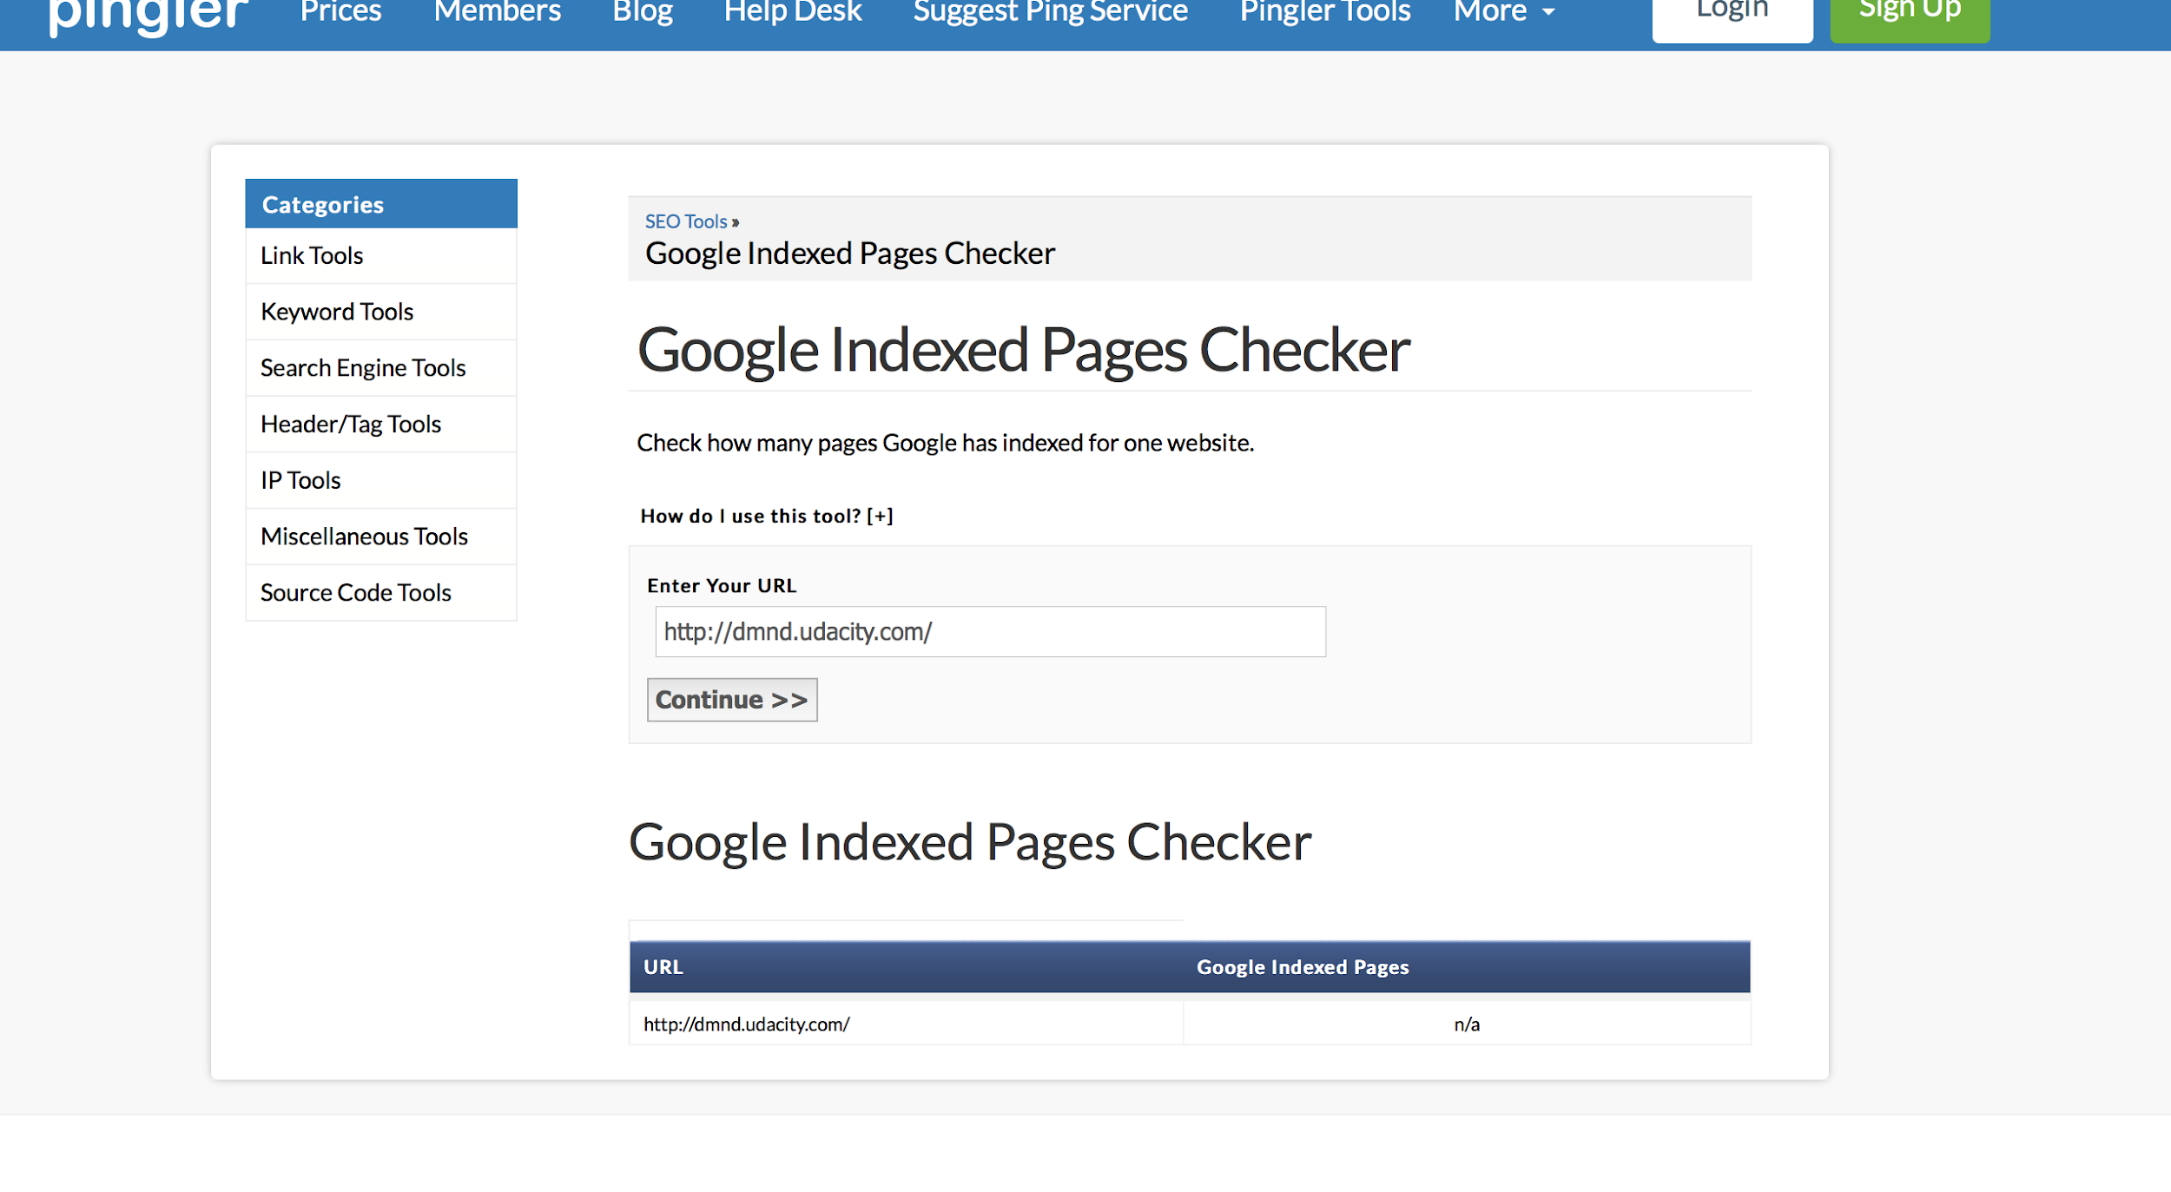
Page Index
Page index is important due to the fact it's the website used when the web browser is opened. In this case Udacity DMND has no record of any Index pages.

Slide 11
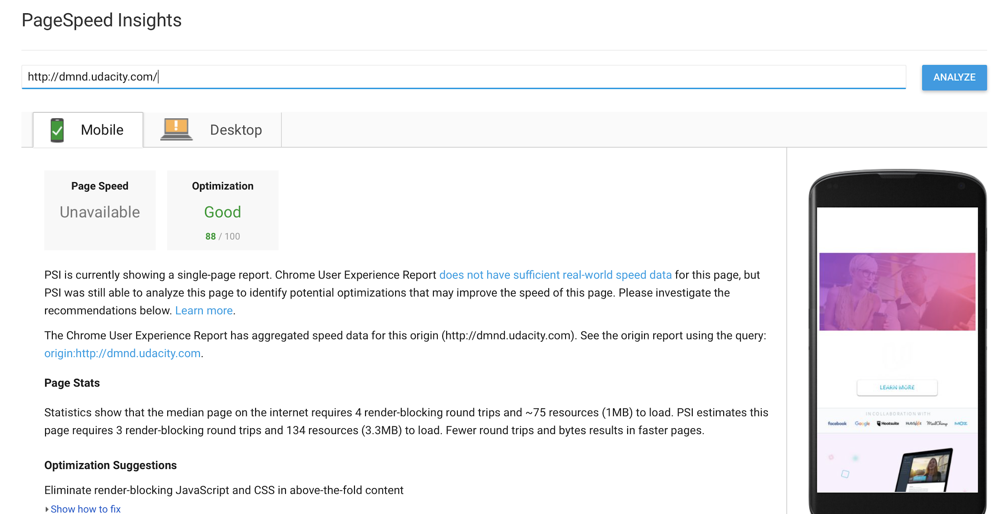
Page Speed
Good page speed is important due to the fact it helps website’s performance optimization.

Slide 12
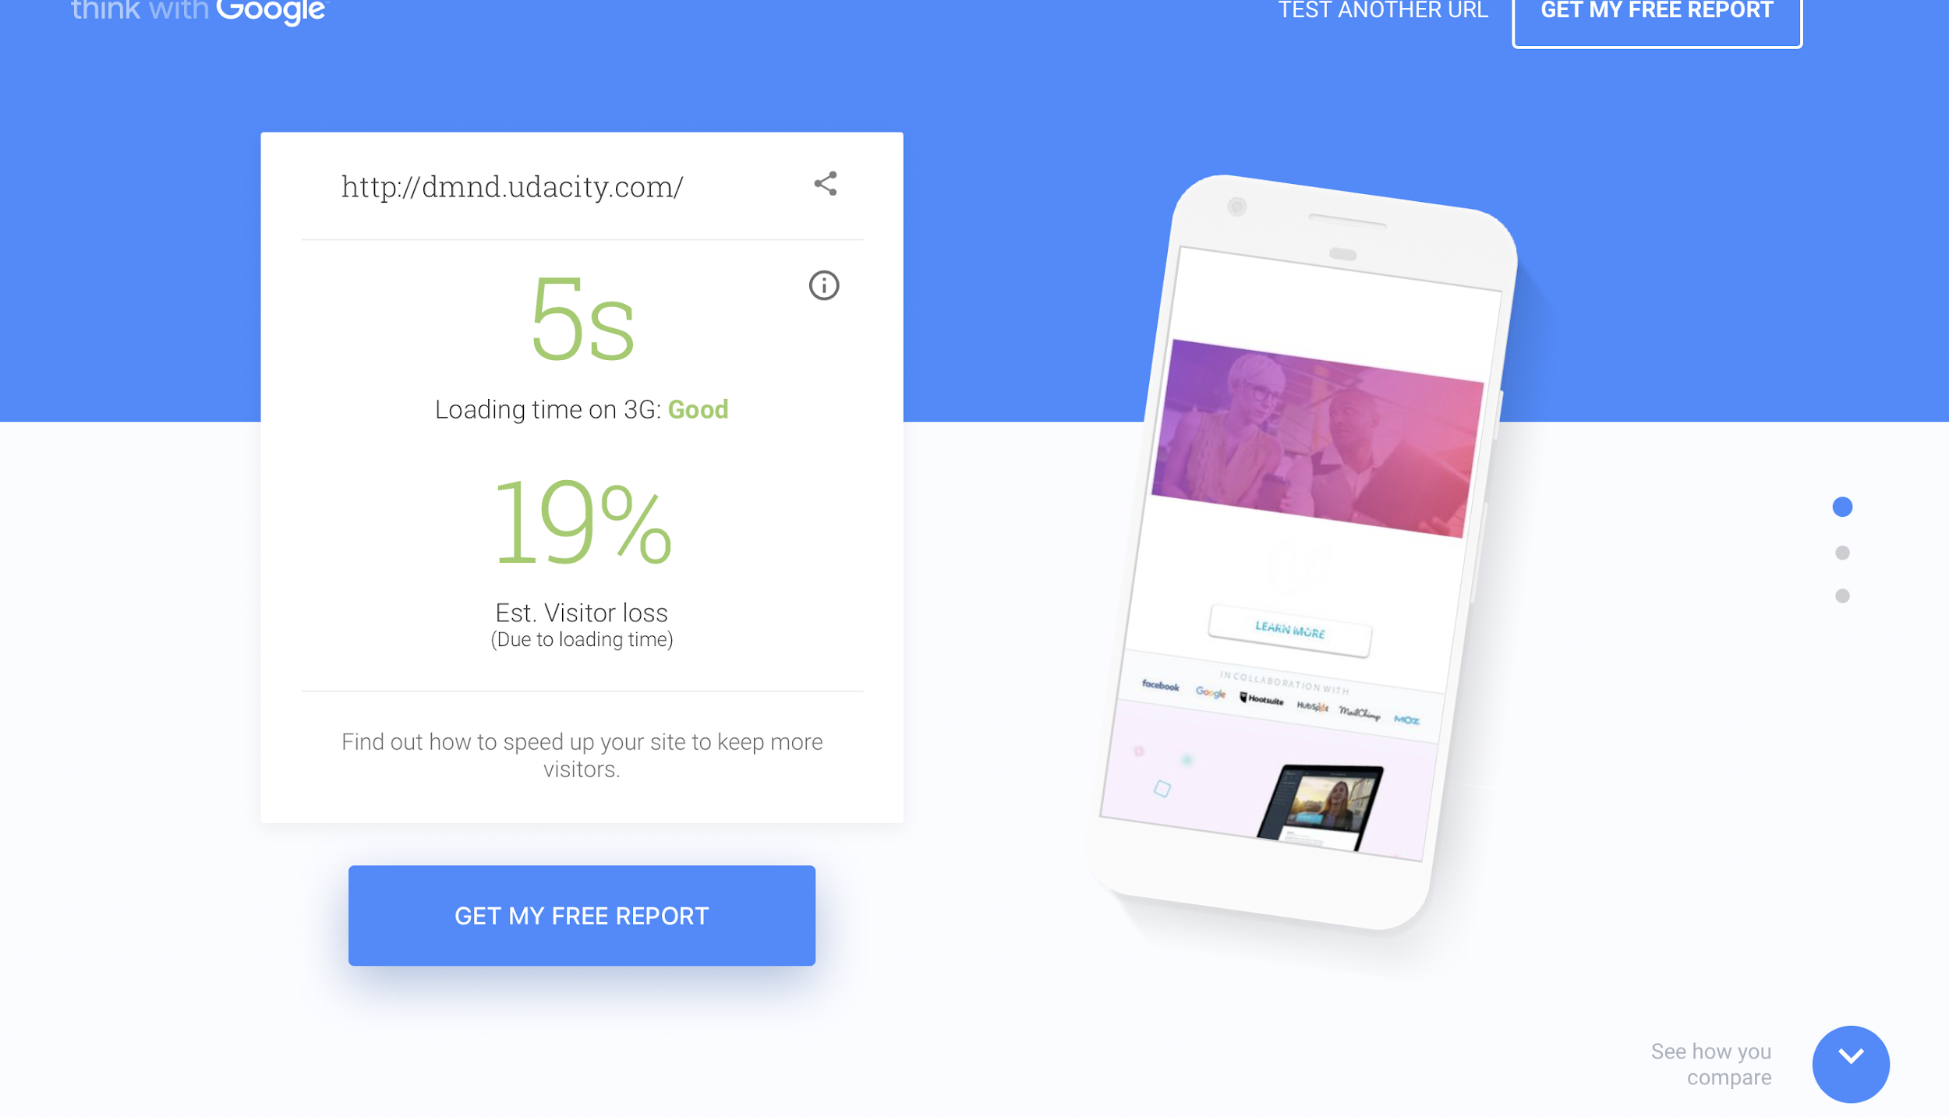
Mobile-Friendly Evaluation
Mobile Evaluation helps optimize your website for mobile devices to drive traffic to your website because mobile devices are more convenient than desktops

Slide 13
Recommendations

Slide 14
Recommendations
Based on the On site, Off site research, performance of the recommended website http://dmnd.udacity.com/ the following flaws overlooked are
Index Pages are N/A
Mobile Page speed is Good but can be improved
Alt and Meta tags are lacking
To help improve the website's usage and trafficking the following must be done
-more pages must me added to website to improve the google indexation
- More Alt and Meta tags so the page can be tracked by more search engines

