Slide 1
Project 3: Run a Facebook Campaign

Slide 2
Digital Marketing Nanodegree Program (DMND)
(DMND) is my preferred product for my Facebook campaign. The purpose of this campaign is to increase the conversions of the free EBook. My goal is to obtain more potential customers by offering the Free EBook on social Media platforms such as Facebook.
The type of customers I tried attracting were from the ages of 18-25. With interests towards college goals, and were located around cities. I used images similar to college and school experiences to help gain the attention.

Slide 3
Target Persona
Customer Persona
Robert Anderson
Background & Demographics
23 Years Old
Male
Bachelor's Degree
Single
Needs
Experience in Marketing
Self development
Career Recognition
Hunger for success
Hobbies
Sports
Traveling
Meeting with Friends
Goals
Further knowledge in marketing
Good income
Raise a family
Launch stable career
Barriers
Bad time management
Ignorance
Insufficient experience in marketing

Slide 4
Marketing Objective
To achieve the total number of 500 potential customers from Facebook advertising with a Budget of $125 in a 5 day timeframe.

Slide 5
KPI
Will be tracked through the number of page likes and Post engagements.

Slide 6
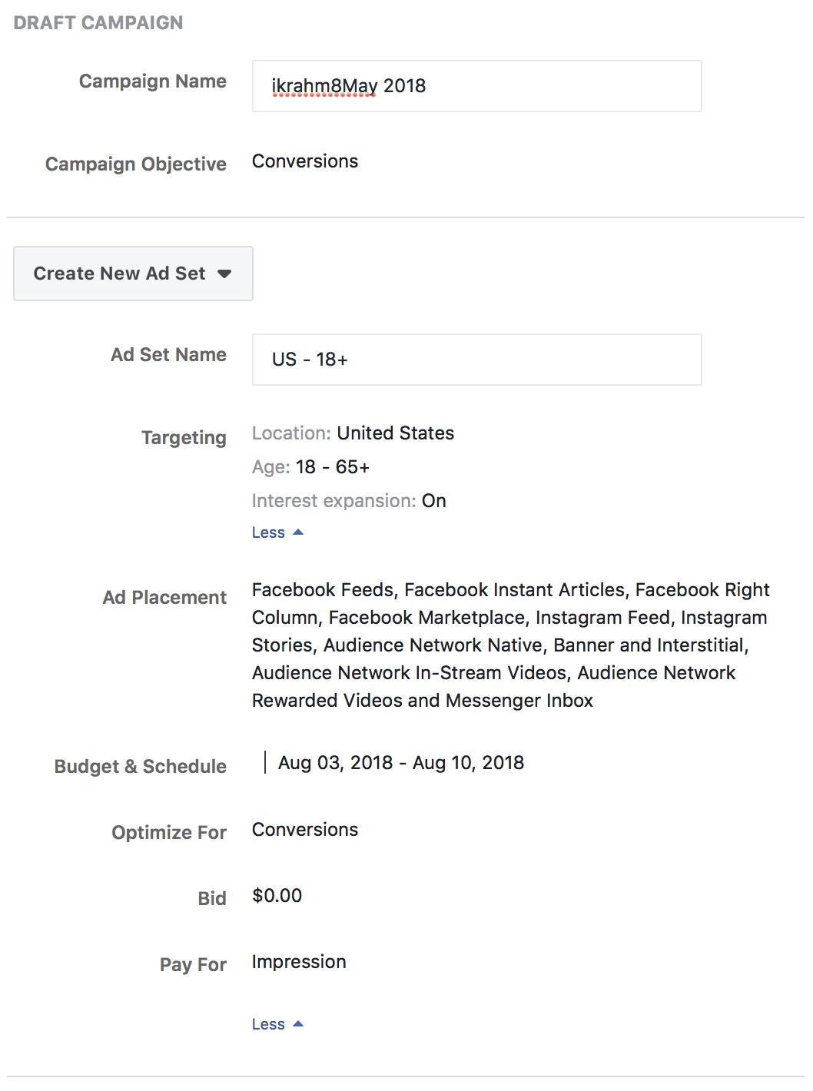
Campaign & Ad Set: Sample
I targeted the minds of Students and recent college graduates with the Text and images provided for the Ad, to attract those types of customers.

Slide 7
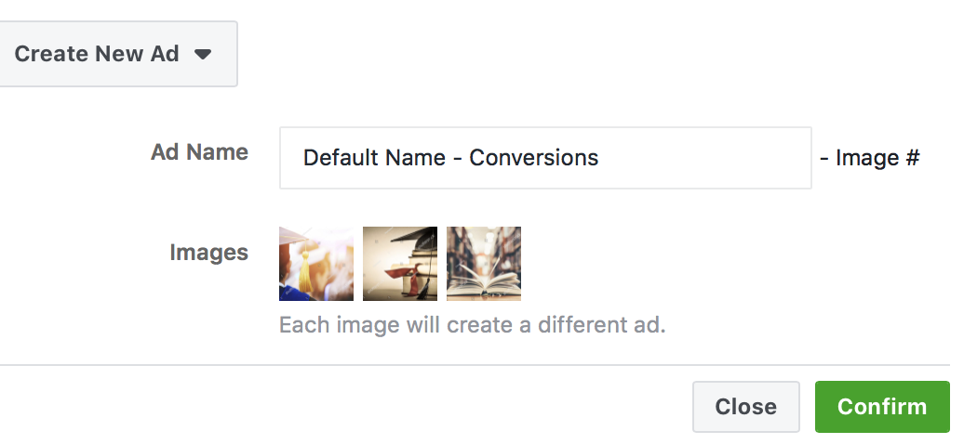
Ad Summary: Sample
I used Images from Stock Image and Text that I personally generated. As shown in the next slide.

Slide 8
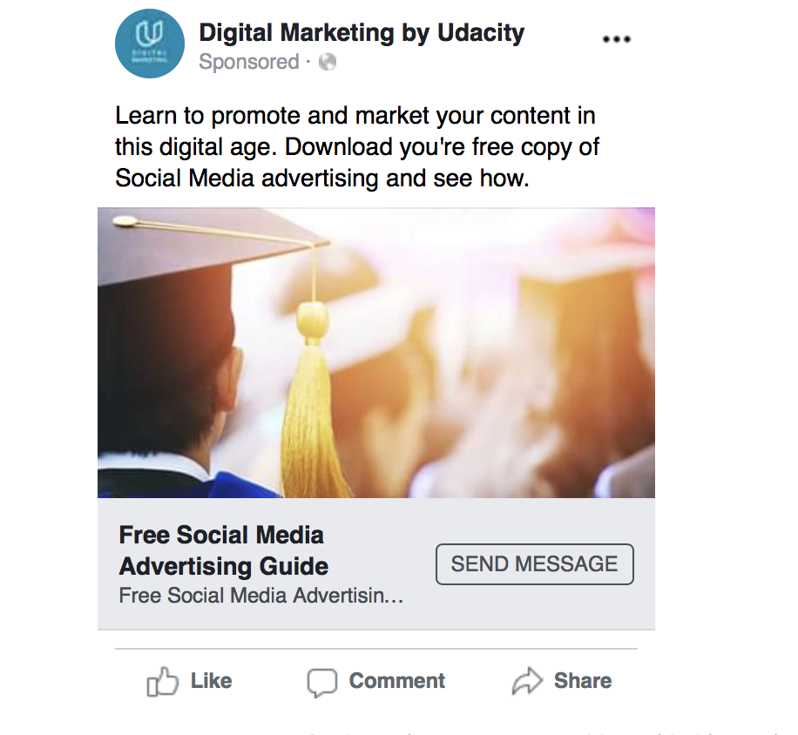
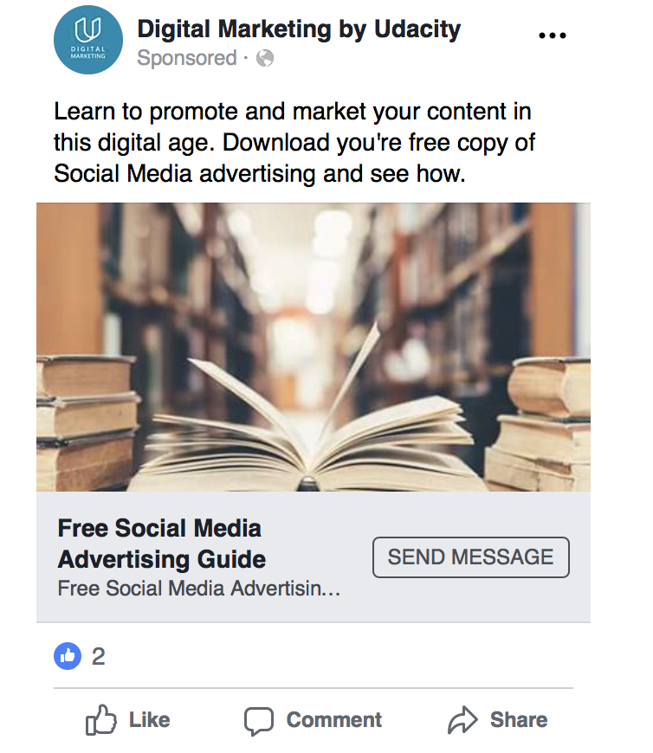
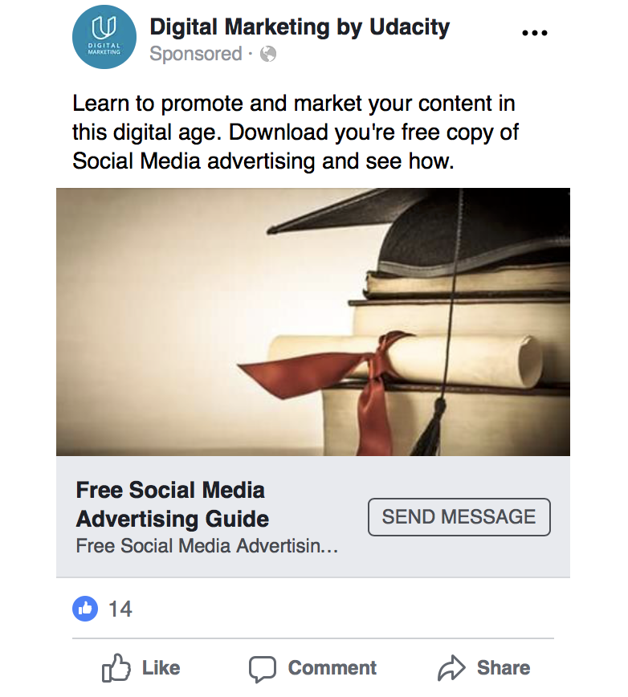
Ad Images: Sample

