Slide 1
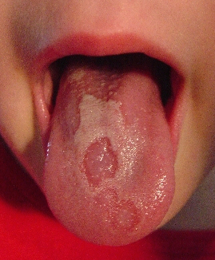
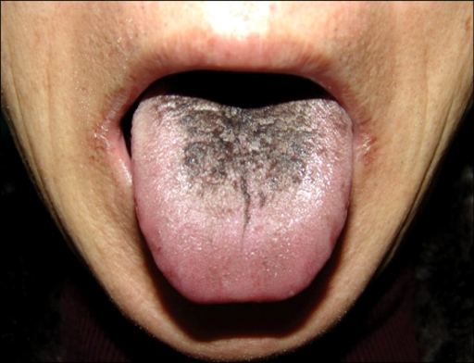
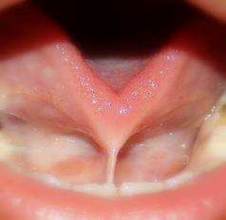
Infections of the tongue:
Ankyloglossia
Geographic tongue
Black hairy tongue
Ita Glick
DEN1114 Histology and Embryology

Slide 2
Ankyloglossia
What is it?
It's more commonly known as tongue tied. When someone is born with their tongue “tied” to the floor of the mouth due to a short thick lingual frenulum, impairing the tongue’s mobility.
This happens when the lingual frenulum fails to separate before birth. It can be linked to genetics, and is more common in males then females.
This condition is very common affecting 5% of newborns.
It can affect a persons speech, eating, swallowing as well as newborns breastfeeding.
What are the symptoms?
Difficulty sticking tongue out of the mouth
Difficulty touching tongue to roof of mouth, or moving it side to side.
Difficulty speaking
Difficulty eating such as sucking a lollipop, or licking an ice cream cone.

Slide 3
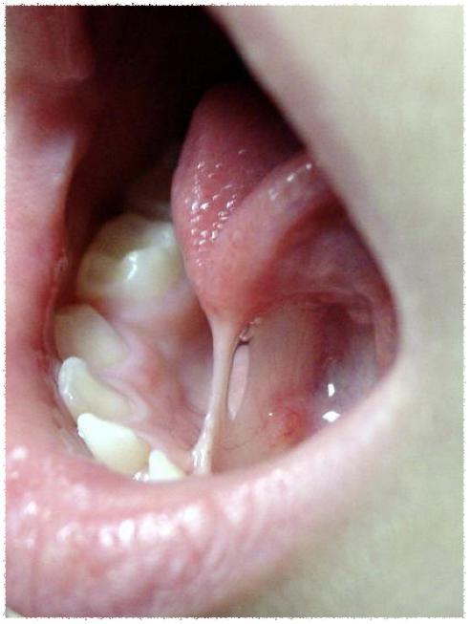
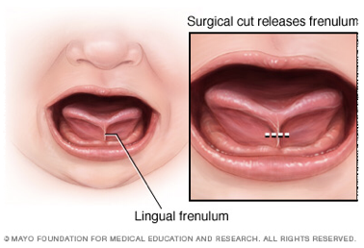
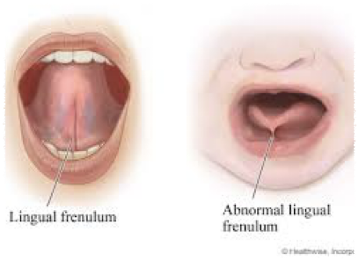

Slide 4
Dental implications:
A patient with tongue tied may have difficulty clearing food debris from their mouth, causing tooth decay or gingivitis.
Patients with tongue tied may develop a gap between their mandibular central incisors
Treatment:
There is a lot of controversy surrounding this topic; some doctors say to cut the lingual frenulum before the baby leaves the hospital, others say to leave it lone. You can leave it alone, and the lingual frenulum may loosen over time, but if it tightens and it gets harder to live with a surgery can be done to cut the lingual frenulum.
A frenotomy is a painless quick procedure, where the doctor just snips the frenulum free.
If the lingual frenulum is too thick a more extensive procedure called a frenuloplasty is done. The patient is put under general anesthesia, and the wound is closed with stitches.

Slide 5
Geographic tongue
What is it?
A tongue lesion, that looks like red and pale pink to white patches on the dorsal surface of the tongue. They can change shape with time.
It is found with all age groups, and shows the sensitivity of the filiform lingual papillae to changes in their environment.
The patches corrospond to the groups of filliform undergoing changes from the parakeratinized epithelium, that are redder to the orthokeratinized epithelium that is whiter.
What are the symptoms?
Red and pink/ whitish patches on tongue’s dorsal surface
Slight burning or soreness of the tongue
Treatment:
No treatment is needed for geographic tongue however any over the counter painkillers can be used to treat pain or discomfort caused by the lesions.
A corticosteroid mouth rinse can be prescribed to help reduce the inflammation.
Avoid flavored toothpaste or foods that cause a reaction.

Slide 6
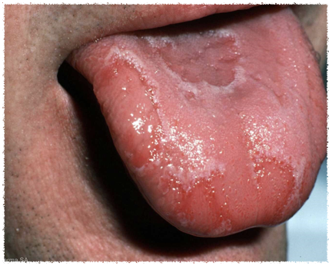
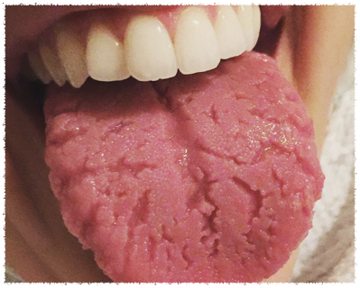
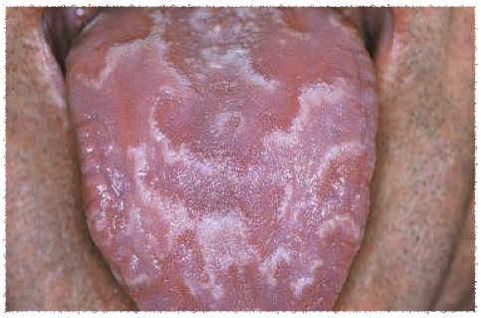

Slide 7
Black hairy tongue
What is it?
A less common lesion of the dorsal surface of the tongue. The usual shedding of the epithelium of the filiform lingual papillae does not happen. This causes a thick layer of dead cells and keratin buildup on the tongue. This can become stained extrinsically by tobacco, medications or colored oral bacteria.
In some cases its caused by high doses of antibiotics or radiation therapy, or it may be an affect of a fungal outgrowth.
Treatment:
Brushing the tongue to help shed the tissue and remove the debris.

Slide 8
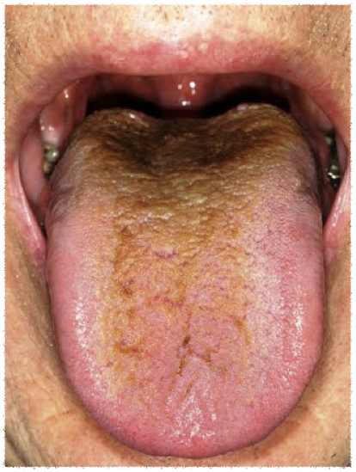
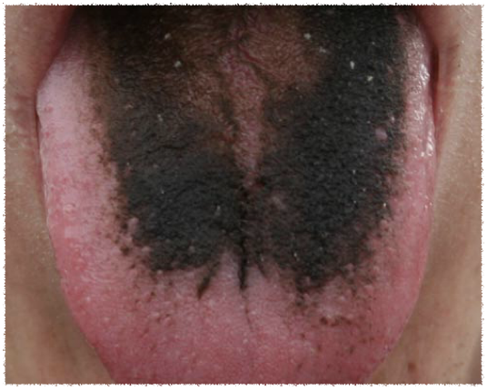

Slide 9

References
https://www.ncbi.nlm.nih.gov/pmc/articles/PMC3200025/?report=classic
http://www.chop.edu/conditions-diseases/ankyloglossia-tongue-tie
ILLUSTRATED DENTAL EMBRYOLOGY, HISTOLOGY, AND ANATOMY. (2015). Elsevier Health Sciences.
https://www.healthline.com/health/geographic-tongue#when-to-call-your-doctor4
https://oralb.com/en-us/oral-health/conditions/bad-breath/black-hairy-tongue-causes-symptoms-treatments

