Slide 1
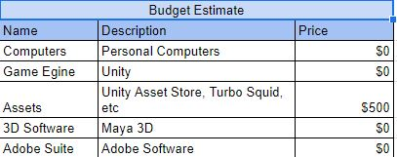
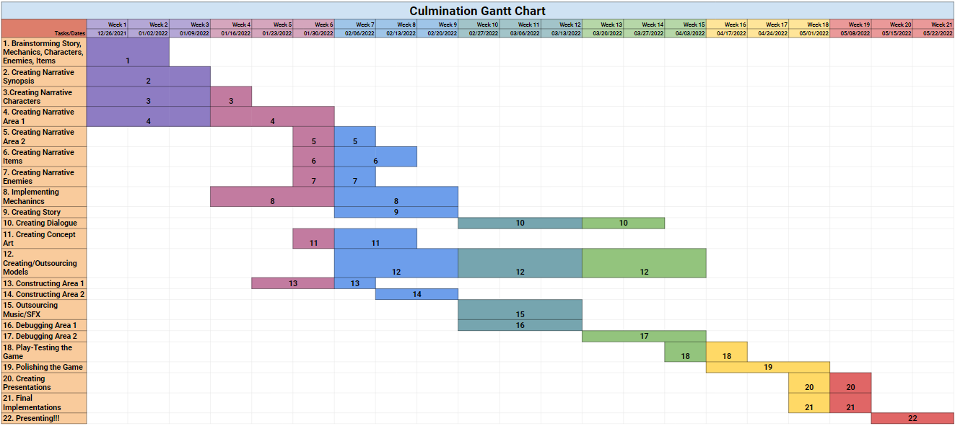
Sirena Isaias Acosta and 3D Modeler
Department of Entertainment Technology
Introduction
Our culmination project including Edgar, Brandon, Jonathan, Jordin, and I will be the Lead level designer. The over all purpose of this project for me is to practice my 3D modeling skills.
The project will help learn new skills. Such as character modeling and different 3D modeling techniques.
Skills include:
Level greyboxing
Basic 3D modeling
Texturing
Budget
Gantt Chart
Images of Game:
Conclusion example
What I want to gain from this project is better experience in level design and a better understanding on how game design in general works when your on a team. This is so I can pursue my career as a level designer.
Production
The production process will be broken down into different processes. In pre-production we will iron out the plot, environment setting, mechanics, art-style, etc. In production phase we will put everything in to action. We will work on our individual task, but if time warrants it we will assist each other to make sure this project becomes a thing. Post Production we will make sure we iron out what we need to have a playable demo.
Method of Communication
Use discord to have meetings.
Github in order to store and share work.
Use Exel and Google docs so we stay on track. While making sure we don’t deviate from what we intended.
Google drive for backup
Results
The results of this project will be a portfolio piece. That will show that I am capable of level design and producing a game.
Acknowledgements
1. Technical Advisor: Hosni

