Slide 1
Space-Based Solar Energy
By: Johnathan Taylor Sarah Adams Taisha Cottrell
Ronghui Wu

Slide 2
Introduction
Space Based Solar Power is the future of harnessing solar energy. The premise behind this idea is solar energy being collected directly from space and transferring it directly to earth or nearby planets.
The demand for energy is constantly growing coupled with the decline of fossil fuels, has put a strain on natural resources. It is essential that we develop additional clean and sustainable energy sources.
SBSP is a viable option which would enable us to draw solar power from the sun 24/7 since there is no atmosphere to lower the amount of solar energy coming to earth. SBSP has the capacity to provide earth with a renewable and reliable source of energy at a cheaper cost than any other energy source.

Slide 3
Information
SBSP originated from Isaac Asimov in 1941 in which he wrote a short story. It entailed energy captured from the sun was transmitted through microwave beams to nearby planets from a space station. Dr. Peter Glaser an aerospace engineer was the first to introduce the concept of a SBSP system in 1968.
In 1978, he was granted a patent for satellite solar powered system that transported solar power over long distances by beaming microwaves from an antenna in space to a much larger on the ground.
However, due to a change in administration, it was put on hold and wouldn't be examined at until 1998 when Japan’s space agency began developing a space solar power system which still remains today. Currently, NASA is operating a Space Solar Power Exploratory Research and Technology Program.

Slide 4
How It Works
There are two methods for SBSP. They are Microwave Transmitting Satellites and Laser Transmitting Satellites. MTS would be stationed in a high geosynchronous orbit thirty five thousand kilometers above earth's surface.
The satellite would proceed to collect solar radiation through amplifying mirrors and currently available solar cells and would beam that stored energy back to earth through an electromagnetic beam. Microwave beams would be captured on earth and be converted to electricity. .
LTS would be stationed about 400 kilometers above the earth's surface and would be smaller than the microwave satellite. The power collected in space would be used to generate a single wavelength light beam. A set of optic shapes would shape size of the light beam and a control system would make sure the laser is aimed at the correct receiver on earth. Once received by a photovoltaic cell receiver the light beam would be converted to electricity

Slide 5
Economic Benefits
The idea of harvesting solar energy is promising but it comes with technical challenges as well economical price. The estimated life cycle of Satellite Solar Power Station is about 30 years. Therefore, its cost cannot be evaluated with the present day’s transportation framework (Flournoy, 2012).
According to (Flournoy, 2012), “With technological advancement, SSPS power cost could be reasonable or less than various earth-based energy resources. With the progression to reduce the satellite dispatch cost and supplementary innovation changes, SSPS seems to be feasible in the coming future.

Slide 6
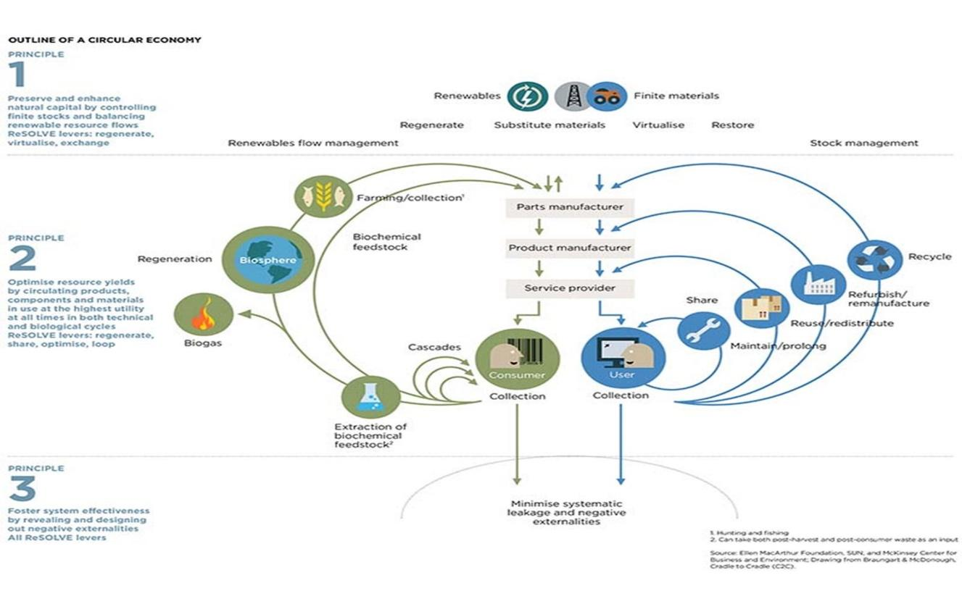
Economic Benefits continued
Creative progress in microwave advancement is going ahead around the globe in this way.” However, according to ( (Caton, 2015) “It may be difficult to convince investors to commit to an SBSP system that is undeveloped, unproven, and high risk when terrestrial systems that tap into the same renewable energy source already exist”. With the development of a SBSP system, it will increase the need for skilled and qualified workers to maintain the system. Below is a diagram depicting the positive impacts of harvesting sustainable resources:

Slide 7
Environmental Benefits
In terms of the environment, for example, for every 1 kWh of electricity generated by CO2, the carbon pollution factor generated by coal fuel is 322.8 g/kWh, and the carbon pollution factor generated by oil fuel is 258.5 g/kWh. Solar power, on the other hand, is only 5.3 g/kWh. Therefore, solar energy considered a clean energy source. As a very important form of solar energy utilization, photovoltaic power generation has the characteristics of environmental protection and low carbon. It will not pollute the air and water, discharge toxic or harmful substances, and pose no threat to the environment.
The full environmental benefits of space solar energy last come from most of the work done outside the earth's biosphere. By extracting materials from the moon or near - earth likes and building Space-based components, space solar energy will have virtually no impact on the terrestrial environment, just by building energy receivers on earth.

Slide 8
Environmental Benefits Continued
One, long-term profitability result stemming from SBSP, is that as the more energy we use from the sun, the less resources we take from Earth. A benefit that we would see immediately is the decrease in electricity bills across the world, since SBSP is geographically widely available. Since fossil fuels cause harmful gas emissions that in return are the main cause of air pollution, using SBSP would mitigate this issue astronomically.
Furthermore, the heat waves produced by these satellites would dissipate into space, which is another benefit of SBSP. Additionally, this environmentally feasible option would generate more jobs in a field that is still new to many. Although the satellites would have relatively low maintenance, which is another benefit to SBSP, the field of astronomy would be less of an unknown to many if there were more jobs offered.

Slide 9
Conclusion
Space Based Solar Power is an extremely resourceful option to renewable energy sources. The production of energy through solar satellites would generate jobs, have an exceeding amount of economic benefits, and pose a long-term solution to air pollution. If the government doesn’t act quickly, Earth will continue to depreciate at alarming rates.

