Slide 1
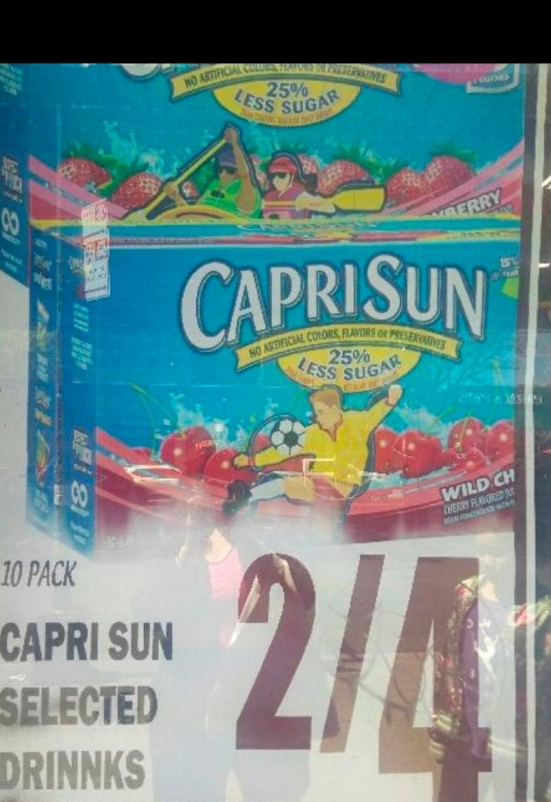
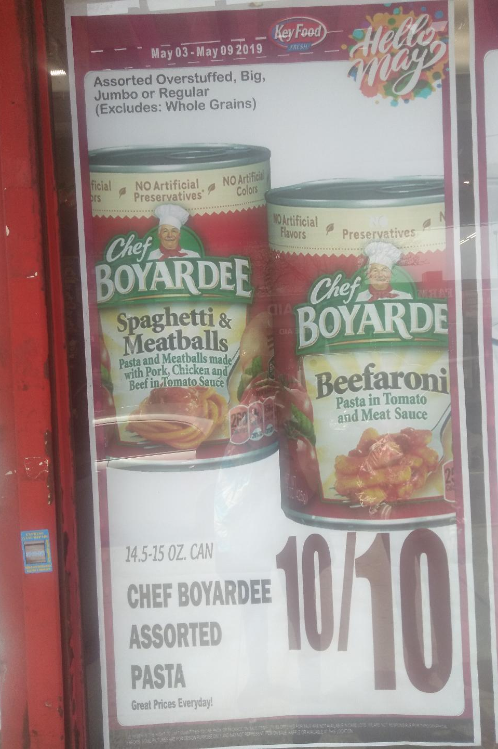
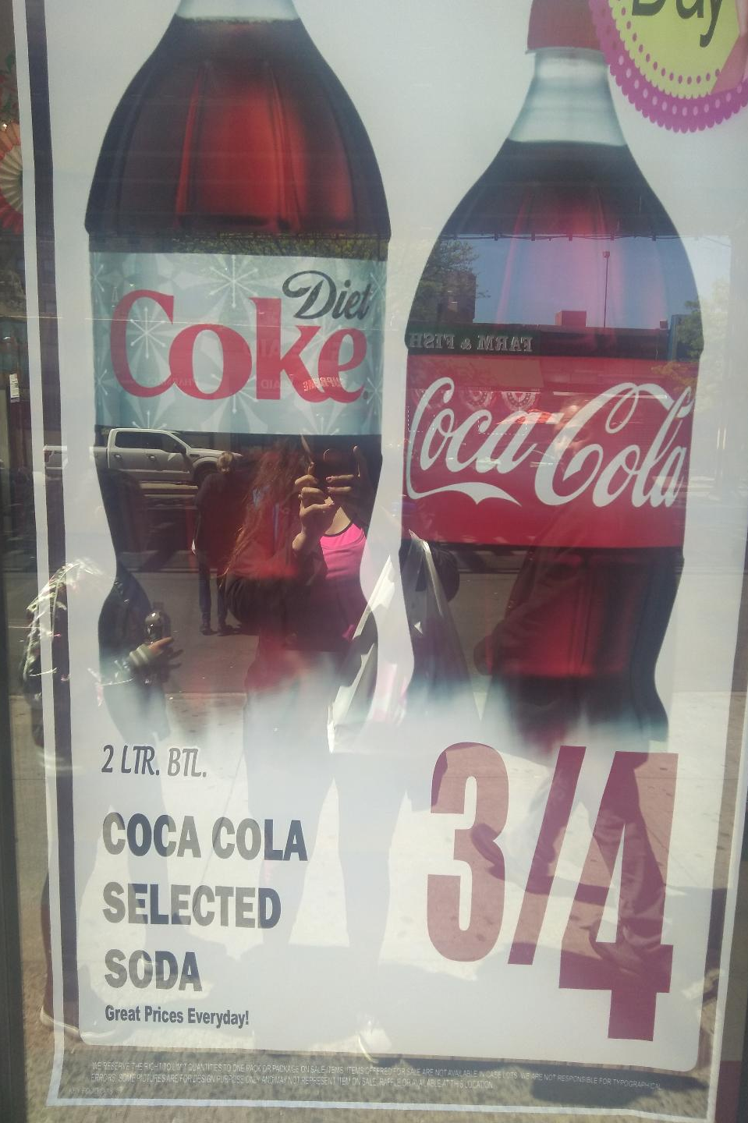
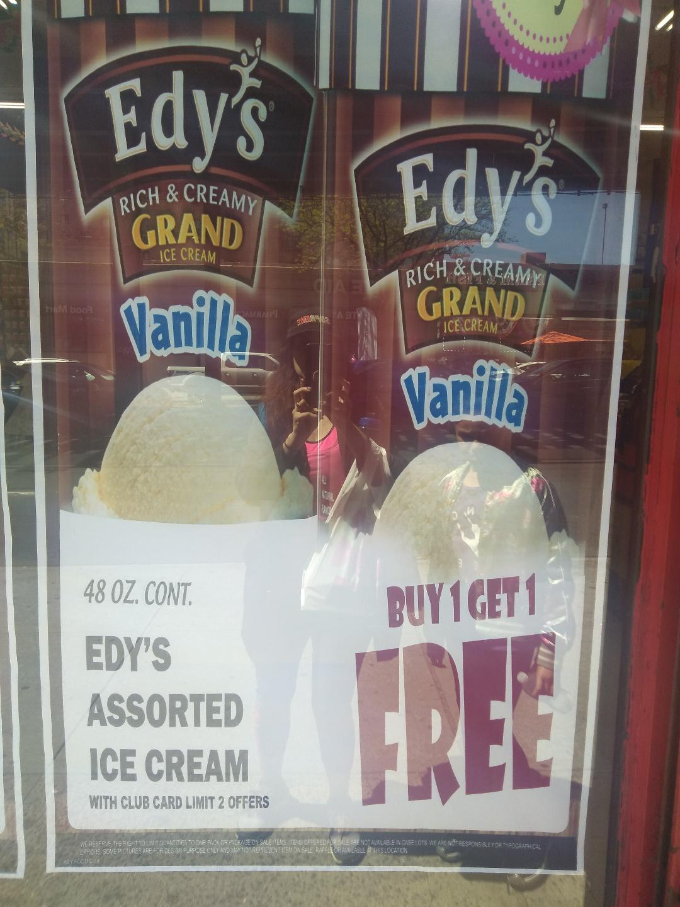
Food Deserts in NYC
Environmental, Health , and Economic Implications
Econ 2505 ID/Spring 2019
Rachel Broomes

Slide 2
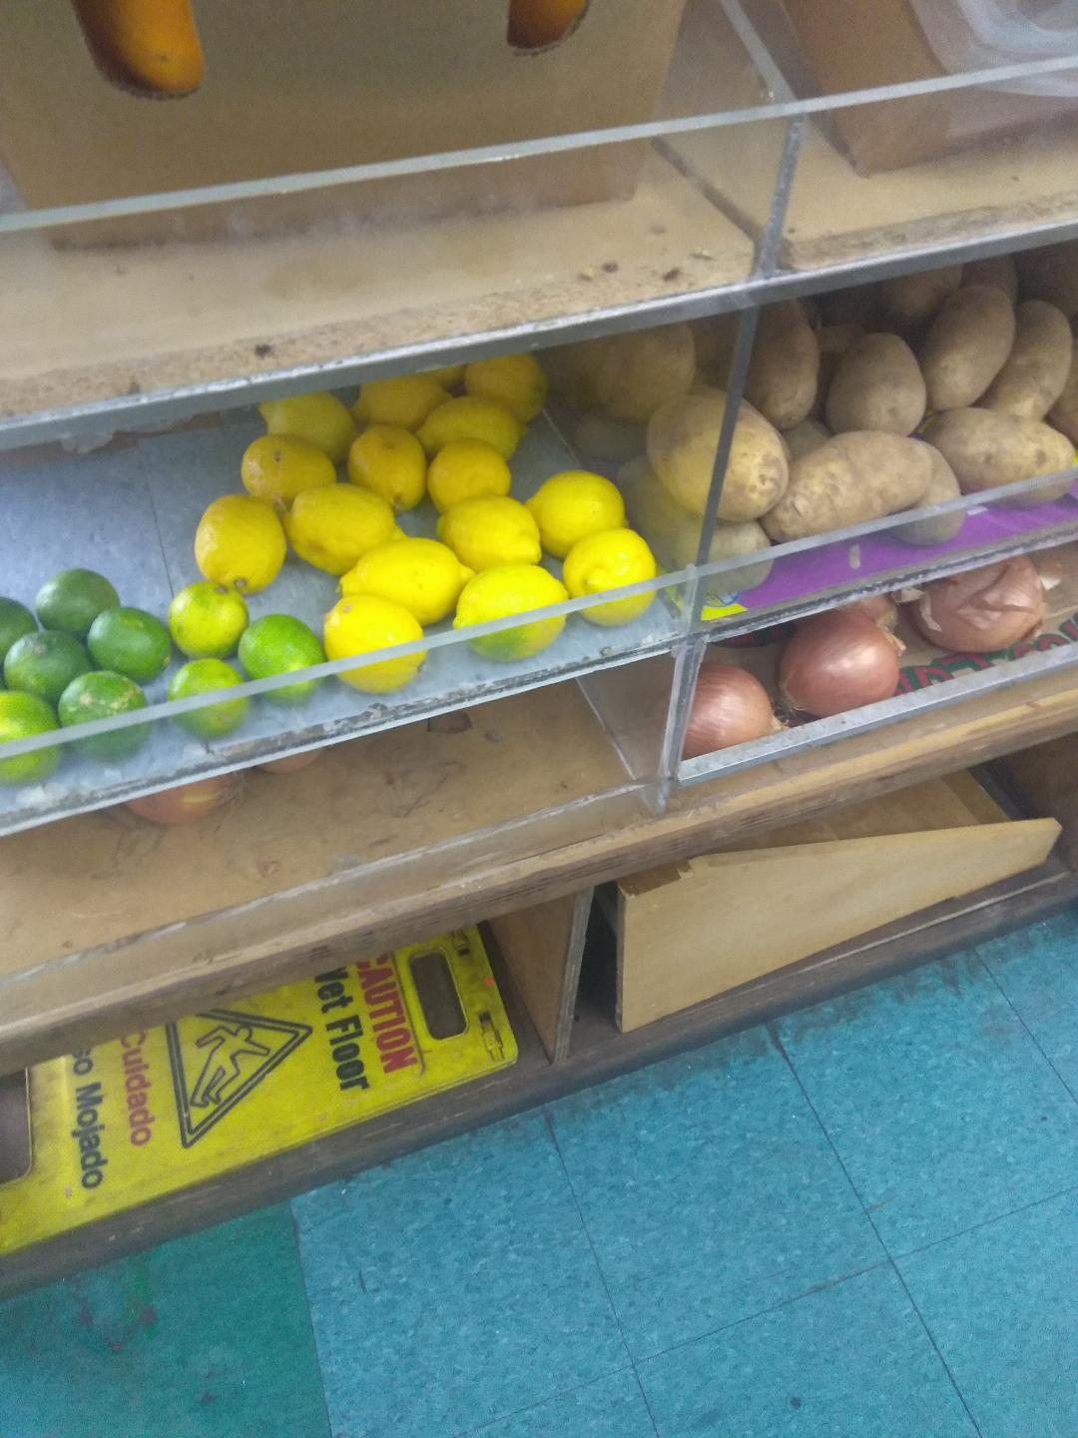
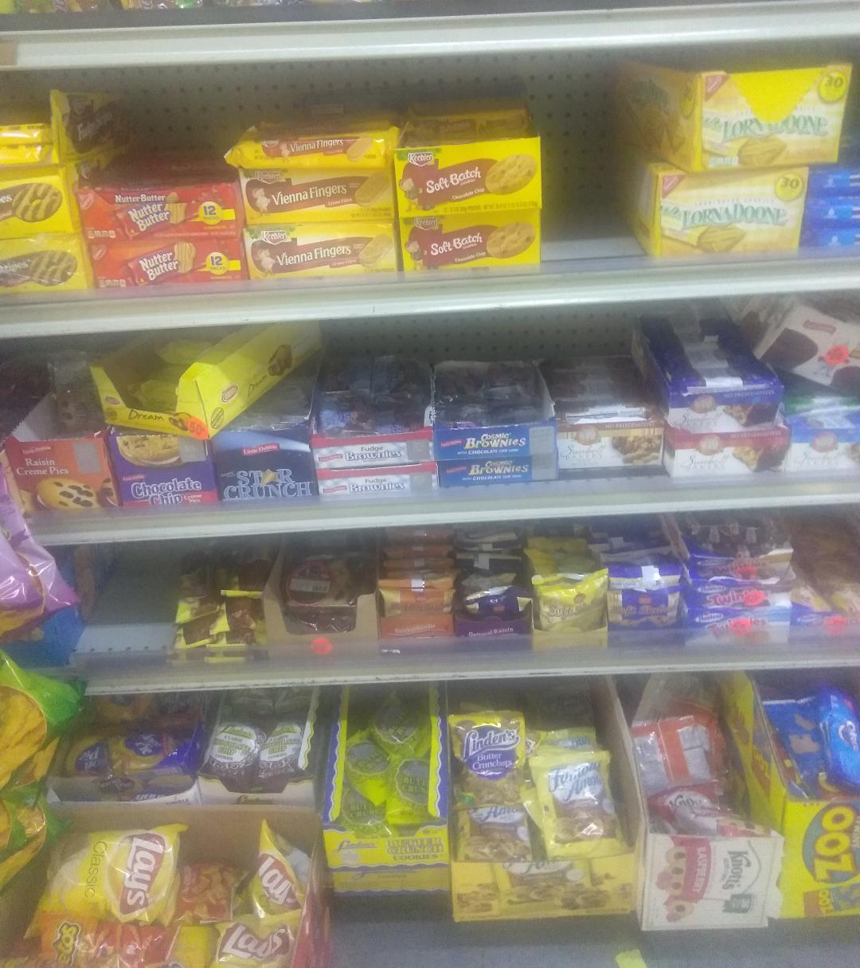
A food desert is an area with…
Notes:
Food desert is area with a lack of access to affordable healthy food choices. Limited supermarkets, an abundance of fast food restaurants, and grocery stores. Both the south Bronx and Harlem have been designated as food deserts. I decided to visit these areas .

Slide 3
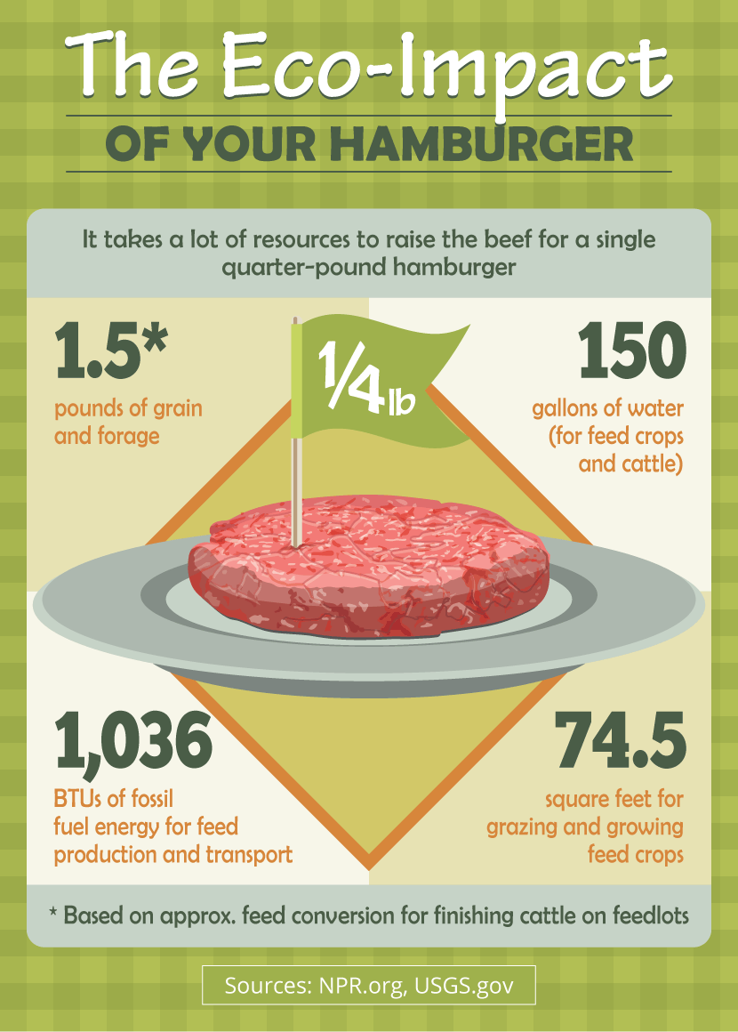
Environmental Implications High beef and low vegetable consumption harm our environment Beef Cattle are a major source of greenhouse gas emission. Consumption of beef products result in 48% of greenhouse gas emissions.
Notes:
Due to the limited access to healthy food choices, residents of these communities consume diets high in beef products, not only is consuming an excessive amount of beef detrimental to ones health, but the way in which it is produced negatively effects the environment. Additionally, transporting from farms harms the environment.

Slide 4
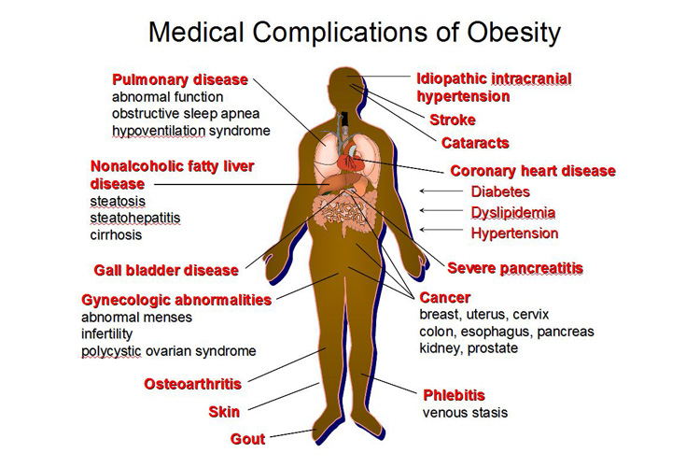
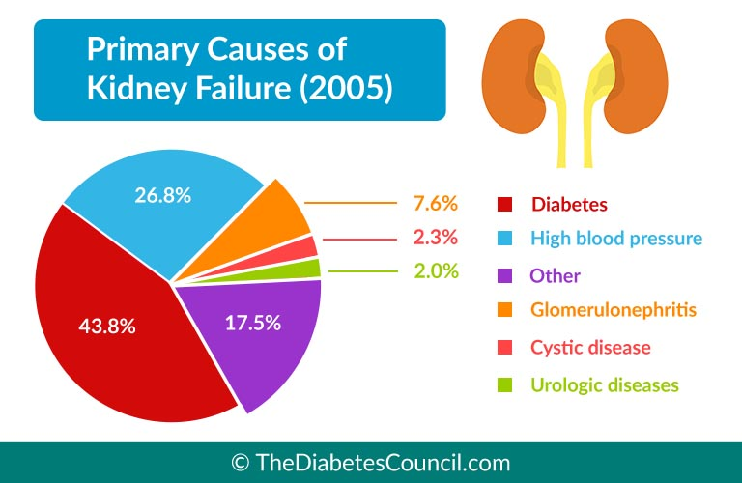
Health Consequences
Diabetes:987,000 New York residents have Type 2 Diabetes(NYC Dept of Health,2019).
Obesity:77% of East Harlem residents are obese(CUNY Public Health,2017).
Hypertension:54% of East Harlem residents are living with Hypertension(CUNY Public Health,2017).
Kidney Failure
Amputations
Notes:
It is no surprise nor coincidence that residents in the south Bronx have one of the highest rates of obesity and diabetes when compared to residents in other areas of NYC.

Slide 5
Economic Implications
Healthcare Costs
Permanent Disability
Reduced Income
Notes:
Diabetes in the U.S. costs over 3oo billion per year:this includes direct and indirect costs. Insulin cost has tripled since 2002. healthcare for someone with diabetes cost twice more than someone without the disease. Become permanently disabled and dependent on government programs such as public assistance or SSI. Reduced income results in less consumer spending.

Slide 6
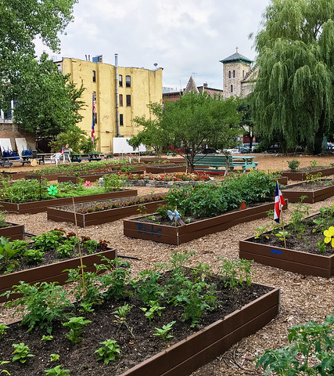
Urban Farms & Community Gardens
Economic benefits: employment and reduction in healthcare costs
Environmental benefits
Health benefits
Notes:
Both urban farms and community gardens address the economic, environmental , and health effects. Provide jobs to the community,reduce health costs associated with chronic disease resulting from poor diets.Reduce carbon emissons, address pollution, reduce food miles. Increase access to fresh fruits and vegetables, educate adults and children healthy eating habits, reduce prevalence of obesity, diabetes, hypertension.

Slide 7
References
American Diabetes Association. (2019). The Staggering Costs of Diabetes. Retrieved from http://www.diabetes.org/diabetes-basics/statistics/infographics/adv-staggering-cost-of-diabetes.html
Cohen, N., Freudenberg, N., Willingham, C. (2017). Nourishing NYCHA: Food Policy as a Tool for Improving the Well-Being of New York City’s Public Housing Residents.CUNY Urban Food Policy Institute. Retrieved from https://academicworks.cuny.edu/cgi/viewcontent.cgi?article=1180&context=sph_pubs
Demuro, K. (2013). Greenleaf Communities: The Many Benefits of Community Gardens. Retrieved fromhttps://greenleafcommunities.org/the-many-benefits-of-community-gardens/
Dorsey, S. (2013). Harlem Grown Urban Farm Gives Unemployed Single Moms a Chance to Earn Some Green. Habitat. Retrieved from https://inhabitat.com/nyc/harlem-grown-urban-farm-gives-unemployed-single-moms-a-chance-to-earn-some-green/
Egli, V., Oliver, M., Tautolo, E. (2016). The Development of a Model of Community Garden Benefits to Wellbeing.Preventive Medicine Reports,3,348-352.doi: 10.1016/j.pmedr.2016.04.005
Food Empowerment Project. (2019). Food Deserts. Retrieved from https://foodispower.org/access-health/food-deserts/
Hamilton, T. (2013). Beef Cattle and Greenhouse Gas Production. Ministry of Agriculture, Food, and Rural Affairs. Retrieved fromhttp://www.omafra.gov.on.ca/english/livestock/beef/news/info_vbn1013a4.htm
The New York City Department of Health and Mental Hygiene. (2013). Diabetes in New York: Epi Data Brief. Retrieved from https://www1.nyc.gov/assets/doh/downloads/pdf/epi/databrief26.pdf
New York City Health. (2019). Health Topics: Type 2 Diabetes. Retrieved from https://www1.nyc.gov/site/doh/health/health-topics/diabetes.page
The Office of Temporary and Disability Assistance. (2018). Supplemental Nutrition Assistance Program. Retrieved from http://otda.ny.gov/programs/snap/
University of Michigan Centers for Sustainable Systems.(2018).Sustainability Factsheet:2018 Collection.Retrievedfromhttp://css.umich.edu/sites/default/files/css_doc/Bound_Factsheets_2018.pdf

