Slide 1
Research of Solid Waste Management and it’s Disastrous Effects
Group members: Utsab Dasrao, Phillip Jiang

Slide 2
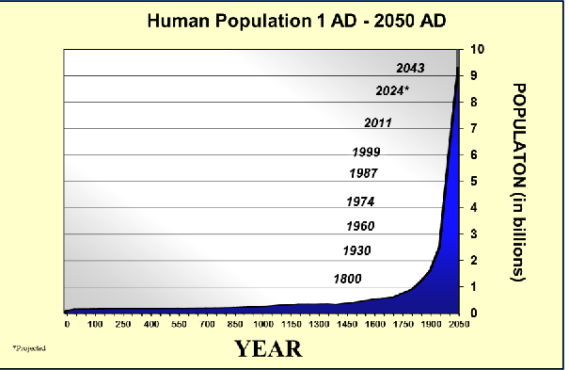
Main reason
As the years go by, earth population also significantly increases. As resources diminish, and garbage pollution increases.

Slide 3
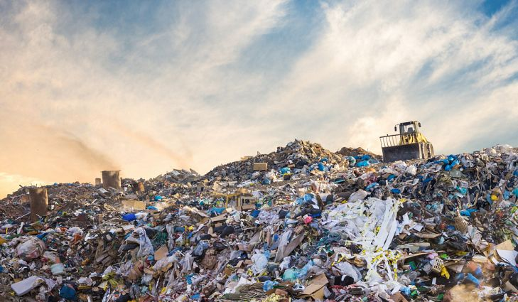
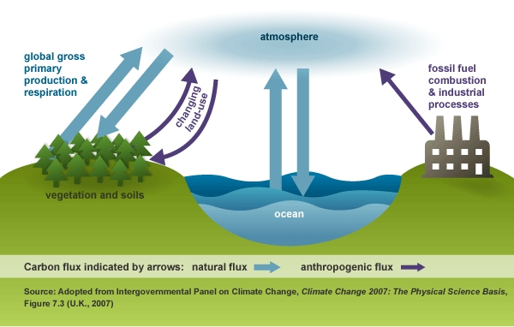
Municipal Solid Waste
Definition: everyday items that are discarded by the public, they are considered to be trash or garbage
11.2 billion metric tons of solid waste are currently being collected around the world every year
Greenhouse gas emissions

Slide 4
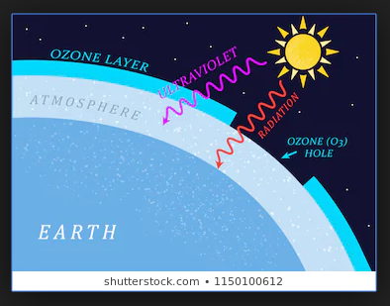
Problems
Wastes eventually pile up and start forming diseases while spreading towards healthy environments
Acid rain
Ozone Layer problems
Climate Change

Slide 5
Addressing the problem
Waste Reduction: Throwing Things Out
Accountability Using different packaging materials

Slide 6
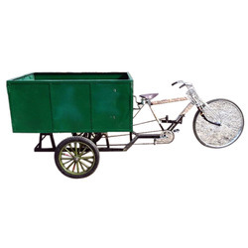
Alternatives
Some people find the Government inadequate when dealing with this problem.
Locals in Coxcatlán and Calipan, have decided to help out with the garbage disposal.
Separating garbage
Sell recyclable garbage to private companies
Engineers in India have also created better.
vehicles for trash collecting

Slide 7
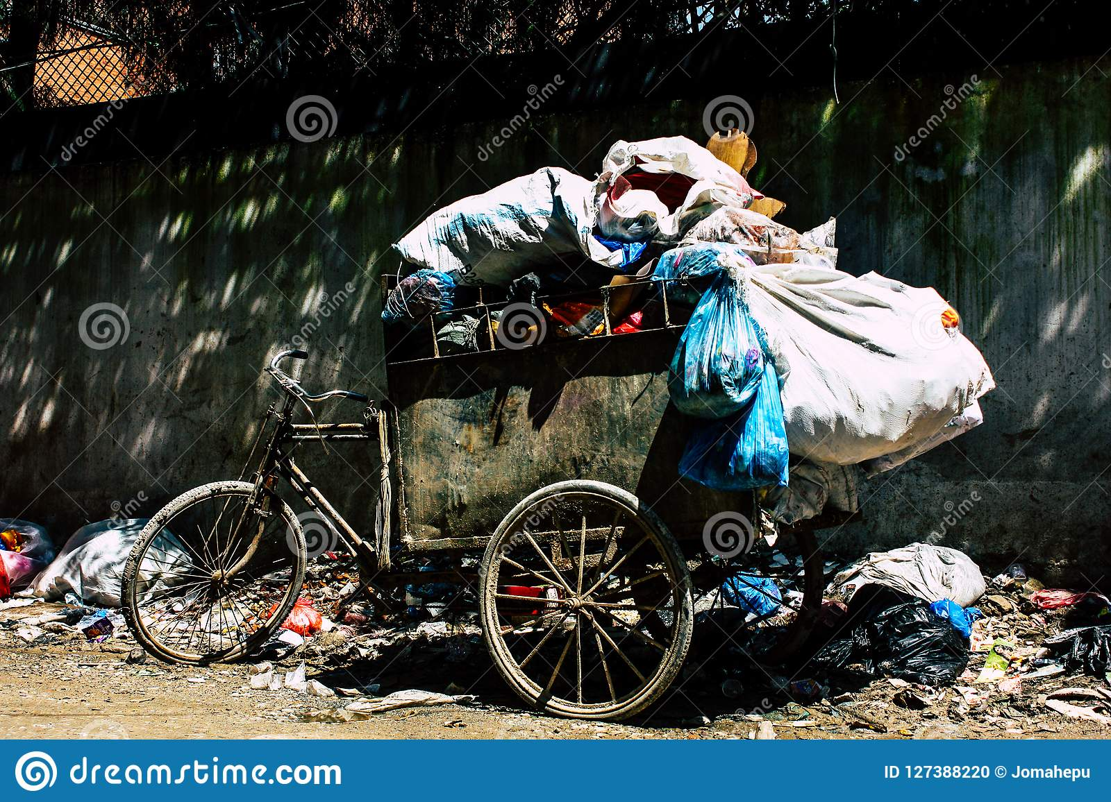
“Garbage Trucks” in third world countries

Slide 8
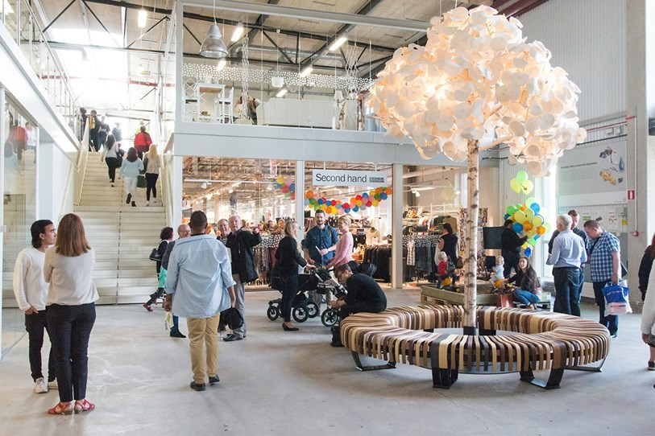
Recycled and Repaired goods mall, at Sweden

Slide 9
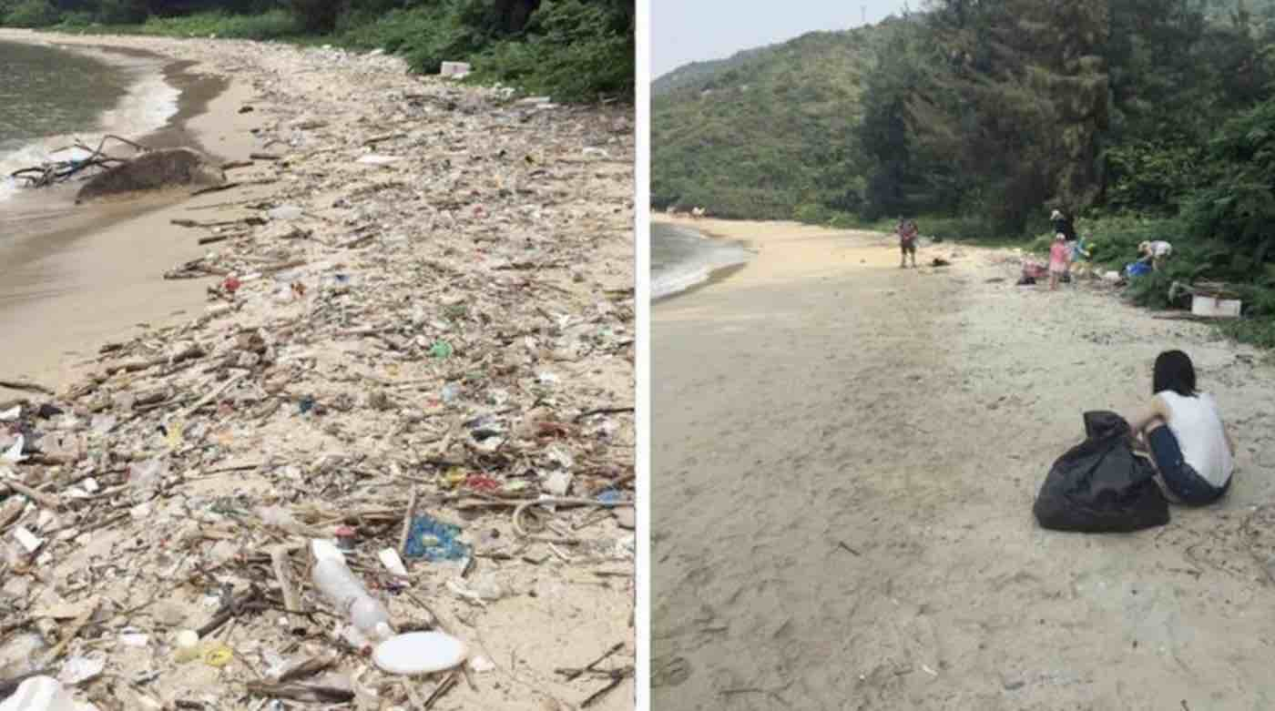
Conclusions
Although we have a problem on hand, it is never too late to start. To actually start this movement, we would need fundind. Usually people are not motivated until they realize the danger they are in. Should we be able to show case the situation we are in, we would be able to receive the funding and momentum for our cause.

