Slide 1
Smart Cities: Economic Sustainability and Global Climate Change
Environmental Economics (ECON 2505ID- HD21)
By: Farid Rodriguez, Wen Jie Long, and Jose Calderon

Slide 2
What is a smart city?
Connected by internet of things
Gathered data with sensors to manage resources efficiently
Improve quality of services
Reduces waste

Slide 3
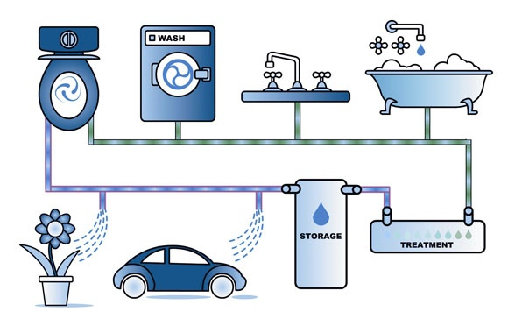
Smart Cities: Transportation and Energy
The transportation and energy is very efficient in a smart city since automobiles are fueled with electricity, and this is electricity is obtained in an environmentally friendly way such as solar panels and wind turbines.
Recycling water is also important. After it’s been used, it’s treated and supplied back to houses for things to be used again.

Slide 4
Road Solutions
Global GHG emissions are greatly affected by the transportation sector (14% of 2010 emissions), the electricity and heat production sector (25% of 2010 emissions), and buildings (6% of 2010 emissions).
A smart city solution would be communication in vehicles and between vehicles which allows intelligent road networks to exist. This “smart” transportation maximizes the utilization of vehicles since passengers can select more options for low-cost, short distance, or fast routes
The improved transportation network can address the negative effects of large urban density, consequently, with improved mobility citizens can better utilize their available time.

Slide 5
Case Study: San Francisco
A leading Smart City
Airbnb helped to create disaster relief tool
Improving public spaces with creative projects
Driven by dissatisfaction with environmental issues.
Driven by desire improve the community

Slide 6
Conclusion
In conclusion, smart cities are the direction to move toward. They have the benefits of having fewer greenhouse gas emissions, better transportation, and reusing more the resources.
Smart cities also allow people to react to natural disasters more quickly and efficiently while helping boost innovation.
They help foster the values in local communities and are vital when it comes to tackling something as large as climate change.

Slide 7
Bibliography
Albino, V., Berardi, U., & Dangelico, R. M. (2015). Smart cities: Definitions, dimensions,
performance, and initiatives. Journal of urban technology, 22(1), 3-21.
Caragliu, A., Del Bo, C., & Nijkamp, P. (2011). Smart cities in Europe. Journal of urban technology,
18(2), 65-82.
Global Greenhouse Gas Emissions Data. (2017, April 13). Retrieved from
https://www.epa.gov/ghgemissions/global-greenhouse-gas-emissions-data
Hurricane Sandy Fast Facts. (2018, October 29). Retrieved from https://www.cnn.com/
2013/07/13/world/americas/hurricane-sandy-fast-facts/index.html
McLaren, D., & Agyeman, J. (2015). Sharing cities : A case for truly smart and sustainable cities.
Retrieved from https://ebookcentral.proquest.com
Mohanty, S. P., Choppali, U., & Kougianos, E. (2016). Everything you wanted to know about smart
cities: The Internet of Things is the backbone. IEEE Consumer Electronics Magazine, 5(3),
60-70.
How Smart Cities can help tackle climate change. (n.d.). Retrieved from
http://www.frontier-economics.com/uk/en/news-and-articles/articles/article-i4604-ho
w-s mart-cities-can-help-tackle-climate-change/#_ftn1

