Slide 1
Electric Vehicles
Henry Lam, Pablo, Joshua

Slide 2
Environmental Concern
The idea of using a car involves gasoline (Petrol). We have been using gas for as long as we remember as well as oil. But theses resources that we use on our vehicles can harm the environment.There is a solution to this is problem and that solution is electric power cars.

Slide 3
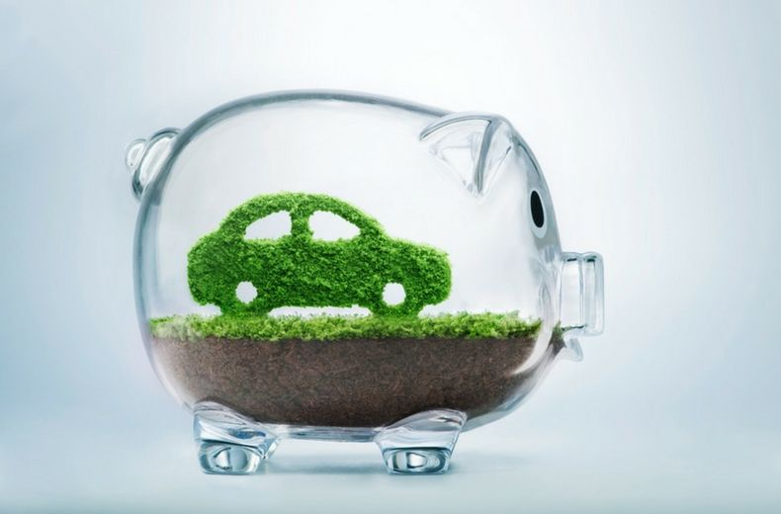
Money Back
If you purchase an Electric Vehicle, you can get up to $7,500 on federal tax credit or for owning an electric vehicle.
Example: In reference to the video “Sustainable City”

Slide 4
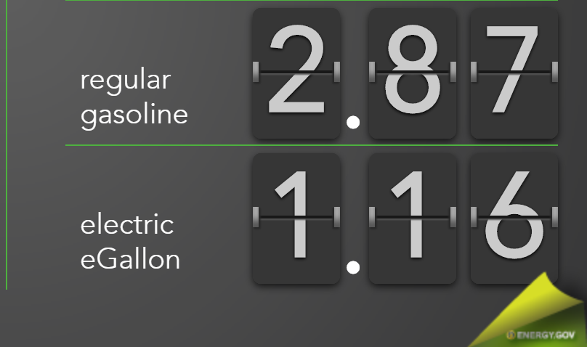
Refilling Benefits
Using Electric Vehicles has less hassle. When refueling your car.
Recharging your car will cost you less money than using actual fuel.
In the long run, you will be saving almost half the amount of money by just charging your car than using fuel.

Slide 5
Economy
One way in which electric vehicles impact the economy is through fuel. According to cleantechnica.com, the US imports 9,401,000 barrels of oil a day. Those barrels equate to a hefty import bill of about $425 million/day, and in a year that is approximately $155 billion. These are huge numbers and not to mention much of the money used to burn these oil based fuels will most likely never make it back to the US economy in any way. Electric vehicles on the other hand can drastically cut this number down. This is possible because these cars do not rely on nonrenewable energy forms but promote the use of renewable sources of energy like solar and wind.

Slide 6
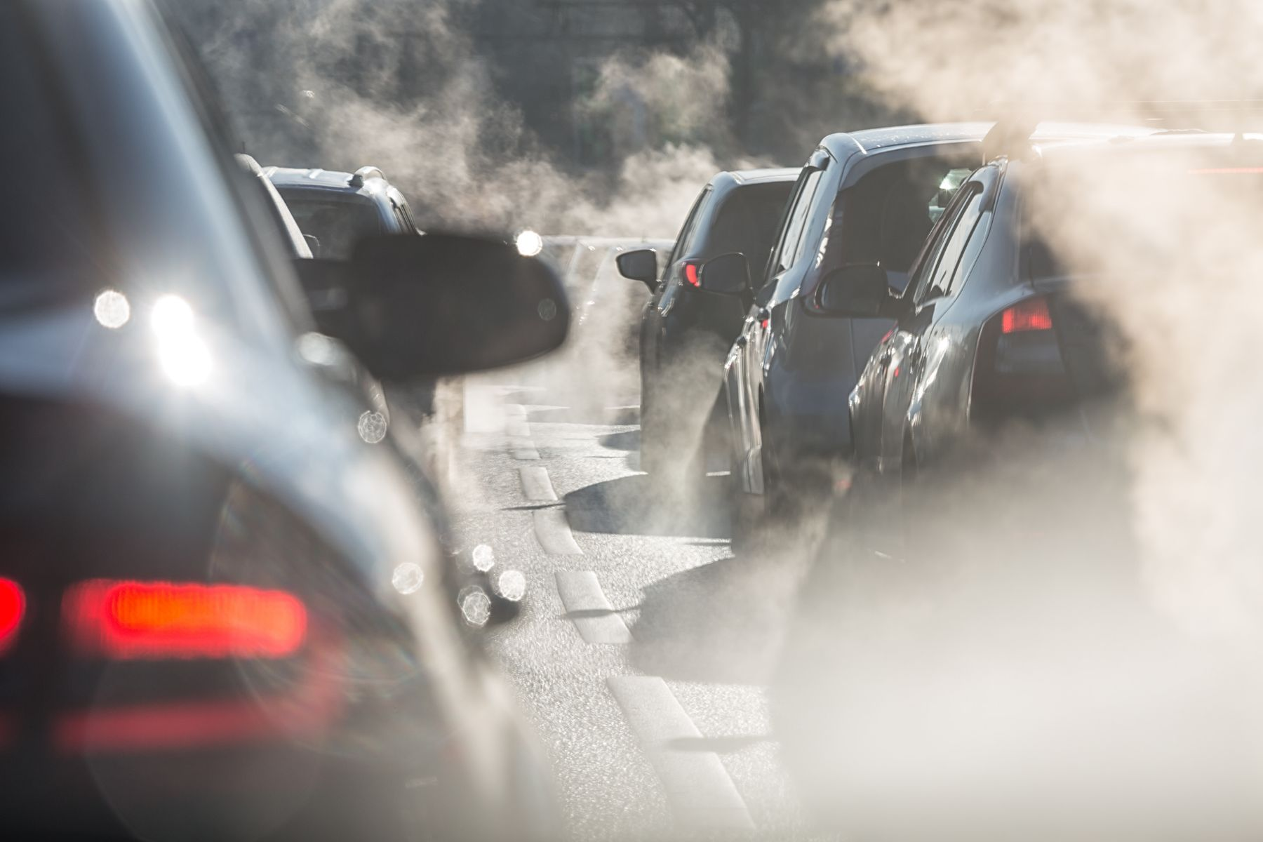
Economy Cont…
Another way in which electric vehicles contribute to the economy is through improving the environment. Pollution, climate change, and health costs all contribute negatively to the economy and transportation is a big reason for carbon emissions that cause these issues. The average new U.S. car that gets 29 miles per gallon has total emissions of about 400 grams of carbon dioxide per mile”, according to the Union of Concerned Scientists. This is a large number factoring all of the cars that are on the road today. Electric vehicles could potentially cut that number down by 75% and have net emissions of 100 grams per mile or less. This means a cleaner more sustainable environment that we live in resulting in better health and extending the lifespan of the earth that we inhabit and thus boosting the economy due to less health expenditures.

Slide 7
Conclusion
In conclusion gas powered cars (Petrol) are now a thing in the past. The government has been relying on this resource for a hundred years and despite them improved the emissions on the car buy installing eco-friendly car parts there is still a global warming issue and cars are one of the main problems. The worst part is there are more CO2 contaminants in highly populated areas. Big cities such as New York deal with pollution from cars every day especially during traffic. The solution to the problem is electric cars and with this solution we can build a cleaner planet earth.

