Slide 1
John Villalona
Mat 2680
Professor Poireir
5/22/23
Using OP Amps to solve a differential equation

Slide 2
The differential we are trying to solve using Op Amps
So, the reason you have plus 50 v is because a summing op amp needs three inputs so that it causes the result of the equation to inverted when the first order derivative is being added with 150v.
One things to under is that the input of 50 v that being connected to inverting summing amp has a gain of 1.
which maybe doesn’t affect the differential equation that we are feeding into the op amps. Also, something that happens to both integrator amps is that we give each one a gain of -1 when you design the op amps using the differential equation that was given as our example equation.
d^2V/dt^2+50dv/dt+150v-50v.
Add picture

Slide 3
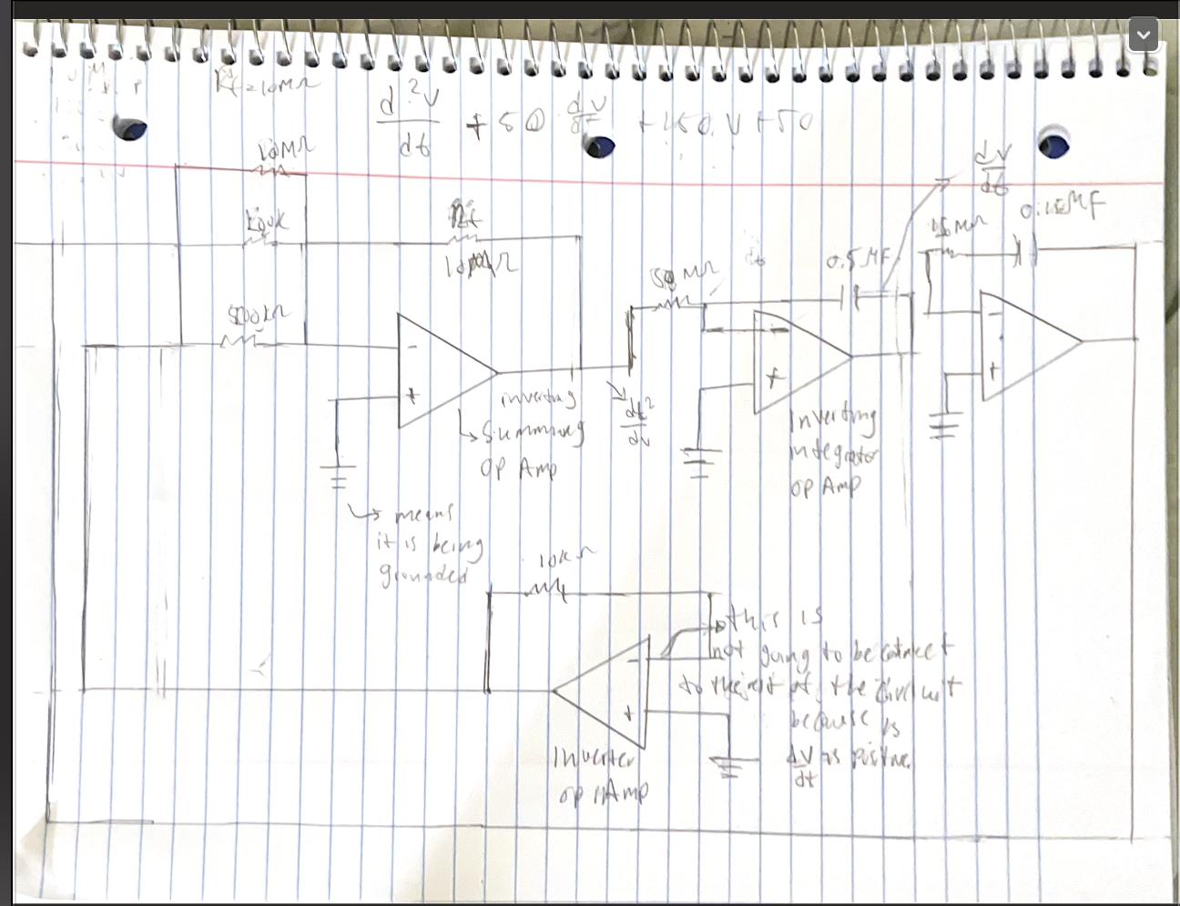
The problem problem we are trying to solve using op Amps
d^2V/dt^2+50dv/dt+150v-50v.
I used https://www.dummies.com/article/technology/electronics/circuitry/how-to-solve-differential-equations-using-op-amps-166161/ as t draw my block diagram .
But you usually use labview which is a problem to create the circuit .
Because of time I didn’t check if there is any error in terms of the math

Slide 4
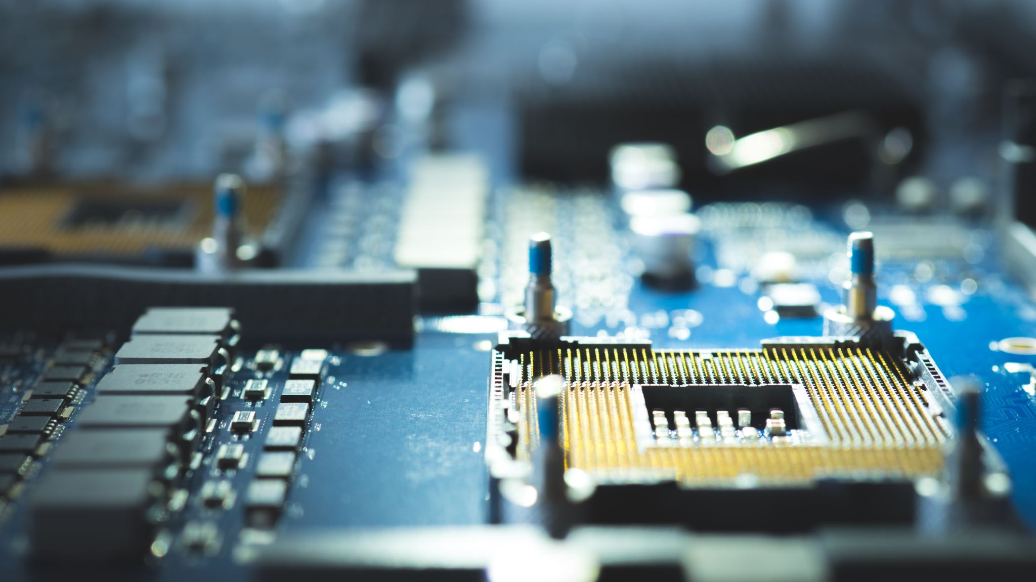
What is OP amps
Op Amps stand for Operational amplifier .
And its job in an IC or an ingrated circuit is to amplify weak signals or voltages when you have things like capacitors and resistors are connected to in and out points on OP amp.
Something that is interesting about Op Amps is that they’re essential component when it come analog devices because it allows a person to many different operations
and that’s the reason why people in the electronics world gave the name Op amps (operational amplifier).
One of the reasons op amps can be used for math or for differential equations is because op amps are components are linear components that be used to solve mathematical operations like adding ,subtracting , integration and differentiation which again is the focus of this project and as filter and for conditioning signals.
Op amps have different amplifier like an inverter, inverter summing amplifier and inverter integration amplifier and their other amps you can use in a circuit .

Slide 5
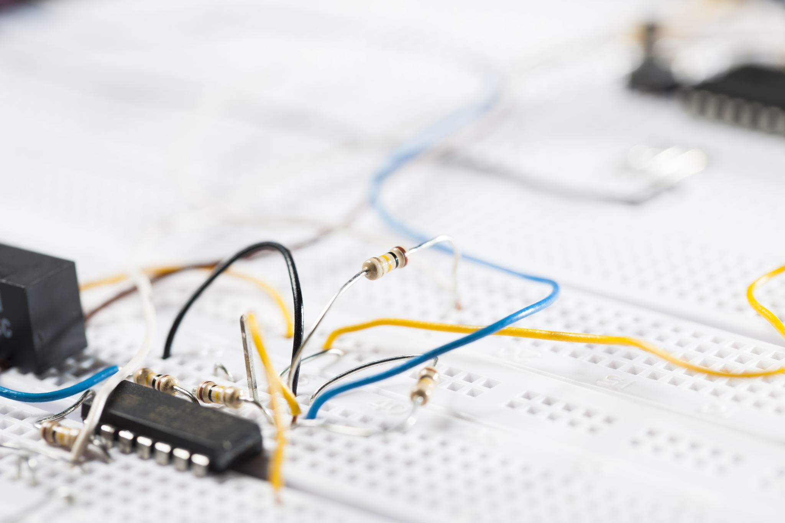
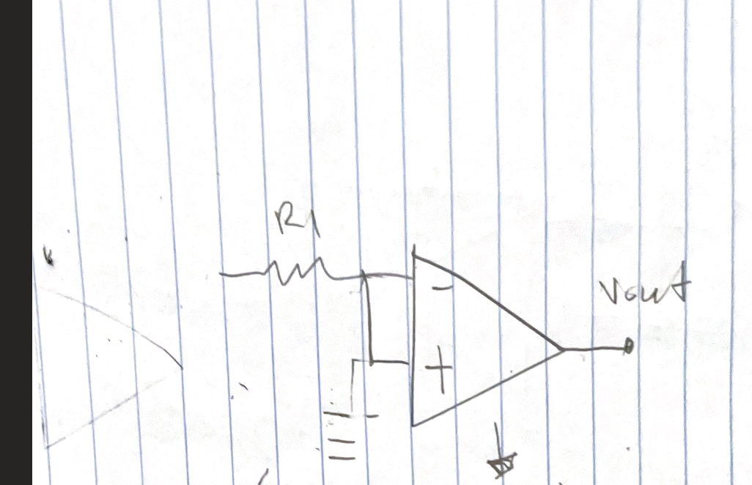
What is an inverter Op amp
Inverter amplifier is just inverting the voltage output or the gain from inputs of the circuit.
Its math formula is Vin(-1)=-Vout

Slide 6
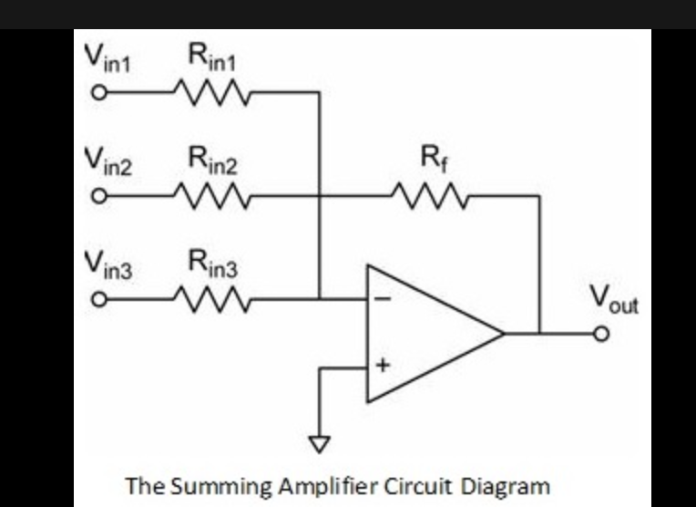
What is an inverter summing Op Amp
An inverting summing amplifier is a Variation of an inverting amplifier that was moded to a summing amplifier . The difference is we are inverting the output of the summing op amp which is the reason it is called the inverter summing op amp.
this allows your inputs or resistors to connected in parallel to each other.
This allows the connection or the circuit of the summing op amp to have one voltage output . Where its Vout will be the total individual voltage of each input will be add to one another and multiplied by the total Rin of the resistors who are in parallel to one another. Then as the formula shows it is being divided by Rf and then that Vout is being inverted .
Math formula for it is -Vout=Rf/Rin(V1+V2+V3+…)
Source for the picture: https://www.electronicshub.org/summing-amplifier/
This picture doesn’t describe the inverting summing op Amp. It is a similar circuit design to the summing op amp but something is added to cause it to be inverted .

Slide 7
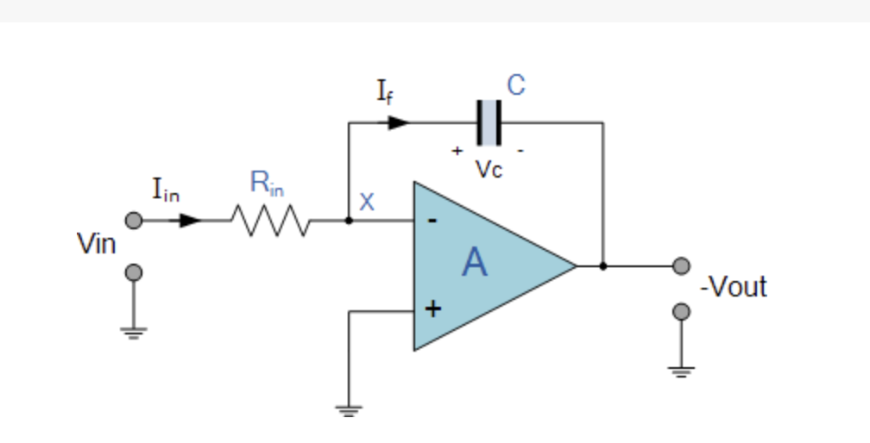
What is an interting Intragrator Op Amp
Then you have an integration amplifier is an amplifier is an ideal op-amp integrator who also acts as an inverting amplifier .
And causes the integration op amp output voltage to be proportional to the input voltage who it is being integrated by a negative integral.
Therefore, this result allows the integration op amp to create or do a mathematical integration when This allows
Math formula for inverter integration amplifier: Xc/RIN or Vout=-(1/jωRC)Vin)
Source for the picture : https://www.electronics-tutorials.ws/opamp/opamp_6.html

Slide 8
sources
https://www.electronicshub.org/summing-amplifier/
https://www.electronics-tutorials.ws/opamp/opamp_6.html
https://www.ablic.com/en/semicon/products/analog/opamp/intro/
https://www.analog.com/en/design-center/glossary/inverting-op-amp.html#:~:text=An%20op%20amp%20inverter%20is,of%20the%20circuit%20is%20%2D1
https://www.allaboutcircuits.com/textbook/semiconductors/chpt-8/introduction-operational-amplifiers/
ttps://www.dummies.com/article/technology/electronics/circuitry/how-to-solve-differential-

Slide 9
Conclusion
I was originally going to write all of this in an essay . After reading the feedback my classmate gave me. It made me wonder who can I explain and show what I am talking about it. I could have gone insane and done a report of it . But I decided and got inspire to approach my project in new way. And this is how this PowerPoint report was born.
I hope you learned a lot or more of op amps and how you can use them to solve a differential equation.

