Slide 1
Differential Equations in Machine Learning

Slide 2
Differential Equations
ORDINARY DIFFERENTIAL EQUATIONS
“ODE is an equation that contains only one independent variable and one or more of its derivatives with respect to the variable.”
Example: y’’ + 10y’ + 9y = 0
PARTIAL DIFFERENTIAL EQUATIONS
“An equation involving only partial derivatives of one or more functions of two or more independent”
Example:

Slide 3
Purpose of Differential Equations
The objective of differential equations is to predict behavior of data in real life problems.

Slide 4
Machine Learning
I am Jayden Smith
I am here because I love to give presentations.
You can find me at:
@username

Slide 5
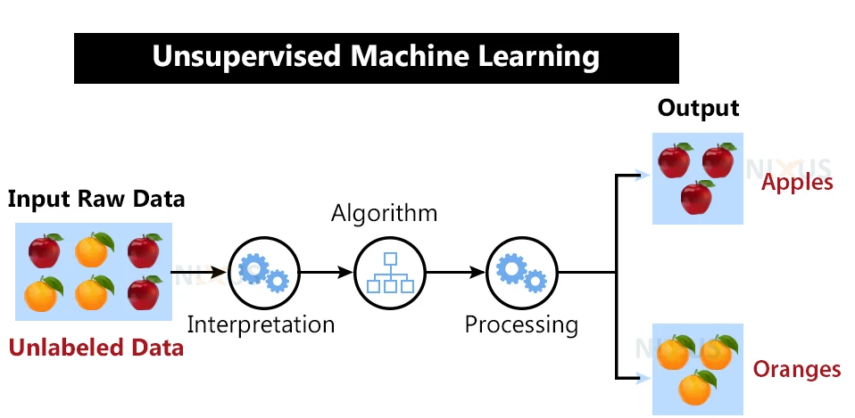
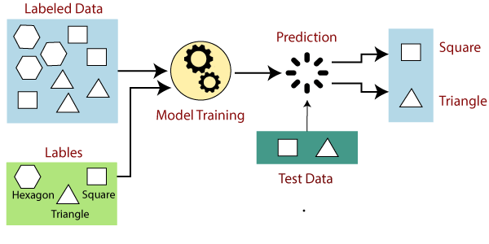
Types of methods
Supervised
It uses both input and output data.
Feedback as input.
Unsupervised
Only uses input.
Interpretation.

Slide 6
Techniques of Machine Learning in supervised method
Regression
Neural Network
Classification
This implies differential equations

Slide 7
Neural Network Technique
According to Patrick, an oxford mathematician says that the purpose of this technique is to combine neural network which are focused on image recognition and understanding of language processing, with differential equations.

Slide 8
Neural controlled by differential equation
In order to add a value of time into the equation, a new variable should be added to d(t).
For example, this variable can use to compare the rate of change dz(t).

Slide 9
IA Solving Differential Equations

Slide 10
Thanks!
Cited work

Slide 11
SlidesCarnival icons are editable shapes.
This means that you can:
Resize them without losing quality.
Change line color, width and style.
Isn’t that nice? :)
Examples:

Slide 12
Diagrams and infographics

Slide 13
You can also use any emoji as an icon!
And of course it resizes without losing quality.
How? Follow Google instructions https://twitter.com/googledocs/status/730087240156643328
✋👆👉👍👤👦👧👨👩👪💃🏃💑❤😂😉😋😒😭👶😸🐟🍒🍔💣📌📖🔨🎃🎈🎨🏈🏰🌏🔌🔑 and many more...

