Slide 1
Differential Equations in Machine Learning by Javier Bonilla
MAT 2680
05/21/23

Slide 2
Differential Equations
ORDINARY DIFFERENTIAL EQUATIONS
“ODE is an equation that contains only one independent variable and one or more of its derivatives with respect to the variable.”
Example: y’’ + 10y’ + 9y = 0
PARTIAL DIFFERENTIAL EQUATIONS
“An equation involving only partial derivatives of one or more functions of two or more independent”
Example:

Slide 3
Purpose of Differential Equations
The objective of differential equations is to predict behavior of data in real life problems.

Slide 4
Machine Learning
Machine learning can predict human actions.
Solve complicated problems involving large data.
It has two types of methods.

Slide 5
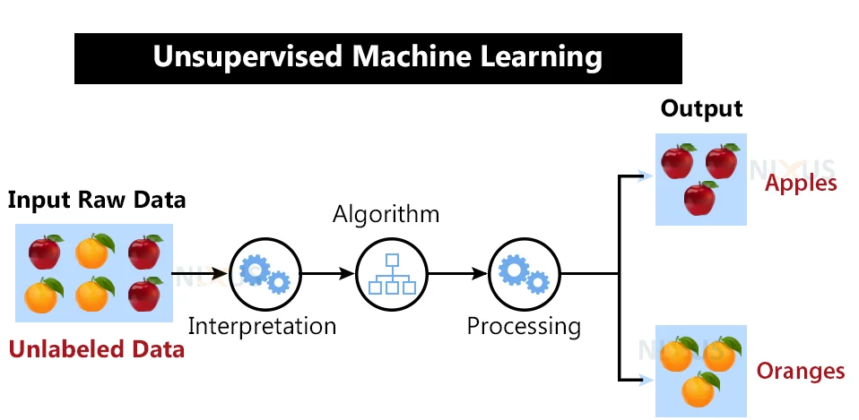
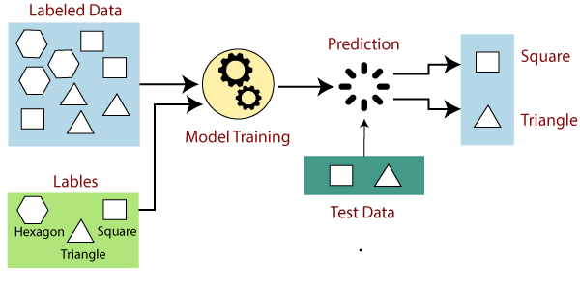
Types of methods
Supervised
It uses both input and output data.
Feedback as input.
Unsupervised
Only uses input.
Interpretation.

Slide 6
Techniques of Machine Learning in supervised method
Regression
Neural Network
Classification
This implies differential equations

Slide 7
Neural Network Technique
According to Patrick, an oxford mathematician says that the purpose of this technique is to combine neural network which are focused on image recognition and understanding of language processing, with differential equations.

Slide 8
Neural controlled by differential equation
In order to add a value of time into the equation, a new variable should be added to d(t).
For example, this variable can be used to compare the rate of change dz(t).

Slide 9
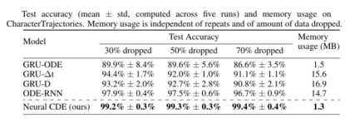
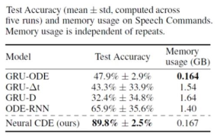
Example of using Neural Controlled DE
Predicting which letter between a, b, and c a person will write with a pen.
Tests which words between “left” and "right” a person will say

Slide 10
IA Solving Differential Equations
Since AI is experimented with many uses, an article from Medium intitled “Artificial Intelligence Can Now Solve Partial Differential Equations” state that:
“Researchers at Caltech have introduced a new deep-learning technique named “Fourier Neural Operator for Parametric Partial Differential Equations” for solving PDEs that is dramatically more accurate than Deep learning methods developed previously.”

Slide 11
Thanks!
Cited work
“Differential Equations - Definition, Formula, Types, Examples.” Edited by Cory Reid and Michael Goldstein, Cuemath, www.cuemath.com/calculus/differential-equation/. Accessed 13 May 2023.
IBM. “What Is Machine Learning?” IBM, 2019, www.ibm.com/topics/machine-learning#:~:text=the%20next%20step-,What%20is%20machine%20learning%3F,rich%20history%20with%20machine%20learning.
Kidger, Patrick. “Machine Learning with Neural Controlled Differential Equations.” University Of Oxford | Mathematical Institute, 1 Mar. 2021, www.maths.ox.ac.uk/node/38559.
MathWorks. “What Is Machine Learning?: How It Works, Tutorials, and Examples.” What Is Machine Learning? | How It Works, Tutorials, and Examples - MATLAB & Simulink, 2017, www.mathworks.com/discovery/machine-learning.html.
Saxena, Pranjal. “Artificial Intelligence Can Now Solve Partial Differential Equations.” Medium, 4 Apr. 2021, medium.com/swlh/artificial-intelligence-can-now-solve-a-mathematical-problem-that-can-make-researchers-life-easier-9602c869128#:~:text=Artificial%20Intelligence%20can%20Now%20Solve%20a%20Mathematical%20Problem%20that%20can,us%20understand%20how%20nature%20works.

