Slide 1
Henry’s Food Adventures
A blog about grubbing in New York City

Slide 2
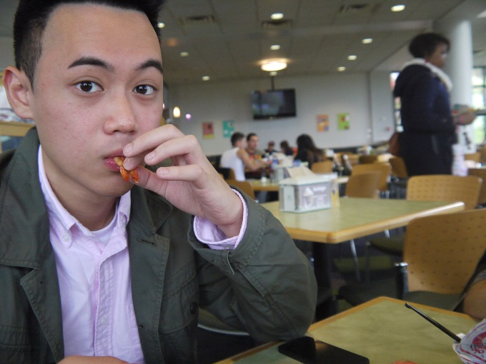
My Bio
Hello there! Henry here. I’m currently a student at the New York City College of Technology studying Visual Communications. I enjoy free-writing, but I especially enjoy writing about food. I’m a big fan of visual graphic design works, photography, and most importantly, EATING (Which is what this blog is mostly about). I enjoy trying all different types of cuisines, because tastes in general are all unique.
I started paying attention to the foods I ate after posting pictures of my daily foods on Facebook two years ago, and receiving many likes from my viewers. My album on Facebook has since exceeded 1,000 pictures today!! It’s so lucky of me to live in New York City where food from different countries are offered with just a quick stroll down a block. Anyways, Interested in restaurant suggestions, or places to eat? Or you just want to grab a quick bite? Feel free to contact me on Facebook or just follow me on Instagram at @Htam93. Thanks for the extra view count, and Happy Eating!

Slide 3
Mission Statement
The strategic mission of Henry’ Food Adventures is to provide viewers with a blog that includes an abundance of suggestions, recommendations and photographs of cuisines that are offered in the New York City area to aid in the choosing of restaurants.
Henry’s Food Adventures offers suggestions, recommendations and photographs to anyone who enjoys eating in general. My blog also caters to any eaters out there willing to try out any new foods. My blog strives to provide readers with up-to date and current information and recipes. My goal is to provide readers with an easy to follow and non-complicated blog.
I will respond to: My readers: They will be addressed in a quick and prompt fashion after reaching out to me section of the blog. The eaters: My short-term goal is to provide the eaters with east to follow recipes on my blog. My long- term goal is to ensure that the eaters will enjoy these recipes that I have provided and recommend them to a friend. I will provide a Feedback section on my page so that my viewers can leave feedback after trying out the recipes.

Slide 4
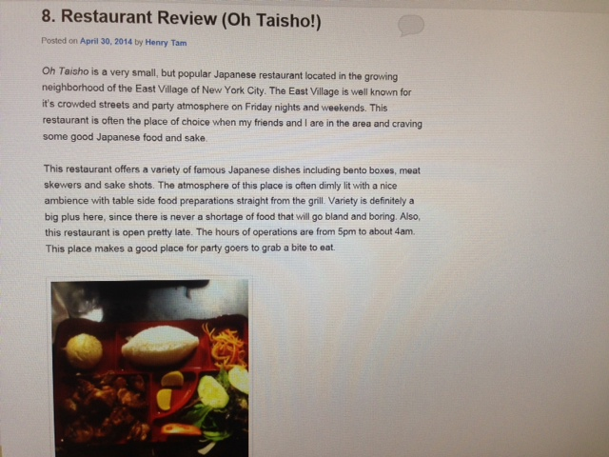
Typical Blog Post
A typical blog post in this blog is composed of my review of what makes this particular restaurant an acceptable one to dine at. Also, photographs are provided to give the viewers a visual sense of what they're going to be eating.

Slide 5
Series Blogging
According to the 2012 United States Census Bureau, there are a total of 45,660 eating establishments ranging from full-service restaurants to bars, taverns and nightclubs. My strive is to bring eaters to the best "cheap-eat" restaurants, "street food" street-carts and places ideal for a dinner date.

Slide 6
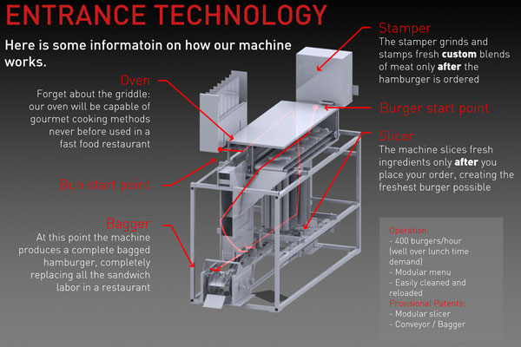
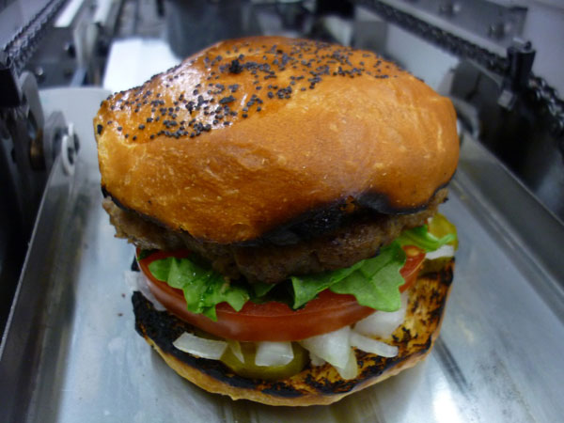
Guest Blogging
To relate with Husaan Iqbal's topic of robot in space, I posted a guest post on the use of robot machinery in compliance with food production. The use of robot machinery in the production of food has it's benefits including the cutting of worker labor hours and worker errors.

Slide 7
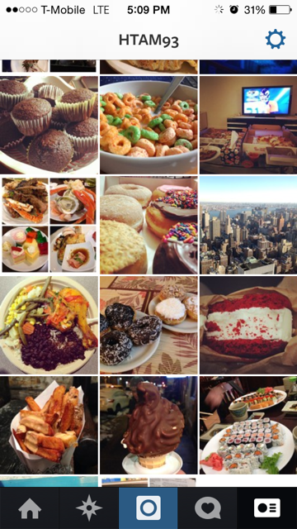
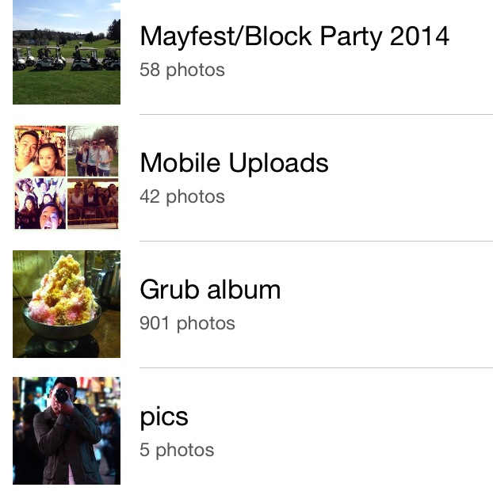
Conclusion
There is only a limited time I can spend on this blog during the span of this semester, and there's only so much that I can post on this blog. To keep tabs on what I'm eating, please feel free to friend me on Facebook or follow me on Instagram. Happy Eating!

