Slide 1
EIS (Electroacoustic Improvisation Summit April 29th at 7pm
Hannah Stoffer Stage Manager

Slide 2
Calendar
Calander
Task | Start date | End date | Duration
Write Proposle | 10/7/21 | 10/10/21 | 3
Meeting with Advisor | 10/21/21 | 5/12/22 | 203
Meetings with Atristic Director | 11/1/21 | 4/7/22 | 157
Production Meetings | 2/21/22 | 4/27/22 | 65
Setup Discord | 2/28/22 | 3/4/22 | 4
Learn Stream Yard | 3/10/22 | 3/16/22 | 6
Tech Live | 4/28/22 | 4/28/22 | 0
Performance | 4/29/22 | 4/29/22 | 0
Strike | 4/29/22 | 4/29/22 | 0
Post Mordem | 5/9/22 | 5/10/22 | 1

Slide 3
Tech /performance schedule

Slide 4
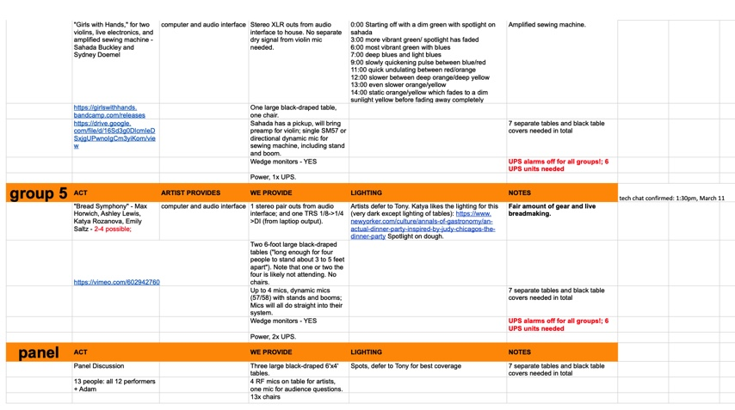
Call Sheet

Slide 5
List of performances
Pendualr
They are a group of physical motion with hanging items such as balloon type objects. They used wire to attach their objects to the poll for them to swing and dangle.
Cast Down Thither
They used two fugal horns and a synthesizer to create the other sounds/motions to form their framework.
Jamshid Jam
One of them used a setar while the other one used a DJ board to create different emotions through vibration and sound.
Girls with Hands
The first girl was playing the violine and the other one used a sewing machine to create sound. They combined contemporary and classical to create an everyday life environment.
Bread Symphony
For their sound they were creating the sound of a sour dough starter when you mix it together.

Slide 6
Light Cue sheet
 | LQ . 3 | Preshow
 | LQ . 4 | Audience Coming in
 | LQ . 5 | House to Half
 | LQ. 7 | Black out
 | LQ 1 | Adam coming out to talk
 | LQ 2 | Group 1 Pendular
 | LQ 3 | Adam
 | LQ 4 | Group 2
 | LQ 5 | Adam?
 | LQ 6 | Group 3 Jamshid Jam
 | LQ 7 | Adam
0:00 | LQ 8 | Group 4 Girls with Hands
3:00 | LQ 8.1 | Fade to green
6:00 | LQ 8.2 | Green & Blue
7:00 | LQ 8.3 | Deep blue & Light blue
9:00 | LQ 8.4 | Pulse red & blue
11:00 | LQ 8.5 | Red & orange
12:00 | LQ 8.6 | Slower color
13:00 | LQ 8.7 | Even slower
14:00 | LQ 8.8 | Orange to yellow
 | LQ 8.9 | Follow
 | LQ 8.91 | Fade to black
 | LQ 10 | Adam
 | LQ 11 | Bread Symphony
 | LQ 11.1 | Fade to red 10 min
 | LQ 11. 2` | Rem Dim
 | LQ 12 | Fade to black
 | LQ 13 | Talk back
 | LQ 15 | House to half

Slide 7
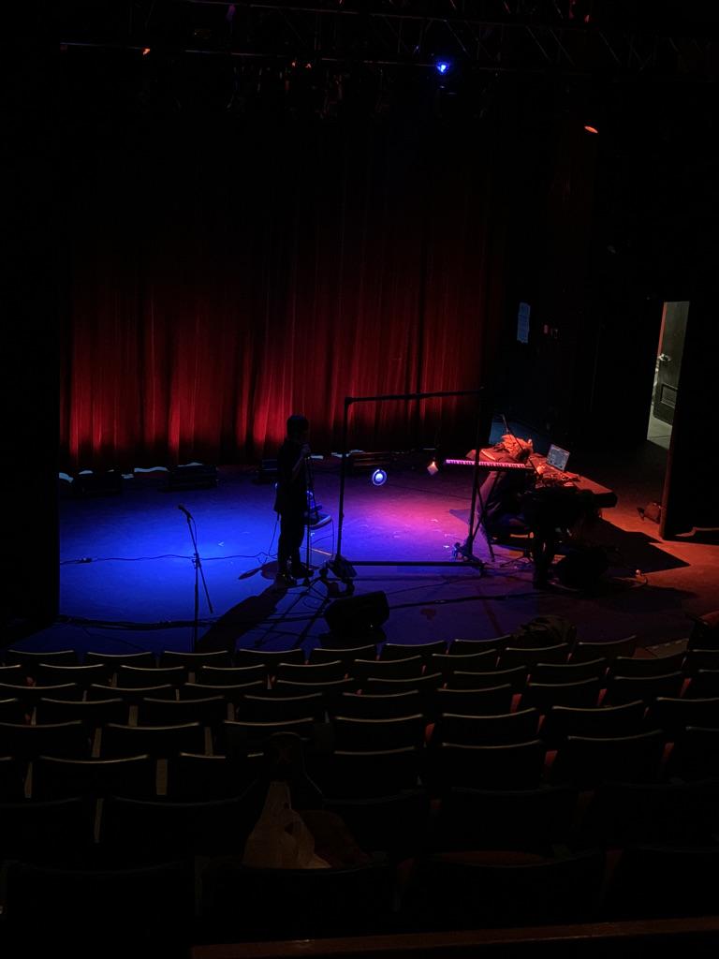
Pendular

Slide 8
Cast down Thither

Slide 9
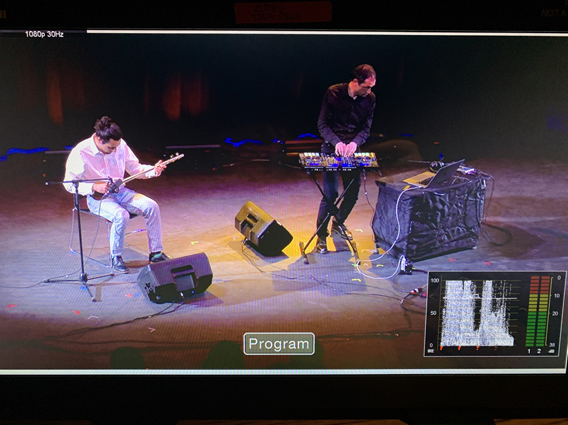
Jamshid Jam

Slide 10
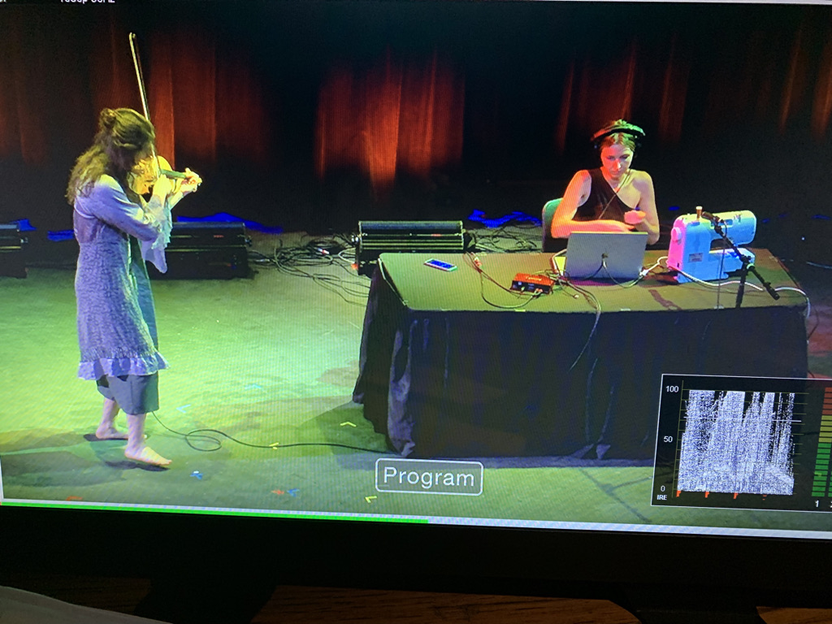
Girls with Hands

Slide 11
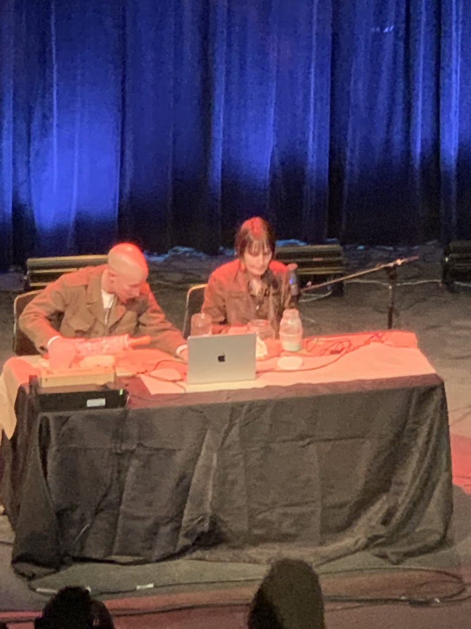
Bread Symphony

Slide 12
Challenges and what I learned
Challenges
Was not sure when to call a certain light cue to go to the next one.
Figuring out the booth and what went where
What I learned
Learned how to call light cues without a script like in a play or musical
Able to work with everyone that was involved with EIS

Slide 13
Thank you ENTERTAINMENT AND EMERGING MEDIA PRODUCTION FACULTY AND STAFF
Adam Wilson – NYC EIS Director
Sue Brandt – General Manager
Tony Giovannetti – Lighting Designer
Yinglian Liu – Who ran the light board
John McCullough – Technical Supervisor Rigging
John Huntington – Audio and Video Supervisor
Saad Farooqi – Video Production Supervisor
Leah Montesinos – House Manager

