Slide 1
Thyroid Gland and Related Diseases
Presented by
Idelina Almanzar
Johanna Barcia
Hilary Pena

Slide 2
Objectives
Diseases related to the Thyroid Gland
Clinical symptoms and oral manifestations of hypothyroidism and hyperthyroidism
Pharmacologic agents to treat hypo/hyperthyroidism
Adverse effects, drug interaction and Mechanism of action
Role of the Dental Hygienist treating patients with these diseases

Slide 3
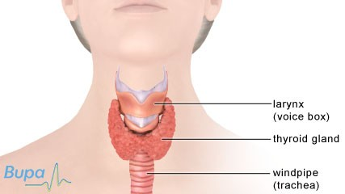
The Thyroid Gland
Thyroid disease is one of the most common type of endocrine disorders.
The thyroid gland regulates the rate of almost all cellular energy-producing processes of the body.

Slide 4
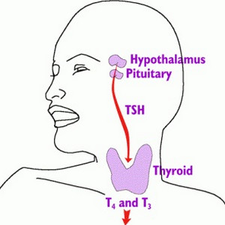
The thyroid accumulates dietary iodine and builds this element into hormones that it releases into the blood as needed.
Thyrotrophin-releasing Hormone (TRH)
Thyroid Stimulating Hormone (TST)
T4 Thyroxine
T3 Tri-iodothyronime (Liver)
There are two main categories of action of the thyroid hormones, those affecting growth and those affecting metabolism.
Normal values are:
TSH <6 mU/l
Free T4 9-25 pmol/l
Free T3 3-9 pmol/l

Slide 5
Malfunction of the Thyroid Gland Leads to:
Hypothyroidism
Hyperthyroidism
Goiter

Slide 6
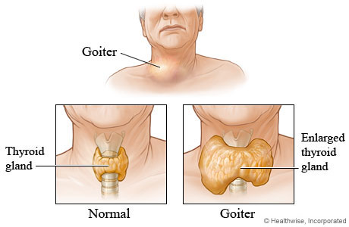

Slide 7
Hyperthyroidism is a condition in which the thyroid gland makes too much thyroid hormone
Some common causes of hyperthyroidism include:
Graves' Disease
Functioning adenoma and toxic multinodular goiter (TMNG)
Excessive intake of thyroid hormones
Abnormal secretion of TSH
Thyroiditis (inflammation of the thyroid gland)
Excessive iodine intake

Slide 8
Symptoms of Hyperthyroidism
Common symptoms include:
Excessive sweating
Heat intolerance
Increased bowel movements
Tremor (usually fine shaking)
Nervousness; agitation
Rapid heart rate
Weight loss
Fatigue
Decreased concentration
Irregular and scant menstrual flow

Slide 9
Hypothyroidism
Hypothyroidism (underactive thyroid) is a condition in which the thyroid gland doesn't produce enough thyroid hormones
common causes of hypothyroidism:
Hashimoto's thyroiditis
Lymphocytic thyroiditis (which may occur after hyperthyroidism)
Thyroid destruction (from radioactive iodine or surgery)
Pituitary or hypothalamic disease
Medications
Severe iodine deficiency
In Hashimoto's disease, also known as chronic lymphocytic thyroiditis, your immune system attacks your thyroid gland. The resulting inflammation often leads to an underactive thyroid gland (hypothyroidism). Hashimoto's disease is the most common cause of hypothyroidism in the United States. It primarily affects middle-aged women, but also can occur in men and women of any age and in children.

Slide 10
Symptoms of Hypothyroidism
Fatigue
Depression
Modest weight gain
Cold intolerance
Excessive sleepiness
Dry, coarse hair
Constipation
Dry skin
Muscle cramps
Increased cholesterol levels
Decreased concentration
Swelling of the legs

Slide 11
Oral manifestations of Thyroid disease

Slide 12
Prevalence and Impact of Thyroid Disease
More than 12 percent of the U.S. population will develop a thyroid condition during their lifetime.
An estimated 20 million Americans have some form of thyroid disease.
Up to 60 percent of those with thyroid disease are unaware of their condition.
Women are five to eight times more likely than men to have thyroid problems.
One woman in eight will develop a thyroid disorder during her lifetime.
Most thyroid cancers respond to treatment, although a small percentage can be very aggressive.
The causes of thyroid problems are largely unknown.
Undiagnosed thyroid disease may put patients at risk for certain serious conditions, such as cardiovascular diseases, osteoporosis and infertility.
Pregnant women with undiagnosed or inadequately treated hypothyroidism have an increased risk of miscarriage, preterm delivery, and severe developmental problems in their children.

Slide 13
Drugs used to treat Thyroid Diseases
Drugs | Pharmacologic category | Mechanism of Action | Adverse effects
Methimazole (Tapazole) | Antithyroid Agent Thioamide | Inhibits the synthesis of thyroid hormone | -CNS -Goiter -Dermatologic
Levothyroxide (Levoxyl) | Thyroid Product | T3 & T4 hormones bind to thyroid receptors proteins in the cell nucleus | -Cardiovascular -CNS -Endocrine
Propylthiouracil | Antithyroid Agent | Inhibits the synthesis of thyroid hormone | -CNS - Hematologic

Slide 14
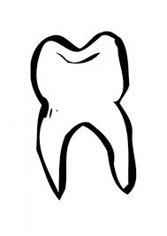
Role of the Dental Hygienist
Detailed medical history
Understanding thyroid dysfunction
Detecting thyroid abnormalities.
The thyroid is extremely sensitive to radiation, and excessive radiation exposure is a known risk factor for various thyroid conditions. Therefore, one way the dental professional can protect the thyroid gland is to use a thyroid collar while exposing Radiographs.
Consultation with the patient's primary care physician or an endocrinologist is warranted if any sign or symptom of thyroid disease is noted on examination.
Many signs and symptoms of thyroid disease are observable during examination of the oro-facial complex.

Slide 15
Palpate and examine the Thyroid Gland!

Slide 16
Which of these two diseases is associated with intolerance to heat, increased cardiac output, and epinephrine must be avoid, when this disease is not controlled?
A) Hyperthyroidism
B) Hypothyroidism

Slide 17
Thyroid disease is mostly seen on:
Men
Women
Both equally

Slide 18
Which of the following is an oral manifestation of Hyperthyroidism?
Delayed dental eruption
Burning mouth syndrome
Dysgeusia
None of the above

Slide 19
Can Hypothyroidism be asymptomatic?
True
False

Slide 20
Worked Cited
Shalu, Chandna, and Manish Bathla. "Oral manifestations of thyroid disorders and its management." Indian Journal of Endocrinology and Metabolism. 15.2 (2011): 113-116. Print.
Wynn, Richard L, Timothy F Meiller and Harold L Crossley. Drug Information Handbook for Dentistry. Hudson: Lexicomp, 2013-2014.
http://www.ncbi.nlm.nih.gov/pubmed/7532241
Hall , Sandra. "Prescribing in thyroid disease." Pharmacology. (2002): n. page. Print.

