Slide 1
How to launch a startup tech company in manhattan: A GUIDE
by Paulina Nawiesniak, Lamar Sinclair and Jennifer Travinski

Slide 2
Why it’s good to know about nyc startups
Because we’re all New Yorkers, this guide is applicable. If you get tired of working for someone else one day and decide to venture out on your own to build your own tech business in Manhattan, this guide will be instrumental for your success.
If you’re an entrepreneur, or even if you aren’t, you may be interested to learn that New York has always been an epicenter of entrepreneurial activity. What is an entrepreneur you might ask? Per the JCS Group, an entrepreneur “undertakes, manages and assumes the risk of a new enterprise”. And according to Ibrahim et al., entrepreneurial traits like risk-taking, autonomy and innovation distinguish successful entrepreneurs from the general population.
It is true, however, that most entrepreneurs DO fail. HOWEVER, if you follow this guide, your chances of launching a successful startup tech company in Manhattan will be better. There are certain factors and attributes that successful startups in Manhattan all possess, and this research guide will outline them for you.

Slide 3
What do you have to offer?
In this case, we’re talking about tech startups. But whatever the startup, it’s crucial to know what product or services you plan to offer AND if it’s something that the market needs. Per Forbes.com, the top reason startups fail is that they make a product no one wants. In the case of tech companies, Manhattan, much like Silicon Valley, will always have a need for them. Because of the internet boom as well as well city initiatives that have helped laid-off workers start businesses after the recession, technology growth has skyrocketed in Manhattan.

Slide 4
Do you need a technology background?
You might be wondering if you need to be an expert in tech to launch such a business. The answer is no. While some founders have a tech background, most actually don’t. So what DOES it take? While it’s useful to pick up some tech skills for familiarity’s sake, the more important attributes are a passion to pursue your startup and an understanding of what it takes to get the startup going.

Slide 5
Have a business plan
Now that you know your business will have a demand and you have a passion to launch your business, you’ll need a business plan. Affordable free sample business plans are available online, such as through BPlans, E-Venturing and Work.com. These companies provide planning tools, advice and assistance in sorting financial information. It’s critical in Manhattan especially to understand how and if your business model can work.

Slide 6
Networking, networking, networking
Networking events are an excellent way to meet other entrepreneurs, investors and marketing experts. Events like “Startup Weekend” in New York allow for mentors, investors, developers and marketers to come together and after 54 hours, an entrepreneur is allowed to pitch his or her idea to startup experts. Events like this will put you in touch with excellent contacts, and will also help you gauge how ready you are to begin your business: can you quit your day job and assume the risk, or do you need to do more work?

Slide 7
funding
Speaking of investors, the next important component is funding. While some founders might be fortunate enough to have savings or help from family and friends, most will need to seek funding elsewhere. The good news is that it’s much easier than in the past to raise money. Other startups provide affordable loans, as well as venture capitalists (VCs) in NYC who are interested in funding startups. The best idea is to research which VCs are geared toward tech startups in order to make your best pitch to them.
There are also traditional bank loans, which require a good business plan and credit history. There are also crowdfunding campaigns like Kickstarter that fund creative ideas.
Whatever your source of funding, most investors will want to see growth before investing, so it’s important to be able to showcase how your business has grown or will grow for them.

Slide 8
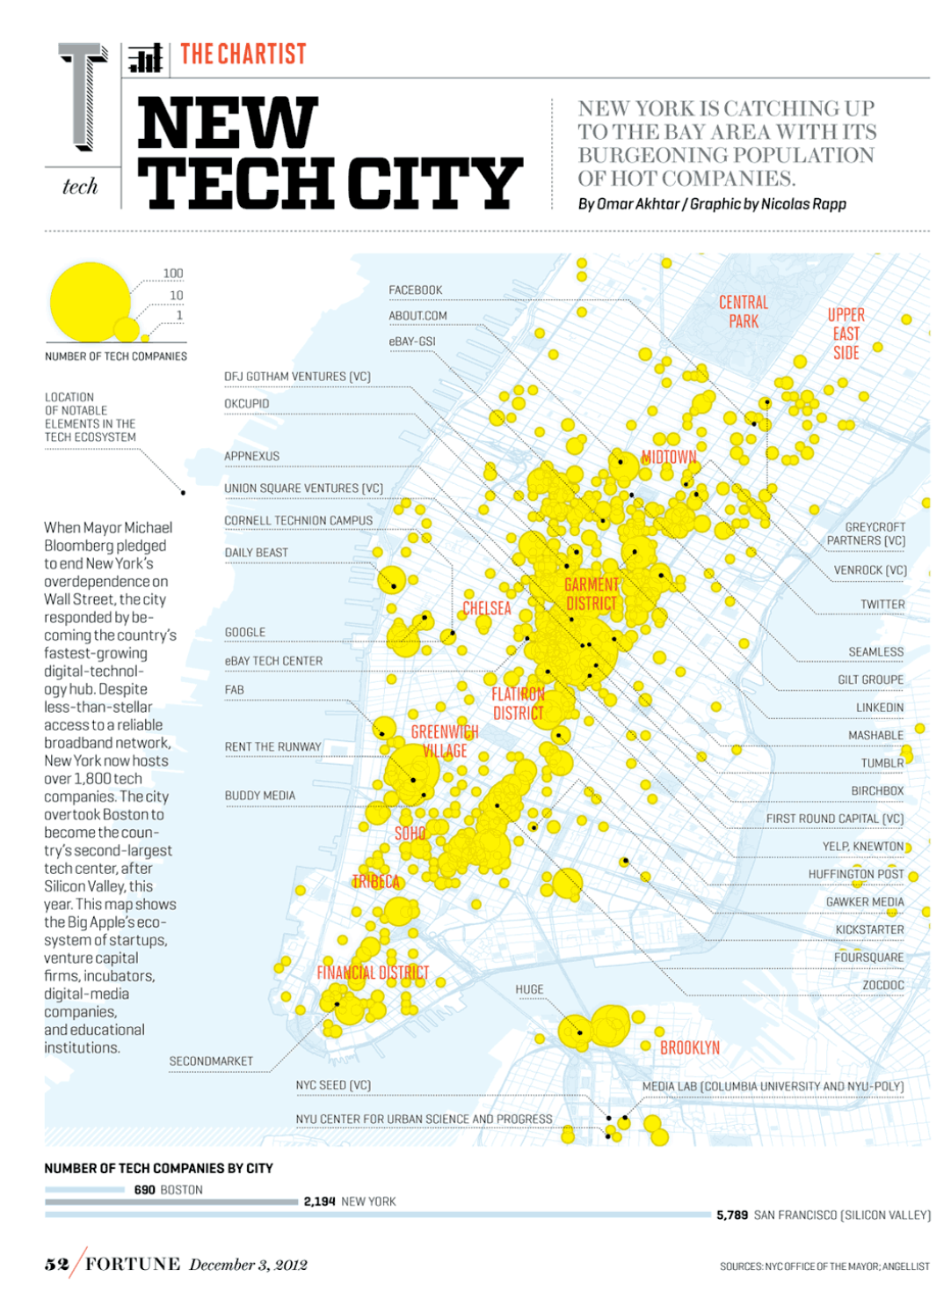

Slide 9
How to furnish your startup office
Most startups don’t have the money to buy brand new office supplies and furniture. The key is to think of what you really need to make the office run, rather than what would look the nicest.
Check into used furniture and equipment. If you want to buy new furniture, you can try to attend auctions.
It may be easier to run the business on cell phones alone. Phone systems can be expensive and as long as you use proper phone etiquette, cell phones will suffice.
Rather than buying computers and software, many startups will task their employees with using their own laptops. Otherwise basic computers will suffice.
The key is to focus on growing your business and product and not to spend money where it’s not needed while launching your startup.

Slide 10
staffing
Startups in Manhattan won’t have the time or resources to train new or inexperienced hires, especially tech startups. The key is knowing how to find, interview and hire experienced workers who are going to help your startup, rather than slowing down workflow or possibly damaging relationships with your customers.
Start with a good job description when you’re advertising, using words like tech experience, commitment, flexibility, focus, etc.
Use free sources like LinkedIn, headhunters, job search engines, networking and word of mouth.

Slide 11
What kinds of workers should you hire?
Employees are going to be costlier. W2 employees have salaried income with taxes deducted and typically receive benefits, which are expensive for a startup. 1099 contractors, on the other hand, work without tax deductions and are not afforded benefits.
If you want a permanent worker and can afford to offer benefits, hire an employee. If you want to save money and be able to hire more workers on an as-needed basis, using 1099 contractors is a more affordable way.
Also consider telecommuting. Tech workers are great candidates to work from home to optimize their productivity without the cost of making space for them in the office.

Slide 12
Where can I rent my startup space?
Much like with the office décor or equipment, the actual office space for the tech startup does not need to be brand new. In fact, a startup is going to want to rent the cheapest space possible to accomplish the work. It’s not about the space, but rather the product or service you’re providing, so it’s important to think about affordability.
The most affordable options are co-working (sharing your space) and subletting. You might also consider asking a client if they have extra space to be used.
Midtown, Midtown South and Lower Manhattan have some cheaper office spaces available if you want your own office. Try Class C buildings because they are older, have fewer amenities and will be the cheapest.

Slide 13
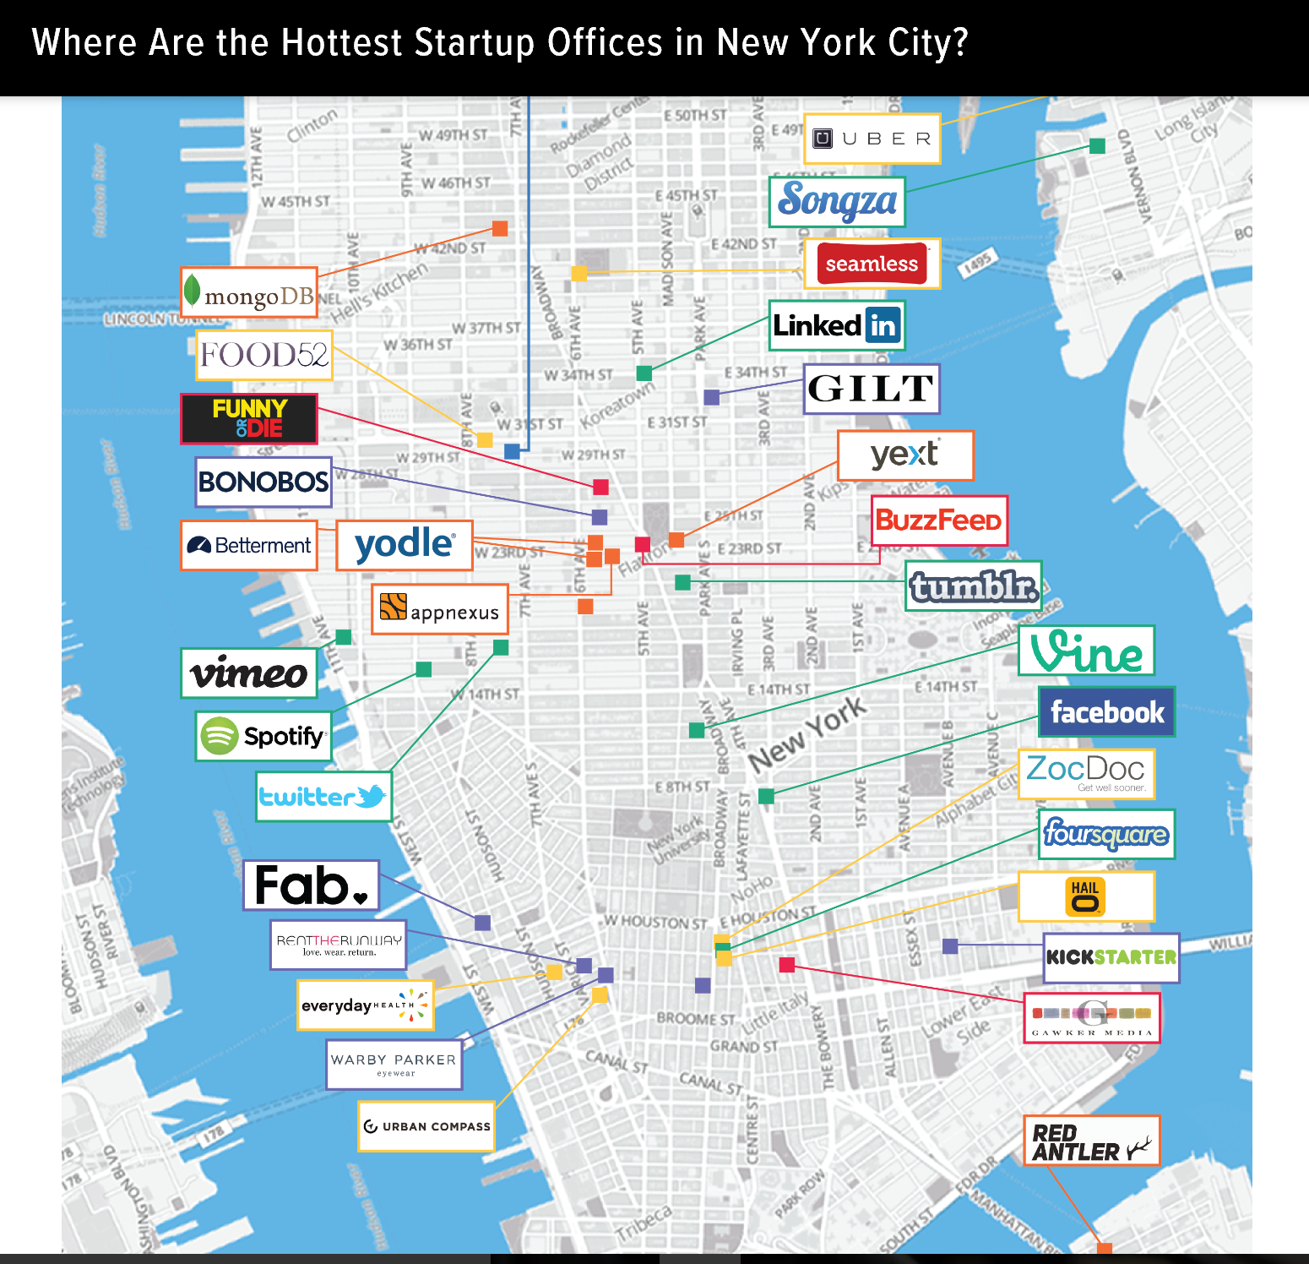

Slide 14
CONCLUSIONS
Although it can be a challenge to launch a startup tech company in Manhattan, it is possible to do so successfully if you take the proper steps to plan.
We’ve spoken about the necessity to have a strong business plan, a product or service in demand, networking contacts, funding strategies, an affordable location or alternative space sharing solution, modest furnishings and equipment, and the most effective workforce in order to launch a tech company in Manhattan.
The most important component for a successful startup, however, is the passion to create a business here in New York.

Slide 15
BIBLIOGRAPHY
Armstrong, A. “Effective Staffing Strategies for Technology Startups.” Tech.co. Published 23 Sep. 2015. https://tech.co/effective-staffing-strategies-technology-startups-2015-09
BusinessTown, LLC. “How to Furnish Your Office on a Budget.” Videos to Start and Build Your Business. Published 2017. https://businesstown.com/articles/how-to-quickly-cheaply-and-effectively-furnish-and-equip-your-office/
Gerber, S. “11 Tips for Finding Office Space on a Shoestring Budget.” AmericanExpress.com. Published 9 Jan. 2012. https://www.americanexpress.com/us/small-business/openforum/articles/11-tips-for-finding-office-space-on-a-shoestring-budget/
Gordon, J. S. “By the People, For the People.” JCS-Group.com. Published Feb. 2014. http://www.jcs-group.com/people/industrial/america.html
Ibrahim, A. B. and J. R. Goodwin. "Perceived Causes of Success in Small Business." American Journal of Small Business, vol. 11, no. 2, Fall 86, pp. 41-50. EBSCOhost, citytech.ezproxy.cuny.edu:2048/login?url=http://search.ebscohost.com/login.aspx?direct=true&db=bth&AN=5748352&site=ehost-live&scope=site.
Patel, N. “90% of Startups Fail: Here’s What You Need to Know About the 10%.” Forbes.com. Published 16 Jan. 2015. https://www.forbes.com/sites/neilpatel/2015/01/16/90-of-startups-will-fail-heres-what-you-need-to-know-about-the-10/#df3cdbc66792

Slide 16
bibliography
Plagianos, I. “Want to Launch a Tech Startup? Here’s How These NYC Entrepreneurs Did It.” DNAInfo.com. Published 16 Apr. 2015. https://www.dnainfo.com/new-york/20150416/financial-district/want-launch-tech-startup-heres-how-these-nyc-entreprenuers-did-it
Rich, L. “Why You Should Start a Company in…New York.” FastCompany.com. Published 19 Jan. 2010. https://www.fastcompany.com/1520081/why-you-should-start-company-new-york
Rosinsky, A. “Is There Any Cheap Office Space in NYC?” Metro Manhattan Office Space. Published 13 Aug. 2013. http://www.nyc-officespace-leader.com/blog/is-there-any-cheap-office-space-in-nyc
Shah, Sohin. “The Startup Scenario in New York City.” ValuationApp.info. Published 9 Dec. 2012. Photo credit. http://valuationapp.info/the-startup-scenario-in-new-york-city/
Susman, A. “Where Are the Hottest Startup Offices in New York City?” The Huffington Post. Published 30 May 2014. Photo credit. https://www.huffingtonpost.com/aron-susman/where-are-the-hottest-sta_b_5412899.html
Whitaker, B. “Small Business 101: How to Get Started.” NYTimes.com. Published 2 May 2007. http://www.nytimes.com/2007/05/02/business/smallbusiness/01websb101.html

