Slide 1
Group C Class Presentation How to Travel to Hong Kong
Group Presentation How To Travel to Hong Kong

Slide 2
Project Description
The group project is done for LIB -1201 research class, and intended to inform people how to travel to Hong Kong by air.
Our group will describe the ways for the traveler to do that not only efficiently, but also with pleasure.
The presentation will try to cover the interesting spots to attend and many useful tools to apply while traveling.

Slide 3
The Road Map & Milestones

Slide 4
How To Travel to Hong Kong
Our intended audience is the travelers, specifically travelers to Hong Kong
This Information resource would help them to learn a lot of new helpful and useful tips and enjoy the experience

Slide 5
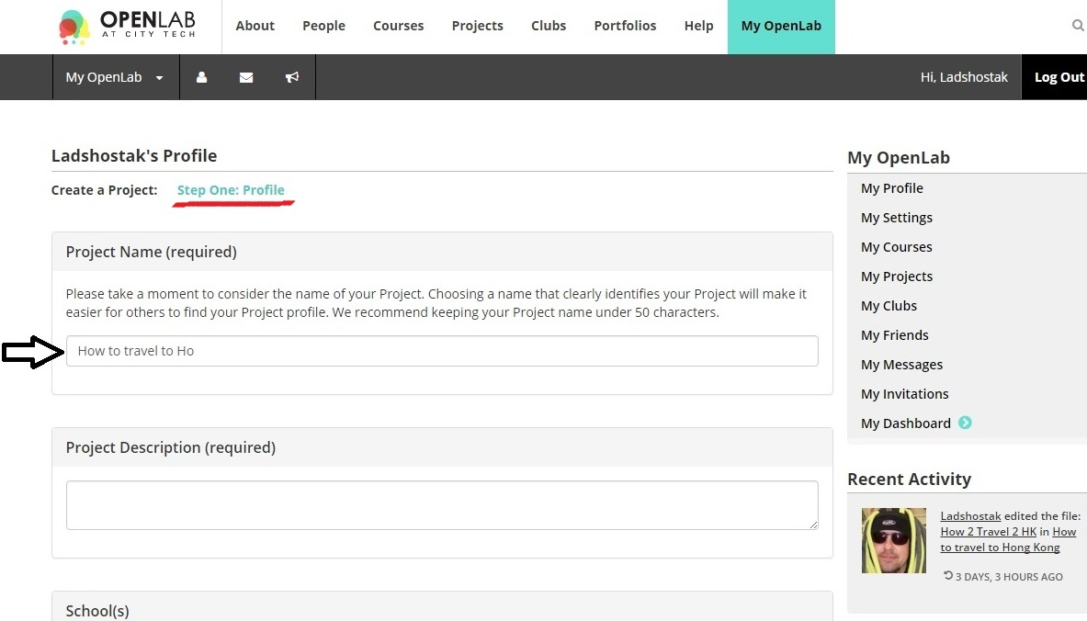
B.C.

Slide 6
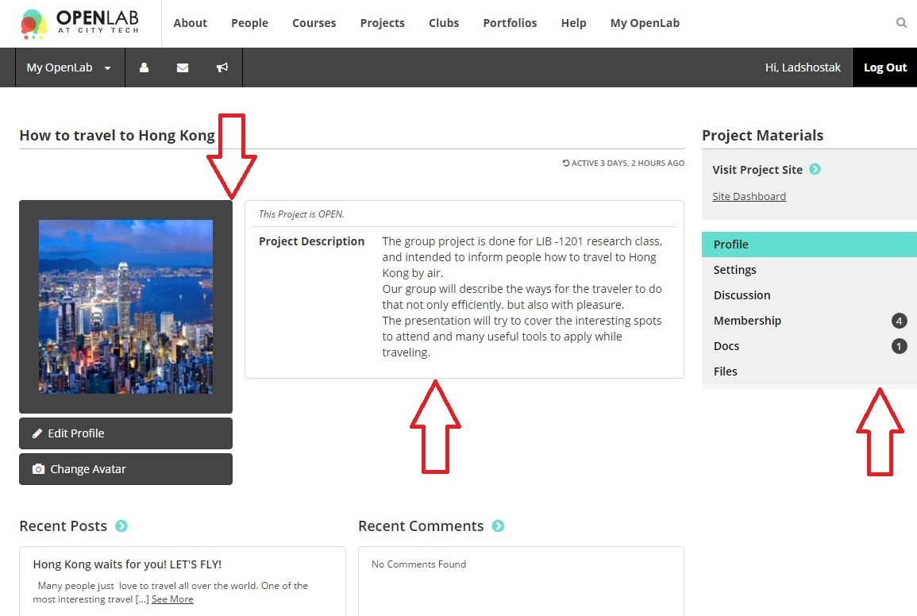
Second iteration –Project Profile Profile avatar, project description, settings, and member privileges created

Slide 7
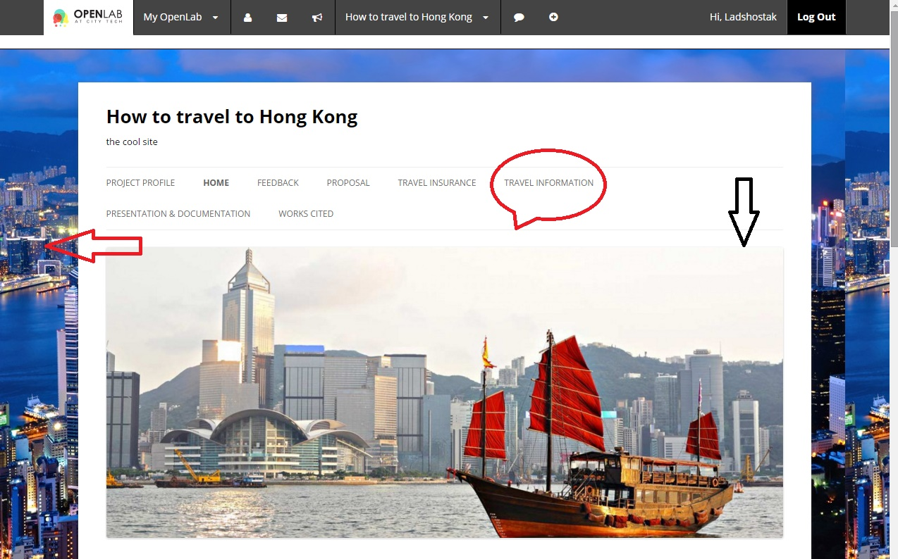
Third step background, header picture, roadmap created

Slide 8
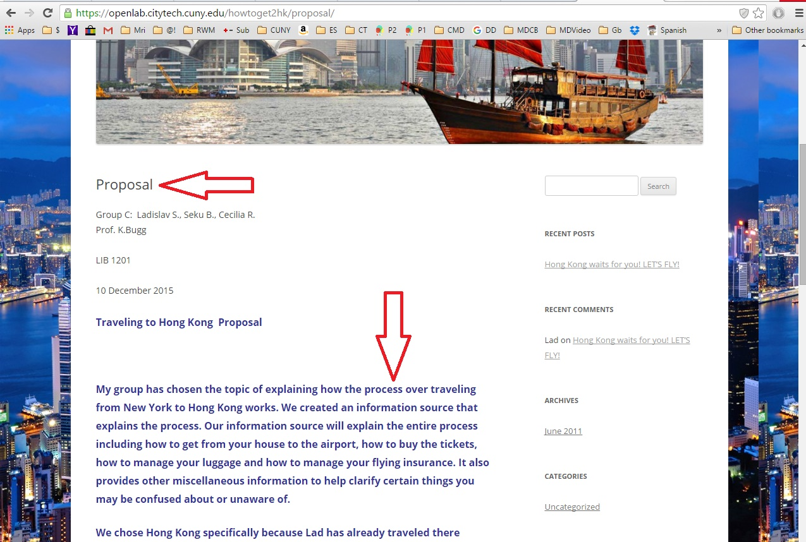
700 words proposal

Slide 9
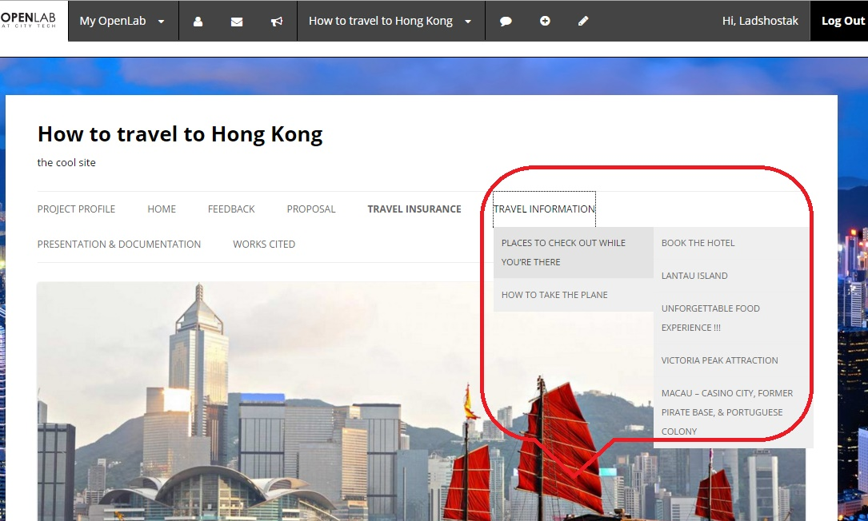
Additional pages, tabs, sub tabs, and headers
Special thanks to Sam Yannotti for helping us to manage the tab order

Slide 10
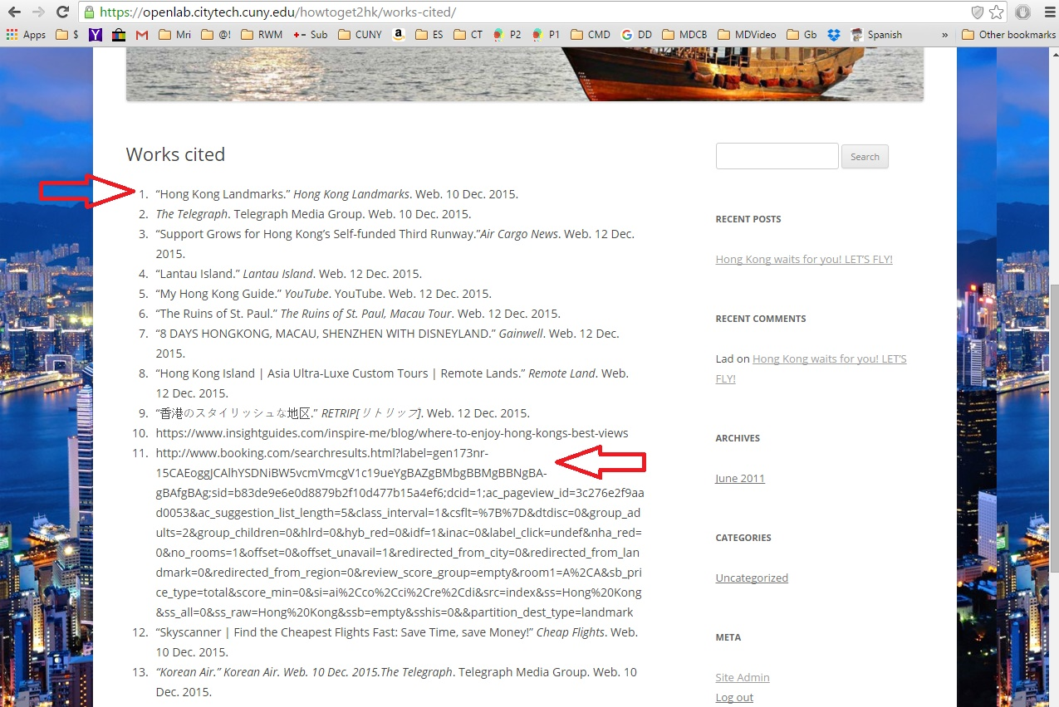
Dropped all links into specially created tab, working MLA for Works Cited

Slide 11
How our research helped us to inform the project ?
This project required a lot of information of different kind. While researching materials for the project we learned a lot of interesting facts and found useful tools.
During our investigation we read tons of social-economic, geographic, historical, technological, and other material.
We critically evaluated numerous web sources for the for this project. Then we carefully selected the relevant data for our assignment.
This project provided us with the chance to show our ability to collect and create new information on the web.
The group created an information source practically from scratch, implementing variety of documenting tools and methods learned on the go and in the class during the semester, such as a web site, blog, Power Point, etc.
We managed to find, analyze and implement the information relevant to our topic using whole types of media and formats.
We also cite the sources in accordance with copyright in MLA format.
It was a tremendous effort of collaboration while completing our challenging assignment.
Among our major challenges were scarce of the time, miscommunication, luck of hardware recourses and technological knowledge, procrastination, poor motivation, and poor sense of responsibility.

Slide 12
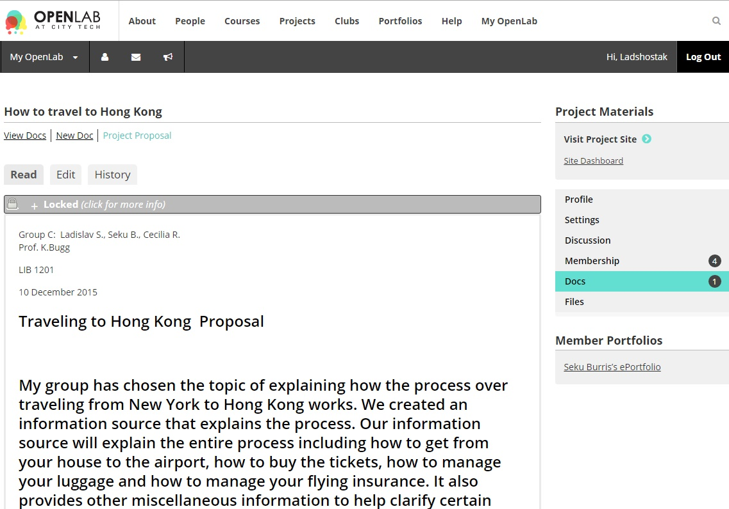
The Proposal of 700 words!

Slide 13
How the proposal was done?
The group discussed what should be put in proposal and delegated Seku to type it into the web site
While Seku was typing the proposal Lad was full feeling the other tabs of the website
After Seku created a piece of the art Lad suggested to extend the work to 700 words to comply with the project rubric.
Then we reread it and suggested some additions, so Seku edited it.
After that Lad also uploaded and saved it in the Project materials on the OpenLab under the Doc section

Slide 14
Actual text of the proposal
Traveling to Hong Kong Proposal
My group has chosen the topic of explaining how the process over traveling from New York to Hong Kong works. We created an information source that explains the process. Our information source will explain the entire process including how to get from your house to the airport, how to buy the tickets, how to manage your luggage and how to manage your flying insurance. It also provides other miscellaneous information to help clarify certain things you may be confused about or unaware of.
We chose Hong Kong specifically because Lad has already traveled there multiple times and I work in the airport. A lot of the information also came from airport employees that Seku came into contact with. I was able to ask them directly about how the process works and get concrete answers. Lad and I are the two main sources of primary information but we also used online articles that provided information about traveling via airplane in general. Websites like http://www.skyscanner.com, https://www.koreanair.com, https://www.united.com, http://www.cathaypacific.com and http://www.aircanada.com provided us with specific information regarding travel time, airport discounts and ticket information about various flights. We also used a website that provided us with information on security measures in the airport. It offered us access to several charts explaining what items were allowed and what items were prohibited from being brought on board a plane. Google images had very vibrant pictures of different areas of Hong Kong, China so we just decided to take pictures from there.

Slide 15
Proposal text continued
Our information source is very user friendly and quit easy to navigate through. Once you visit our project profile you’ll be able to read a brief description about what the site has to offer. Upon entering the site you will see that there is a home page with a picture and underneath that there is a brief introduction to the website. Above the picture you will notice a menu which consists of multiple tabs that when clicked provides information about different parts of the process. One tab provides information about travel insurance. It explains the different types of travel insurance that are available as well as the positives and negatives of them. There is another tab named “travel information” and this has a drop down list that provides important information regarding your travel experience. One of the tabs included in the drop down list is named “How to take a plane”. This tab explains step-by-step how to take travel by airplane; starting from your house and ending in Hong Kong. It also briefly talks about how the identification process works in regards to visas. Another tab that is apart of the drop down is called “Airlines to consider”.

Slide 16
Proposal text continued
This simply shows the viewer what airline options are available for them to fly with. It offers different airline options for someone that is not familiar with traveling to Hong Kong to choose from. Another tab is called “TSA and security” and this tab can save you a lot of stress and money if you read it. It offers information regarding the TSA regulation. It also provides you with a list of prohibited items so you do not end up wasting your money by having to throw certain items away. There is a tab called “things to do while you’re there” and this tab is pretty self explanatory. It provides the reader with list of exciting places that should be visited during your time in Hong Kong. In addition to all those tabs we have a “works cited” tab which is also very helpful because most of the information we have gathered is information provided directly from the sources themselves. Anyone can find out more information that we haven’t mention on our website by following the links on our works cited page. If you’re interested in how we split the work and how we managed to put this site together you can check out the “Documentation” tab. It has a list of who did what starting from day one and it also includes information about the many revisions we did for this website. Lastly we decided to include a tab called “Feedback” because we wanted to hear the readers opinions and suggestions for our site.

Slide 17
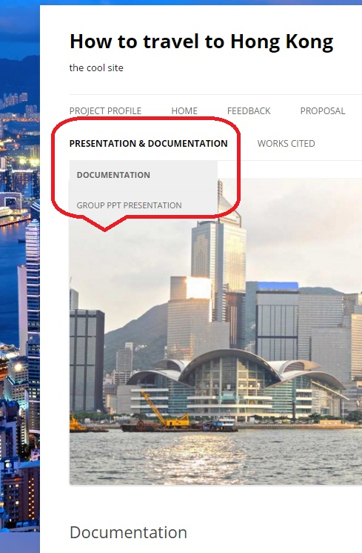
Our Documentation Page

Slide 18
Documentation Part
We replaced the topic with ‘How to Travel to Hong Kong.’ Lad designed and cropped an image of an Asian boat (junk) on water with a background of downtown central Hong Kong. The group thought is beautiful. Seku filled in tabs related to ‘How to travel to Hong Kong (airlines, luggage, and security), arranged and typed the script for the proposal of airlines that travel to Hong Kong with a synopsis of each airline. Lad suggested that we connect the list with its website respectively. When we click the link of its airline the site opens to a beautiful image with descriptive details for visitor, choice. We agreed and were pleased with the results. While documenting the events, “how to” and Seku continued typing he proposal to comply with 700 words as Lad changed the profile of our website to a more efficient and added more appealing events, useful tools to travel well on your trip.

Slide 19
Documentation continued
The group agreed that we needed more time to complete the project. Library offered a study form for the maxim of 3 hours. With only one computer in the room and a time limit it was hard to do the job. Fortunately, Lad had a laptop. Cecilia then used another lab to document of event while establishing How to Travel to Hong Kong. Seku adjusted the proposal for a more formidable format that Lad pointed out should comply with professor’s guidelines. At Seku’s computer he demonstrated what he was precisely doing in its entirety with our proposal. Lad was fulfilling all the content into the rest of the tabs, adjusting and creating extra tabs for PowerPoint and Works Cited. Seku started to transfer the URL-s into MLA format for the Works Cited, but our time was gone! Twenty to we returned the key, 3 hours quickly exhausted as we all were constantly busy.
Since the time management and location was a serious issue the group divided the job among the members and agreed to work from home. We scheduled the final meeting for the minor adjustments and rehearsal on Tuesday morning at 11-00 am. It didn’t happen due to several reasons.

Slide 20
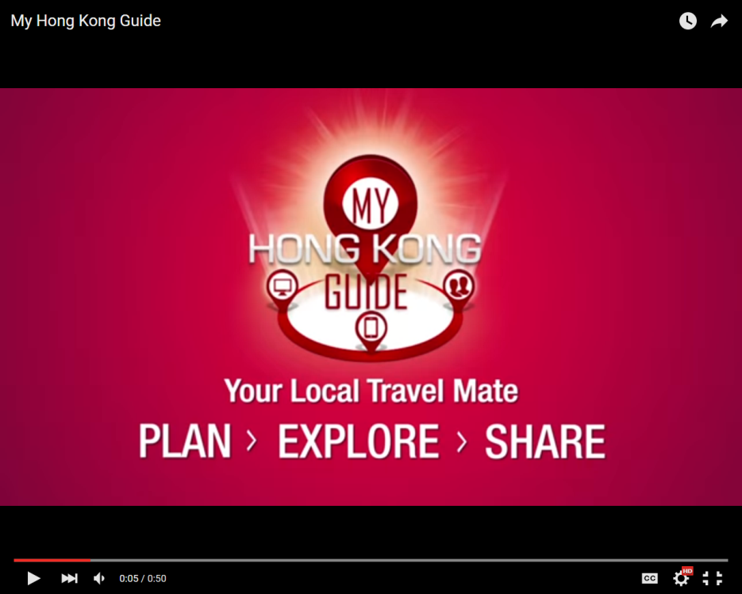
The part of the process integrating and implementing the tool
If you're planning a visit to Hong Kong, watch this video first and learn how to use My Hong Kong Guide, your virtual guidebook to the world's greatest city!
Virtual Guidebook - My Hong Kong Guide

Slide 21
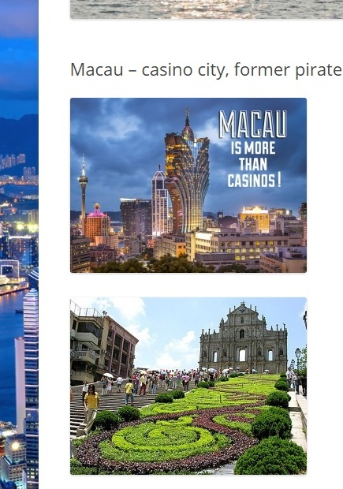
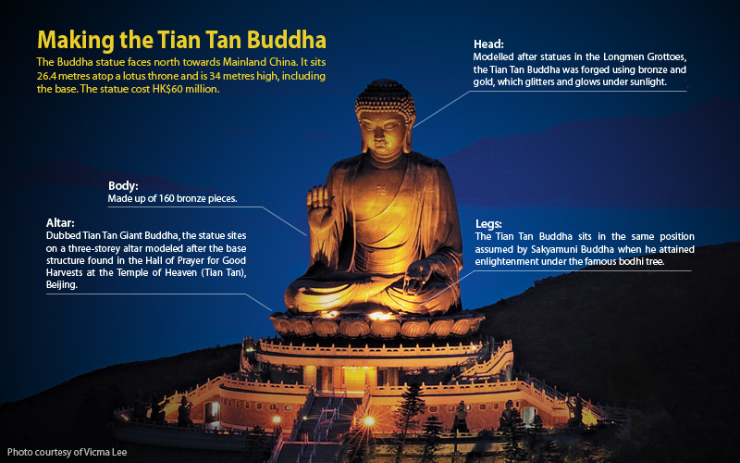
Let's go?
The Buddha statue faces north towards Mainland China. It sits 26.4 meters atop a lotus throne and is 34 meters high, including the base. The statue cost HK$60 million. which took 12 years to complete. Climb the 268 steps for a closer look at this remarkable statue

Slide 22
We were forced to cut of on the statistics and comparative analysis.

Slide 23
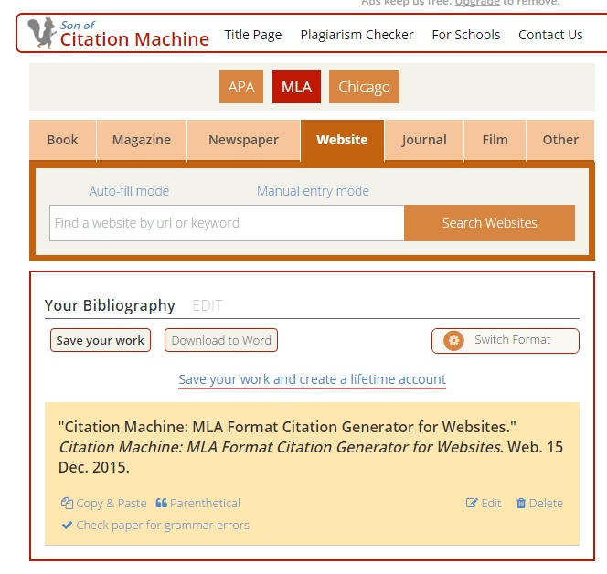
Works Cited
We found more than 15 sources. Using the MLA format Seku tried to put them together into Work Cited tab, specifically created earlier for that. The Lab time was too short and we couldn’t save the work
We faced real problems integrating correctly MLA on the web page
Finally this morning Lad put them into our web site

Slide 24
Works Cited cont’d
“8 DAYS HONGKONG, MACAU, SHENZHEN WITH DISNEYLAND.” Gainwell. Web. 12 Dec. 2015.
“Air Canada.” – Official Site. Web. 10 Dec. 2015.
“Best Five Restaurants in Soho Hong Kong.” About.com Travel. Web. 12 Dec. 2015.
“Citation Machine: MLA Format Citation Generator for Websites.” Citation Machine: MLA Format Citation Generator for Websites. Web. 15 Dec. 2015.
“Hong Kong Island | Asia Ultra-Luxe Custom Tours | Remote Lands.”Remote Land. Web. 12 Dec. 2015.
“Hong Kong Landmarks.” Hong Kong Landmarks. Web. 10 Dec. 2015.
“Korean Air.” Korean Air. Web. 10 Dec. 2015.The Telegraph. Telegraph Media Group. Web. 10 Dec. 2015.
“Lantau Island.” Lantau Island. Web. 12 Dec. 2015.
“My Hong Kong Guide.” YouTube. YouTube. Web. 12 Dec. 2015.
“Online Flight Booking | Airfare | United States – Cathay Pacific.” Cathay Pacific. Web. 10 Dec. 2015.
“SBC FinTech Hong Kong Pitch Day | Startupbootcamp.” SBC FinTech Hong Kong Pitch Day | Startupbootcamp. Web. 12 Dec. 2015.
“Skyscanner | Find the Cheapest Flights Fast: Save Time, save Money!” Cheap Flights. Web. 10 Dec. 2015.
“Support Grows for Hong Kong’s Self-funded Third Runway.”Air Cargo News. Web. 12 Dec. 2015.
“The Ruin’s of St. Paul.” The Ruin’s of St. Paul, Macau Tour. Web. 12 Dec. 2015.
The Telegraph. Telegraph Media Group. Web. 10 Dec. 2015.
“香港のスタイリッシュな地区.” RETRIP[リトリップ]. Web. 12 Dec. 2015

Slide 25
The End

