Slide 1
Servicescapes and Sensory Marketing Managing the Firm’s Physical Evidence
HMGT 4702 Hospitality Service Marketing Management | Ellen Kim

Slide 2
Learning Goals
Appreciate the strategic role of physical evidence as it relates to the marketing of service firms.
Understand the role of the stimulus-response model in forming service evaluations.
Discuss the major components of the servicescapes model.
Describe the managerial use of sensory cues when developing tactical design strategies.

Slide 3
"I recently went to a new doctor and noticed he was located in something called the Professional Building. I felt better right away."
George Carlin, Comedian

Slide 4
Physical Evidence of Service firms
Physical evidence is composed of three categories:
Facility exterior
Facility interior
Other tangibles
The extensive use of physical evidence
varies by the type of service firm.
https://www.youtube.com/watch?v=Om2FMpJVqOY

Slide 5
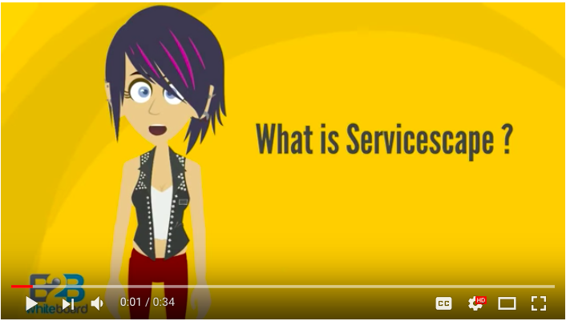
Servicescape
The use of physical evidence to design service environments.
The style and appearance of the physical surroundings and other experiential elements encountered by customers at service delivery sites.
Source:
https://www.youtube.com/watch?v=7ZKlibN-KKU

Slide 6
The Servicescape Model by Booms & Bitner

Slide 7
Managing the Senses When Creating Servicescapes
Sight appeals: location, size, shape, colors, location, architecture, signage, entrance, lighting
Sound appeals: music, announcements, sound avoidance
Scent appeals
Touch appeals
Taste appeals

Slide 8
Sight Appeals: Location
When evaluating locations for the firm, three questions need to be addressed:
How visible is the firm?
How compatible is the firm with its surrounding environment?
How convenient is the location to target customers?

Slide 9
Sight Appeals: Entrance
The firm’s entrance and foyer areas can dramatically influence customer perceptions about the firm’s activities.
Tactical considerations include lighting, safety, and functionality.

Slide 10
Sight Appeals: Signage
The firm’s sign has two major purposes:
To identify the firm
To attract attention

Slide 11
Sight Appeals: Lighting
Low light indicates formality and slower pace.
An environment with bright light is perceived as informal, exciting, and cheerful.

Slide 12
Sound Appeals
Sound appeals have three major roles:
Mood setter
Attention grabber
Informer
Proactive methods for purposely inserting sound into the service encounter can be accomplished through the strategic use of music and announcements
Sound can also be a distraction to the consumer’s experience
Consequently, sound avoidance tactics should also be considered

Slide 13
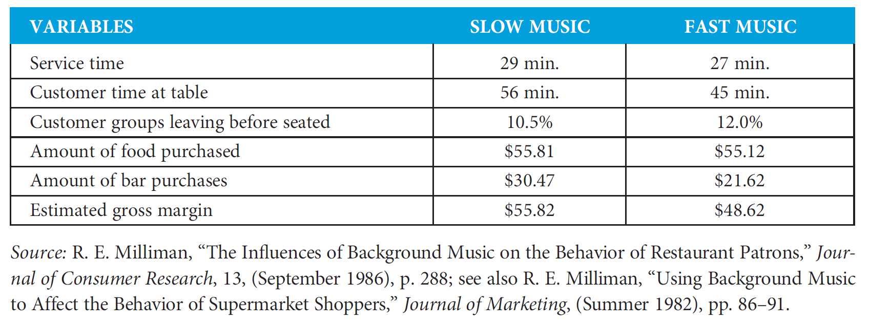
The Impact of Background Music on Restaurant Patrons

Slide 14
Scent Appeals
Stale, musty, foul odors affect everyone and are sure to creative negative impressions
Pleasurable scents often induce customers to make purchases and can affect the perception of products that do not naturally have their own scent

Slide 15
Touch Appeals
Liberal return policies
“Open houses”
Shaking hands with customers
Engaging in face-to-face communications with customers

Slide 16
Taste Appeals
Taste appeals are the equivalent of providing the customer with samples of the service.

Slide 17
Sensory importance
Our senses work in combination. The higher the number of sensory memories activated, the stronger the bounding between brand and consumer.

Slide 18
Managing the Senses When Creating Servicescapes
Who is the firm’s target market?
What does the target market seek from the service experience?
What atmospheric elements can reinforce the beliefs and emotional reactions that buyers seek?
How do these same atmospheric elements affect employee satisfaction and the firm’s operations?
Does the suggested atmosphere development plan compete effectively with competitors’ atmospheres?

