Slide 1
The Experience Economy
HMGT 4702
Hospitality Services Marketing

Slide 2
Learning Goals
Explain the unique nature of services.
Distinguish experiences from goods and services.
Explain the progression of economic value from commodities to experience.
Understand the theatrical metaphor model and discuss the roles of service staff in the experience economy.

Slide 3
Nature of Services
Intangibility
Inseparability
Variability
Perishability

Slide 4
The Progression of Economic Value
EXPERIENCES!
Services
Goods
Differentiation
Relevancy to customer needs
Commodities
Pricing

Slide 5
Progression of Economic Value
Economic offering | Commodities | Goods | Services | Experiences
Economy | Agrarian | Industrial | Service | Experience
Economic function | Extract | Make | Deliver | Stage
Nature of offering | Fungible | Tangible | Intangible | Memorable
Key attribute | Natural | Standardized | Customized | Personal
Method of supply | Stored in bulk | Inventoried after production | Delivered on demand | Revealed over a duration
Seller | Trader | Manufacturer | Provider | Stage (cast)
Buyer | Consumer | Consumer | Consumer | Guest
Factors of demand | Characteristics | Features | Benefits | Sensations

Slide 6
Experiences ≠ Services
The Experience Economy:
An experience occurs when a company intentionally uses services as the stage and goods as props to engage individual customers in a way that creates a memorable event.

Slide 7
Theatrical Metaphor
Role theory: a set of learned behavior patterns used in certain social interactions (customers and employees).
Script theory: a service script specifies behavioral sequences of employees and customers during a service encounter.
Service facilities
Stage on which drama unfolds
This may change from one act to another
Personnel
Front stage personnel are like members of a cast
Backstage personnel are support production team
Roles
Like actors, employees have roles to play and behave in specific ways
Scripts
Specifies the sequences of behavior for customers and employees

Slide 8
Walt Disney Imagineering
Notes:
https://www.youtube.com/watch?v=lX78z9bLaQk

Slide 9
Branding through Immersive Storytelling and Experiences
Notes:
https://stories.starbucks.com/stories/2016/who-is-starbucks-siren

Slide 10
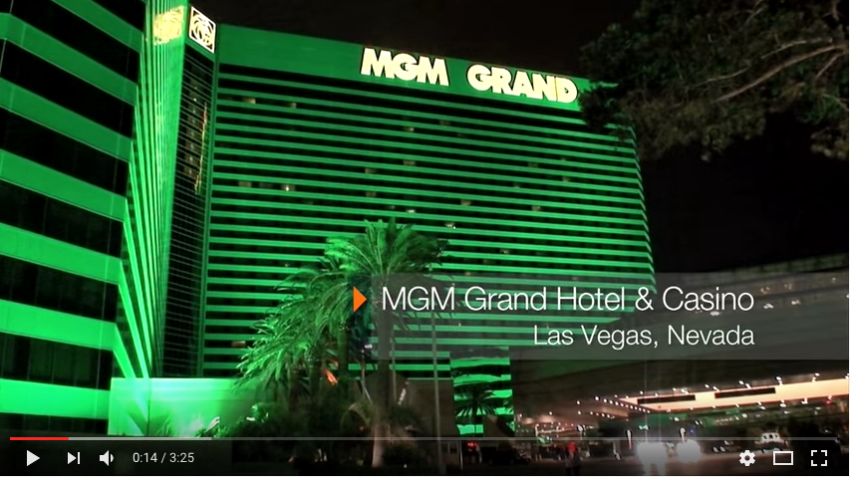
Notes:
http://vimeopro.com/fakedigitalentertainment/advertising/video/53447697
https://www.youtube.com/watch?v=vrM-53ZHc28

Slide 11
Chipotle – Back to the Start
Notes:
https://www.paceco.com/insights/strategy/chipotle-brand-storyteller/

