Slide 1
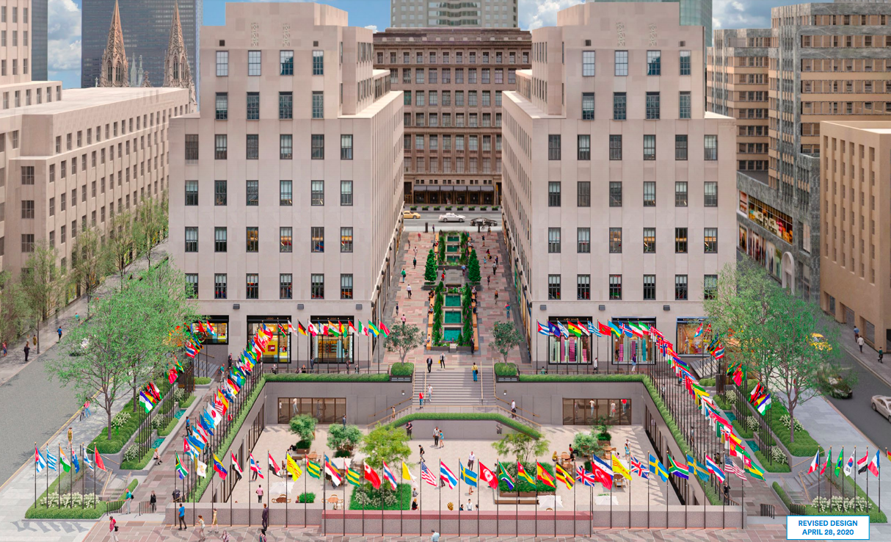
Rockefeller Center
Milly escobar
Professor Karen goodlad
(photo creds: 6sqft)

Slide 2
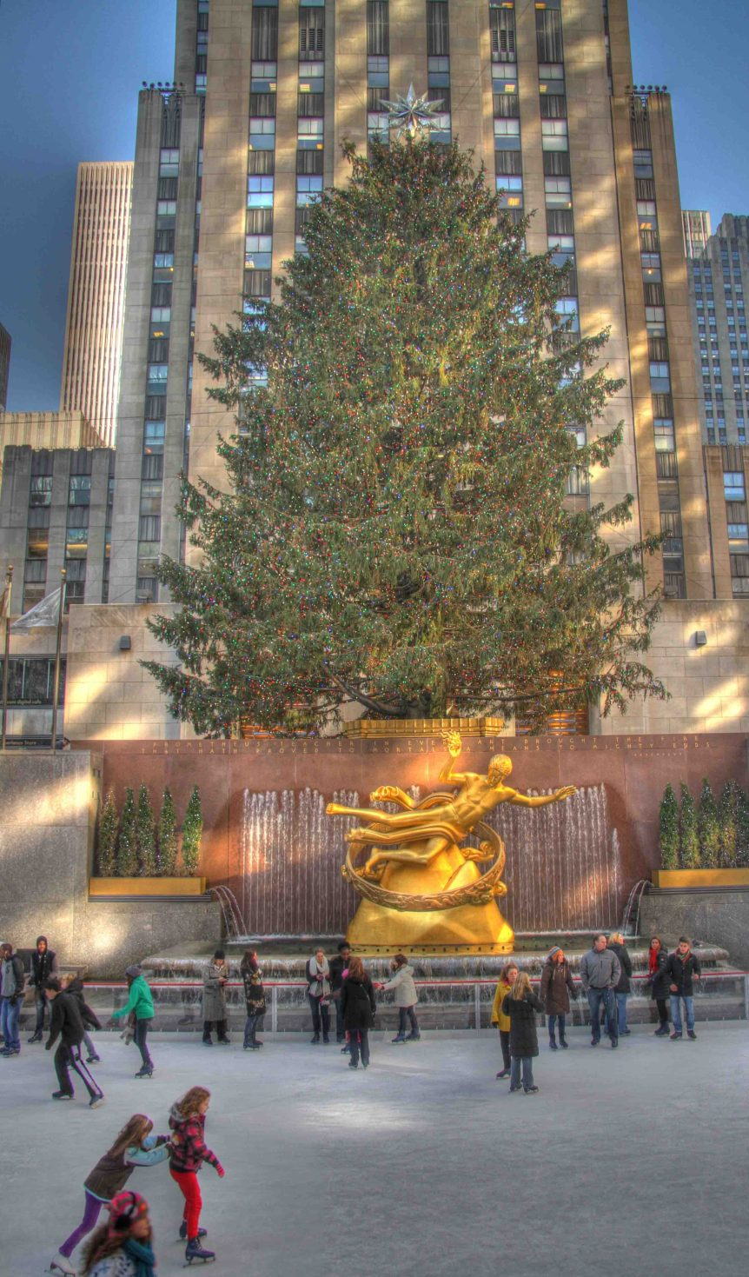
WHAT IS ROCKEFELLER CENTER
Rockefeller center is place in new York city that attracts many tourist all year long. Although everyone loves to see it as the seasons go by, it is most populated in the winter time. In this place, New York city has a tradition of putting up a Christmas tree from 60-100ft tall every single year. Many people travel from all over the country in order to get the in person experience of seeing the tree and experiencing winter in the big apple.
(Photo credit: Sallans Corner)

Slide 3
History of Rockefeller center
Rockefeller center used to be part of Columbia university but it was then sold in order to create something new to the city. During this time people were suffering from the great depression so when this happened workers from the area chipped in for a tree, this true was nothing big but it meant a lot to them and symbolized hope during this hard time. They had never planned that this became a tradition for nyc but as time went by everyone just kept following it and it had received love from all around the world. This was the history behind Rockefeller center this tradition lives on forever!

Slide 4
Special features of rockefeller center
Rockefeller center is known for the Christmas tree which ranges from 60-100 ft high but there is also an ice rink where people can enjoy the view and have fun at the same time. This is usually one of the most popular places where many couples get engaged in.
Besides the main attractions, Rockefeller center has much more to offer. Rockefeller center Is also popular for the stores it has in town, many include the nitendo store, the f.a.o store, the lego store, kate spade and plenty of others.
lAST BUT NOT LEAST, IT HAS PLENTY OF RESTAURANTS WHERE GUEST CAN DINE IN FOR BRUNCH OR DINNER. there ARE ALSO PLENTY OF BAKERIES IN THE AREA FOR GUEST TO TRY.

Slide 5
Transportation, cost, accessibility and food options
Rockefeller is one of busiest attractions during the winter time so it is nice to plan ahead for those who would be traveling a long way.
Rockefeller is located in Manhattan ny, only a 15 minute walk from central park so it would be nice to take advantage of public transportation unless you would want to be overcharged and stuck in traffic in order to get to your destination
Rockefeller center is open to the public and is visible for everyone to see from different angles, the only thing you pay for is ice skating and for your own shopping necessities.
Rockefeller center is a easy way to get around and there are a lot of ramps available for those who are handicapped.

Slide 6
tHE CATEGORY OF TOURISM A VISITOR MAY ENGAGE IN
A category of tourism a visitor may engage in is CULTURAL TOURISM. They would engage in cultural tourism because there are lots of art in this place, from statues to decorations to things people sell on the side of the street. Not only that but since Rockefeller center is so known it usually attracts a bunch of people from all over the place which makes it a diverse community.
Another category would be Natural tourism because Rockefeller center is open the public and allows everyone to experience the skyline, there are a bunch of buildings which have been standing there for a long time.

Slide 7
What a visitor should consider
A visitor consider the fact that it is located in Manhattan near 5th ave and 15 minutes from central park, it would be good for them to consider this in order to know what the environment may be like ahead of time
The visitor should also be aware of how packed it gets during the month of December, there are usually a bunch of people visiting this exact spot so it would be useful to plan a time where it may not be as packed
Last but not least they should consider planning a good amount of time to explore everything as a whole, from the tree up until all the shopping stores.

Slide 8
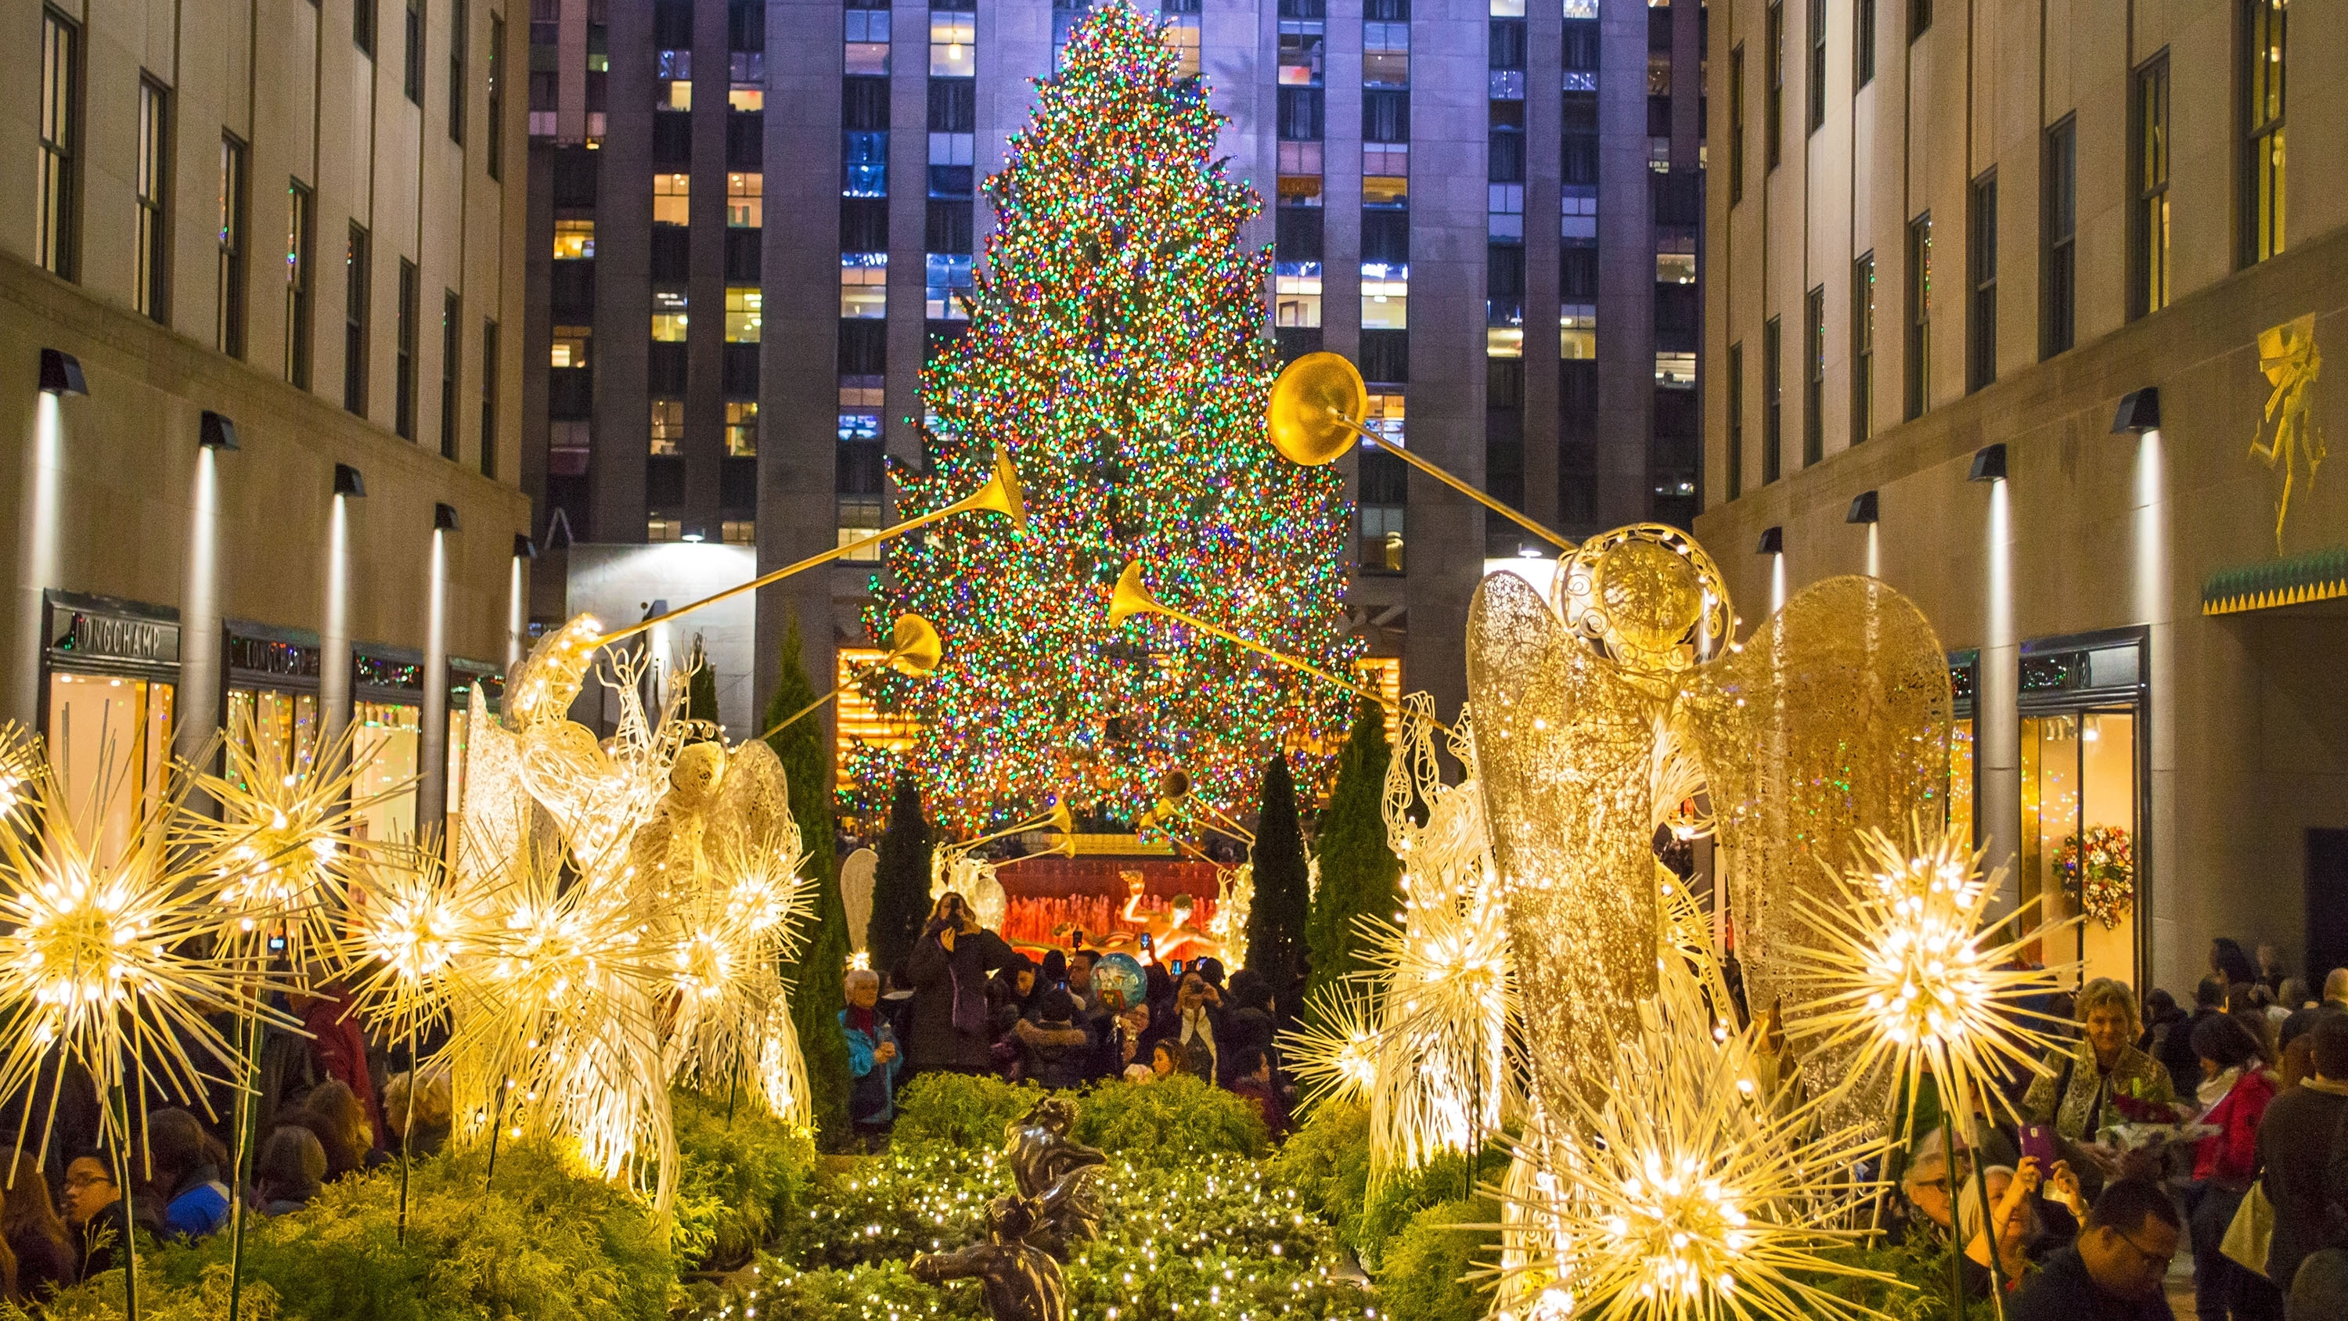
In conclusion, ROCKEFELLER CENTER IS ONE OF THE MOST KNOWN TOURIST ATTRACTIONS IN NEW YORK CITY. tHIS PLACE HAS BEEN HERE FOR MANY YEARS BUT IT HAS IMPACTED THE NEW TORK EXPERIENCE FOR THE LIVES OF MANY AND HAS CAUSED A RISE IN THE TOURIST INDUSTRY. There are plenty of opportunities to take part in while visiting, you can go watch the rockettes, take a stroll in the stores or take a stolll on the ice rink. There are plenty of things to do in town and its always amazing to create memories with love ones. This is the place to come with family because it allows everyone to enjoy this life changing opportunities.
(phot creds: nysightseeing)

