Slide 1
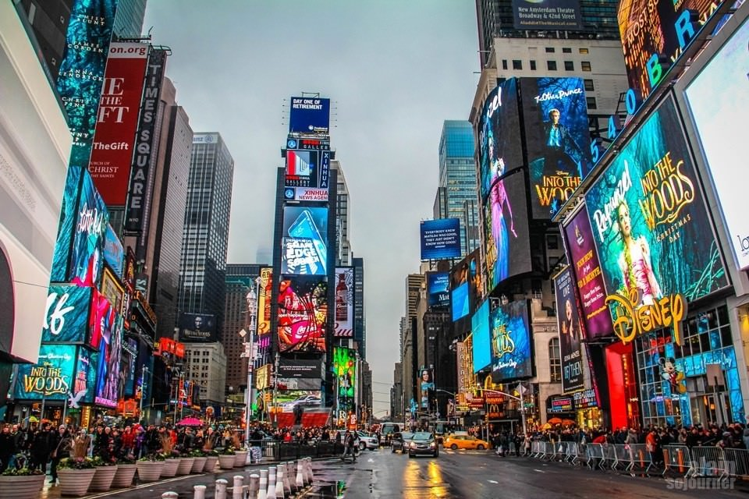
Time Square
By: Jadira Bermudez

Slide 2
Category of tourism
I believe that Time Square is mostly in the category of domestic tourism and maybe even outbound tourism
Outbound tourism refers to a tourist traveling from the country of their origin to another country
Domestic tourism refers some traveling and being tourist in their own country
Time Square can be classified as a recreational and cultural tourism attraction

Slide 3
History on Time Square
Before the 20th century, Time Square was named Longarce Square, which was a reference to the square’s blooming carriage industry
In 1904, the square was renamed as The New York Times moved into the new Times building, which is known as One Time Square. The building is also known for the annual New Year’s Eve ball drop
Not long after The New York Times moved to Time Square where the first electrified advertisement popped up in the square

Slide 4
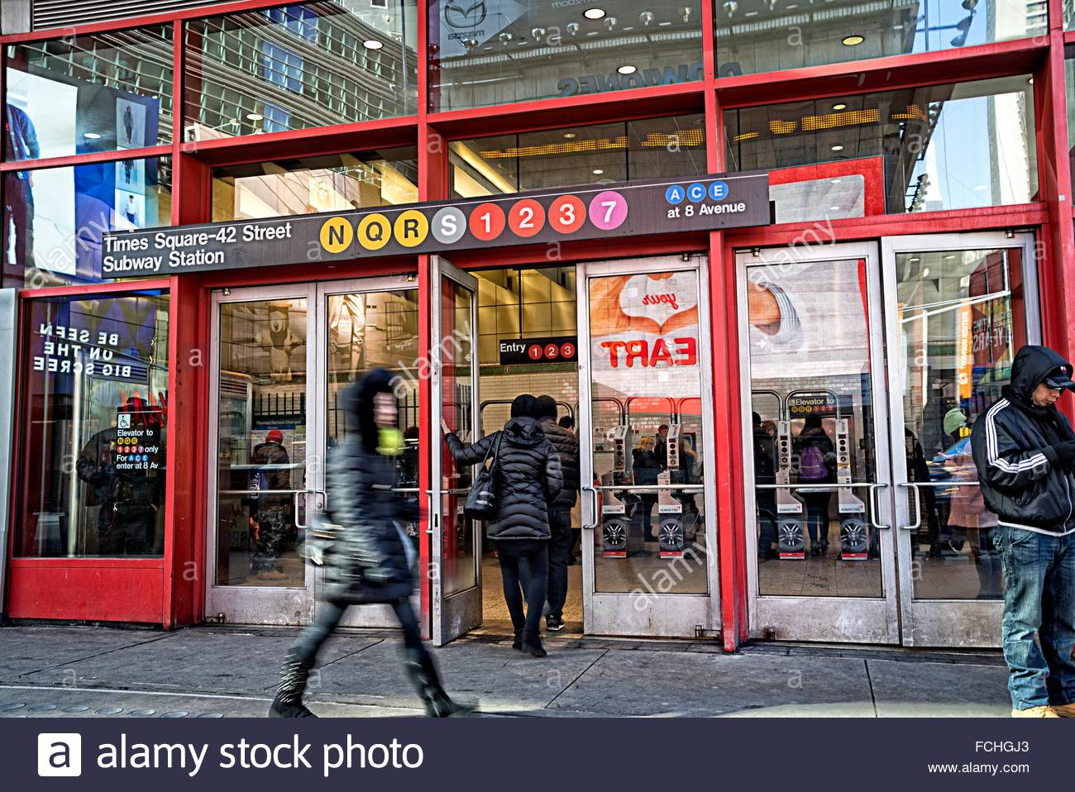
Transportation
One thing about leaving in New York you can always find a way to get around and it doesn’t have to by car. It ease to come and leave from Times Squares massive subway where almost every train you’ll need to get home or to get there is there and at easy access.

Slide 5
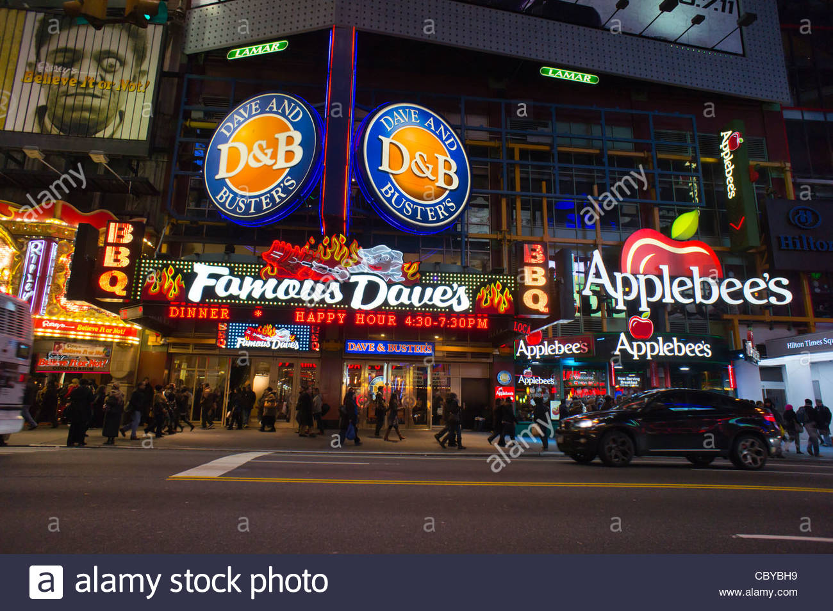
Food
When it comes to finding the nice place to have a proper meal whether its lunch or dinner, Time Square has plenty to offer. There are some famous restaurants in the square that are perfect for a night out on the town. The only thing to keep in mind is the when it come to pricing it may be on the expensive side.

Slide 6
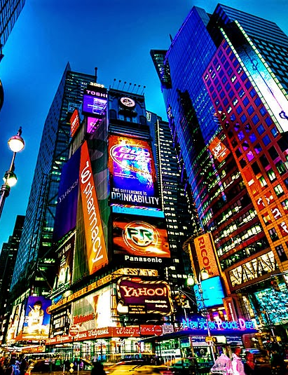
Special Features
A great feature that come with time square is all the shopping places. All around Time Square you'll find flagship stores and amazing shops for gift shopping whether its cloths, sweets, or movie related.
One of the biggest attractions in Time square are the course of musicals. Broadway has been a great way to bring people to time square with the amazing theaters and lights promoting the open coming shows and the shows that are showing currently
Lastly the night life, being in Time Square at night can be one of the most beautiful things you can ever see. With all the light and advisements if you are a visitor you will be in awe.

Slide 7
What to consider?
When travel by car it is very hard to find parking and if you go through a parking company it is extremely expensive and not for a long amount of time
When traveling my train at rush hour it is extremely crowded and hot so you want to leave at a good time, so you can get a seat after a long day especially if you have younger kids with you
Things are extremely overpriced so if you are going to Time Square to shop or by treats make sure you have a good amount of money in your possession

Slide 8
Reference list
Habitat, New York. “Explore Times Square in New York City!” New York Habitat, www.nyhabitat.com/blog/2013/01/14/visit-times-square-new-york/.
“Tourism - Definition, Types & Forms, History & Importance.” Tourism Notes, 9 Aug. 2020, tourismnotes.com/travel-tourism/.

