Slide 1
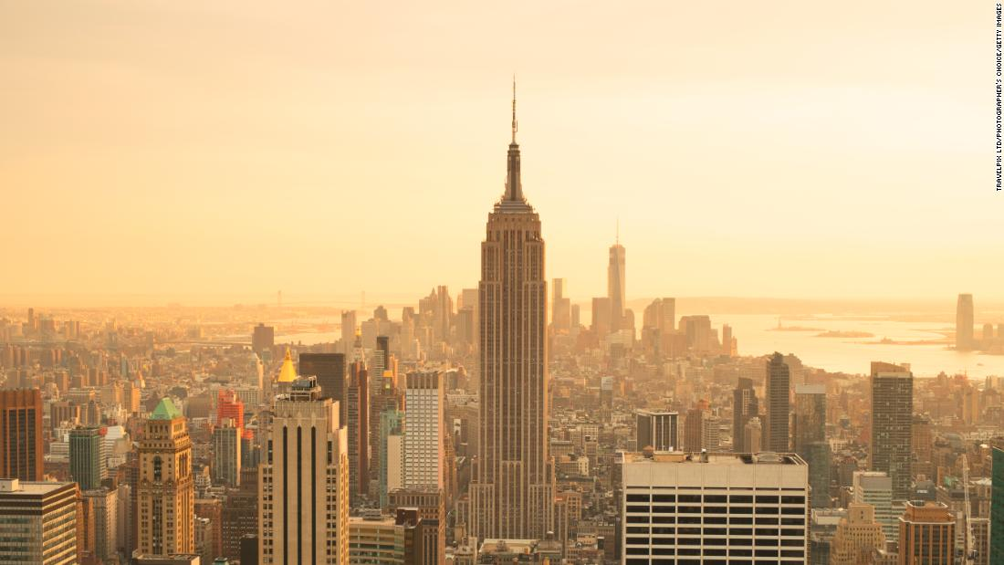
Empire State Building
Professor: Karen goodlad
Course: HMGT 1101
student: cristina simeon

Slide 2
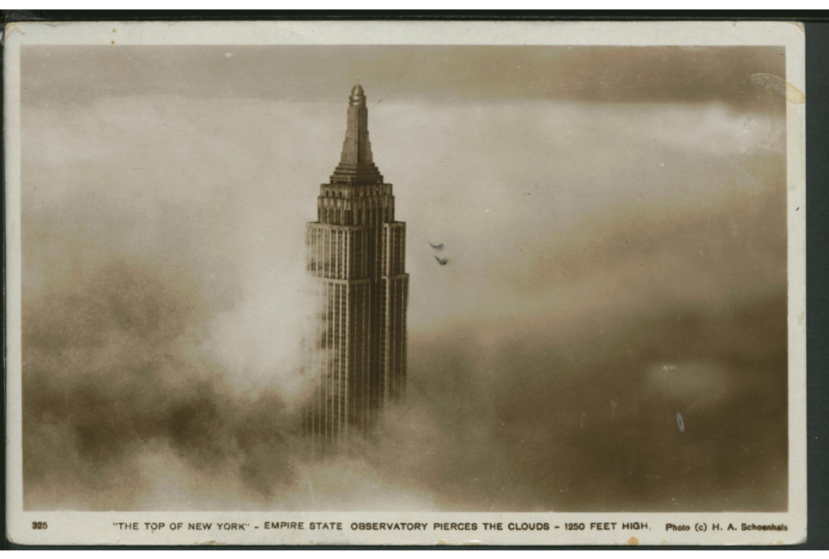
History of Empire State
The Empire State Building is a building in New York City that in the past was one of the tallest skyscrapers, but is now recognized for its structure, design and historical value (Art Deco). Construction of the Empire State Building began in 1930, and completed in 1931, around one year (410 days), about four floors per week. It was a race to build the tallest and most modern building.
The architects: Lamb & Harmon.
This building was previously the Waldford Astoria Hotel.

Slide 3
Waldorf Astoria Hotel
The Waldford Astoria Hotel was located on the same land as the Empire State Building (1897-1929), previously it was a farm of the Astor family, many years later it was demolished and the Empire State Inc. company built, the Empire State Building. The hotel moved to 50th Street and Park Avenue.

Slide 4
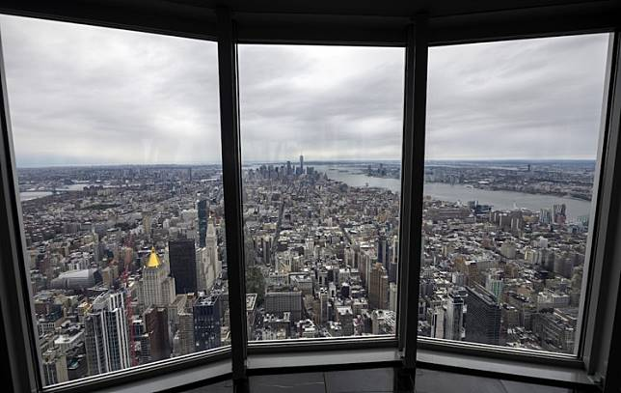
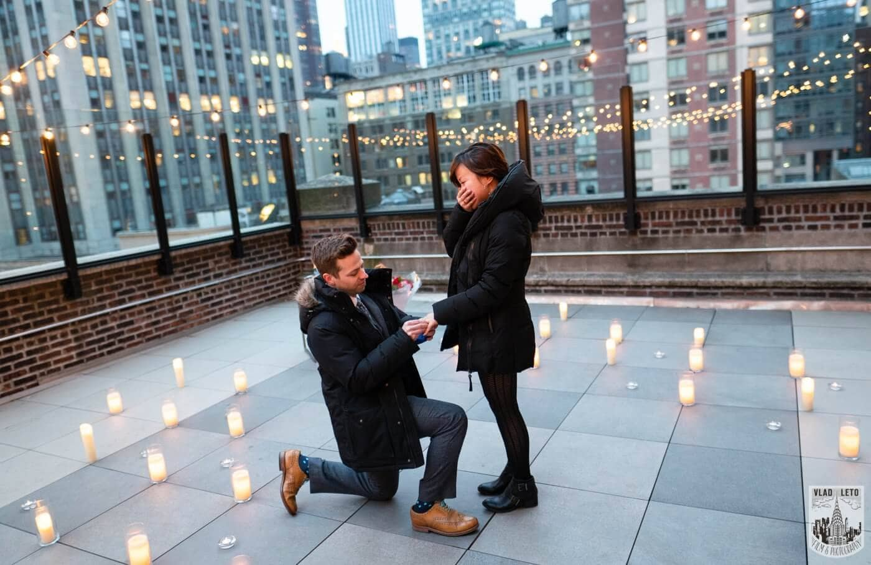
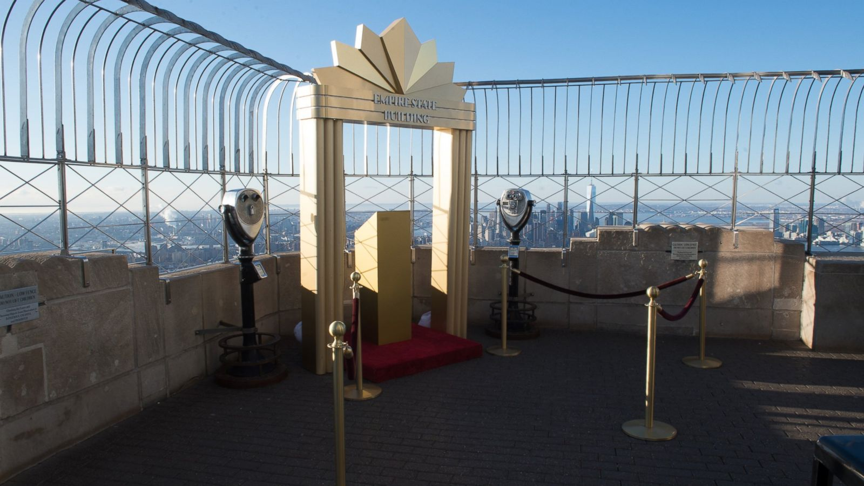
The category of tourism a visitor may engage
The Empire State Building is a reference point for visitors from the world, in addition to the beauty of the design and the structure of the building, it is a symbol with great historical value and also an icon for New York City.
Empire State Building is characterized by the light show. The best time to enjoy this moment is at night because there are not many people, and it is ideal for couples. Also, that many celebrities have visited this building.
The Empire State Building it is known from the movie King Kong, it was the highest until 1970, it has an airship docking station (although no ship unloaded there), and it is also a romantic place to propose.

Slide 5
Empire State Building Features
The visitor must consider that the entrance to the Empire State Building must be paid in advance, to avoid queues the visitor can buy a special pass for access to the observatory on the 86th and 102nd floor.
The building is known for the main deck observatory on the 102nd and 86th floor, prices vary for adults ($ 72), child (66), and senior ($70).
Inside the building the visitors will find some coffee shops such as Starbucks, as well as restaurants located on the ground level of the building, before going up.

Slide 6
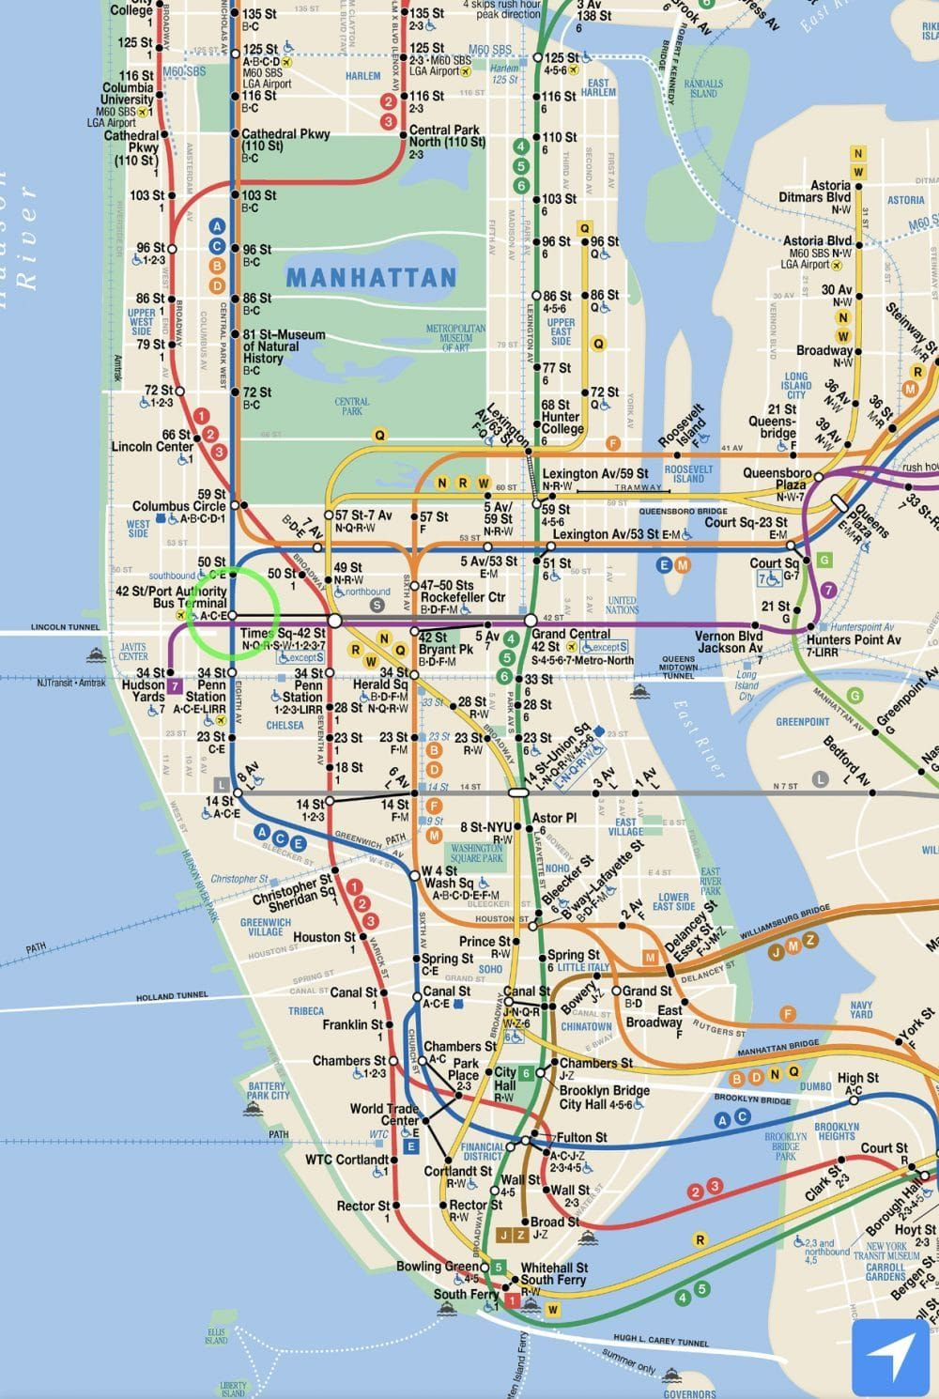
Location- Subways
Located on 34th street Fifth Avenue.
For lines 1, 2, 3 or A, C, E, take the 34nd Street- Penn Station exit.
For the N, Q, R, W or B, D, F, M lines, take the exit at 34th Street-Herald Square Station. From the station it is a five minute walk.
For lines 4, 5, 6 or 7, take the Grand Central Terminal exit. From the station it is a 10 minute walk.
The tourist could save money by buying the metrocard that is cheaper than going to a car rental agency. If the visitor stayed for a week, the visitor could get the metrocard for week, which means tourist can take unlimited trains for a week.

Slide 7
Conclusion
Empire State Building is one of the most visited and recognized skyscrapers in the world.
The prominence of the Empire State Building in the world is due to the beautiful design and architecture that makes it a cultural and symbolic attraction.
The building is located on the world famous Fifth Avenue, where fashionable brand clothing is displayed in stores.

Slide 8
References
Urban Archive. (n.d.). Empire State Building. Retrieved November 16, 2020, from
https://www.urbanarchive.org/sites/v99f8jzGwJ7/bNGXbrTGWqa
Destination: romance. (2005, January). Travel Trade Gazette UK & Ireland. 10-11. Retrieved November 16, 2020, from http://search.ebscohost.com.citytech.ezproxy.cuny.edu/login.aspx?direct=true&db=hjh&AN=15898975&site=ehost-live&scope=site
Empire State Building Lights Tower to Celebrate EMS Week 2020. (2020, May18). Retrieved November 16, 2020, from https://www1.nyc.gov/site/fdny/news/fa3320/empire-state-building-lights-tower-celebrate-ems-week-2020#/0

