Slide 1
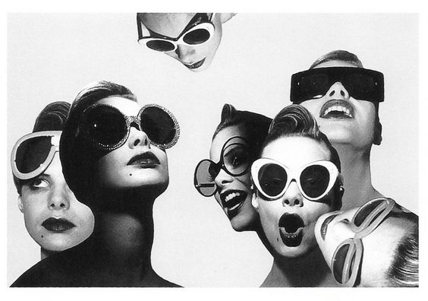
TREND FORECASTING -SUNGLASSES-
BUF 3100
Haluhi Kato

Slide 2
TABLE OF CONTENS
1. Consumer Profile
11. History
111. Trend Forecast of 2020

Slide 3
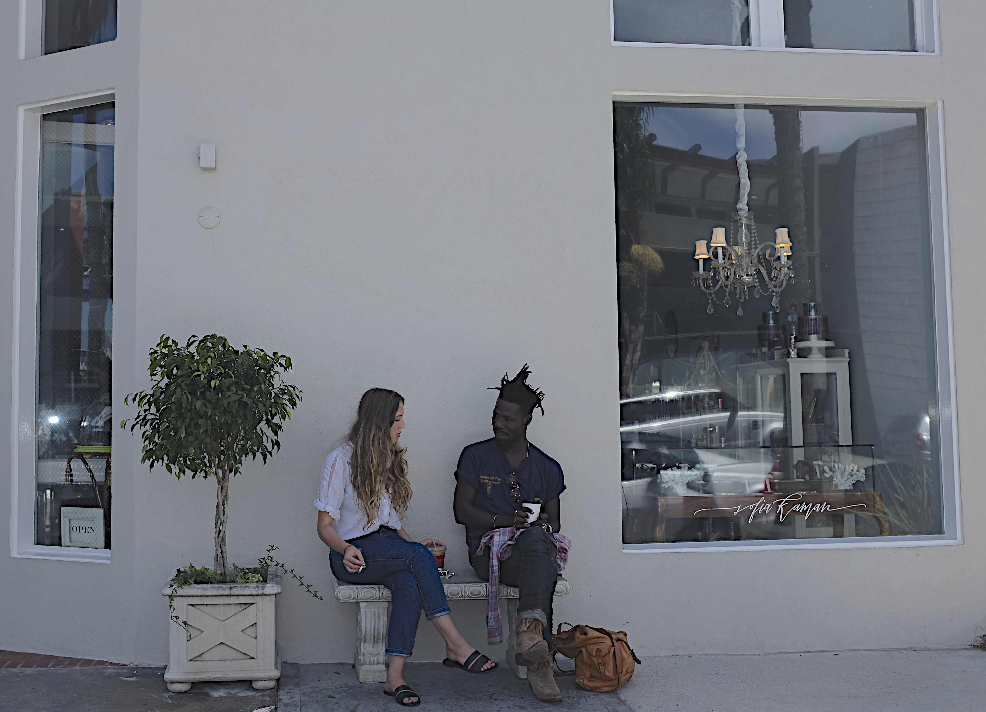
Consumer Profile
Demographic / Psychographic
Residence in beach city of Los Angeles
20 s-30s ( Generation Z / Millennials )
With bachelor degree
Average household income : $67,647 / $2500 per month for 1 BR apartment
Newly married or singles
Surfing, Yoga, Pilates “Health and Eco-Friendly” Life Style
Participate social events

Slide 4
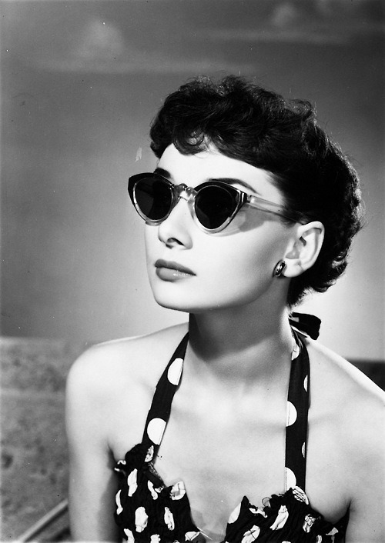
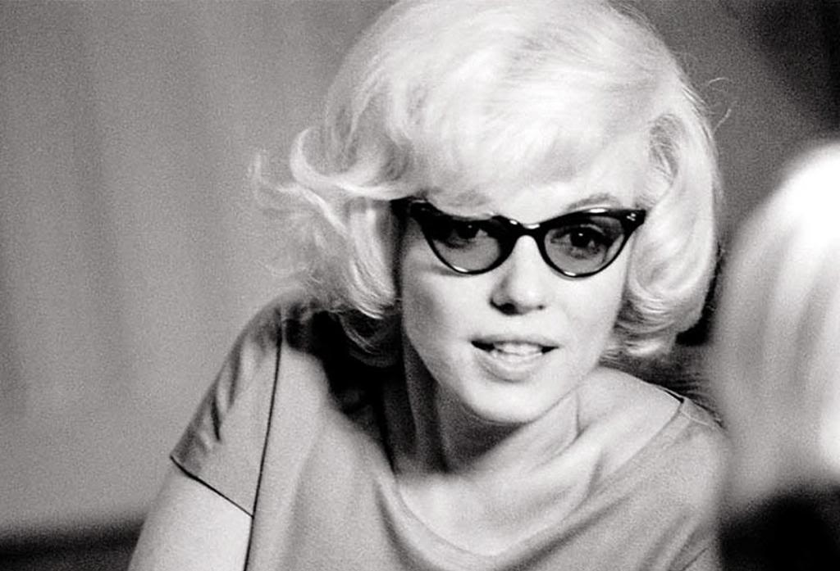
History of Sunglasses
“WAYFARER”
“AVIATOR”
1930s
-40s
1950s
1960s
“BROWLINE”
“CAT-EYE”
Anti-glare for WWII

Slide 5
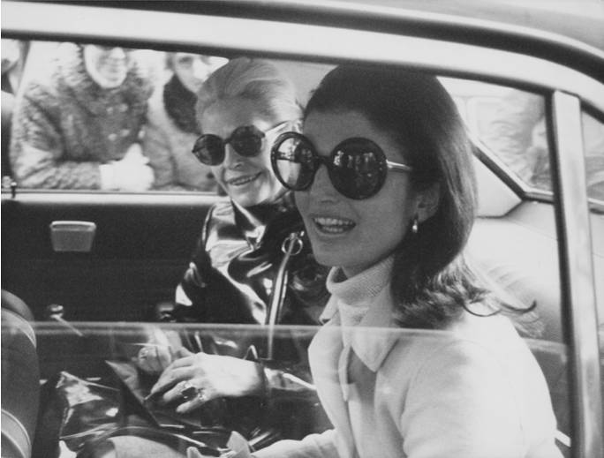
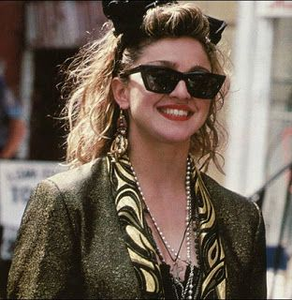
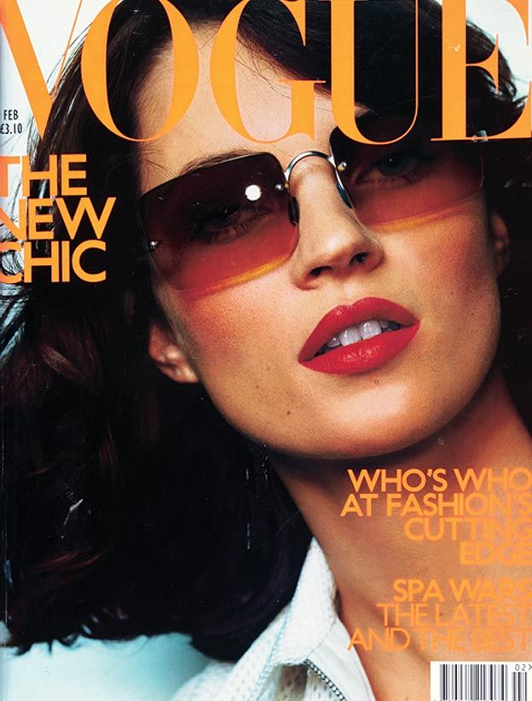
1970s
1980s
1990s
2000s

Slide 6
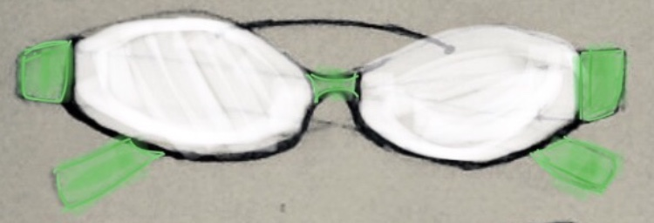
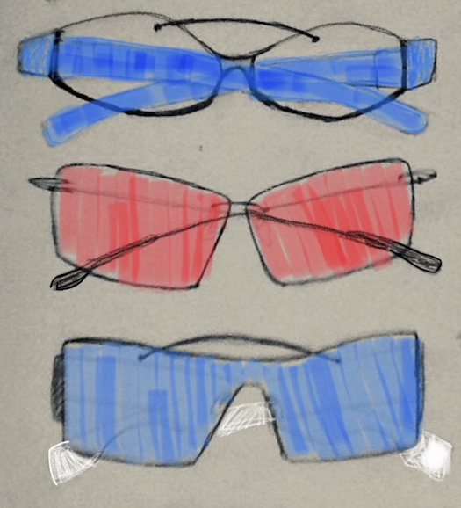
Trend Forecasting of 2020
Material
CR 39, Organic plastic lens
Thinner & Lighter
With UV protection
Monel for metal frame
Frameless
+
Square
+
Futuristic Shield

