Slide 1
Rocco Piscatello, A Designer
Presentation: by Florence F Litchmore-Smith
October 9,2020

Slide 2
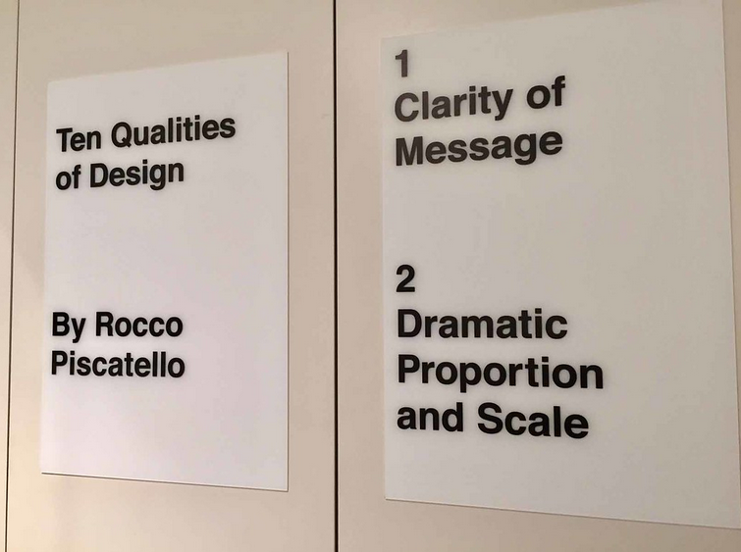
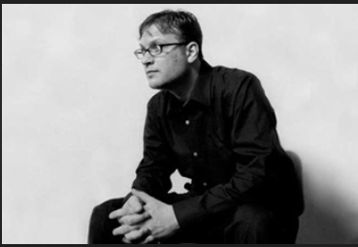
Ricco Piscatello
3D helps foster conceptual understanding and visual and spatial thinking.

Slide 3
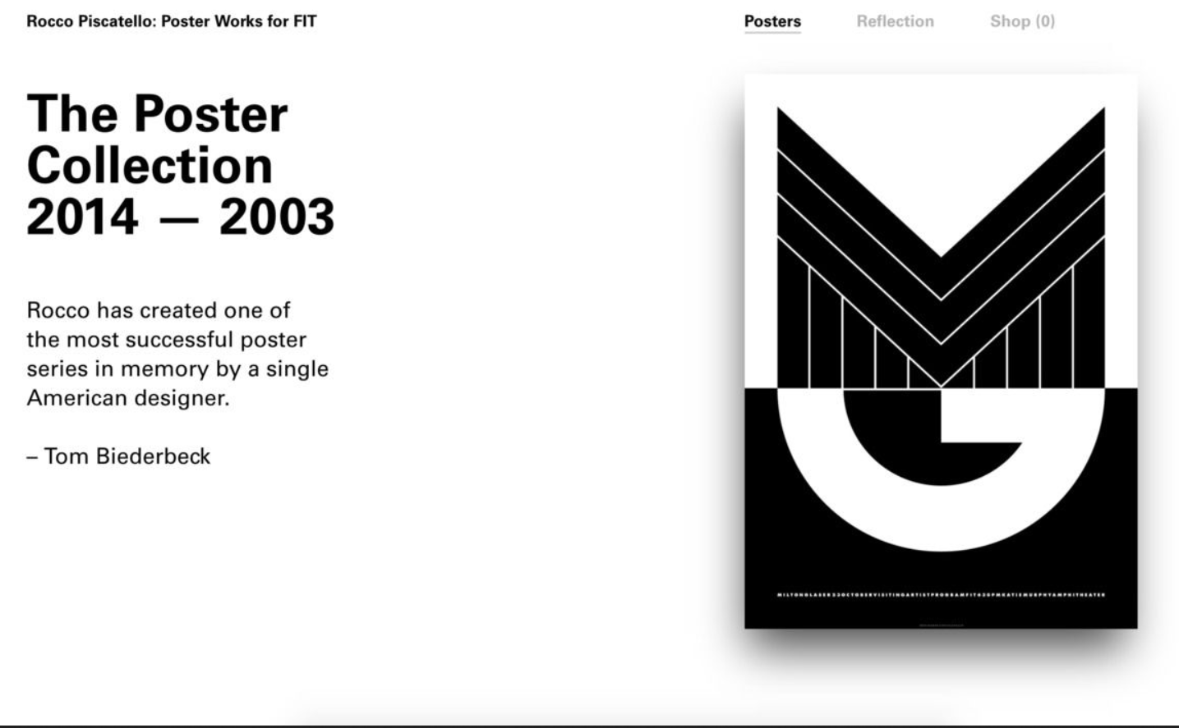
Rocco Piscatell: scale type and Geometry

Slide 4
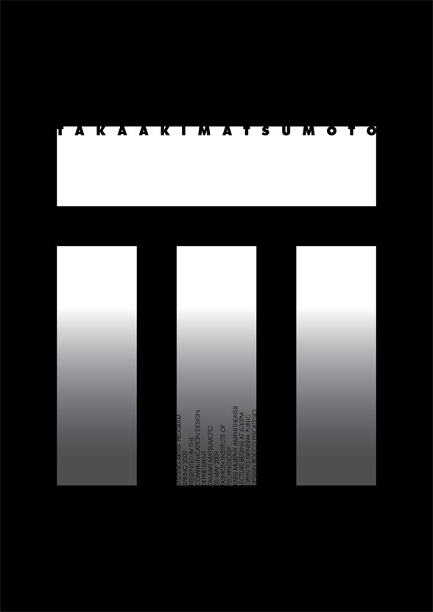
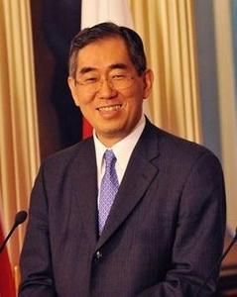
Rocco Piscatello Typography Design was custom
:
  Takaaki Matsumoto is a Japanese Politian of the Democratic Party of Japan, who is the Minister of Foreign Affairs.
  With Matusumoto Incorporated in a New York City based design consulting firm, specialized in graphic and product design. Takaaki Matsumoto and his staff service a broad range of national and international clients.

Slide 5
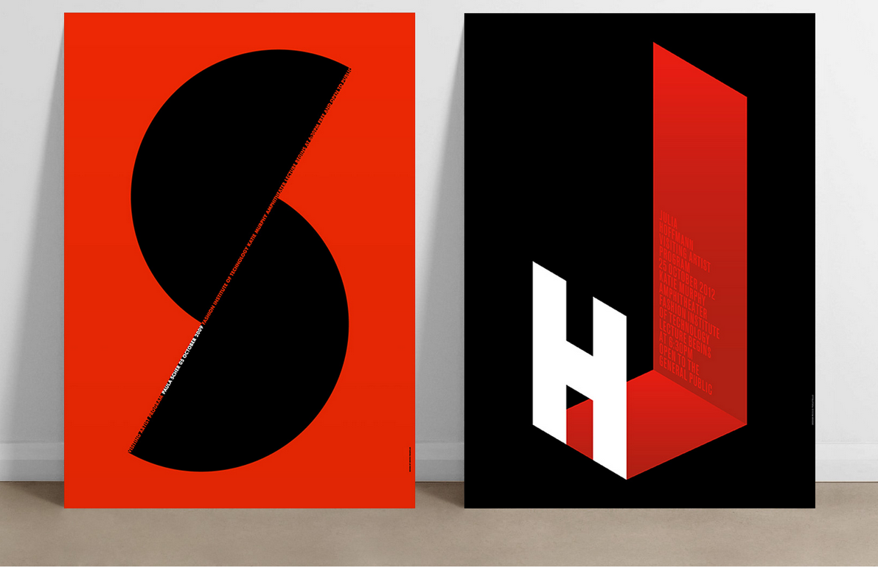
Rocco Piscatello Design of Strong Message
Piscatello designed his first poster for the Visiting Artist Program for FIT in 2003. Since then, he has created 24 posters, each design approached in the same manor.
“Piscatello’s poster design is often based on the initial letter of the lecturer’s last name.

Slide 6
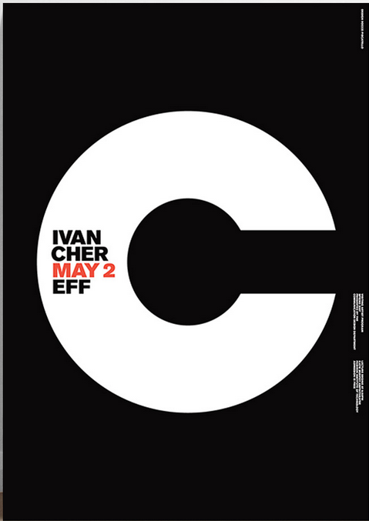
Riccco Piscatello Designs and Biography
Rocco Piscatello is 76 years old, and was born on February 14, 1944. Rocco currently lives in Ronkonkoma, New York.
Rocco is the principal of New York based Piscatello Design Center. Rocco specialized in the creation of design systems that integrate brand identity, interactive digital experiences, and environmental signate for clients and cities around the world. His passion is for helping companies create great brands, products and services through the poser of design.

Slide 7

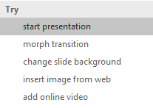

More questions about PowerPoint?
Select the Tell Me button and type what you want to know.
Visit the PowerPoint team blog
Go to free PowerPoint training
SELECT THE ARROW WHEN IN SLIDE SHOW MODE

