Slide 1
Survey Research and Correlation
How can we use the data that you have coded to conduct a correlational analysis?
Ex:
What did you hear that you thought was related to having positive experiences at City Tech? or to viewing the college or activities favorably?
What did you hear that you thought was related to having negative experiences?
How would you express these impressions in the form of a testable prediction?

Slide 2
We have already covered descriptive and qualitative research methods.
We have the data that began as qualitative (the focus group interviews) and how can this data be used to derive some further meaning?
The next step is to examine it more closely to see whether there are any patterns that emerged – in terms of attitudes, experiences, etc.
To do this, we would employ a more formal form of qualitative analysis known as correlational analysis.
Correlation means simply ‘associated with’ or ‘linked with.’
This means we want to determine whether we find any associations between variables

Slide 3
I. Correlational Analysis
Overview of Correlational Analysis.
Designing a correlational analysis using the focus group data you analyzed.
Aggregating the data
Identifying possible relationships between variables
Operationalizing (defining) variables
Designing a survey and determining the appropriate scale to measure variables.

Slide 4
What is correlation analysis?
Correlation is a statistical technique that can show whether and how strongly pairs of variables are related.
For example, height and weight are related; taller people tend to be heavier than shorter people.
But the relationship isn't perfect. People of the same height vary in weight, and you can easily think of two people you know where the shorter one is heavier than the taller one.
Nonetheless, the average weight of people 5'5'' is less than the average weight of people 5'6'', and their average weight is less than that of people 5'7'', etc.
Correlation can tell you just how much of the variation in peoples' weights is related to their heights.
Creative Research Systems http://www.surveysystem.com/correlation.htm

Slide 5
Although this correlation is fairly obvious your data may contain unsuspected correlations.
You may also suspect there are correlations, but don't know which are the strongest.
A careful correlation analysis can lead to a greater understanding of your data.

Slide 6
Source: http://www.slideshare.net/anilmishra7777/correlation-analysis-ppt

Slide 7
1. Positive Relationship: One or more variables move in the same direction.
Ex: The higher the price of tablets, the greater the number sellers are willing to supply.
Price of tablets $700
$500 $400
$300
$200
0 25 50 75 100
Number of tablets offered for sale
2. Negative Relationship: One or more variables change in the opposite direction.
Ex: The higher the price of gasoline per gallon, the fewer the number of miles driven per week

Slide 8
Negative relationship
Price of gasoline
Per gallon
$6
$5
$4
$3
$2
$1
0
25 50 75 100 125 150
Number of Miles driven per week

Slide 9
3. A partial correlation would examine the relationship between two variables (X and Y) while eliminating the influence of a third variable.
This is referred to as holding the third variable constant.
Ex: The higher the price of gasoline per gallon, the fewer the number of miles driven per week, everything else constant.
What are some possible variables that would need to be held constant?
And WHY do they need to be held constant?
Dilute the relationship between x and y
Contribute to drawing inaccurate conclusions

Slide 10
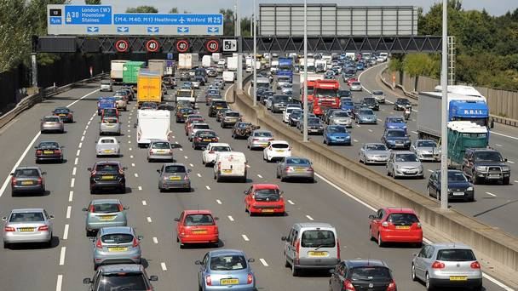
4. Linear and non-linear correlations (relationships)
Linear: The x and y variables change in direct proportion to one another:
Ex: Miles per hour and distance travelled:
Driving at 60 miles per hour, you will cover 300 miles in 5 hours.
Hours of 5
Driving
4
3
2
1
0 60 120 180 240 300 Miles travelled

Slide 11
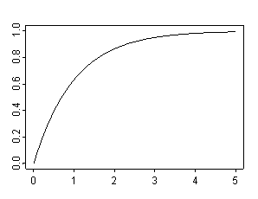
Non linear relationship: There is no predictable relationship between the change in one variable and a change in the other.
Ex. The more hours of sun per day, the more rapidly a plant will grow in a week:
Hours of sun 8 per day 7
6
5
4
3
2
1
Inches of growth per week

Slide 12
Correlation analysis using the focus group data:
Step one: Aggregating the data/observing relationships
Variable name | Positive | Negative
1. Sense of Community | 55 | 14
2. Career Related | 51 | 0
3. Academic Support | 63 | 11
4. Commuter school | 16 | 1
5. Financial value | 36 | 0
6. Student/prof. relations | 36 | 4
7. Technology related | 35 | 7
8. Communication | 83 | 12
9. Work-life balance | 12 | 9
10. Reputation | 3 | 17
Other | 55 | 14

Slide 13
Communication: Clear understanding between individuals; being open minded; clear exchange of ideas
Sense of Community: Positive experience both in and outside of the college; having support from others; a sense of belonging to a circle; unity and mutual respect
Career Related: Developing job skills and networking; training and ambition; career opportunities such as internships;
Student/prof. relations: Having a reliable guide for students; having mutual respect; prof. is knowledgeable and inspirational; having clear office hours; answering emails in a reasonable time frame.

Slide 14
Step 2: Identifying correlations between variables
What variables appear to be strongly correlated with having a positive experience at City Tech?
What variables appear to have a strong correlation with having a negative experience?
For instance: Does a ‘sense of community’ appear to be positively correlated with having a positive experience?
Or, does ‘commuter school’ appear to be negatively correlated with having a positive experience?

Slide 15
Step 3: Operationalizing variables
Developing an operational definition of “sense of community,” “commuter school,” “career related,” “student/professor relations”, etc.
For instance: If a ‘sense of community’ appears to be strongly correlated with having a positive experience, we need to define what sense of community means? Does it mean “satisfied”? “Fulfilled”? Etc.
…If student/professor relations appears to be strongly correlated with having a positive experience, we need to define what this variable means, etc.
Once we have definitions, there needs to be a means of measuring these variables (“sense of community,” “student/prof. relations”, etc).
How do we go about doing this?

Slide 16
Step 4: Survey research - Development of a measurement scale:
Which scale is the best fit for measuring the variables you have defined?
Nominal
Ordinal
Interval
Ratio
Source:
http://www.mymarketresearchmethods.com/types-of-data-nominal-ordinal-interval-ratio/

Slide 17
Nominal Scales are used to measure variables that do not have a quantitative value. They are labels that are mutually exclusive – that is – a variable assumes a value that cannot assume another value
http://www.mymarketresearchmethods.com/types-of-data-nominal-ordinal-interval-ratio

Slide 18
Ordinal scales – the order of the values that the variable receives is what is important and significant. Ordinal scales are also Likert scales.
“Ordinal scales are typically measures of non-numeric concepts like satisfaction, happiness, discomfort, etc” (but cannot quantify the difference between each value)
Examples of ordinal scales:
Very unhappy
Unhappy
OK
Happy
Very happy
_______________________________________________________________
Very satisfied
Somewhat satisfied
Neutral (or not sure)
Somewhat unsatisfied
Very unsatisfied
http://fivethirtyeight.blogs.nytimes.com/?_r=0 (Nate Silver/NYTimes)
http://www.mymarketresearchmethods.com/types-of-data-nominal-ordinal-interval-ratio

Slide 19
Interval scale: A numeric scale in which we know both the order and the exact differences between values.
Ex: The Fahrenheit temperature scale: The difference between each value, 65⁰, 66⁰, 67⁰ degrees etc. is exactly the same – one degree.
The increments are known, consistent and measurable.
Interval scales are also well suited for measures of central tendency (i.e. median, mean, mode). For instance, we can calculate the average temperature for year 2014, or for Summer 2015, etc.
http://www.mymarketresearchmethods.com/types-of-data-nominal-ordinal-interval-ratio

Slide 20
Ratio Scale: Measure the order and the exact value between units.
A ratio scale has a measure that has a true “0” point which means that the data can be used in several kinds of statistical analyses.
Ex: Height and weight.

Slide 21
So which kind of scale will be most appropriate for the variables you have identified?
II. Determining this is a first step in designing a survey
What are your goals? What do you want to find out more about?
Who is the target audience?
Defining a timeline…over what time period will you conduct the survey?
Selecting a methodology for conducting your survey.
http://www.upa.pdx.edu/IOA/newsom/pa551/lecture1.htm

Slide 22
II. Survey Research
What are the advantages of survey research?
Defining the goals of your survey
Who is the target audience?
Defining a timeline
Selecting a methodology for conducting your survey

Slide 23
Advantages:
Survey research is appealing because of the low cost of obtaining information and easily accessible information¹.
Conducting accurate surveys that provide meaningful information is central to market research – especially in our consumer-driven economy
WHY? Businesses and media sources spend billions annually just to find out what people think; to find out what their preferences are and to identify niche markets for their products and services.
If the research conducted is well-done and yields accurate information, this can be highly profitable.
On the other hand, poorly conducted or flawed survey research design can be extremely costly for the business.
¹Information cited from “Survey Research Design”. Martyn Shuttleworth, https://explorable.com/survey-research-design

Slide 24
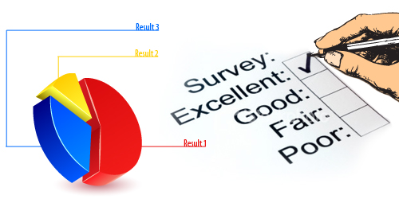
Steps in Effective Survey Design¹:
How to avoid Bias? How can you be sure your survey represents a cross-section of the population?
Basically, it is difficult to do so.
Even so, surveys can be a very effective research tool in gaining an accurate picture of opinion if designed thoughtfully.
2. Establishing your research goals:
Your questions should not be so broad that you have to ask too many questions or so narrow that you don’t cover the topic thoroughly.
¹https://explorable.com/survey-research-design

Slide 25
3. Defining your sample group:
Who is your sample group?
4.

