Slide 1
By: Humzah Butt

Slide 2
Plan
Analysis of the Brand
Identity, Positioning, Values
Marketing Mix
Competitive Analysis
Marketing Strategy

Slide 3
KEY DATES
Analysis of the brand
1945 : Céline Vipiana and her husband created a made-to-measure children's shoe business.
1960 : New positioning, focus on women's RTW business with a sportswear touch.
1996 : Céline integrated the LVMH Group.
1997 : Michael Kors became Céline's first women RTW designer and Creative Director
2008 : Bernard Arnault appointed Phoebe Philo as the new CD for the brand
2018: Philo steps down as CD, Hedi Slimane enters

Slide 4
Brand Identity
Positioning : Céline is a Parisian luxury brand that offers innovative and timeless RTW and leather goods designed for elegant women who are looking for an effortless style.

Slide 5
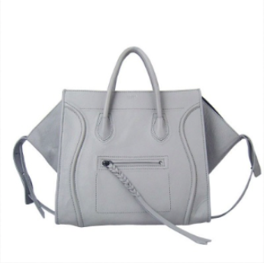
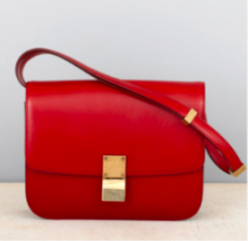
Physique

Slide 6
Personality
Elegant
Timeless
Minimalist
Chic
Parisian
Effortless

Slide 7
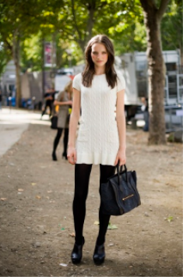
Culture
Parisian style of life
French elegance at the cutting edge of fashion
For trendy women who are looking for an effortless and minimalist Parisian look.

Slide 8
Reflection
This brand is especially dedicated to intellectual women who have their inner and specific own style.
“Simplicity is the ultimate sophistication” - L. Da Vinci. This quote summarizes the idea of Céline internalization.

Slide 9
Self-Image
They want to belong to the elites.
Céline is for confident consumers who strive for being at the cutting edge of fashion.

Slide 10
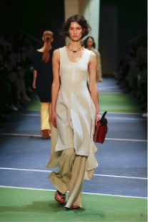
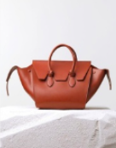
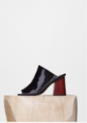
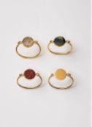
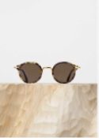
Marketing Mix
Products

Slide 11
Marketing Mix
Price
Coats : 700 to 4990€
Tops : 580 to 3300€
Trousers : 950 to 1390€
Dresses : 2250 to 6900€
Bags : 780 to 3300€
Shoes : 380 to 820€

Slide 12
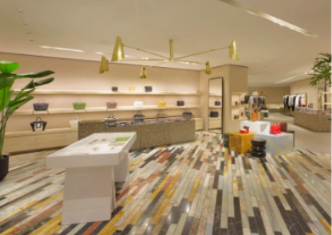
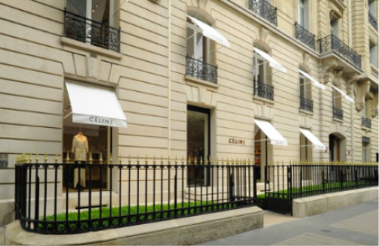
Marketing Mix
Place
100+ stores worldwide in 4 continents
Department stores such as Barneys New York, Bergdorf Goodman, Harrods (London) and Galeries Lafayette (Paris)
Very selective distribution
No partnerships with e-shops

Slide 13
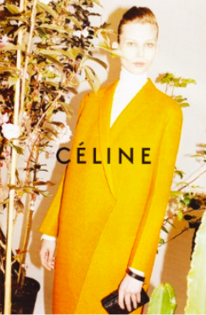
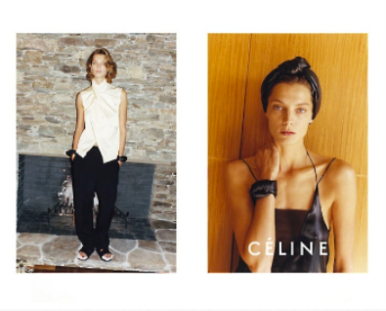
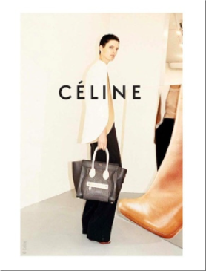
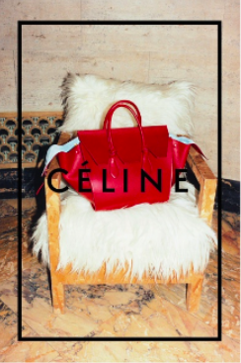
Marketing Mix
Promotion
Very traditional ads
No presence on social media
No E-shops
Strong image control

Slide 14
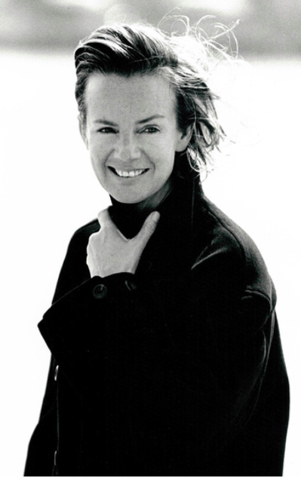
Competitive Analysis
Competitor: Jil Sander
The fashion house “Jil Sander” was founded in Rotherbaum, Germany in 1968 by Jil Sander
Product Range
Woman Clothing
Men Clothing
Accessories
Fragrances

Slide 15
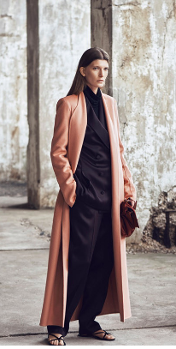
Competitive Analysis
Target and Positioning
Women: 30+
Fashion Aware
High Income
Educated
Minimalistic
Playing with Femini/Masculinity
Simple

Slide 16
Competitive Analysis
Jil Sander
Price: 650 EUR
Celine
Price: 739 EUR

Slide 17
Competitive Analysis
Jil Sander
Price: 405 EUR
Celine
Price: 680 EUR

Slide 18
Competitive Analysis
Jil Sander
Price: 331 EUR
Celine
Price: 603 EUR

Slide 19
Positioning Map

Slide 20
Marketing Strategy
The goal for Celine is to position them in the luxury fashion market as a pioneer in sustainable/wearable technology. In order to introduce the wearable tech products with the ability to customize, they’d have to start by hosting events where their consumer base can come and try out the customizable feature when it comes to their Belt and Classic bags by using AR technology.
Spring 2020- Introduce “Douane by Celine” by hosting a Member’s Only Event party at the Paris Flagship store where loyal customers who have been shopping with Celine for a while can check out a try out the new bag as well as post it on their social media pages with the hashtag “#DouaneNights”.
Summer 2020- Hosting a virtual fashion show that showcases their new upcoming Douane Collection of Ready-To-Wear mixed with the leather goods which will exclusively show on their Instagram Live for the mass audience to view and possibly want to purchase.
Fall 2020- Douane Collection available to purchase in 3-5 colorways with more styles and colors coming in 2021.

