Slide 1
MAT 2572 Probability w/Statistics, Halleck
Day 23 slides:
7.4 Drawing Inferences About µ

Slide 2
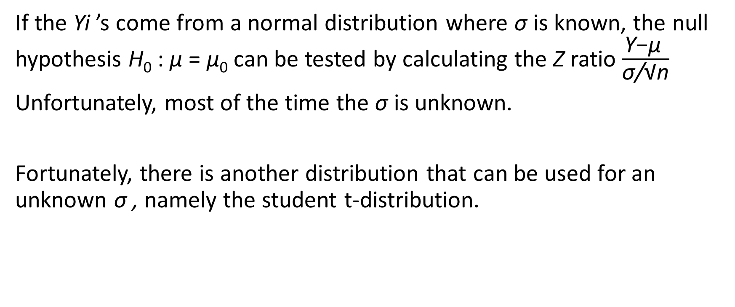
An unrealistic assumption
If the Yi ’s come from a normal distribution where σ is known, the null hypothesis H₀ : μ = μ₀ can be tested by calculating the Z ratio $\frac{\text{Y}\text{−}\text{μ} }{\text{σ}\text{/}\text{√}\text{n}}$
Unfortunately, most of the time the σ is unknown.
Fortunately, there is another distribution that can be used for an unknown σ , namely the student t-distribution.

Slide 3
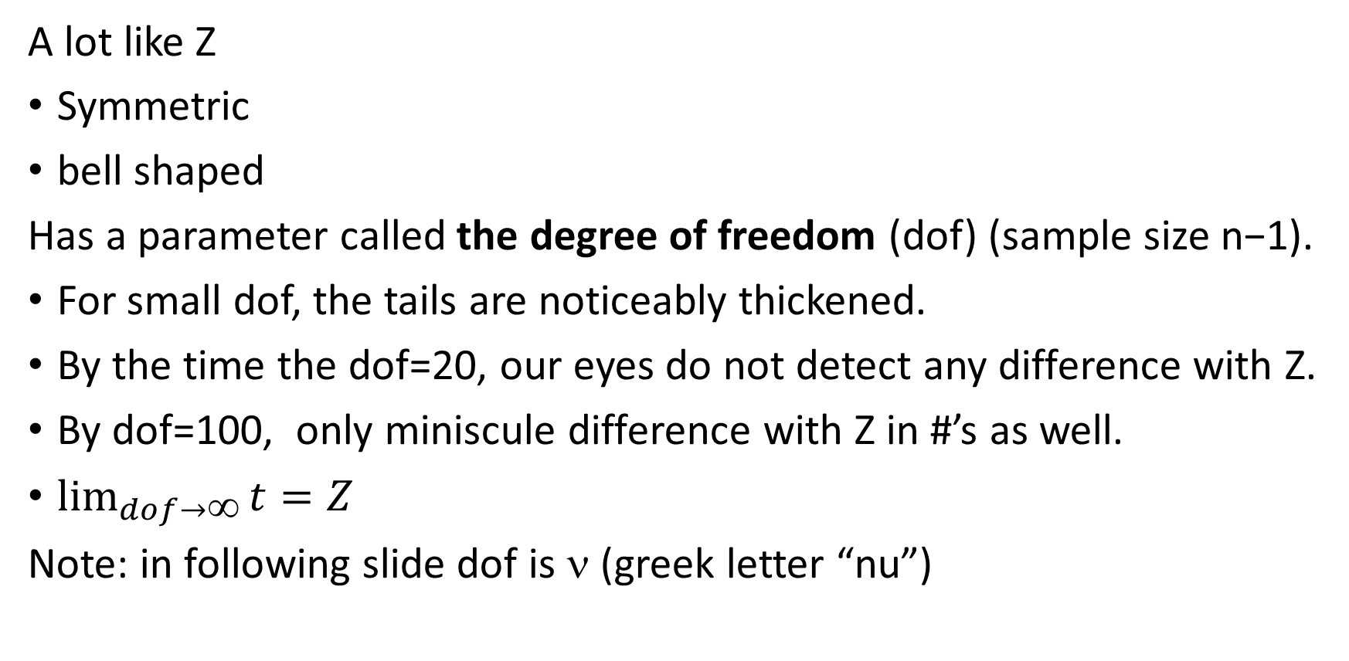
t-distribution
A lot like Z
Symmetric
bell shaped
Has a parameter called the degree of freedom (dof) (sample size n−1).
For small dof, the tails are noticeably thickened.
By the time the dof=20, our eyes do not detect any difference with Z.
By dof=100, only miniscule difference with Z in #’s as well.
$\lim_{dof→∞}{t=Z}$
Note: in following slide dof is ν (greek letter “nu”)

Slide 4
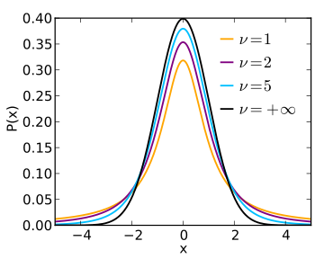

Slide 5
Case Study 7.4.1: range of echolocation system
To hunt flying insects, bats emit sounds and then listen for their echoes. Until an insect is located, these pulses are emitted at intervals of from 50 to 100ms. When an insect is detected, the pulse-to-pulse interval decreases to ~10ms, enabling bat to pinpoint prey.
How far apart are bat and the insect when bat first senses insect? Or, put another way, what is effective range of bat’s echolocation system?

Slide 6
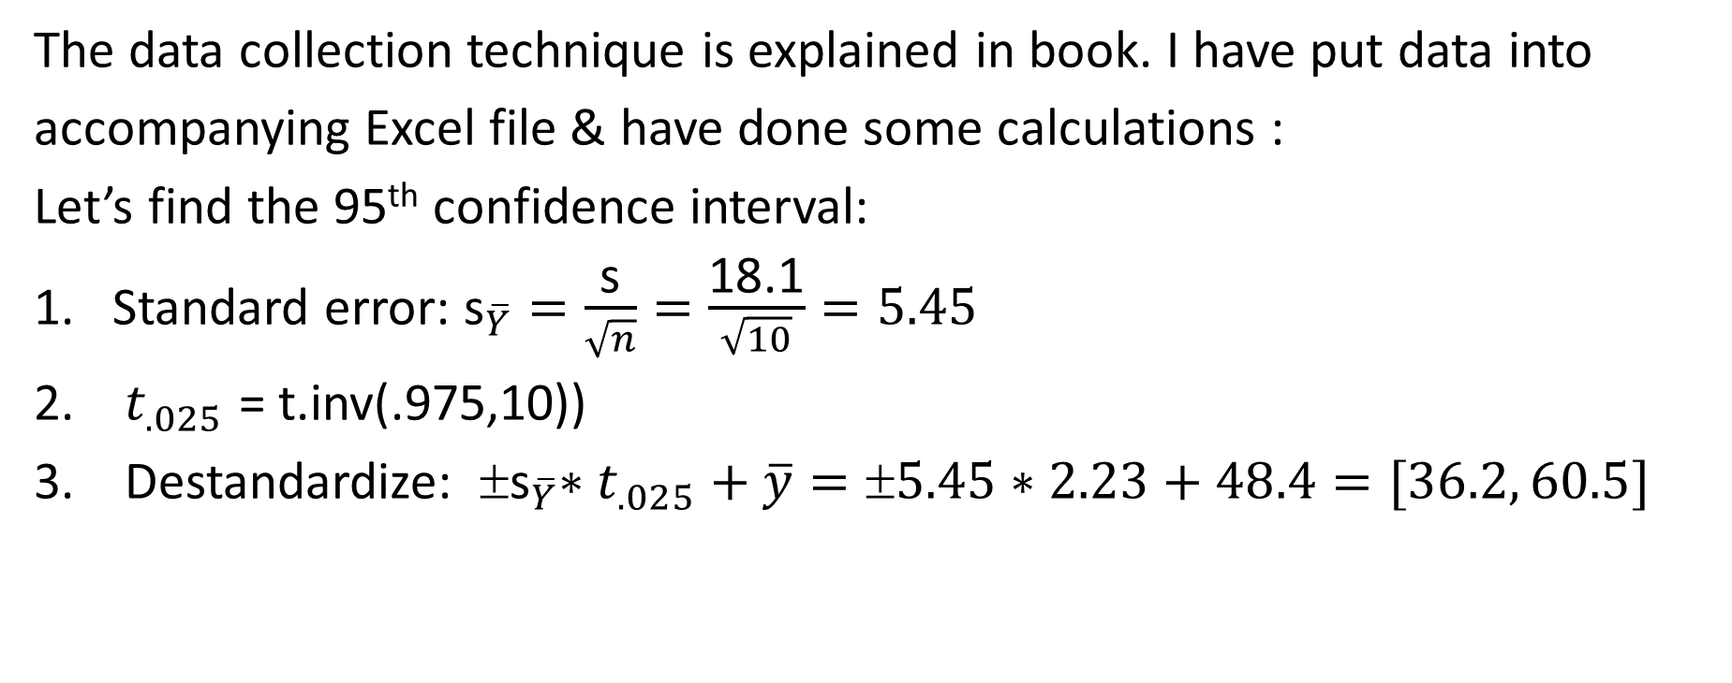
Case Study 7.4.1: echolocation system (cont.)
The data collection technique is explained in book. I have put data into
accompanying Excel file & have done some calculations :
Let’s find the 95th confidence interval:
Standard error: ${\text{s}}_{\overline{Y}}=\frac{\text{s}}{\sqrt{n}}=\frac{\text{18.1}}{\sqrt{10}}=5.45$
$t_{.025}$ = t.inv(.975,10))
Destandardize: ${ \text{s}}_{\overline{Y}}∗t_{.025}+\overline{y}=±5.45∗2.23+48.4=[36.2, 60.5]$
mean | 48.4
ssd | 18.1
n | 11
dof | 10

Slide 7
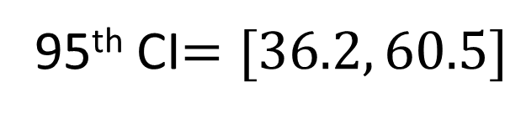
Case Study 7.4.1: echolocation system (cont.)
95th CI$=[36.2, 60.5]$
37.5 43.0 48.4 53.9 59.3

Slide 8
Case Study 7.4.1: echolocation system (cont.)
Since n is relatively small (<30), our analysis is only valid if the data are normally
distributed. As can be seen from the histogram below, this seems to be the case.

Slide 9
Non-example 7.4.1
This data set is also
of relatively small size
(n = 20). However, this
time the data are not
normally distributed.
Hence, we can not use
the t-distribution.
Exercise: can you think
of a distribution that
could model this data?
NOTE: once the data set is large enough (n>20), then we do
not have to investigate the shape of the underlying data.

Slide 10
Summary for when t-distribution can be used for estimations about mean. If n…
> 100: there is no practical difference with the normal distribution.
> 30: t-distribution can be used even if original distribution is non-normal.
< 30: t-distribution can only be used if the original distribution is normal.

Slide 11

Case study 7.4.2: Ratios of the width and length of Shoshone rectangles
The ancient Greeks called a W x L rectangle “golden” if the ratio W/L is the same as L/(W+L). For example a 5 x 8 rectangle is approximately golden: 5/8=.625≈8/(5+8)=8/13=.615.
The Shoshone Indians have many rectangles in their crafts, such as rugs. A study has been done to see if they had a similar sense of aesthetic to the Greeks.
Data & analysis are in accompanying Excel file.

