Slide 1
MAT 2572 Probability w/Statistics, Halleck
Day 22 slides:
6.2 The Decision Rule
6.4 Type I and Type II Errors

Slide 2
Hypothesis Testing: rejection region approach
Any function of the observed data whose numerical value dictates whether H₀ is accepted or rejected is called a test statistic (TS).
The set of values for the test statistic that result in the rejection of H₀ is called the rejection region (RR).
The point(s) that separate(s) RR from the acceptance region is called the critical value(s) (CV).
The probability that the TS lies in RR when H₀ is true is called the significance level α (typically 1, 5 or 10%).
NOTES:
The lower the α, the stronger the evidence needed to reject H₀.
If α is not explicitly given, assume that it is 5%.

Slide 3
Rejection Region Approach (cont.)
Treatments are different depending on whether RR is one-tailed or two-tailed (tail(s) gel(s) with H₁):
One-tailed: The FDA has received complaints from consumers that the amount of cocoa in their containers is less than the 8 oz claimed on the box. To investigate, the FDA purchases a random sampling of 20 boxes and finds that the average amount in the boxes is 7.93 oz. If the standard deviation is .25 oz, does the FDA have enough evidence to conclude that the manufacturer is indeed cheating the consumer?
Two-tailed: Joan’s 15 measurements of the distance to a star average 545 light years (LY), which differs from the published distance of 534 LY. If the standard deviation is 10 LY, does Joan have enough evidence to reject the accepted distance?

Slide 4
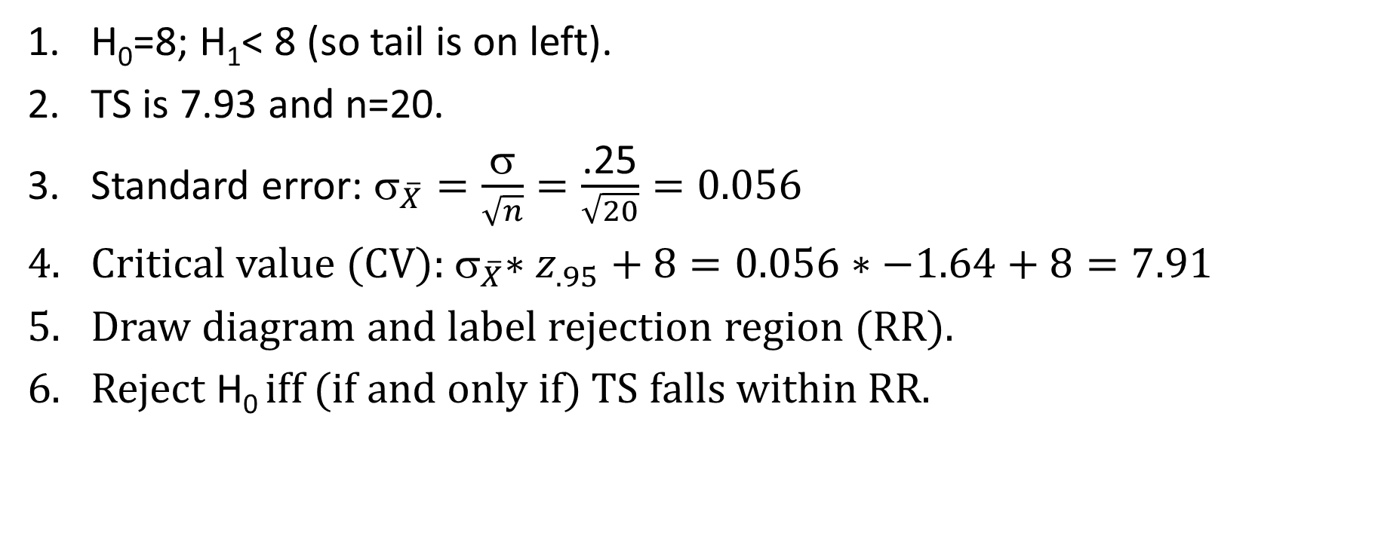
Rejection Region: one-tailed (cocoa) example
H₀=8; H₁< 8 (so tail is on left).
TS is 7.93 and n=20.
Standard error: ${\text{}}_{\overline{X}}=\frac{\text{σ}}{\sqrt{n}}=\frac{\text{.}\text{25}}{\sqrt{20}}=\text{0.0}\text{56}$
Critical value (CV):${ \text{}}_{\overline{X}}∗z_{.95}+8=\text{0.0}56∗−1.64+8=7.91$
Draw diagram and label rejection region (RR).
Reject H₀ iff (if and only if) TS falls within RR.

Slide 5
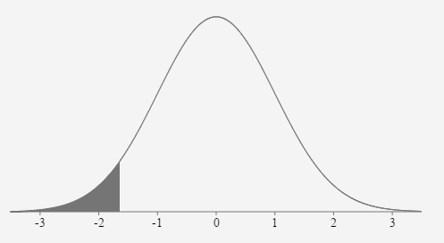
Critical Region: one-tailed example (cont.)
TS=7.93>7.91=CV
⇒ TS does NOT fall within RR
⇒ we do NOT reject H₀.
Thus, we do NOT have enough evidence to say cocoa company is cheating consumer.
Rejection region
z_{.95} = −1.65
7.91 1.65${\text{}}_{\overline{X}}$ 8
CV 7.93 =TS

Slide 6
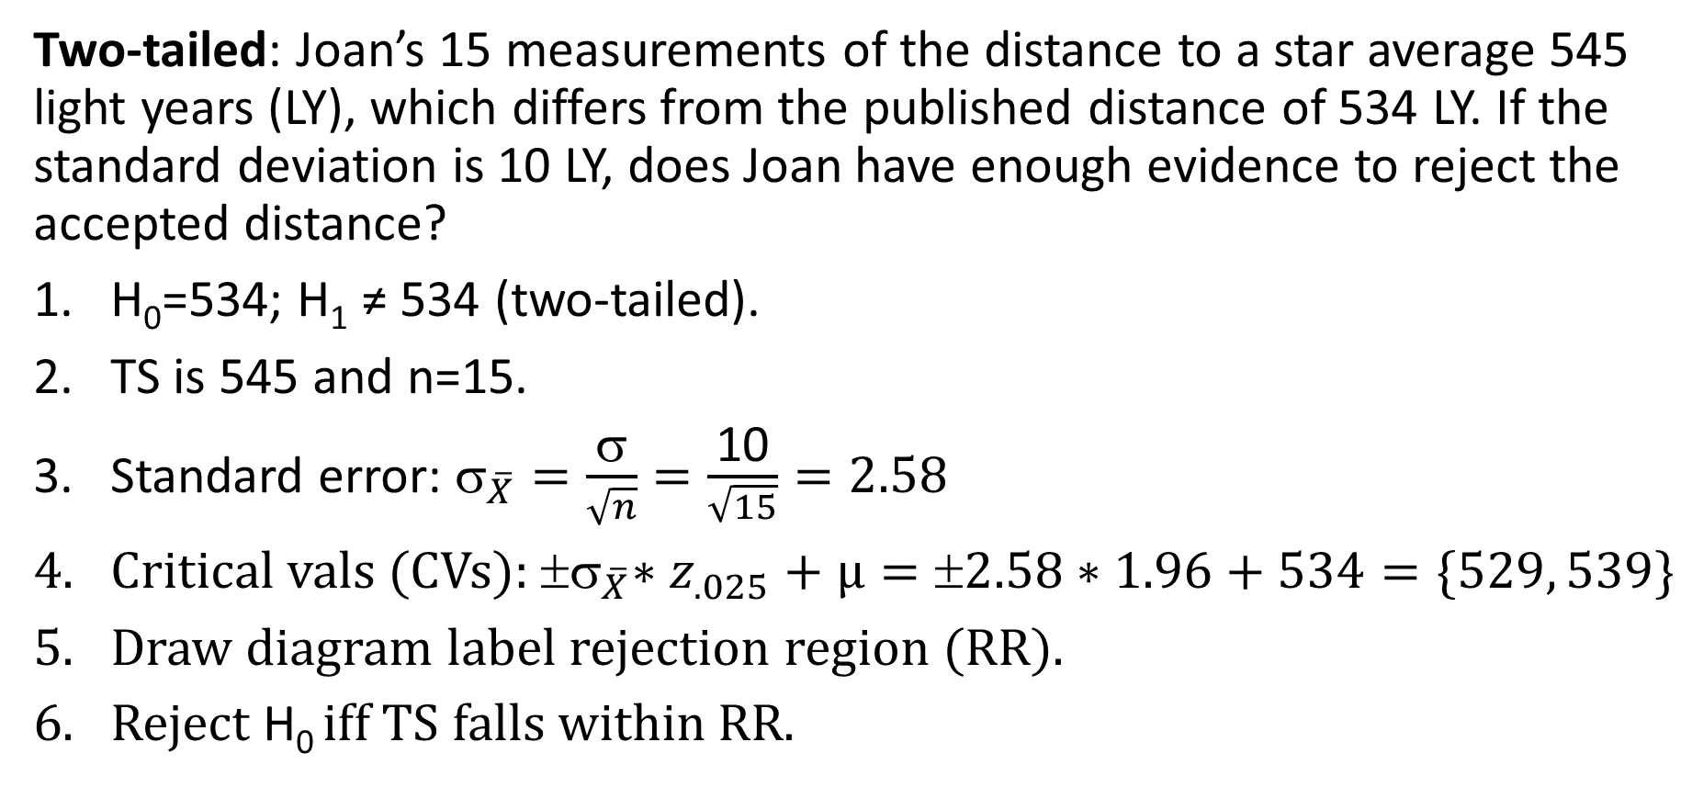
Critical Region: two-tailed example
Two-tailed: Joan’s 15 measurements of the distance to a star average 545 light years (LY), which differs from the published distance of 534 LY. If the standard deviation is 10 LY, does Joan have enough evidence to reject the accepted distance?
H₀=534; H₁ ≠ 534 (two-tailed).
TS is 545 and n=15.
Standard error: ${\text{}}_{\overline{X}}=\frac{\text{σ}}{\sqrt{n}}=\frac{\text{10}}{\sqrt{15}}=2.58$
Critical vals (CVs):${ \text{σ}}_{\overline{X}}∗z_{.025}+µ=±2.58∗1.96+534=\{529, 539\}$
Draw diagram label rejection region (RR).
Reject H₀ iff TS falls within RR.

Slide 7
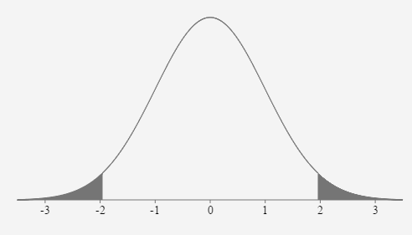
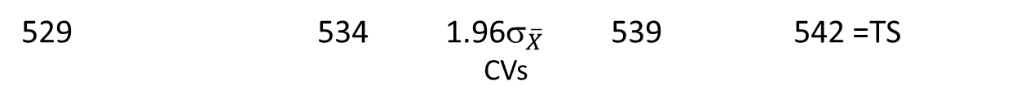
Critical Region: two-tailed example (cont.)
Rejection region
TS=542>539=CV
⇒ TS IS within RR
⇒ we DO reject H₀.
Thus, Joan rejects the published/accepted value of the star’s distance.
z_{.025}=1.96
529 534 1.96${\text{}}_{\overline{X}}$ 539 542 =TS
CVs

Slide 8
Hypothesis Testing: p-value approach
As with the critical region approach, calculate the test statistic (T.S.).
The p-value of an observed test statistic is the probability of getting a value for that test statistic as extreme as or more extreme than what was actually observed (assuming H₀ to be true).
Reject H₀ iff the p-value is less than the significance level α.
How strength of evidence (p-value) and significance level (α) are related:
The strength of evidence needed to reject H₀ is inversely related to α.
The lower the p-value, the stronger your evidence.

Slide 9
P-value Approach (cont.)
Treatments are again different depending on whether rejection region is one- or two-tailed:
One-tailed: pet food always specifies a maximum moisture content. Pets-R-Us store brand says it’s dry food has an 11% max moisture content. 9 samples are taken and average 11.5%. If σ = 1%, can we say that the moisture content of Pets-R-Us food is too high?
Two-tailed: the mercury content of fish was measured 5 years ago at .11 ppm. If today, 25 fish are caught and the mercury content averages .10ppm with σ = .02, can we say that the mercury levels have changed?

Slide 10
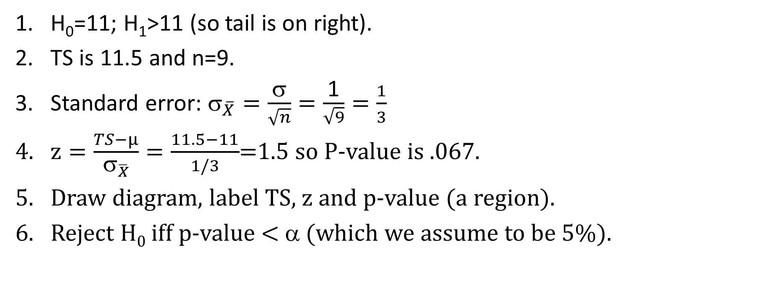
P-value: one-tailed example
H₀=11; H₁>11 (so tail is on right).
TS is 11.5 and n=9.
Standard error: ${\text{}}_{\overline{X}}=\frac{\text{σ}}{\sqrt{n}}=\frac{\text{1}}{\sqrt{9}}=\frac{1}{3}$
$z=\frac{TS−µ}{{\text{σ}}_{\overline{X}}}=\frac{11.5−11}{1/3}$=1.5 so P-value is .067.
Draw diagram, label TS, z and p-value (a region).
Reject H₀ iff p-value < α (which we assume to be 5%).

Slide 11
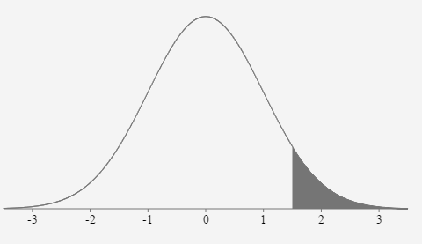
P-value: one-tailed example (cont.)
Since p-value = .067 is NOT <.05=α,
we do not reject H₀ .
We can NOT say that the moisture content of Pets-R-Us food is too high
p-value = .067
1.5
11.5
10.3 10.7 11 11.3 11.7
TS

Slide 12
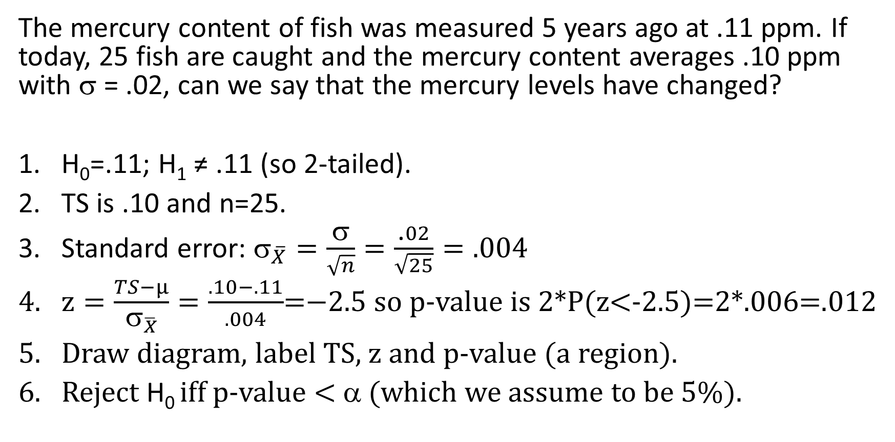
P-value: two-tailed example
The mercury content of fish was measured 5 years ago at .11 ppm. If today, 25 fish are caught and the mercury content averages .10 ppm with σ = .02, can we say that the mercury levels have changed?
H₀=.11; H₁ ≠ .11 (so 2-tailed).
TS is .10 and n=25.
Standard error: ${\text{}}_{\overline{X}}=\frac{\text{σ}}{\sqrt{n}}=\frac{\text{.}02}{\sqrt{25}}=.004$
$z=\frac{TS−µ}{{\text{σ}}_{\overline{X}}}=\frac{.10−.11}{.004}$=$−$2.5 so p-value is 2*P(z<-2.5)=2*.006=.012
Draw diagram, label TS, z and p-value (a region).
Reject H₀ iff p-value < α (which we assume to be 5%).

Slide 13
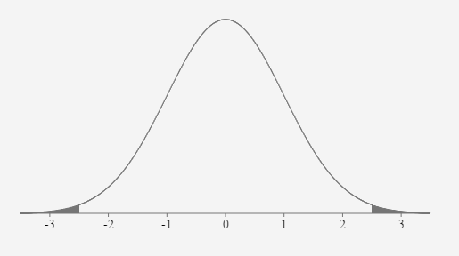
P-value: two-tailed example (cont.)
Since p-value = .012 <.05=α,
we DO reject H₀ ; in other words, the mercury content of the fish has changed.
P-value = .012
-2.5
.100
.102 .106 .11 .114 .118
TS

Slide 14
Exercise:
Create your own one- and two-tailed examples.
Exchange problems with your neighbor.
Solve ex 1 using critical region and ex 2 using p-value approaches.

Slide 15
Type I and Type II Errors
 |  | True State of Nature
 |  | H₀ is true | H₁ is true
Our Decision | Fail to reject H₀ | Correct decision | Type II error
 | Reject H₀ | Type I error | Correct decision
Court-of-law analogy:
type I error = convict an innocent
is considered worse than
type II error = not convict a guilty

Slide 16
Chance of type I error
Coincides precisely with significance level α.
For a criminal case, you want it to be low (perhaps α=1%).
For a civil case, can be a higher (perhaps α=5 or 10%).

Slide 17
β=Chance of type II error
We introduce a new parameter β and a new picture.
On the same set of axes as the curve around the hypothesized mean, we create a curve around the actual mean.
We look at 2 situations:
  one where they are close (->)
  and one where they are far
  apart (next slide).
Region under new curve
not in RR corresponds to β.
The power = 1−β represents
ability to recognize H₀ is false.

Slide 18
β=Chance of type II error (cont.)
Situation where hypothesized mean and actual mean are far apart:
In contrast to last slide where β was high (so power is low), here we have that β is low (so power = 1−β is high).

Slide 19
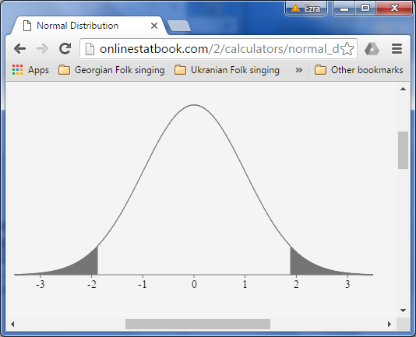

Exercise 6.2.2
An herbalist suspects his extracts affect IQ scores of students with ADD. 22 children take doses for two months. Children with ADD typically score an average of 95 on the IQ test with a standard deviation of 15. Let H₀ be the assumption that the extracts have no affect on the scores. If α=0.06, what values of $\overline{Y}$would cause H₀ to be rejected? Assume H₁ is 2-sided.
Standard error:
${\text{}}_{\overline{X}}=\frac{\text{σ}}{\sqrt{n}}=\frac{\text{15}}{\sqrt{22}}=3.2$
z_{.03}=1.88, so CVs:
${ \text{σ}}_{\overline{X}}∗z_{.03}+µ$
$=3.20∗1.88+95$
$=\{89, 101\}$
Reject if $\overline{Y}$< 89 or > 101
88.6 91.8 95 98.2 101.4

Slide 20
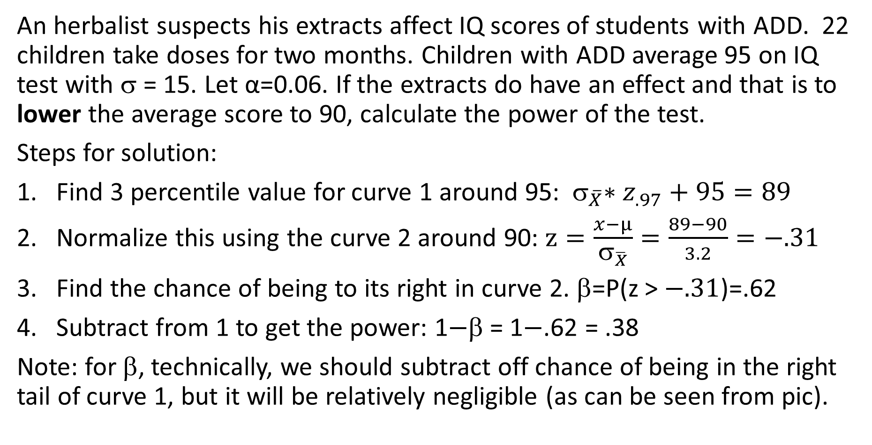
Exercise 6.2.2 (cont.) & 6.4.3
An herbalist suspects his extracts affect IQ scores of students with ADD. 22 children take doses for two months. Children with ADD average 95 on IQ test with σ = 15. Let α=0.06. If the extracts do have an effect and that is to lower the average score to 90, calculate the power of the test.
Steps for solution:
Find 3 percentile value for curve 1 around 95: ${ \text{}}_{\overline{X}}∗z_{.97}+95=89$
Normalize this using the curve 2 around 90: $z=\frac{x−µ}{{\text{σ}}_{\overline{X}}}=\frac{89−90}{3.2}=−.31$
Find the chance of being to its right in curve 2. β=P(z > $−.31$)=.62
Subtract from 1 to get the power: 1$−$β = 1$−$.62 = .38
Note: for β, technically, we should subtract off chance of being in the right tail of curve 1, but it will be relatively negligible (as can be seen from pic).

Slide 21
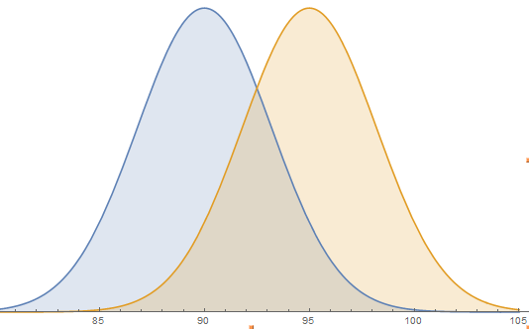
β = Area under blue curve to right of red line = .62
Power = 1−β = Area under blue curve to left of red line = .38
Hypothesized distribution:
brown curve
Actual distribution:
blue curve

Slide 22
Summary of β and power
Given the actual distribution, β, the chance of a type II error, is the chance of falling within accepted region of hypothesized distribution.
1−β represents the “power” of a test, namely its ability to reject H₀ when it is false.
The farther apart the actual and hypothesized means (relative to the standard error), the higher the power.

