Slide 1
MAT 2572 Probability w/Statistics, Halleck
Day 19 slides:
4.4 The Geometric Distribution
4.5 The Negative Binomial Distribution

Slide 2
Geometric Distribution
Consider a series of independent trials, each having one of two possible outcomes, success or failure. Let p= P(success). Define the random variable X to be the number of failures BEFORE the first success occurs.
p_{G}(k) = P(G = k) = P(First success occurs on the (k+1)^{st} trial)
= P(First k trials end in failure and (k+1)^{st} trial ends in success)
= P(First k trials end in failure) · P((k+1)^{st} trial ends in success)
=q^{k}p, k =0, 1, . . .

Slide 3
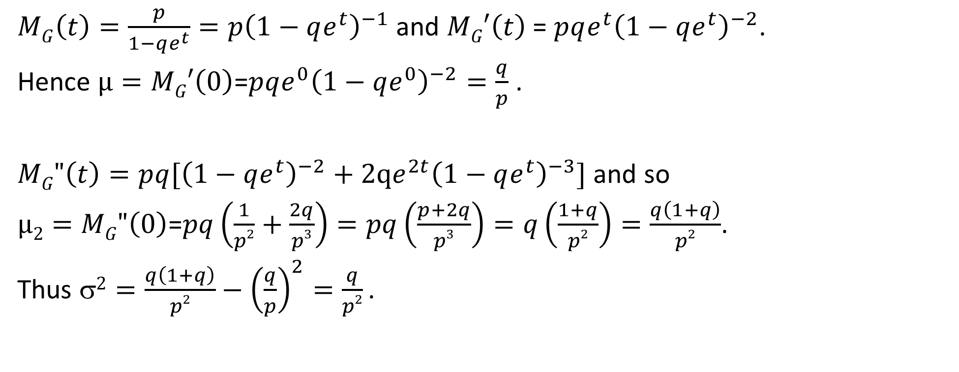
Geometric Distribution (cont.)
$MG\left(t\right)=\frac{p}{1−qe^{t}}=p{\left(1−qe^{t}\right)}^{−1}$ and $MG′\left(t\right)$ = $p{qe^{t}\left(1−qe^{t}\right)}^{−2}$.
Hence $µ=MG′\left(0\right)$=$p{qe^{0}\left(1−qe^{0}\right)}^{−2}=\frac{q}{p}$ .
$MG"\left(t\right)=p{q[\left(1−qe^{t}\right)}^{−2}+2qe^{2t}{\left(1−qe^{t}\right)}^{−3}]$ and so
$µ2=MG"\left(0\right)$=$pq\left(\frac{1}{p2}+\frac{2q}{p3}\right)=pq\left(\frac{p+2q}{p3}\right)=q\left(\frac{1+q}{p2}\right)=\frac{q\left(1+q\right)}{p2}$.
Thus $2=\frac{q\left(1+q\right)}{p2}−{\left(\frac{q}{p}\right)}^{2}=\frac{q}{p2}$ .

Slide 4
Example 4.4.2: Sum of 4 geometrics
City Tech bookstore has promotion. For every $100 of textbooks that a student purchases, she randomly gets a letter T, E, C or H. If she gets all 4 letters, she can sell back her books for 100% of purchase price as long as she remains a student. On average, how many $100’s does a student need to spend before she earns this privilege.
Let G_{i} be RV representing $100’s spent by a student unsuccessfully before adding i^{th} letter. Let X represent total # of $100’s spent by student.
Then X=(G₁+1)+(G₂+1)+…+(G₄+1)=$\sum_{i=1}^{4}{G_{i}}+4$ and E(G)=$\sum_{i=1}^{4}{E\left(G_{i}\right)}+4$ For G_{i}, there are 5−i letters still to find.
Hence chance of getting new one is $p=\frac{5−i}{4}$ and $q=1−\frac{5−i}{4}=\frac{i−1}{4}$ .
So $E\left(X\right)=\sum_{i=1}^{4}{\frac{i−1}{5−i}}+4=\frac{0}{4}+\frac{1}{3}+\frac{2}{2}+\frac{3}{1}+4=8\frac{1}{3} or \$833$.

Slide 5
Negative Binomial Distribution
Consider a series of independent trials, each having one of two possible outcomes, success or failure. Let p= P(success). Define the random variable NB to be the number of failures before the r^{th} success occurs.
p_{NB}(k) = P(NB = k) = P(r^{th} success occurs on the (r+k)^{th} trial)
= P(r −1 successes occur in first r + k −1 trials and success occurs on the (r+k)^{th} trial)
= P(r −1 successes occur in first r + k −1 trials) · P((r+k)^{th} trial ends in success)
= $\left({r+k−1 \atop r−1}\right)p^{r−1}q^{r+k−1−(r−1)}p=\left({r+k−1 \atop r−1}\right)p^{r}q^{k}$, k =0, 1, . . .

Slide 6
Rinaldi: 3.2.2, example 13
Roll a fair die. What is probability that 2nd 6 appears on 10th roll?
What is success? 6 $\left(so p=\frac{1}{6}\right)$.
What is failure? Anything but 6 $\left(so q=\frac{5}{6}\right)$.
How many failures have happened? 10 − 2 = 8 (so k=8)
How many successes have happened? 2 (so r=2)
$P(k)=\left({r+k−1 \atop r−1}\right)p^{r}q^{k}$ so $P\left(8\right)=\left({2+8−1 \atop 2−1}\right){\left(\frac{1}{6}\right)}^{2}{\left(\frac{5}{6}\right)}^{8}=\left({9 \atop 1}\right)\frac{5^{8}}{6^{10}}≈6\%$

Slide 7
Rinaldi: 3.2.2, example 14
What is chance that the 5th child of couple is their 2nd girl?
What is success? g$irl\left(so p=\frac{1}{2}\right)$.
What is failure? b$oy\left(so q=\frac{1}{2}\right)$.
How many failures have happened? 5 − 2 = 3 (so k=3)
How many successes have happened? 2 (so r=2)
$P(k)=\left({r+k−1 \atop r−1}\right)p^{r}q^{k}$ so $P\left(3\right)=\left({2+3−1 \atop 2−1}\right){\left(\frac{1}{2}\right)}^{2}{\left(\frac{1}{2}\right)}^{3}=\left({4 \atop 1}\right)\frac{1}{32}=\frac{1}{8}$

Slide 8
Negative Binomial: MGF, expectation & variance
Consider a series of independent trials, each having one of two possible outcomes, success or failure. Let p= P(success). Define the random variable NB to be the number of failures before the r^{th} success occurs.
p_{NB}(k) = $\left({r+k−1 \atop r−1}\right)p^{r−1}q^{r+k−1−(r−1)}p=\left({r+k−1 \atop r−1}\right)p^{r}q^{k}$, k =0, 1, . . .
Note that NB=G₁+G₂+...+G_{r} where each G_{i} is a geometric distribution with the same chance of success p (unlike Example 4.4.2 where each p is different).
Using various theorems we get the following:
M_{NB}$(t)={\left(\frac{p}{1−qe^{t}}\right)}^{r}$, E(NB) $=\frac{rq}{p}$, $2=\frac{rq}{p2}$

Slide 9
Rinaldi: 3.2.2, example 14 cont.
What is expectation for how many births before a 2nd girl is born?
What is success? g$irl\left(so p=\frac{1}{2}\right)$.
What is failure? b$oy\left(so q=\frac{1}{2}\right)$.
How many successes have happened? 2 (so r=2)
What is expectation for number of failures? E(NB) $=\frac{rq}{p}=\frac{2(.5)}{.5}=2$
So Expectation for # of births is E(NB+2)=E(NB)+2 $=2+2=4$
I.e., on average, it will take 4 births to get the 2nd girl.

Slide 10
Example 4.5.1 Baseball strike
The Yankees go on strike due to a conflict with management. Their tactic is to play passively. In particular, at bat, they will not swing. On average, how many runs will they score if the opposing pitcher has a 50% chance of getting a strike?
We consider expectation for just one inning. Using properties of expectation, we then multiply by 9.
To get on base, a batter must reach 4 balls before 3 strikes. This is NB with r=4 and k=0,1 or 2:
P(walk)$=\sum_{k=0}^{2}{\left({4+k−1 \atop 4−1}\right){\left(\frac{1}{2}\right)}^{4+k}}$
$=\left({4+0−1 \atop 3}\right){\left(\frac{1}{2}\right)}^{4}+\left({4+1−1 \atop 3}\right){\left(\frac{1}{2}\right)}^{5}+\left({4+2−1 \atop 3}\right){\left(\frac{1}{2}\right)}^{6}=\frac{1}{16}+\frac{4}{32}+\frac{10}{64}=\frac{11}{32}$

Slide 11
Example 4.5.1 Baseball strike (cont.)
P(walk)$=\frac{11}{32}$ and P(strike out)$=\frac{21}{32}$. To score j runs, the team must have 3+j walks before the 3rd strike out. This is NB with r=3 and k=3+j. The chance of event is $\left({r+k−1 \atop r−1}\right)p^{r}q^{k}=\left({3+3+j−1 \atop 3−1}\right){\left(\frac{21}{32}\right)}^{3}{\left(\frac{11}{32}\right)}^{3+j}$, j =1, 2, . . .
So E(runs)$=\sum_{j=0}^{∞}{j\left({3+3+j−1 \atop 3−1}\right){\left(\frac{21}{32}\right)}^{3}{\left(\frac{11}{32}\right)}^{3+j}=\sum_{k=3}^{∞}{(k−3)\left({3+k−1 \atop 3−1}\right){\left(\frac{21}{32}\right)}^{3}{\left(\frac{11}{32}\right)}^{k}}}$
$=\sum_{k=0}^{∞}{(k−3)\left({3+k−1 \atop 3−1}\right){\left(\frac{21}{32}\right)}^{3}{\left(\frac{11}{32}\right)}^{k}}+{\left(\frac{21}{32}\right)}^{3}\left(3∗1{+2∗3\left(\frac{11}{32}\right)}^{1}{+1∗6\left(\frac{11}{32}\right)}^{2}\right)$
$=E\left(NB−3\right)+$2.52$=\frac{3∗11}{21}−3+2.52=\frac{11}{7}−3+1.63=$.203
So E(X)=9*.203=1.83, i.e., the Yankees will score on average 1.83 runs per game.

