Slide 1
MAT 2572 Probability w/Statistics, Halleck
Day 14 slides:
4.2 Poisson Distribution

Slide 2
Poisson Distribution
We often have a binomial situation where #trials n is large but the probability of a success p is small. If we let λ =np, then we can approximate the binomial distribution with a new distribution called Poisson:
$$P\left(X=k\right)≈\frac{{\text{λ}k\text{e}}^{−\text{λ}}}{k!}, k=0, 1, 2, ….$$
For fixed λ, this becomes a better approximation as n gets large and is exact in the limit. We would like to
Prove the last formula
Provide some binomial examples approximated by Poisson
Note: Poisson is a distribution in its own right regardless of its binomial connection. [Clearly each probability is positive and $\sum_{k=0}^{∞}{\frac{{\text{}k\text{e}}^{−\text{}}}{k!}}={\text{e}}^{−\text{}}\sum_{k=0}^{∞}{\frac{{\text{}k}^{ }}{k!}={\text{e}}^{−\text{}}{\text{e}}^{\text{}}=1]}$

Slide 3
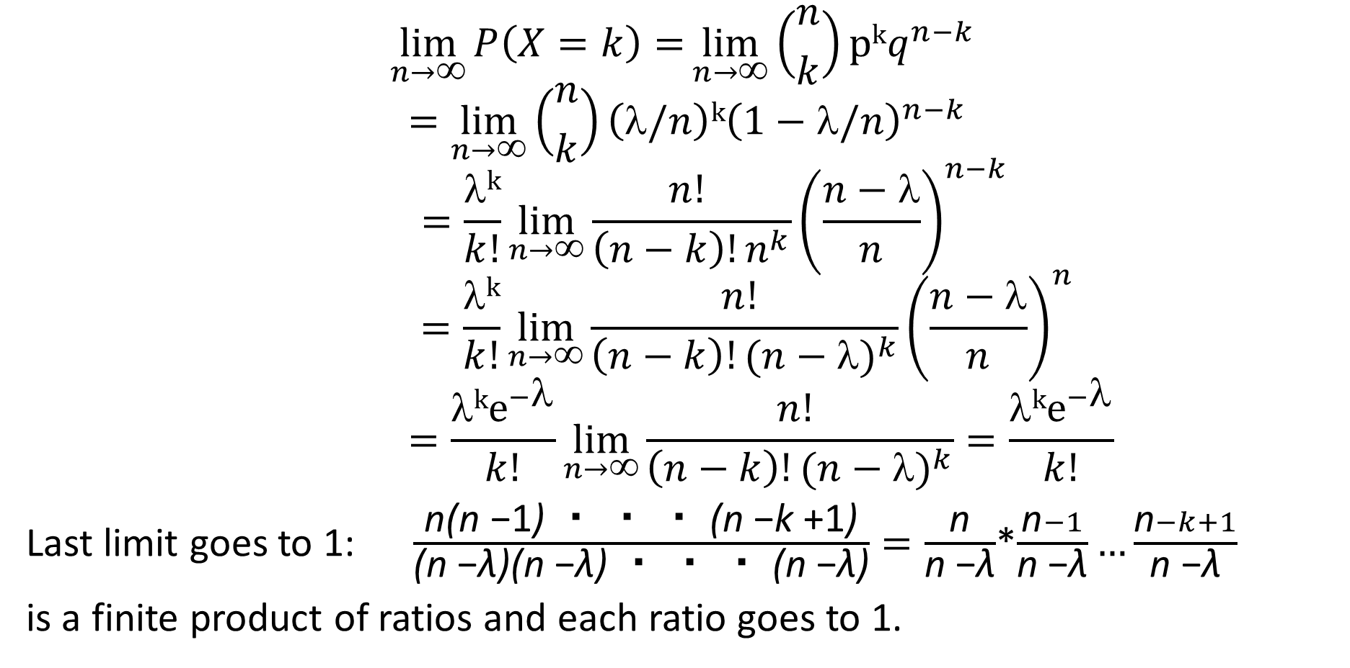
1. Proof of Poisson approximation of binomial
$$\lim_{n→∞}{P\left(X=k\right)=}\lim_{n→∞}\left({n \atop k}\right)pkq^{n−k}$$
$$=\lim_{n→∞}\left({n \atop k}\right)\left(\text{λ}/n\right)k{\left(1−\text{λ}/n\right)}^{n−k}$$
$$=\frac{\text{λ}k}{k!}\lim_{n→∞}\frac{n! }{\left(n−k\right)!n^{k}}{\left(\frac{n−\text{λ}}{n}\right)}^{n−k}$$
$$=\frac{\text{λ}k}{k!}\lim_{n→∞}\frac{n! }{\left(n−k\right)!{(n−\text{λ})}^{k}}{\left(\frac{n−\text{λ}}{n}\right)}^{n}$$
$$=\frac{{\text{}k\text{e}}^{−\text{}}}{k!}\lim_{n→∞}\frac{n! }{\left(n−k\right)!{(n−\text{})}^{k}}=\frac{{\text{}k\text{e}}^{−\text{}}}{k!}$$
Last limit goes to 1: $\frac{\text{n}\text{(}\text{n} \text{−1}\text{) }\text{・ ・ ・ }\text{(}\text{n} \text{−}\text{k} \text{+1}\text{)}}{\text{(}\text{n} \text{−}\text{λ}\text{)(}\text{n} \text{−}\text{λ}\text{) }\text{・ ・ ・ }\text{(}\text{n} \text{−}\text{λ}\text{)}}=\frac{\text{n}}{\text{n} \text{−}\text{λ}}$*$\frac{\text{n}−1}{\text{n} \text{−}\text{λ}}…\frac{\text{n}−k+1}{\text{n} \text{−}\text{λ}}$
is a finite product of ratios and each ratio goes to 1.

Slide 4
Binomial example approximated by Poisson
Every mile driven in a city has chance of 1 in 10,000 for a car accident as a result of someone else’s careless driving. In a given year, you drive 2000 miles in the city without ever being careless. What is chance that you will have no accidents? Exactly 1 accident? More than 1 accident?
Using binomial distribution
P(0)=(9999/10000)²⁰⁰⁰ = 81.872%
P(1)=2000(1/10000)(9999/10000)¹⁹⁹⁹ = 16.376%
P(>1) = 1−(81.9%+16.4%)=1.752%
Using Poisson approx: =np= 2000(1/10,000)=1/5 & P(k)= λ^{k}e^{− λ}/k!
P(0)=e ^{− λ} = e ^{− 0.2}=81.873%
P(1)= λe ^{− λ} = 16.375%
P(>1) = 1−(81.9%+16.4%)=1.752%

Slide 5
More binomial examples approximated by Poisson.
# of kids on a subway line on a particular day getting caught jumping turnstiles with no one around and no cameras. (1 in 1000?)
# children born in NYC with Down’s Syndrome in a given year to 30 year old mothers who are not tested (1 in 1000).
#mistakes for a 1000 word essay (1 in 200).
Number of people in a filled auditorium with a particular birth day (say June 21st , which is Poisson’s!)
Number of pieces of luggage lost by a frequent flyer over the course of 5 years (say 300 flights and every 200th checked bags is lost).

Slide 6
How Poisson can be used to model
Use data (given as a table) to calculate mean
$$\text{µ}=\sum_{k=0}^{n}{k∗p\left(k\right)}$$
On same set of axes, graph the data and the Poisson distribution using $\text{µ}$ for the parameter λ.
If the fit is pretty close (expect some discrepancy due to randomness), then you found a good model.
[Perhaps the next step is to figure out why (is there a binomial process behind the curtains?)]

Slide 7
Problem 4.2.12
#of bags lost | frequency
0 | 9
1 | 13
2 | 10
3 | 5
4 | 2
 | 39
Weekly luggage losses by commuter airline (see excel file)
Using raw data, the frequency table is on right ->
Use table to get µ = 1.44 (~1 ½ bags lost per wk)
Graph the data and the Poisson formula results on the same graph
It is pretty good fit,
so we accept the model.
5. Next we ask:
How are bags lost?
Is there an underlying
binomial process?

Slide 8
Some criteria for Poisson
Do the events occur independently?
Does the probability that an event occurs during a given subinterval stay constant over the entire interval from 0 to T?

Slide 9
Examples and non-examples of Poisson.
Example | Non-example | why
# of clicks in a Geiger counter where the time interval is much less than half life | # of clicks in a Geiger counter where the time interval is on the same order as the half life | the chance of a click decreases over time as the radioactive part is lost
#empty taxi cabs which pass a given corner late at night | #busses arriving at a bus stop | Busses tend to bunch up during rush hours and during non-rush hours, they are on a schedule
#parties arriving at a restaurant during a prime time or during a non prime time | #people arriving at a restaurant | Especially during prime times, people tend to meet as a family, organization or friend unit
#car accidents on a rural stretch of road under dry conditions at a certain hour of the day | #car accidents in a stretch of road under all conditions | Accident rate will depend on weather as well as the time of day and amount of traffic
Exercise: come up with your own example and non-example!

Slide 10
Intervals Between Events: The Poisson/Exponential Relationship
Poisson is a DISCRETE distribution. We are counting how many events happen in one interval. Here is what a typical time-line looks like:
The data produced would be 1,1,2,1,0,3 for a frequency table:
We can instead measure the TIME between events, indicated
by the y’s in the diagram: 1.6, 0.4, 0.6, 1.0, 1.4, 0.2, 0.4
x | f(x)
0 | 1
1 | 3
2 | 1
3 | 1

Slide 11
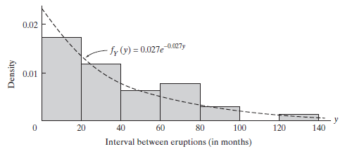
Time between eruptions of Mauna Key (See Excel file)
When graphing, do not use histogram for data. Instead, use DENSITY function:
Divide each frequency by total #of data points and by width of each interval.
Thus probability for an interval will correspond to the area under curve!

Slide 12
Exercise 4.2.27
Commercial airplane crashes in China occur at the rate of 2.5 per yr.
Give 2 reasons for assuming that such crashes are Poisson events and 2 reasons that question the use of Poisson.
What is the probability that four or more crashes will occur next year?
What is the probability that the next two crashes will occur within three months of one another?

Slide 13
Exercise 4.2.27 (cont.)
Commercial airplane crashes in China occur at the rate of 2.5 per yr.
Give 2 reasons for assuming that such crashes are Poisson events and 2 reasons that question the use of Poisson.
Poisson:
Rate does change over several years, but this problem is calculating just what is happening within one year.
Especially for the last 20 years, crashes are isolated events. Particular kinds of planes do not have vulnerabilities that break down in clusters as was true before.

Slide 14
Exercise 4.2.27 (cont.)
Commercial airplane crashes in China occur at the rate of 2.5 per yr.
Give 2 reasons for assuming that such crashes are Poisson events and 2 reasons that question the use of Poisson.
Not Poisson:
Rate does change within a year, especially if a country has areas of harsh weather in the winter. Also planes tend to travel full (and hence are more likely to crash) during holiday times.
Planes on occasion will crash into each other (hence not independent).

Slide 15
Exercise 4.2.27 (cont.)
Commercial airplane crashes in China occur at the rate of 2.5 per yr.
What is the probability that 4 or more crashes will occur next year?
This is a Poisson problem:
P(X ≥ 4)=1−P(X=0, 1, 2 or 3)
=1−e^{−2.5}(1+2.5/1+2.5²/2+2.5³/6+2.5⁴/24) = 11%
So there is an 11% chance that 4 or more crashes will occur next year.
Here are the Excel commands:
=1-EXP(-2.5)*(1+2.5/1+2.5^2/2+2.5^3/6+2.5^4/24)
=1-POISSON.DIST(4,2.5,TRUE)

Slide 16
Exercise 4.2.27 (cont.)
Commercial airplane crashes in China occur at the rate of 2.5 per yr.
What is the probability that the next two crashes will occur within three months of one another?
This is exponential. Let Y represent the time between the next 2 crashes. Tricky thing here is to remember to convert 3 months to yrs.
P(Y≤3)=$\int_{0}^{1/4}{2.5e^{−\left(5/2\right)t}}=e^{−\left(5/2\right)t}\left|\begin{matrix}0 \\ \\ t=1/4\end{matrix}\right.={1−e}^{−5/8}$=.46
Hence, there is 46% chance that the next 2 crashes will be within 3 months of each other.

Slide 17
Exercise 4.2.29: hybrid exponential/binomial
50 spotlights have just been installed in an outdoor security system. The lights burn out at the rate of 1.1 per 100 hours (or the average lifetime of a bulb is 100/1.1=90 hours). What is the expected number of bulbs that will last for at least 75 hours?
Consider i^{th} bulb, let Y_{i} represent how long it lasts and X_{i} indicate whether it lasts the 75 hours (X_{i} is 0 if not and 1 if yes).
We use the exponential distribution with λ = 1.1/100,
P(Y_{i} ≥ 75)=$\int_{75}^{∞}{1.1/100e^{−}}$^{(1.1/100)t}dt=$e^{−\left(1.1/100\right)t}\left|\begin{matrix}75 \\ \\ t=∞\end{matrix}\right.=e^{−\left(1.1/100\right)75}$=.44
The upshot is that p=P(X_{i}=1)=P(Y_{i} ≥ 75)=.44!

Slide 18
Exercise 4.2.29: hybrid expon/binom (cont.)
50 spotlights have just been installed in an outdoor security system. The lights burn out at the rate of 1.1 per 100 hours (or the average lifetime of a bulb is 100/1.1=90 hours). What is the expected number of bulbs that will last for at least 75 hours?
Switching gears to use the binomial distribution X=∑X_{i}:
n=50 bulbs each with a p=44% chance of lasting 75 hours: E(X)=np=50(.44)=22.
Hence, on average, 22 of the spotlights will still work after 75 hrs.

