Slide 1
MAT 2572 Probability w/Statistics, Halleck
Day 12 slides:
3.6 The Variance

Slide 2
What is variance?
Variance is a measure of dispersion or variation, the extent to which values are spread out.
Let’s look at 2 very simple examples:
X Y
Both μ_{X} and μ_{Y} are both 0.
  For X, any outcome will be 1 unit from the mean.
  For Y, any outcome will be 1000 units from the mean.
  Clearly, the Y has a much larger variance.

Slide 3
For X and Y from the previous example, Var(X)=1² and Var(Y)=1000².

Slide 4
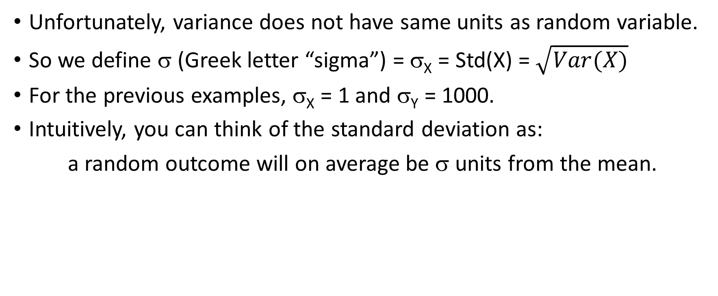
Standard deviation
Unfortunately, variance does not have same units as random variable.
So we define σ (Greek letter “sigma”) = σ_{X} = Std(X) = $\sqrt{Var(X)}$
For the previous examples, σ_{X} = 1 and σ_{Y} = 1000.
Intuitively, you can think of the standard deviation as:
a random outcome will on average be σ units from the mean.

Slide 5
Interpretation of variance
The notion of “average distance from the mean” introduced in the previous slide is not quite correct.
A more precise notion is: put weights on the shaft as before and spin around the fulcrum, then the resistance to a change in the speed of rotation, the moment of inertia, is the same as the variance.
      I = =

Slide 6
Theorem 3.6.1 (computational formula)
In practice, the definition for variance is hardly ever used.
Instead, it is calculated using:

Slide 7
Binomial (replacement) vs
Hypergeometric (non replacement)
For an urn with r red chips and w white chips, and n selections, we saw that that expectation for the number of red chips selected is nr/(r+w) regardless of replacement. For example if there are 3 red and 7 white and 5 chips are selected, then on average, 5*3/(3+7)=1.5 red chips will be selected.
Before doing the calculations, do you think the variance will be the same for the 2 distributions? If not, which one will be bigger? Why?

Slide 8
Variance properties
Given Y=aX+b, Var(Y)=a²*Var(X)
[in other words, variance is affected by scaling but not by shifting]
IN THE CASE OF INDEPENDENCE:
V(X+Y)=V(X)+V(Y) [and this extends to multiple summands as well]

Slide 9
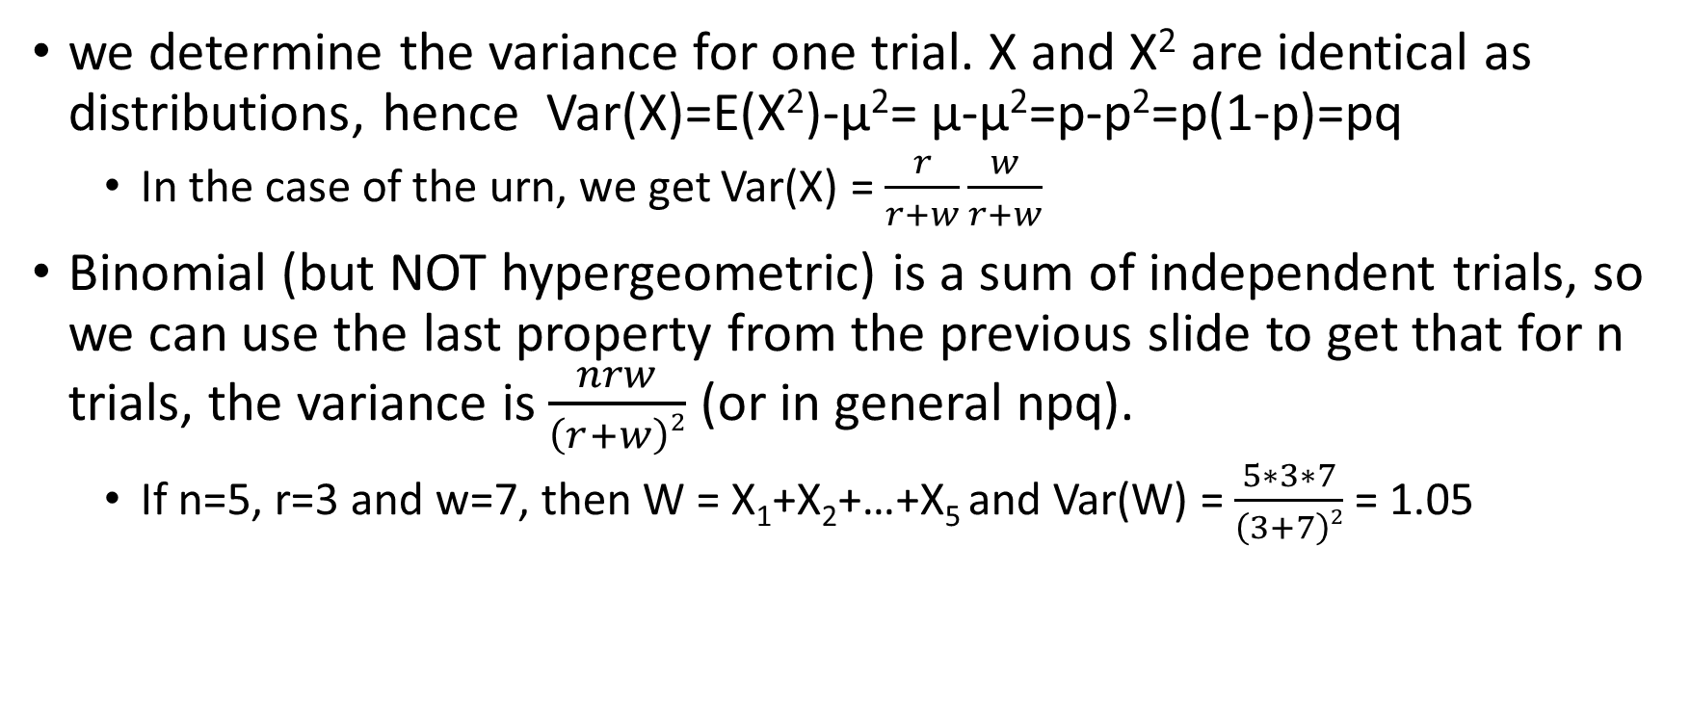
Returning to binomial vs. hypergeometric
we determine the variance for one trial. X and X² are identical as distributions, hence Var(X)=E(X²)-μ²= μ-μ²=p-p²=p(1-p)=pq
  In the case of the urn, we get Var(X) = $\frac{r}{r+w}\frac{w}{r+w}$
Binomial (but NOT hypergeometric) is a sum of independent trials, so we can use the last property from the previous slide to get that for n trials, the variance is $\frac{nrw}{\left(r+w\right)2}$ (or in general npq).
  If n=5, r=3 and w=7, then W = X₁+X₂+…+X₅ and Var(W) = $\frac{5∗3∗7}{\left(3+7\right)2}$ = 1.05

Slide 10
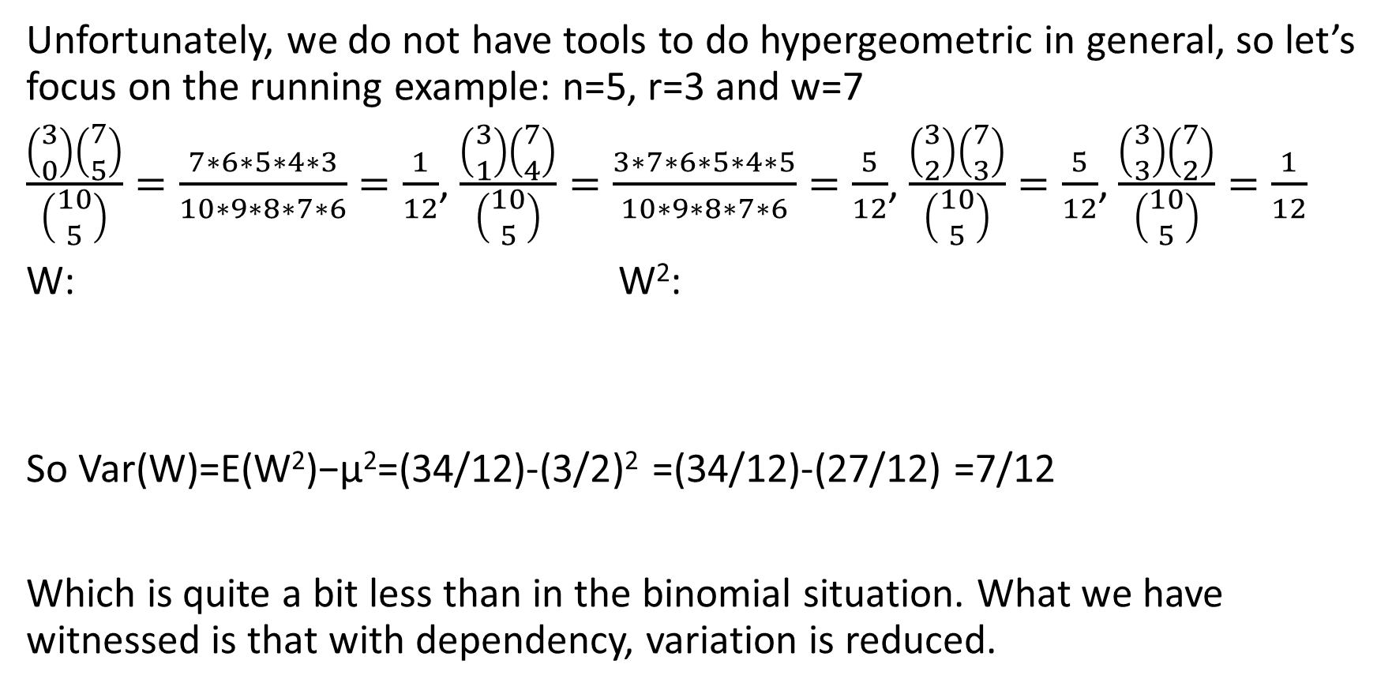
binomial vs. hypergeometric (cont.)
Unfortunately, we do not have tools to do hypergeometric in general, so let’s focus on the running example: n=5, r=3 and w=7
$\frac{\left(\begin{matrix}3 \\ 0\end{matrix}\right)\left(\begin{matrix}7 \\ 5\end{matrix}\right)}{\left(\begin{matrix}10 \\ 5\end{matrix}\right)}=\frac{7∗6∗5∗4∗3}{10∗9∗8∗7∗6}=\frac{1}{12}$, $\frac{\left(\begin{matrix}3 \\ 1\end{matrix}\right)\left(\begin{matrix}7 \\ 4\end{matrix}\right)}{\left(\begin{matrix}10 \\ 5\end{matrix}\right)}=\frac{3∗7∗6∗5∗4∗5}{10∗9∗8∗7∗6}=\frac{5}{12}$, $\frac{\left(\begin{matrix}3 \\ 2\end{matrix}\right)\left(\begin{matrix}7 \\ 3\end{matrix}\right)}{\left(\begin{matrix}10 \\ 5\end{matrix}\right)}=\frac{5}{12}$, $\frac{\left(\begin{matrix}3 \\ 3\end{matrix}\right)\left(\begin{matrix}7 \\ 2\end{matrix}\right)}{\left(\begin{matrix}10 \\ 5\end{matrix}\right)}=\frac{1}{12}$
W: W²:
So Var(W)=E(W²)−μ²=(34/12)-(3/2)² =(34/12)-(27/12) =7/12
Which is quite a bit less than in the binomial situation. What we have witnessed is that with dependency, variation is reduced.

Slide 11

1st continuous example (uniform)
f (t)=1, 0 ≤ t ≤ 1
Recall μ=$\frac{1}{2}$
E(Y²)=$\int_{0}^{1}{\text{t}\text{2} }$dt = (1/3)$\text{t}\text{3}$ $\left|\begin{matrix}1 \\ 0\end{matrix}\right.$ = 1/3
Hence, Var(Y)=E(Y²)-μ²=(1/3)-(1/2)²=(1/3)-(1/4)=1/12
And σ≈.29

Slide 12
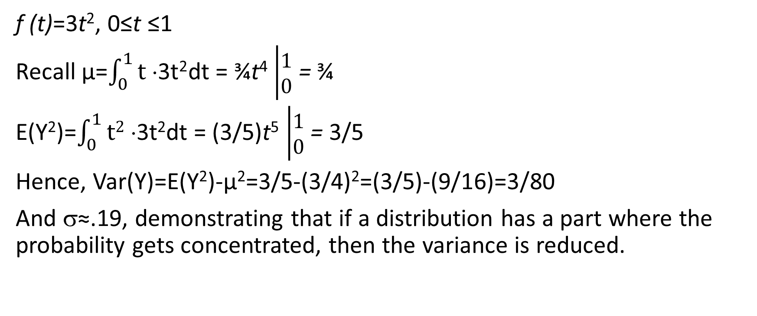
2nd Continuous example:
f (t)=3t², 0≤t ≤1
Recall μ=$\int_{0}^{1}{\text{t} ⋅\text{3}\text{t}\text{2}}$dt = ¾$\text{t}\text{4}$ $\left|\begin{matrix}1 \\ 0\end{matrix}\right.$ = ¾
E(Y²)=$\int_{0}^{1}{\text{t}\text{2} ⋅\text{3}\text{t}\text{2}}$dt = (3/5)$\text{t}\text{5}$ $\left|\begin{matrix}1 \\ 0\end{matrix}\right.$ = 3/5
Hence, Var(Y)=E(Y²)-μ²=3/5-(3/4)²=(3/5)-(9/16)=3/80
And σ≈.19, demonstrating that if a distribution has a part where the probability gets concentrated, then the variance is reduced.

Slide 13
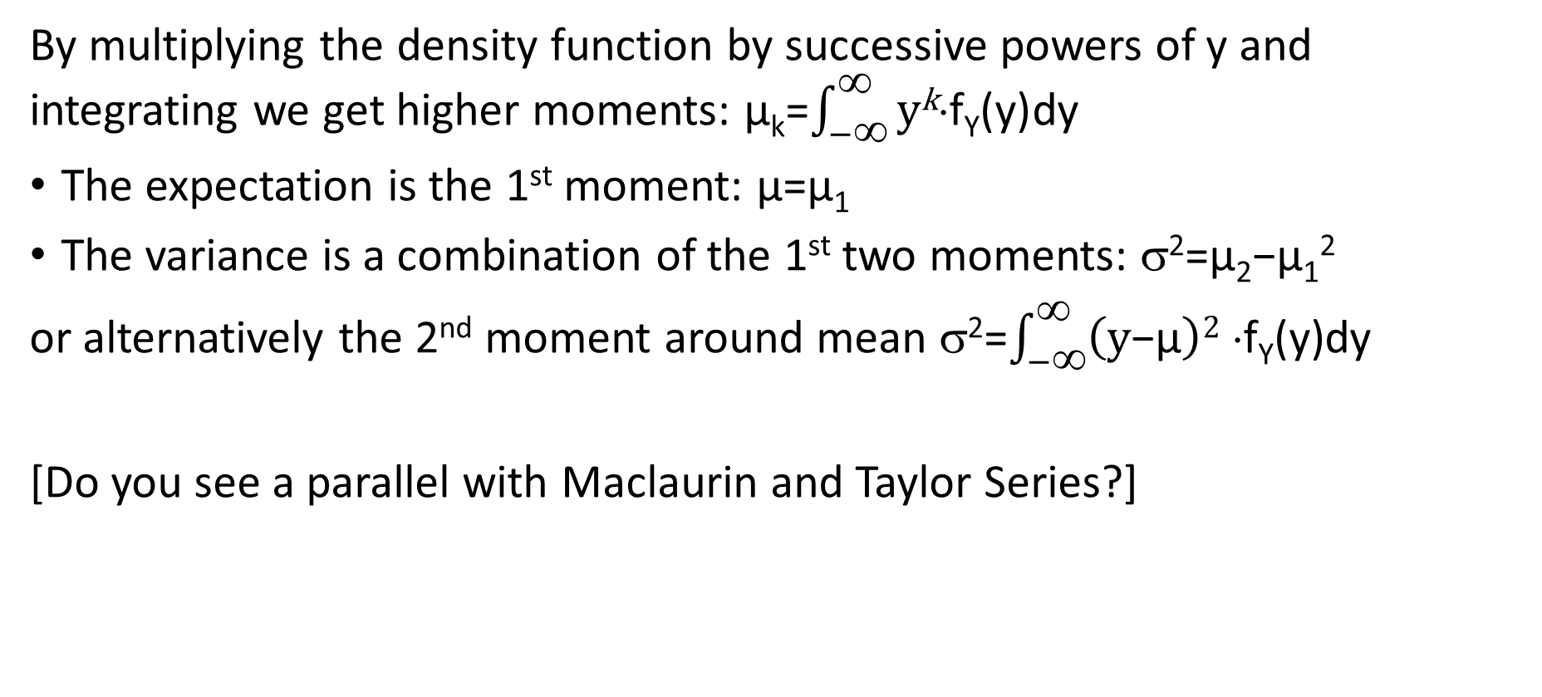
Higher Moments
By multiplying the density function by successive powers of y and integrating we get higher moments: μ_{k}=$\int_{−∞}^{∞}{\text{y}\text{k}⋅\text{f}\text{Y}\text{(}\text{y}\text{)}}$dy
The expectation is the 1st moment: μ=μ₁
The variance is a combination of the 1st two moments: σ²=μ₂−μ₁²
or alternatively the 2nd moment around mean σ²=$\int_{−∞}^{∞}{\left(\text{y}\text{−}\text{μ}\right)\text{2} ⋅\text{f}\text{Y}\text{(}\text{y}\text{)}}$dy
[Do you see a parallel with Maclaurin and Taylor Series?]

Slide 15
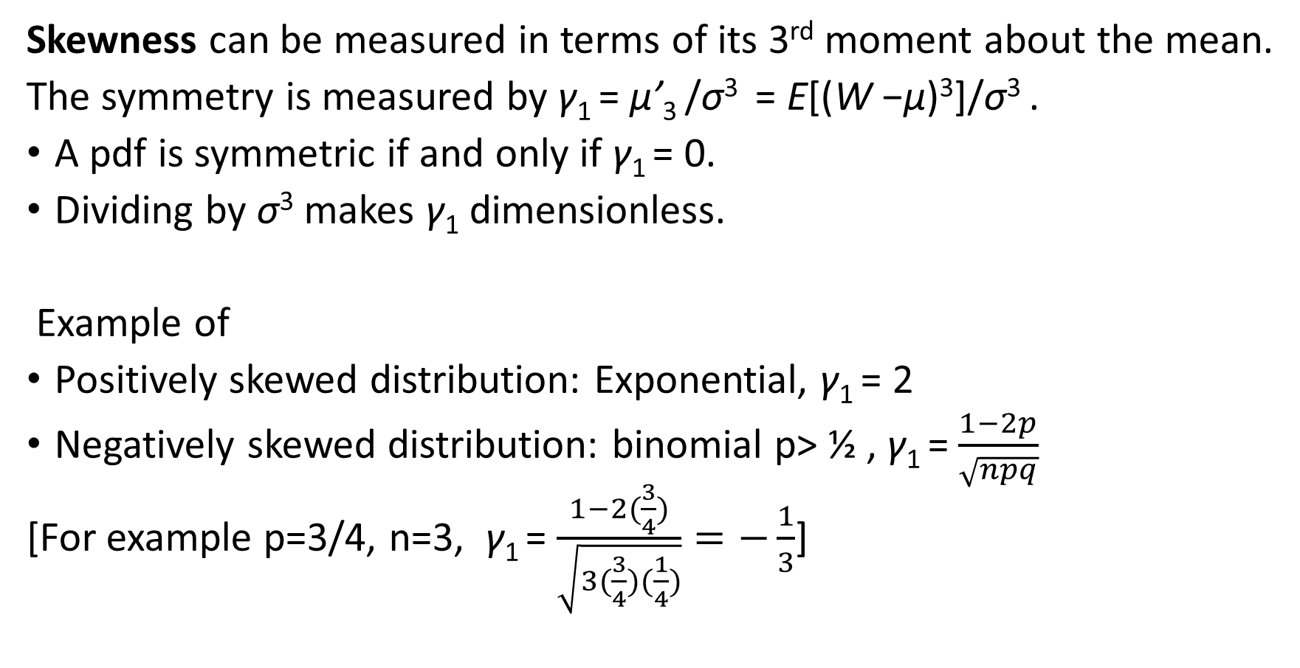
More advanced moments
Skewness can be measured in terms of its 3rd moment about the mean.
The symmetry is measured by γ₁ = μ’₃ /σ³ = E[(W −μ)³]/σ³ .
A pdf is symmetric if and only if γ₁ = 0.
Dividing by σ³ makes γ₁ dimensionless.
Example of
Positively skewed distribution: Exponential, γ₁ = 2
Negatively skewed distribution: binomial p> ½ , γ₁ = $\frac{1−2p}{\sqrt{npq}}$
[For example p=3/4, n=3, γ₁ = $\frac{1−2(\frac{3}{4})}{\sqrt{3(\frac{3}{4})(\frac{1}{4})}}=−\frac{1}{3}$]

Slide 16
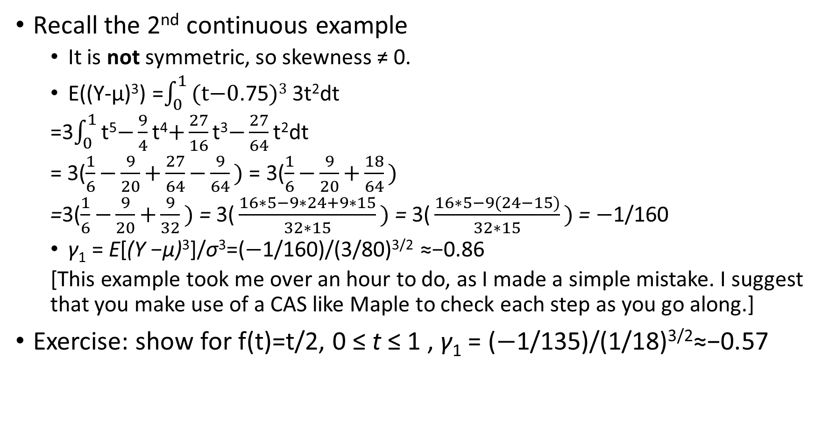
Another negatively skewed example
Recall the 2nd continuous example
  It is not symmetric, so skewness ≠ 0.
  E((Y-μ)³) =$\int_{0}^{1}{\text{(}\text{t}\text{−0}\text{.75}\text{)}\text{3} }$3t²dt
  =3$\int_{0}^{1}{\text{t}\text{5}\text{−}\frac{9}{4}\text{t}\text{4}\text{+}\frac{27}{16}\text{t}\text{3}\text{−}\frac{27}{64}\text{t}\text{2}\text{dt} }$
  = 3($\frac{1}{6}\text{−}\frac{9}{20}\text{+}\frac{27}{64}\text{−}\frac{9}{64}\text{) }$= 3($\frac{1}{6}\text{−}\frac{9}{20}\text{+}\frac{18}{64}\text{)}$
  =3($\frac{1}{6}\text{−}\frac{9}{20}\text{+}\frac{9}{32}\text{)} \text{=} \text{3(}\frac{16∗5−9∗24+9∗15}{32∗15}\text{)} \text{=} \text{3(}\frac{16∗5−9(24−15)}{32∗15}\text{)}$= $\text{−}$1/160
  γ₁ = E[(Y −μ)³]/σ³=($\text{−}$1/160)/(3/80)^{3/2} ≈−0.86
  [This example took me over an hour to do, as I made a simple mistake. I suggest that you make use of a CAS like Maple to check each step as you go along.]
Exercise: show for f(t)=t/2, 0 ≤ t ≤ 1 , γ₁ = ($\text{−}$1/135)/(1/18)^{3/2}≈−0.57

Slide 17
More advanced moments (cont.)
Kurtosis, a 2nd “shape” parameter involves the 4th moment about μ:
γ₂ = μ’₄ /σ⁴−3 = E[(W −μ)⁴]/σ⁴−3
We subtract 3 so that the normal distribution has γ₂ = 0.
Dividing by σ⁴ makes γ₂ dimensionless.

Slide 18

Kurtosis for uniform distribution: f(y)=1, 0 ≤ t ≤ 1
E((Y-μ)⁴) =$\int_{0}^{1}{\text{(}\text{t}\text{−0}\text{.5}\text{)}\text{4} }$dt = (1/5)$\text{(}\text{t}\text{−0}\text{.5}\text{)}\text{5}\left|\begin{matrix}1 \\ 0\end{matrix}\right.$ = 1/80
Hence, γ₂ = E[(Y −μ)⁴]/σ⁴−3 = (1/80)/(1/12)²−3 = (9/5)−3 = −1.2

Slide 19
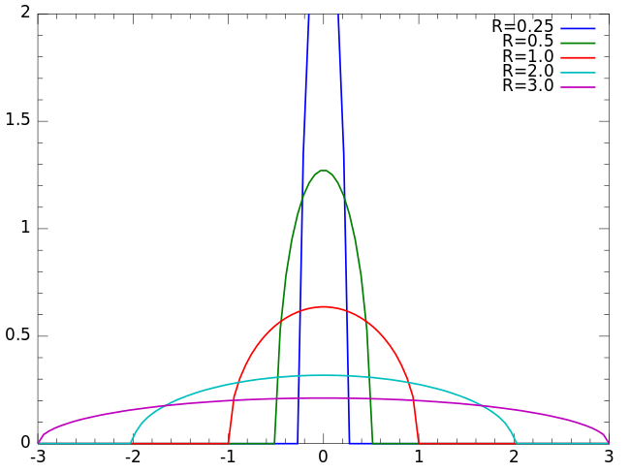
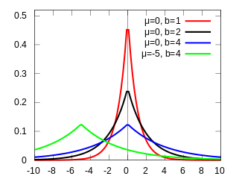
More examples of distributions w/ significant Kurtosis:
  Semicircle: γ₂ = −1 Laplace: γ₂ = 3
All the distributions within each diagram have the same kurtosis, demonstrating that when we divide by σ⁴, we eliminate any affect of scaling from γ₂.

Slide 20
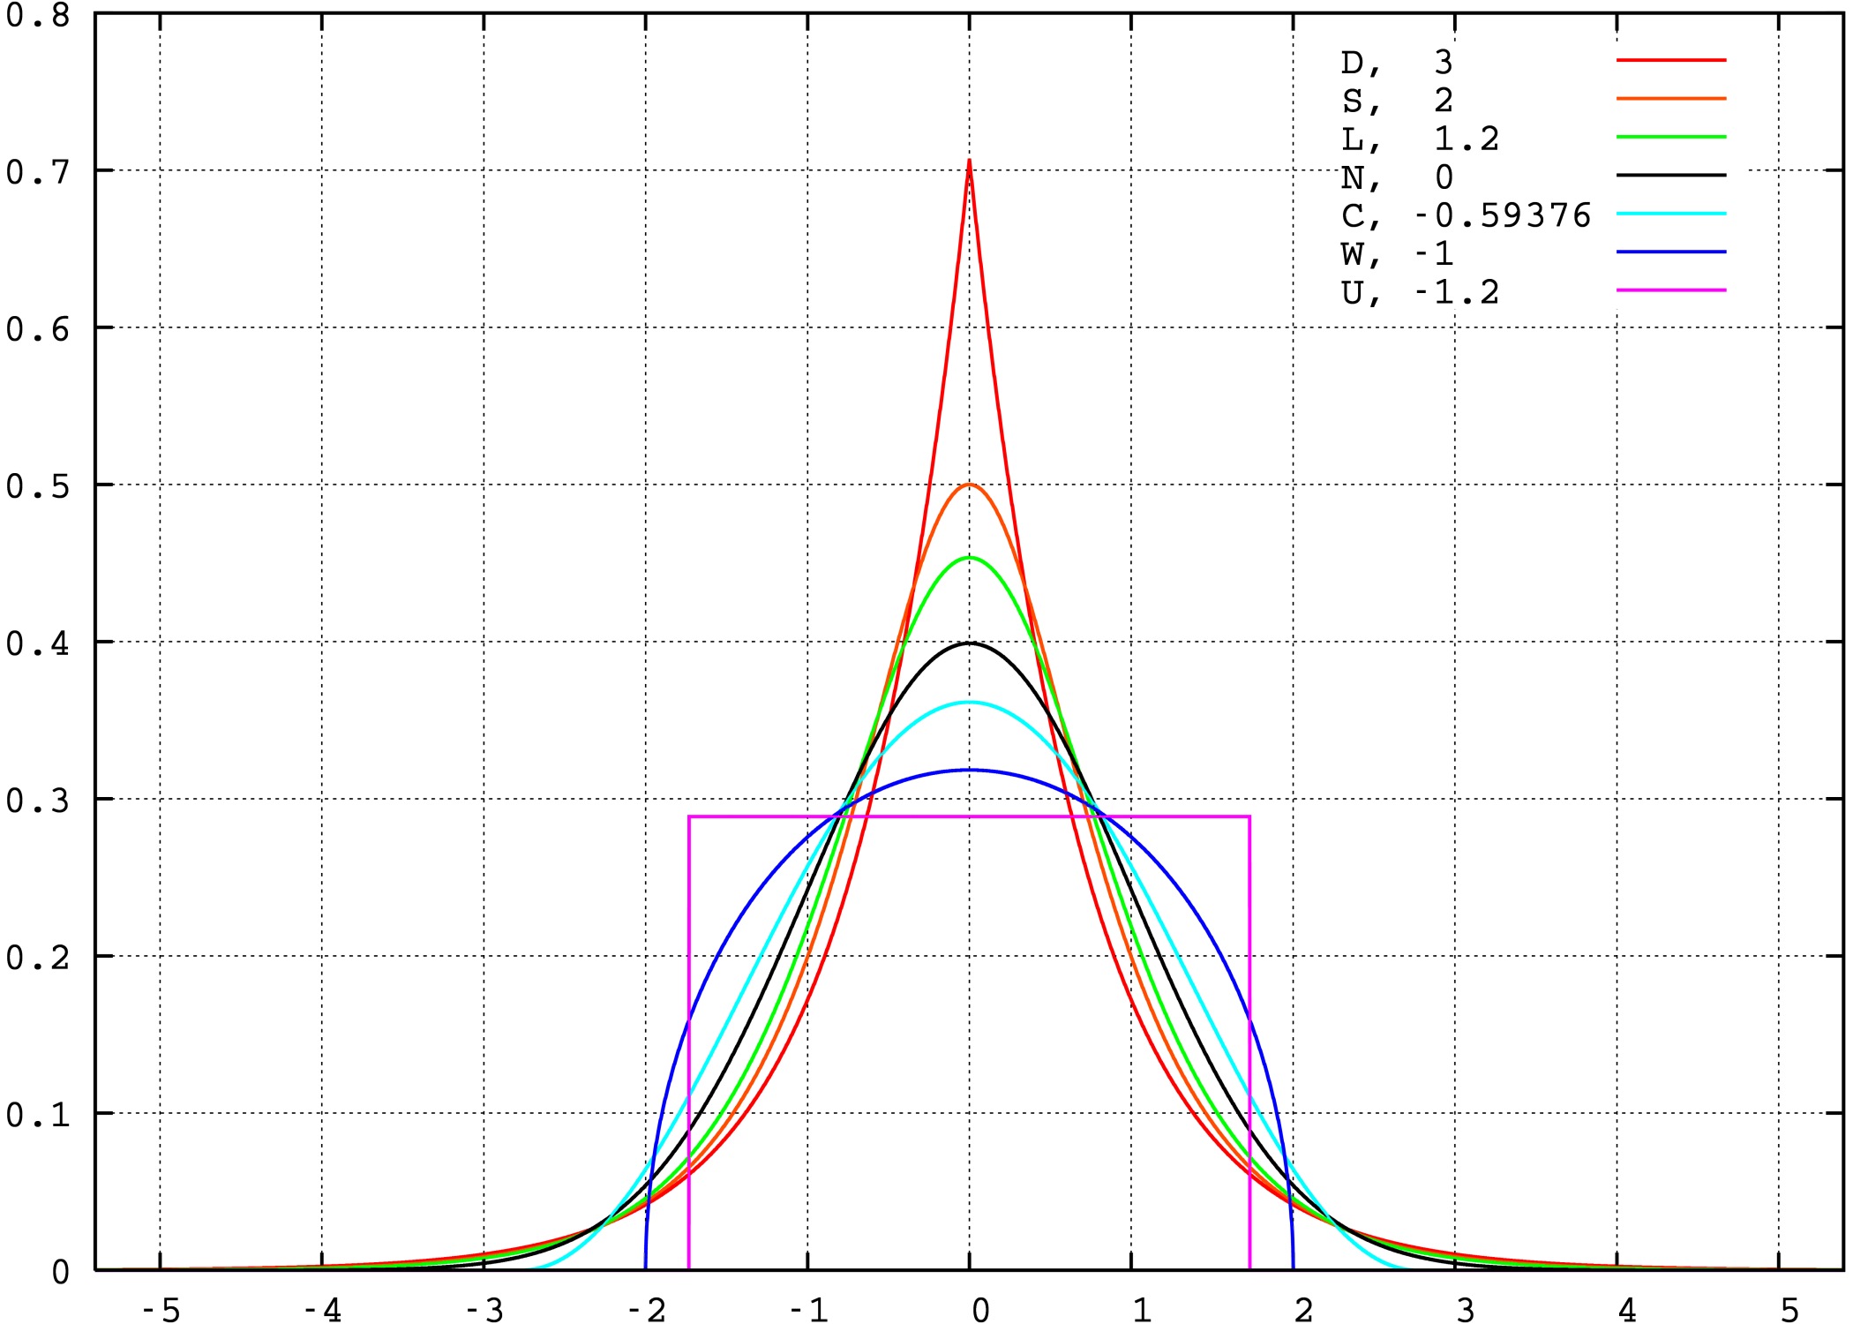
Kurtosis for distributions with finite support
>0 if highly peaked
<0 if has shoulders
(part of distribution about one σ from mean)

