Slide 1
MAT 2572 Probability w/Statistics, Halleck
Day 11 slides:
3.5 Expected Values

Slide 2
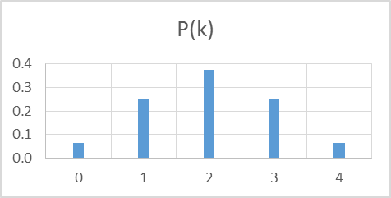
Review: Discrete random variable
Can be presented as a two row matrix:
Row 1: “outcomes”, arbitrary real numbers (can be countably ∞)
Row 2: probabilities, positive real numbers which sum to 1
(can be zero, but then the corresponding outcome never occurs)
Binomial example: fair coin flipped 4 times & # of heads counted

Slide 3
Measures of central location
Given a distribution, often we want to know an average (1. mean, 2. median) or most likely (3. mode) outcome.
The expected value or mean is our familiar “average”:
sum of all outcomes weighted by their likelihoods 0*(1/16)+1*(1/4)+2*(3/8)+3*(1/4)+4*(1/16)=4/16+12/16+12/16+4/16=32/16=2
2. If we sum up the probabilities from left to right and stop when we get to 50%, that outcome is the median. 1/16, 1/16+1/4=5/16, 1/16+1/4+3/8=11/16>1/2
The partial sums (1/16, 5/16, 11/16,…) reach (and overtake) 1/2 at outcome 2,
so 2 is the median.
3. The outcome that is most likely to occur is 2, so that is the mode.
For symmetric distributions, mean and median always coincide.

Slide 4
Mean as dot product of 2 vectors
My favorite way to describe the mean is as the dot product of the vector of outcomes with the corresponding vector of probabilities:
μ = E[X] = X⋅P(X)
For our running example:
<0, 1, 2, 3, 4>⋅<1/16, 1/4, 3/8, 1/4, 1/16>
= <0, 1, 2, 3, 4>⋅<1, 4, 6, 4, 1>/16
=(0*1+1*4+2*6+3*4+4*1)/16 = 32/16 = 2

Slide 5
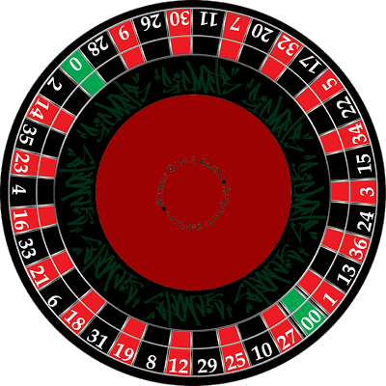
Roulette betting on red or black
Suppose that you bet $1 on red. On average, how much will you win or lose?
In terms of colors, there are 3 outcomes, green (house), red or black. However, we want to think of the outcomes in terms of your earnings. If it is red, you earn $1. If it is either black or green, you lose the $1 you bet. There are 18 red, 18 black and 2 green, so since each slot is equally likely, the RV is:
Taking dot product gives -1/19, a loss of ~ 5.3 cents.
The number −0.053 is the expected value of X.

Slide 6
Roulette (cont.)
Suppose that you bet $1 on red. On average, how much will you win or lose?
Physically, an expected value can be thought of as a center of gravity. Here, for
example, imagine two bars of height 10/19 and 9/19 positioned along a weightless X-axis at the points −1 and +1, respectively. If a fulcrum were placed at the point −0.053, the system would be in balance:

Slide 7
Expected value for discrete RV’s
Let X be a discrete random variable with probability function p_{X} (k).
The expected value of X, denoted E(X) (or sometimes or μ_{X} ) is
Note: μ is the Greek letter “mu” [pronounced (quickly) me-you]

Slide 8
Testing a mix of blood samples
In the testing for rare diseases, a laboratory takes a number of samples and mixes parts of them together. Most of the time the test will come out negative. However, if the test comes out positive, then the sample (or samples) that has the disease must be found. Setting aside a divide and conquer approach, let’s say that if a batch is positive, then all the samples in the batch are tested individually. If a batch consists of 50 samples, at what frequency of the disease does it make sense to just test each individually from the start?
If p is the frequency of a disease, then the chance of having at least one sample with the disease is 1− (1−p)⁵⁰, in which case a total of 51 samples have to be tested. Otherwise, just the initial test had to be made. Here is the table:
k | 1 | 51
P(k) | (1-p)⁵⁰ | 1-(1-p)⁵⁰

Slide 9
Testing a mix of blood samples (cont.)
If a batch consists of 50 samples, at what frequency does it make sense to just test each individually from the start?
With table: E(X)= (1-p)⁵⁰ +51(1-(1-p)⁵⁰)
If we evaluate the expectation for various values of p, we get:
Note that there is no savings if the disease is at the 10% level.
On the other hand, at the 1% prevalence level,
the number of tests needed on average is reduced by ~60% (50 → 21)
k | 1 | 51
P(k) | (1-p)⁵⁰ | 1-(1-p)⁵⁰

Slide 10
Example: Suppose that you roll a die (E(X)=3.5), then double the value and subtract 1. On average, what will you get?
2(3.5)-1=6

Slide 12
Example: Expectation for rolling 2 dice & summing
On average, each die is 3.5, therefore, on average the sum will be:
E(X+Y)=E(X)+E(Y)=3.5+3.5=7
For n dice, the average sum will be n*3.5.

Slide 13
Expectation for binomial
If you flip a fair coin, on average you will get ½ head.
If you flip n fair coins, on average you will get n* ½ heads
If the coin is not fair,
the average for one flip is p
the average for n flips is np
Example: suppose a coin has a 60% chance of being a head.
If the coin is flipped 40 times, on average, you will see 24 heads.

Slide 14
Expectation for hypergeometric
An urn contains r red chips and w white chips, where r + w = N. Draw n chips from the urn one at a time without replacing any of the chips selected. Count the number of red chips among the n removed.
Suppose that n=1, then this is the binomial situation with p=r/N, so expectation is r/N.
For an arbitrary n, we can think of the RV as a sum of RV’s, one corresponding to each chip removal. Using the addition rule, we get
E(W)=E(X₁ + X₂ +…+ X_{n})= E(X₁)+ E(X₂) +…+ E(X_{n})=n*r/N=nr/(r+w)
Example: suppose r=4,w=6 and n=5, then E(W)=5*4/(4+6)=2

Slide 15
Review of continuous random variables
Recall that the Continuous RV is given by a density function f(y). The probability of any particular outcome is 0. The probability of an interval on the other hand is the area above the interval and underneath the density function:
Now that we have an idea of expectation (and median) for discrete RV’s, we would like to carry that notion over to continuous.

Slide 16
For symmetric distributions, the idea of the middle should be pretty obvious, but how can we find it computationally?
The main idea from discrete was that we take the outcomes, multiply by the probabilities and sum. Can we do this with continuous RV’s?

Slide 17
Expectation for Continuous RV’s
Take the outcomes---y---multiply by the “probabilities”---f(y)--- and “sum”: for the continuous situation this means integrate.
Uniform: $\int_{a}^{b}{\text{y} ⋅ \text{1}\text{/(}\text{b}\text{−}\text{a}\text{)}}$dy = 1/(b−a)y²$/2\left|\begin{matrix}b \\ a\end{matrix}\right.$= (b²−a²)/(b−a)$/2$=(a+b)/2
This last expression is the midpoint of the endpoints for our interval, exactly what we should expect! (pardon the pun)

Slide 18
Let’s revisit our second continuous example:
f (t)=3t², 0 ≤t ≤1
Remembering our fulcrum tool for
understanding what the expectation is,
where do you guess the expectation is?
At what point along the t-axis would fulcrum balance an object of this shape (say a steel plate)?

Slide 19

Our second continuous example (cont.):
f (t)=3t², 0≤t ≤1
$\int_{0}^{1}{\text{t} ⋅\text{3}\text{t}\text{2}}$dt = ¾$\text{t}\text{4}$ $\left|\begin{matrix}1 \\ 0\end{matrix}\right.$ = ¾
Which should coincide with about where you thought the fulcrum should be (I felt it would be somewhere to the right of 2/3).

Slide 20

Our second continuous example (cont.):
f (t)=3t², 0≤t ≤1
$\int_{0}^{1}{\text{t} ⋅\text{3}\text{t}\text{2}}$dt = ¾$\text{t}\text{4}$ $\left|\begin{matrix}1 \\ 0\end{matrix}\right.$ = ¾
Note that this distribution is not symmetric, hence the median may not be the same as the mean. Recall: the notion of median: the point where half the probability is on either side. To find it, let’s review what the cumulative distribution is.

Slide 21
Reminder: cumulative distribution function
The cumulative distribution is the amount of area (probability) to
the left of the inputted point.

Slide 22
Our second continuous example (cont.):
f (t)=3t², 0≤t ≤1
F_{Y}(y)=$\int_{0}^{y}{\text{3}}\text{t}\text{2}$dt = $\text{t}\text{3}$ $\left|\begin{matrix}y \\ 0\end{matrix}\right.$ = $\text{y}\text{3}$
Now we set the CDF to ½
and solve for y: $\text{y}\text{3}$=½ so $y=\sqrt[3]{\text{½}}=0.794$
Note: the distribution is skewed to the left (where the tail is). The mean which is .75 for this situation is more sensitive to skewing and in fact, its position compared to the median can be used as an indicator of any skewing.

Slide 23
3.5.6 Exponential distribution
The distance, Y , that a molecule in a gas travels before colliding with another molecule can be modeled by the exponential pdf
f_{Y} (y)= (1/μ)e^{−y/μ}, y ≥0
Using integration by parts, we find that
E(Y )=$\int_{0}^{\text{∞}}{\text{w} ⋅\left(\text{1/}\text{μ}\right)\text{e}\text{−}\text{w}\text{/}\text{μ}}$dy = μ[−we^{−w} −e^{−w}] $\left|\begin{matrix}\text{∞ } \\ 0\end{matrix}\right.$ = μ
Showing that the use of μ for the parameter is apt: μ does represent the average distance that a molecule travels between collisions.
At room temp and sea level, μ ≈ 0.5 micrometer (μm) for N₂.
(1 μm=10⁻³ mm, diameter of human hair ranges from 17 to 181 μm)

Slide 24
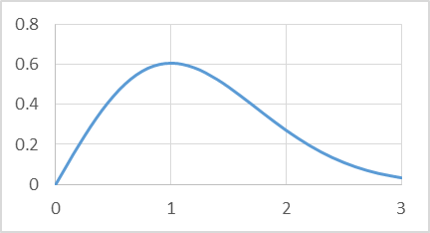
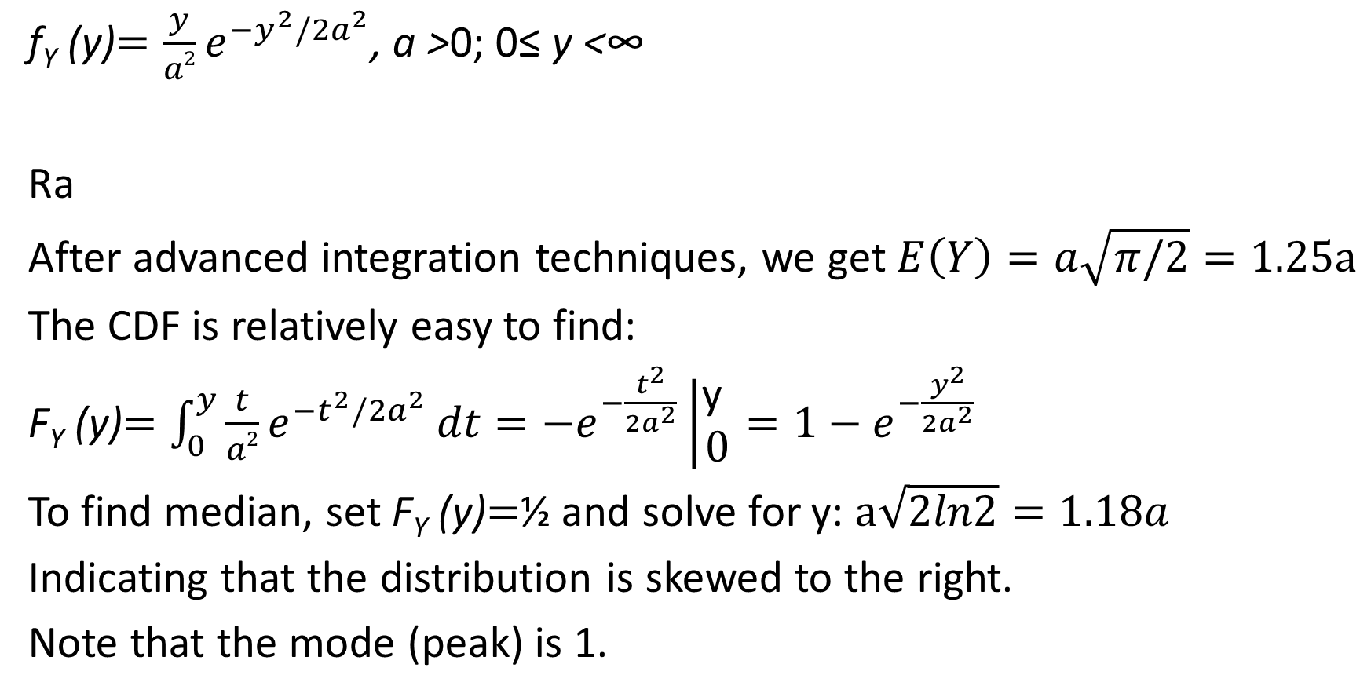
Example 3.5.7 Rayleigh distribution
PDF for Raleigh distribution with a=1
f_{Y} (y)$=\frac{y}{a2}e^{−y^{2}/2a^{2}}$, a >0; 0≤ y <∞
Ra
After advanced integration techniques, we get $E\left(Y\right)=a\sqrt{π/2}=1.25a$
The CDF is relatively easy to find:
F_{Y} (y)$=\int_{0}^{y}{\frac{t}{a2}e^{−t^{2}/2a^{2}}}dt=−e^{−\frac{t^{2}}{2a^{2}}}\left|\begin{matrix}\text{y} \\ 0\end{matrix}\right.=1−e^{−\frac{y^{2}}{2a^{2}}}$
To find median, set F_{Y} (y)$=$½ and solve for y: $a\sqrt{2ln2}=1.18a$
Indicating that the distribution is skewed to the right.
Note that the mode (peak) is 1.

Slide 25
The Expected Value of a Function of a Random Variable
Discrete:
Continuous:

Slide 26
Discrete Example
A fair coin is tossed twice & # of heads is counted: what is E(X²)?
X:
X²:
So E(X²)=1/2+1=3/2
(note that X is symmetric, so E(X)=1)
k | 0 | 1 | 2
P(k) | 1/4 | 1/2 | 1/4
k | 0 | 1 | 4
P(k) | 1/4 | 1/2 | 1/4

Slide 27
Continuous example: 3.5.14
A point y is selected at random from the interval [0, 1], dividing the line into two segments.
What is expected value for ratio of shorter segment to longer segment?
w.l.o.g., y is in LHS of interval as in the picture (we use symmetry).
Ratio of shorter segment to longer segment is y/(1-y) so
E(Y/(1-Y)) =$\int_{0}^{\text{1/2}}{\text{y}\text{/(1−}\text{y}\text{) }}$2dy =2$\int_{0}^{\text{1/2}}{\text{(}\frac{1}{1−y} −1)}$dy
=2(-ln(1-y)-y) $\left|\begin{matrix}\text{1/2} \\ 0\end{matrix}\right.=2ln2−1=0.39$
.39≈.4=2/5 so on average, longer is about 2 ½ times as long as shorter.

