Slide 1
MAT 2572 Probability w/Statistics, Halleck
Day 8 slides:
3.3 Discrete Random Variables

Slide 2
Discrete Random Variable examples (we are already familiar with)
Uniform: roll a fair 6-sided die and read off the value of the face. Since there are 6 outcomes and each outcome x is equally likely, then p(x)=1/6
Binomial: flip a fair coin n times and count the number of heads. The chance of k heads $p\left(k\right)=\frac{\left(\begin{matrix}n \\ k\end{matrix}\right)}{2n}$
Hypergeometric: urn has r red chips and w white chips, where r + w = N.
Draw n chips from the urn then the chance of k red chips is $p\left(k\right)= \frac{\left(\begin{matrix}r \\ k\end{matrix}\right)\left(\begin{matrix}w \\ n−k\end{matrix}\right)}{\left(\begin{matrix}N \\ n\end{matrix}\right)}$
What characterizes a discrete random variable?
In our attempt to generalize, let’s apply what we know about a probability function to this situation.

Slide 3
Discrete probability function
If, in addition, S is a subset the real numbers R, then S is discrete random variable (we usually the letter X or Y in that case).
Can you provide 3 examples of discrete probability functions that are not RV’s?

Slide 4
Example 3.3.1: Ace-six flat die
Cube is shortened in the one-six direction, so 1’s and 6’s are more likely to occur: p(1)= p(6)= 1/4 while p(2)= p(3)= p(4)= p(5)= 1/8
Is this a probability function?
Is it a discrete probability function?
Is it a discrete random variable?
Is it a symmetric distribution?
If so, what is the axis of symmetry?
If 2 ace-six flat dice are rolled, what is the chance of getting a 7?
How does that compare with fair dice?

Slide 5
Example 3.3.2: 1st head on an odd toss
Suppose a fair coin is tossed until a head comes up for the first time. What are the chances of that happening on an odd-numbered toss?
Last time, we looked at this example of a geometric distribution and found that the chance for outcome $k$∈N, p(k)=$\frac{1}{2k}$ , so the chance that it happens on an odd-numbered toss is:
$\frac{1}{21}$+$\frac{1}{23}$+$\frac{1}{25}$…=$\frac{\frac{1}{2}}{1−\frac{1}{\begin{aligned}4 \\ \end{aligned}}}=\frac{2}{3}$

Slide 6
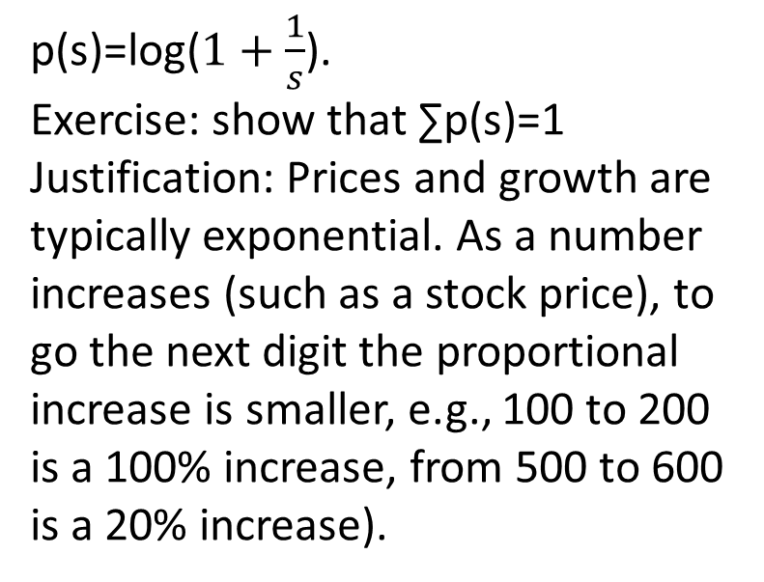
Example 3.3.3
Collect (by hand or using a computer program) all the numbers that appear in a newspaper. Find the proportions according to their first digit 1,2,..9 (assuming all numbers are converted to scientific notation).
Is the distribution uniform?
According to Benford, no!
p(s)=log($1+\frac{1}{s}$).
Exercise: show that ∑p(s)=1
Justification: Prices and growth are typically exponential. As a number increases (such as a stock price), to go the next digit the proportional increase is smaller, e.g., 100 to 200 is a 100% increase, from 500 to 600 is a 20% increase).
Warning: the IRS uses Benford’s law to catch tax cheats! So if you are not going to respect tax laws, be sure to at least respect Benford’s law!

Slide 7
Example 3.3.4
Is this a probability function?
Is it a discrete probability function?
Is it a discrete random variable?
If λ= 1 , do we get a distribution we have already seen?
[Hint: What if you flip a coin and count how many excessive flips it takes (we know we have to flip it at least once) or equivalently how many tails we get before getting that first head?]

Slide 8
Example 3.3.5 Sums of RV’s
For the sum of 2 dice, we assign separate Random Variables X₁ and X₂ to each of the individual dice, then X= X₁+ X₂.
The binomial distribution can be thought of the sum of n random variables X= X₁+ X₂ +…+ X_{n} where each X_{i} is the outcome for a the ith toss, 0 or 1, depending on if toss i was a tail or a head.
This feature of being able to take simpler random variables and form more complicated ones from them is an important concept we will see repeatedly.

Slide 9
Random Variable redefinition
A function whose domain is a sample space S and whose values form a finite or countably infinite set of real numbers is called a discrete random variable. We denote random variables by uppercase letters, often X or Y .

Slide 10
The probability function:
Associated with every discrete random variable X is a probability (density) function denoted p_{X} (k), where
p_{X} (k)= P({s ∈ S | X(s)=k})
Note that p_{X} (k) = 0 for any k not in the range of X. For notational simplicity, we delete all references to s and S and write p_{X} (k)= P(X =k).

Slide 11
Example 3.3.8
As part of her warm-up drill, each player on State’s basketball team is required to shoot free throws until two baskets are made. If Rhonda has a 65% success rate at the foul line, what is the pdf of the random variable X that describes the number of throws it takes her to complete the drill? Assume that individual throws constitute independent events.
Closely related to the geometric distribution except that instead of needing to make one head (a basket), Rhonda needs to make 2.
[We use the same technique used for the world series analysis.] For X to be k, she makes a basket on the kth toss, but she also must have a basket in exactly one other attempt. There are k-1 slots for that 1st basket, so P(X=k)=(k-1)p²q^{k-2}
Of course, there is no reason to just stop at 2. Any number of baskets could be asked for. [This generalization of the geometric is called the negative binomial distribution.]

Slide 12
Cumulative distribution function
Let X be a discrete random variable. For any real number t, the probability that X takes on a value ≤t is F_{X} (t) the cumulative distribution function (cdf):
F_{X} (t)= P({s ∈ S | X(s)≤t})
Note: references to s and S are typically deleted, and the cdf is
written F_{X} (t)= P(X ≤t).

Slide 13
Example 3.3.9
Suppose that a coin is flipped 50 times and the chance of head is .6. What is the chance that between 21 and 40 of the flips (inclusive) were heads?
Symbolically:
Answer is 99.6%. Using software, this can be most easily found by writing as a difference of cumulative values: F_{X}(40)-F_{X}(20).
Excel: =BINOM.DIST(40,50,.6,true)-BINOM.DIST(20,50,.6,true)
R: pbinom(40,50,.6)-pbinom(20,50,.6)

Slide 14
Example 3.3.10
Suppose that two fair dice are rolled. Let the random variable X denote the larger of the two faces showing: (a) Find F_{X} (t) for t =1, 2, . . . , 6 and (b) Find F_{X} (2.5).
If we carve up the sample space for rolling 2 dice according to this random variable, we get L shapes with sizes 1, 3, 5, 7, 9 and 11 (note how sum is 36). Hence F_{X} (t) are the successive partial sums: 1, 4, 9, 16, 25, 36 divided by the cardinality of the sample space which is 36.
F_{X} (2.5) is the same as F_{X} (2) since the outcomes are whole numbers.
Learning from (b) describe the graph of F_{X} (t) as a function of t?

