Slide 1
MAT 2572 Probability w/Statistics, Halleck
Day 7 slides:
3.1 Random Variables
3.2 Binomial and Hypergeometric Probabilities

Slide 2
Random variable
An experiment where the outcomes are numbers (real)
Flipping a coin is NOT: S={h,t}
Rolling 2 dice is NOT: S={(1,1),(1,2),…(6,6)}
However, we get an RV if we
flip a coin 5 times and count the number of heads: S={0,1,…,5}
Sum the faces of the dice: S={2,3,…,12}
Random variables can either be
discrete (above 2 examples are)
continuous: heights of people to infinite precision
(not realizable in practice: all measurements are technically discrete as there is rounding, e.g., for heights, typically to the nearest inch or cm)

Slide 3
Example of discrete RV w/ ∞ sample space
Remember that there is difference between continuous and infinite. It is possible to have an infinite number of outcomes yet for the outcomes not to form a continuum.
Example: flip a coin until you get a head. While it is unlikely, it is possible for the experiment to continue forever if each time the flip gives a tail. The sample space for this experiment is 0,1,2,… the set of whole numbers (counting numbers start with 1).
If the chance of getting a head is ½, then the sum of the probabilities for each outcome is the geometric series 1/2+1/4+1/8+…=$\frac{\text{1/2}}{\text{1−1/2}}=1$
In fact this distribution is an example of a geometric distribution.

Slide 4
Bernoulli experiment
If we flip a coin n times, the outcome is a sequence of heads and tails. To get an RV, we typically count the number of heads, but we could just as easily count the tails.
More generally, an experiment with 2 outcomes is repeated and we get a sequence of “successes” and “failures”. We can count the number of “successes” or we can count the number of “failures”. However, to do a problem, you usually focus on one or the other.

Slide 5
Binomial distribution
Given a Bernoulli experiment such as coin flipping, if chance of heads is p (coin could be bent) then the chance of tails is q=1-p.
Given a sequence of heads and tails, its chance is p raised to the number of heads in the sequence times q raised to the number of tails in the sequence, e.g., HTHTHHH has chance p⁵q².
The number of sequences with k heads and n-k tails is $\left(\begin{matrix}n \\ k\end{matrix}\right)$ so the chance of a sequence with k heads is $\left(\begin{matrix}n \\ k\end{matrix}\right)$p^{k}q^{n-k}.
For instance the chance of a sequence with 5 heads and 2 tails is $\left(\begin{matrix}7 \\ 5\end{matrix}\right)$p⁵q² [k=5 and n=7] (any rearrangement of the above sequence).

Slide 6
Individual sequences (not an RV) vs. chance of a sequence with a specified number of heads (an RV):

Slide 7
Chance that a 7 game series ends in n games
The World Series in baseball is a seven-game series, where the first team to win four games is declared the champion. The series, then, can last anywhere from four to seven games. Calculate the likelihoods that the series will last four, five, six, or seven games. Assume that
each game is an independent event
American League team wins any particular game with a p chance

Slide 8
Chance that a 7 game series ends in n games
What is chance series will last four, five, six, or seven games?
Trick is to think what must happen before the final win:
If n is 4, then losing team won none of 3 preceding games: p³p +q³q.
If n=5, losing team won once in preceding games $\left(\begin{matrix}4 \\ 1\end{matrix}\right)$p³qp + $\left(\begin{matrix}4 \\ 1\end{matrix}\right)$pq³q
If n=6, losing team won twice in preceding games: $\left(\begin{matrix}5 \\ 2\end{matrix}\right)$p³q²p + $\left(\begin{matrix}5 \\ 2\end{matrix}\right)$p²q³q
If n=7, losing team won 3x in preceding games: $\left(\begin{matrix}6 \\ 3\end{matrix}\right)$p³q³p + $\left(\begin{matrix}6 \\ 3\end{matrix}\right)$p³q³q

Slide 9
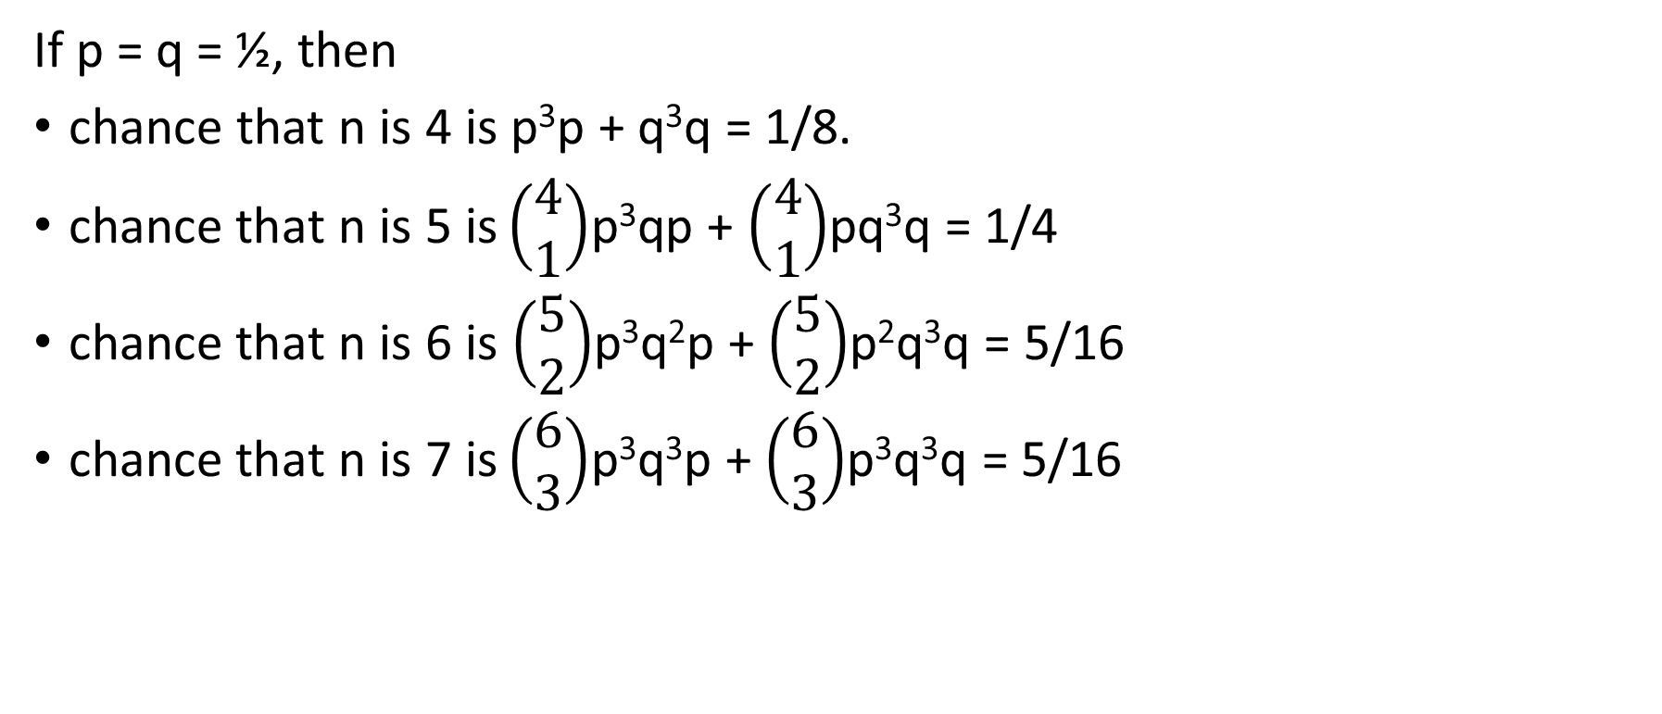
Chance that a 7 game series ends in n games
If p = q = ½, then
chance that n is 4 is p³p + q³q = 1/8.
$\text{chance} \text{that} \text{n} \text{is}\text{ 5 }\text{is}\left(\begin{matrix}4 \\ 1\end{matrix}\right)$p³qp + $\left(\begin{matrix}4 \\ 1\end{matrix}\right)$pq³q = 1/4
$\text{chance} \text{that} \text{n} \text{is}\text{ 6 }\text{is}$ $\left(\begin{matrix}5 \\ 2\end{matrix}\right)$p³q²p + $\left(\begin{matrix}5 \\ 2\end{matrix}\right)$p²q³q = 5/16
$\text{chance} \text{that} \text{n} \text{is}\text{ 7 }\text{is}\left(\begin{matrix}6 \\ 3\end{matrix}\right)$p³q³p + $\left(\begin{matrix}6 \\ 3\end{matrix}\right)$p³q³q = 5/16

Slide 10
Example 3.2.4
The chance of making a 600 or greater on the SAT Reasoning Test in Mathematics is 0.231, while the similar probability for the Reading Test is 0.191. The math nerds propose the following game. 4 students will be selected randomly to provide their math scores. 4 other students will be selected randomly to provide their reading scores. If more of the first group exceeds 600 on the mathematics test than 2nd group exceeds 600 on the reading test, then the last class will be spent doing math. Otherwise it will be spent reading. What is the chance that the class will be doing math on the last day?

Slide 11
Example 3.2.4 cont.
chance that more get math scores above 600 corresponds to the sum of the entries above the diagonal: 38%
Hence there is almost a 2/3 chance that they will be reading on the last day class, certainly not what the math nerds had in mind.

Slide 12
Hypergeometric Distribution
An urn contains r red chips and w white chips, where r + w = N. Draw n chips from the urn one at a time without replacing any of the chips selected. What is chance that exactly k red chips were among the n removed?
(note: if replacement happens each time a chip is removed, this would be a special case of the binomial distribution. What would p equal?)
Example: n=5, r=4, w=6 (then N=10). What is P(2)? $\frac{\left(\begin{matrix}4 \\ 2\end{matrix}\right)\left(\begin{matrix}6 \\ 5−2\end{matrix}\right)}{\left(\begin{matrix}10 \\ 5\end{matrix}\right)}$=$\frac{6∗20}{6∗7∗6}$=$\frac{10}{21}$

Slide 13
Example 3.2.6
A Lottery features Fantasy Five. The player chooses five numbers from a card containing the numbers 1 through 36. Each day five numbers are chosen at random, and if the player matches all five, the winnings can be as much as $200,000 for a $1 bet. There were allegations that certain biases were happening, e.g., that the winning #’s were more likely to be chosen from 1 to 12. Let’s investigate this allegation.
P(3 of the winners among #’s 1-12)=
In one year, 18% of draws had that makeup.
Do we have enough evidence to say that there was bias?

Slide 14
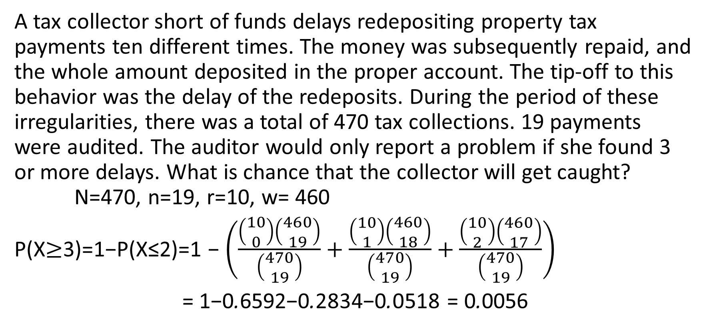
Example 3.2.8
A tax collector short of funds delays redepositing property tax payments ten different times. The money was subsequently repaid, and the whole amount deposited in the proper account. The tip-off to this behavior was the delay of the redeposits. During the period of these irregularities, there was a total of 470 tax collections. 19 payments were audited. The auditor would only report a problem if she found 3 or more delays. What is chance that the collector will get caught? N=470, n=19, r=10, w= 460
P(X$≥$3)=1−P(X≤2)=1 − $\left(\frac{\left(\begin{matrix}10 \\ 0\end{matrix}\right)\left(\begin{matrix}460 \\ 19\end{matrix}\right)}{\left(\begin{matrix}470 \\ 19\end{matrix}\right)}+\frac{\left(\begin{matrix}10 \\ 1\end{matrix}\right)\left(\begin{matrix}460 \\ 18\end{matrix}\right)}{\left(\begin{matrix}470 \\ 19\end{matrix}\right)}+\frac{\left(\begin{matrix}10 \\ 2\end{matrix}\right)\left(\begin{matrix}460 \\ 17\end{matrix}\right)}{\left(\begin{matrix}470 \\ 19\end{matrix}\right)}\right)$
= 1−0.6592−0.2834−0.0518 = 0.0056

