Slide 1
MAT 2572 Probability w/Statistics, Halleck
Day 26 slides:
10.5 Contingency Tables (and test for independence).

Slide 2
Reminder: Independence
Events A and B are independent if (any one of the following is true):
Occurrence of A does not influence whether B occurs: P(B|A)=P(B)
Occurrence of B does not influence whether A occurs: P(A|B)=P(A)
The chance that both A and B occur can be found by multiplying chances that they occur individually: P(A∩B)=P(A)*P(B)
Example of 2 events that are
independent: rolling doubles & green die is 1 (why?);
dependent: rolling doubles & sum of dice is even (why?).

Slide 3
What is a contingency table?
Cardinal product of 2 variables partitioned into a finite # of categories. Examples:
Thumbs (↓, →, or ↑) for 2 film reviewers.
For major US cities:
Mobility index (high and low) vs. suicide rate (high and low)
Salem witch trial victims:
(male and female) vs. (execute and not execute)
Blood pressure:
Father (high, medium, low) vs. child (high, medium, low)

Slide 4
Thumbs (↓, →, or ↑) for 2 film reviewers.

Slide 5
Mobility vs. suicide rate
Young, P. V., and Schmid, C. Scientific Social Surveys and Research. Prentice Hall, 1966, p. 319.

Slide 6
(male/female) vs. (execute/not execute)
 | female | male
Yes | 14 | 5 | 19
No | 127 | 39 | 166
 | 141 | 44 | 185

Slide 7
BP: Father (high, med, low) vs. child (high, med, low)

Slide 8
2x2 in symbols
Observed ->
<- Assuming Independence

Slide 9
So our expected is

Slide 10
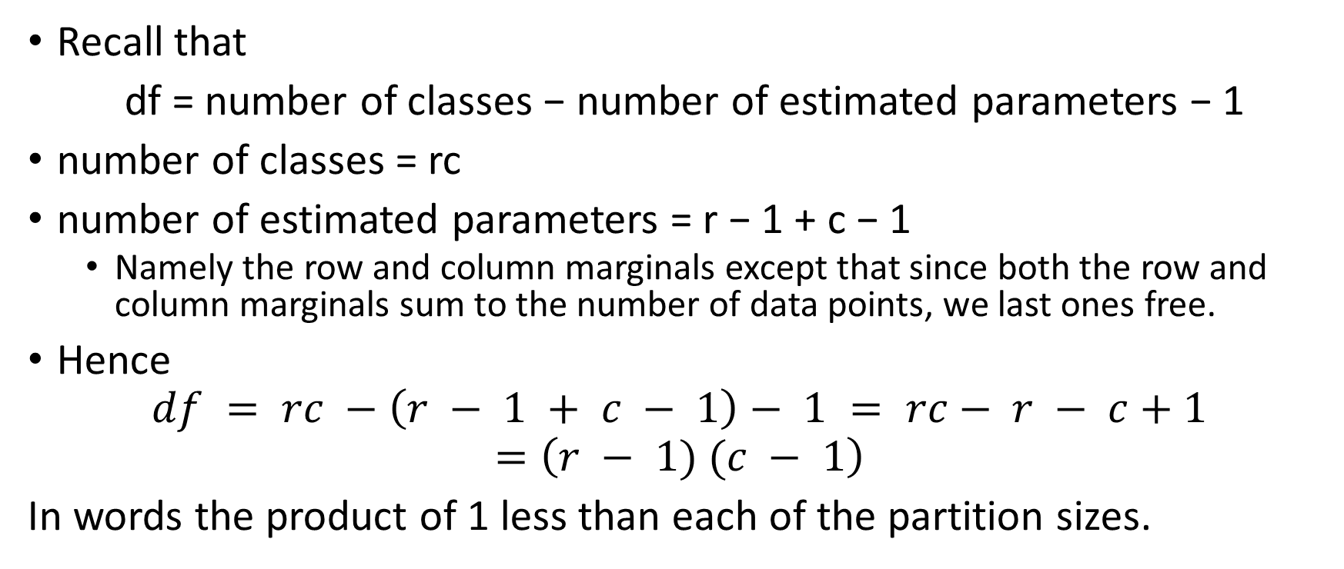
Degrees of Freedom
Recall that
df = number of classes − number of estimated parameters − 1
number of classes = rc
number of estimated parameters = r − 1 + c − 1
  Namely the row and column marginals except that since both the row and column marginals sum to the number of data points, we last ones free.
Hence
$$df = rc −\left(r − 1 + c − 1\right)− 1 = rc− r − c+1$$
$$=\left(r − 1) (c − 1\right)$$
In words the product of 1 less than each of the partition sizes.

